Slide 1
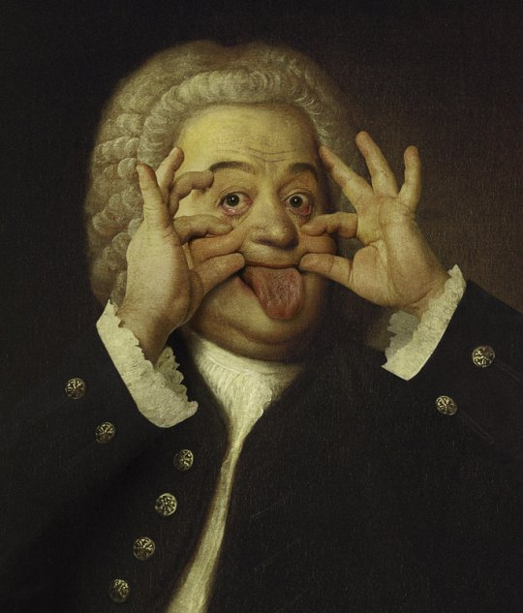
JS BACH: CANTATA ‘EIN FESTE BURG IST UNSER GOTT’, MVTS 1, 2 & 8

Slide 2
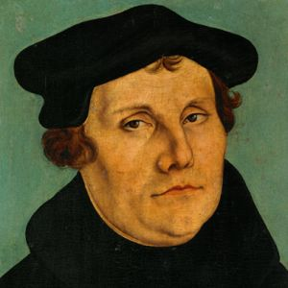
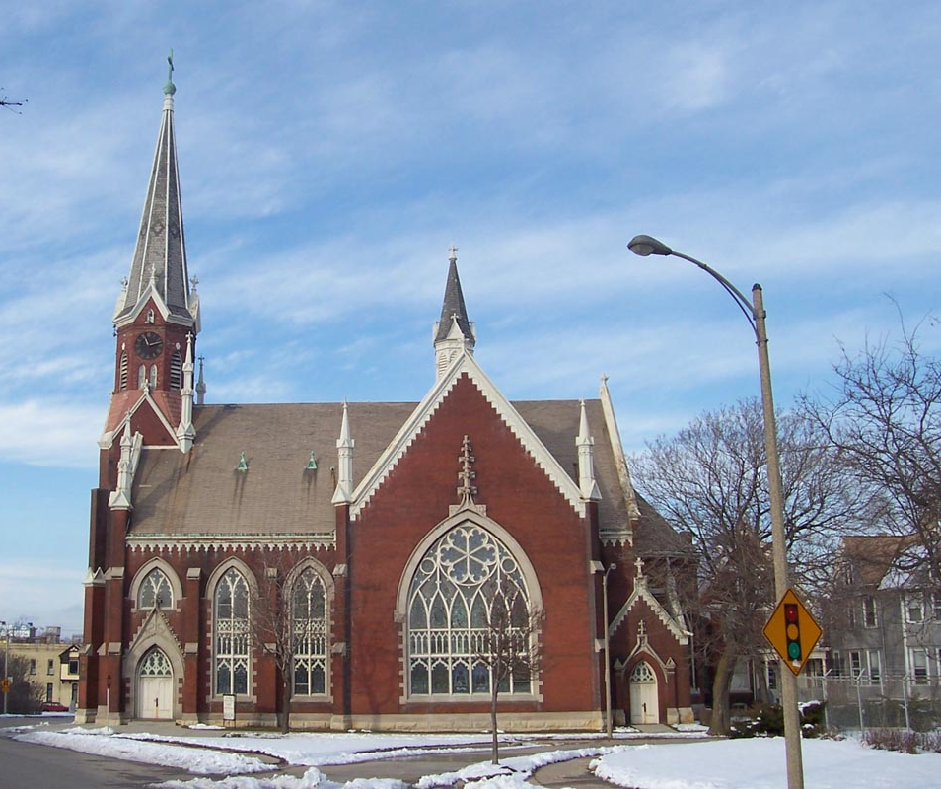
BACKGROUND
In the 16th century, the founder of the Protestant (Lutheran) church in Germany, Martin Luther, sought to involve ordinary worshippers in the medieval Catholic church more actively than had been the case.
This led to a new tradition of congregational singing in German, where previously the emphasis had been on choral music with Latin texts.
The new hymns, known as chorales, were soon incorporated into more elaborate vocal works such as cantatas.

Slide 3
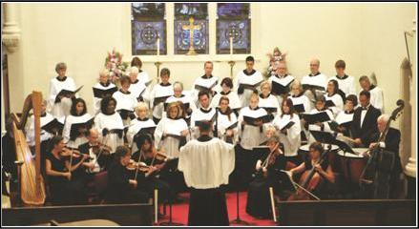
cantatas
The cantata (literally meaning ‘sung’) is an extended piece of music for voices and accompaniment and was a popular form during the Baroque period.
Many cantatas were written for soloists and chorus, accompanied by orchestra with continuo.
Chorales were interspersed with solo arias and recitatives.
The cantata was an integral part of the Lutheran church services and followed immediately after the reading of the Gospel.

Slide 4
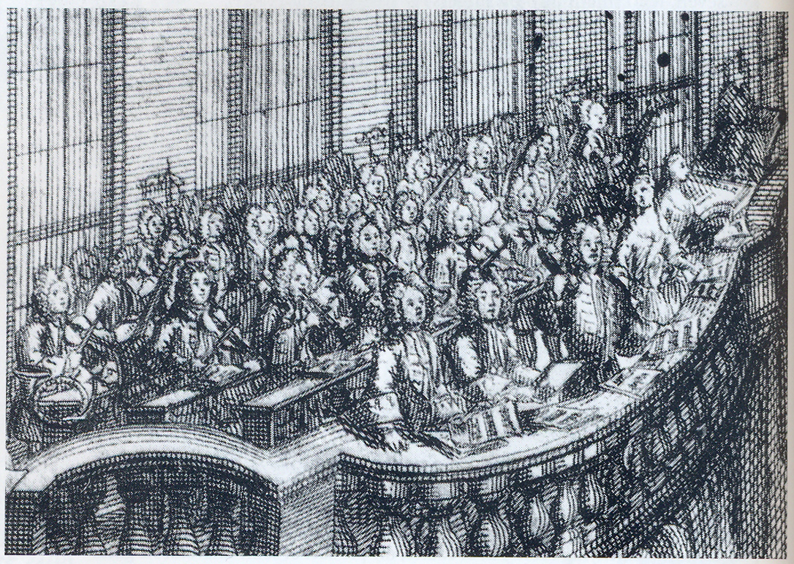

Slide 5
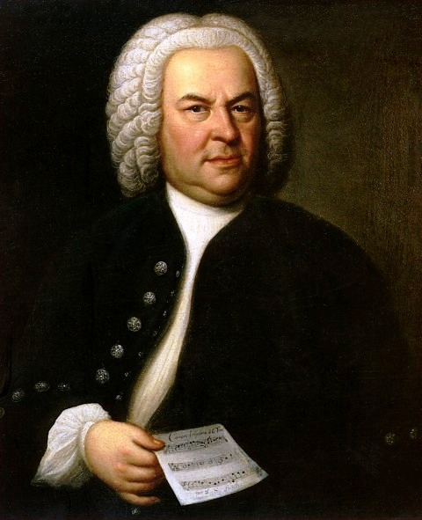
JOHANN SEBASTIAN BACH
In 1723, the German composer J.S. Bach (1685-1750), was appointed as the Cantor of St Thomas church (Thomaskirche)in Leipzig.
He was required to teach singing, train the choir and provide music for the church.
A cantata was required for Sunday services and additional church holy days.
Bach wrote many church cantatas (over 200)!!!

Slide 6
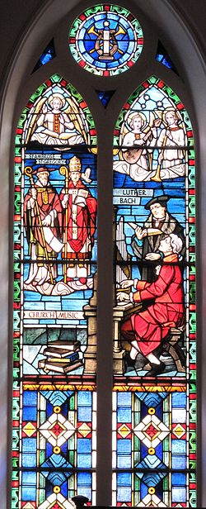
Cantata 80
Is arguably the best known of J.S. Bach’s cantatas and includes the most famous of all Lutheran chorales, ‘Ein feste Burg ist unser Gott’ (‘A mighty fortress in our God’).
The chorale was written by Luther himself and it became a familiar hymn tune.
The use of Luther’s existing chorale melody in Bach’s Cantata is known as cantus firmus (fixed song).
This, the final version, was completed in 1730 for the Feat of the Reformation on October 31st.

Slide 8
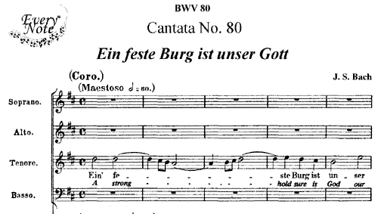
Cantata 80
The chorale is made up of nine phrases. See translation in back of anthology.
Bach’s congregation at St Thomas church would have known this melody by heart, which meant that they would still have been able to recognise it when Bach presented it in a rhythmically varied form or with melodic ornamentation.
The chorales appears in four of the cantata’s eight movements. We will study 3 of these.

Slide 9
Cantata 80
The cantata consists of eight movements:
1. Chorus: Ein feste Burg ist unser Gott
2. Aria and duet (bass and soprano): Alles, was von Gott geboren
3. Recitative and arioso (bass): Erwäge doch, Kind Gottes
4. Aria (soprano): Komm in mein Herzenshaus
5. Chorale: Und wenn die Welt voll Teufel wär
6. Recitative and arioso (tenor): So stehe denn bei Christi blutgefärbten Fahne
7. Duetto (alto, tenor): Wie selig sind doch die, die Gott im Munde tragen
8. Chorale: Das Wort sie sollen lassen stahn

Slide 10
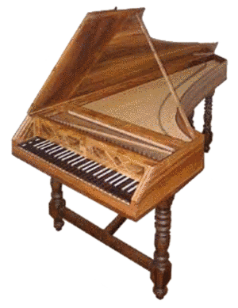
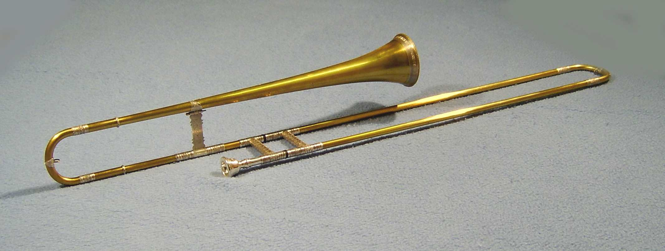
instrumentation
The instruments are arranged in families.
The oboes are found at the top of the score above the string family, whose members are arranged from the highest pitches down to the lowest.
The continue parts are found at the bottom of the score.
This is the only Bach Cantata to differentiate between continuo parts – ‘Violoncello e cembalo’ and ‘violoncello e organo’. In this recording, a bass sackbut reinforces the lower parts.

Slide 11
What can I remember?
Movement 1 so far!
What type of work are we studying?
When was it written?
Which era of music was it composed in?
Where would it have been performed?
Why is the fact that it is written in German significant?
What is a cantus firmus?
Where did the cantus firmus come from?
Which type of texture is used at the opening of the work?
What is the relationship between the orchestra parts and the vocal parts?
Which key is the piece in?

