Slide 1
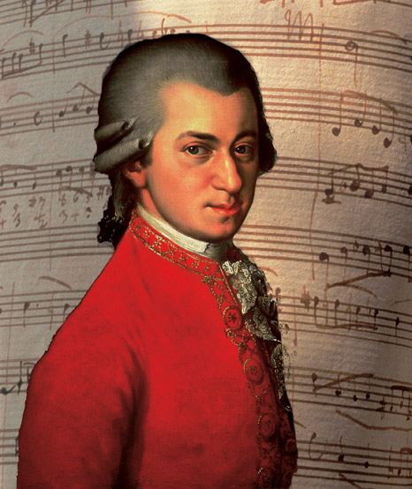
Mozart:
Die zauberflote, excerpts from act 1

Slide 2
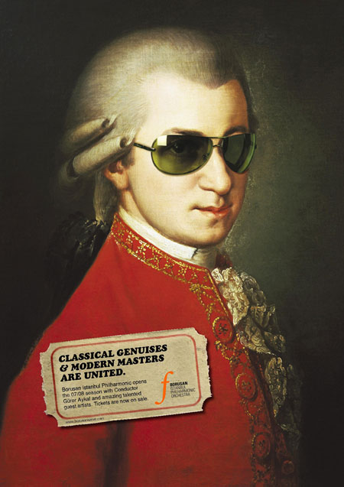
Mozart & operas
Lived from 1756-91 in Austria.
One of the world’s best loved composers.
Helped establish the Classical style at the end of the 18th century.
He was one of the first composers of opera to write in the vernacular (language of the people). Most operas at the time had Italian words and almost all of the best-known composers were Italians.
Opera had been invented in Italy at the start of the 17th century and were written in Italian, including those by the German composer Handel. In Germany and England, the audiences would receive booklets containing a translation of the text.
Despite Mozart’s language breakthrough, his later operas were almost all in Italian, including his famous The Marriage of Figaro.
Opera in the Baroque periods had been very static with a series of solo recitatives and da capo arias and very few ensemble pieces. However in Classical opera there was more variation of mood within arias. Duets and larger ensembles became an essential ingredient of the style.

Slide 3
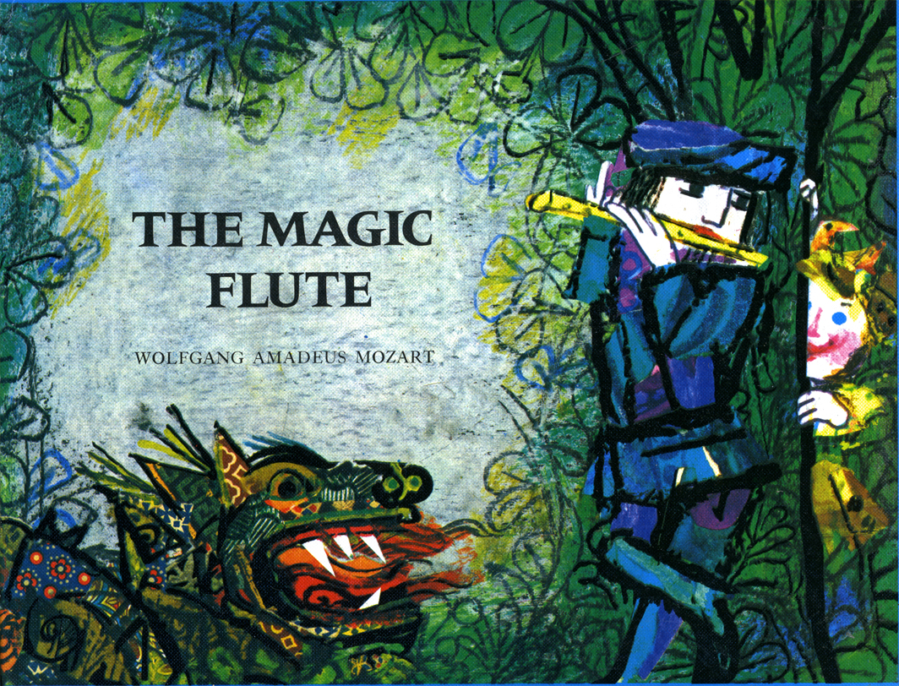
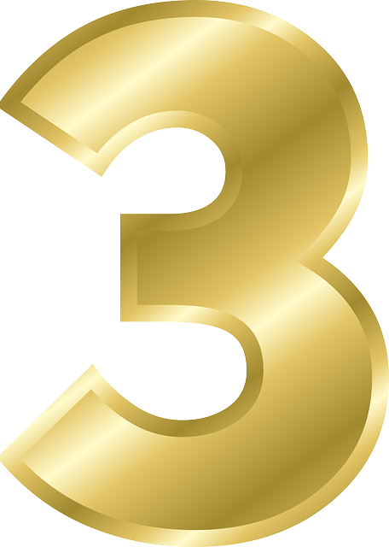
BACKGROUND
The Magic Flute was the last of Mozart’s operas to be performed in his lifetime.
First performance at the Freilhaus-Theater auf der Wieden in Vienna in 1791, with Mozart conducting. This is from the Classical era.
The Magic Flute is a Singspiel (play with singing) – a popular form of the time that included arias, ensembles and spoken dialogue.
Mozart’s friend Schikaneder, wrote the libretto (the text of the opera).
They were both freemasons and the opera incorporates much masonic symbolism, particularly concerning the number 3.

Slide 4
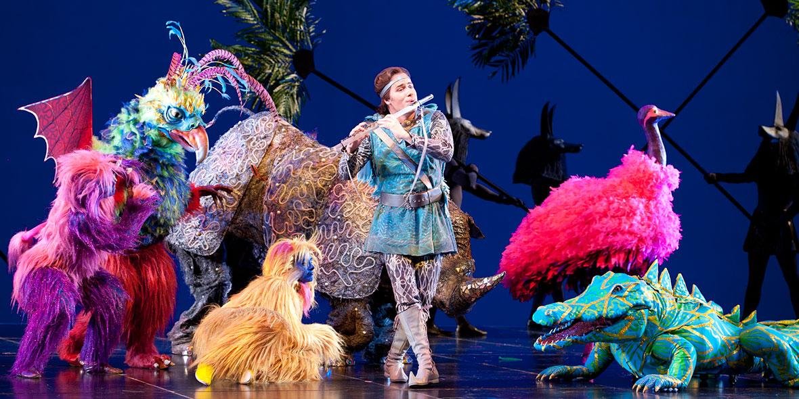
BACKGROUND
The Magic Flute is set in ancient Egypt.
It combines a fairy-tale plot with philosophical ideas and psychological drama.

Slide 5
Following the score
This is a vocal score. The voice parts are shown in full but the orchestral accompaniment has been reduced and adapted for piano.
Notice how abbreviations of the German names for some of the more prominent instrumental solos have been marked in the score. It will usually be easiest to follow the vocal line.
Have a look at the score now.

Slide 6
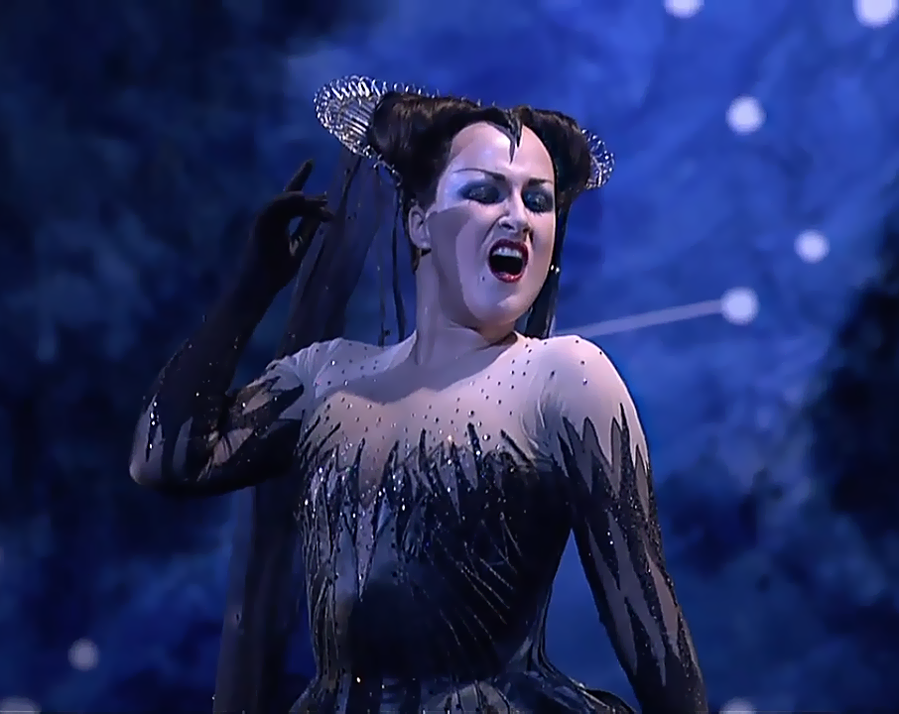
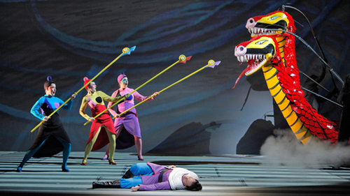
storyline
The opera is divided into two acts with a rather convoluted plot.
The first act opens with Prince Tamino, the hero, fleeing a deadly serpent when three ladies appear and save him. They are the attendants of the Queen of the Night, whose daughter Parmina has been kidnapped by the ‘evil’ Sarastro. The three ladies place a padlock over Papageno’s mouth waning him not to lie.

Slide 7
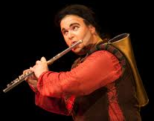
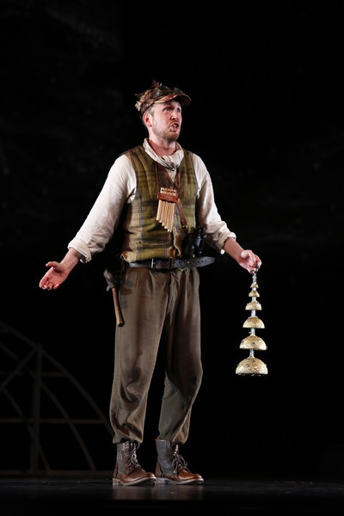
storyline
The Queen, appearing in a burst of thunder, expresses her grief at the loss of Pamina, then commands Tamino to rescue her (No. 4 ‘O zittre nicht’). The three ladies then remove the padlock from Papageno’s mouth and instruct him to accompany Tamino. As protection against danger, they give Tamino a magic flute and Papageno magic bells (No. 5 ‘Hm! Hm! Hm! Hm!).

Slide 8
WHAT CAN YOU REMEMBER?
Which piece are we studying?
Who is it written by?
Which year as it written in?
Which era of music is it from?
What type of work is it? (Be very specific…)
Which language was it written in and why?
Why is the number 3 significant?
Briefly outline the plot in the Act 1, No. 4 (the first of the two songs we are studying)
What is a recitative?
What is an aria?
What are the intervals in a Diminished 7th chord?
What is a Neapolitan 6th chord?
Where do you often find a Neapolitan 6th chord?
What is a half-diminished chord?
What is the difference between a suspension and an appoggiatura?

