Slide 1
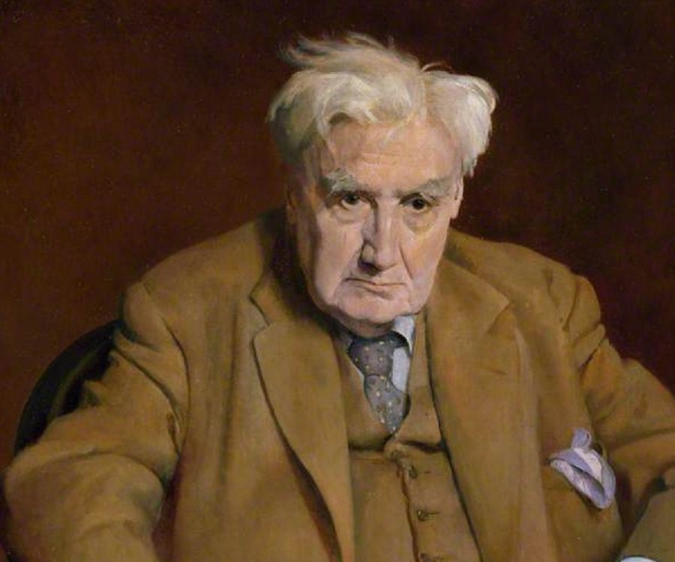
Vaughan williams:
on wenlock edge:
Nos 1, 3 & 5

Slide 2
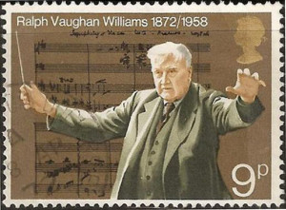
Ralph Vaughan Williams
1872-1958, born in Gloucestershire
Educated at Charterhouse School, RCM and Trinity College, Cambridge
Leading British composer of the time
Wrote 9 symphonies, several concerti, major choral works and solo songs

Slide 3
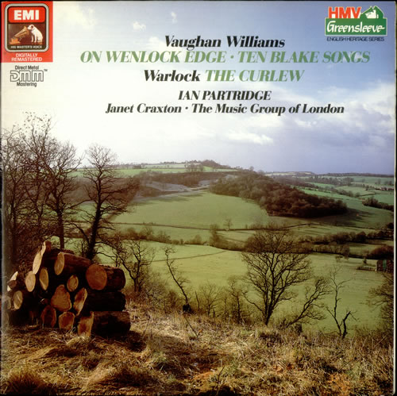
On wenlock edge
Written in 1909
By this time, some European composers (e.g. Schoenberg) were abandoning the system of major-minor tonality in their writing.
Vaughan Williams did not do this, but neither did he limit himself to traditional tonality.
He was influenced by English folk music, the music of Tudor England and of Debussy and Ravel (who was briefly his teacher).
These influences include:
Folk like vocal melodies
Use of modes
False relations
Parallel movement

Slide 4
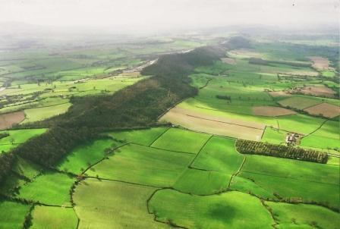
On wenlock edge
On Wenlock Edge consists of 6 poems from A Shropshire Lad by A.E. Housman. Generally melancholic in tone, the subject matter often concerns mortality, the fleeting nature of life and thwarted love.
The work is a song-cycle - a collection of songs in the Western Classical tradition that share similar matter, or all have texts by the same poet.
Written for tenor, piano and string quartet.
‘On Wenlock Edge’
Wenclock Edge is a limestone escarpment in the Shropshire Hills Are of Outstanding Natural Beauty, covered in woodlands.
The poet imagines gales lashing the young trees and reaslises that they same storms were experienced in Roman times. Likewise, people then must have faced the same struggles (the ‘gales of life’) as in his own time. However, just as the storm is brief, so modern sufferings will soon be over, as now those of the Romans are.

Slide 5
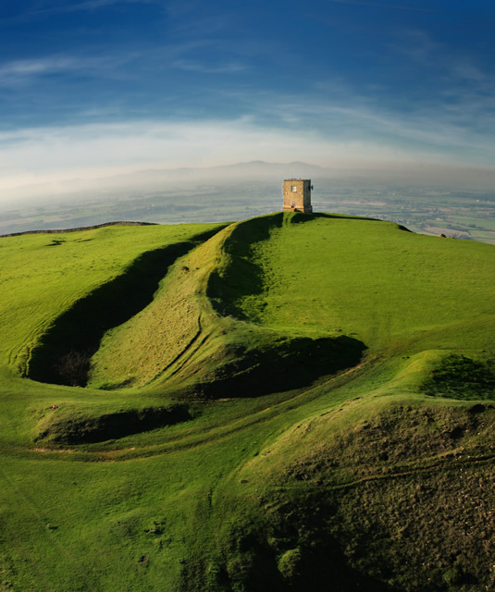
On wenlock edge
‘Is My Team Ploughing?’
This poem is a dialogue between the ghost of a young man and a friend who is still alive. At first, the dead man receives reassurance. But when he asks if his girlfriend is happy, he is told that she no longer grieves, but is ‘well contented’. He then enquires after his friend, and the answer – although enigmatic – is devastating.
‘Bredon Hill’
Tells the story of young love defeated by death. Bredon Hill is near Tewkesbury on the Worcestershire-Gloucestershire border (not Shropshire). On summer Sunday mornings, a young man and his girlfriend would lie on Bredon Hill, listening to the bells calling people to church. The girl in particular would ignore the call, but the young man promised that they would obey the bells’ summons on their wedding day.
At Christmas however, the girl ‘went to church alone’ – she had died – and just one bell tolled. In the final stanza the young man hears the bells as in happier days. He replies that he ‘will come’ – but, although this is not explicit, it will be to his own funeral.

