Slide 1
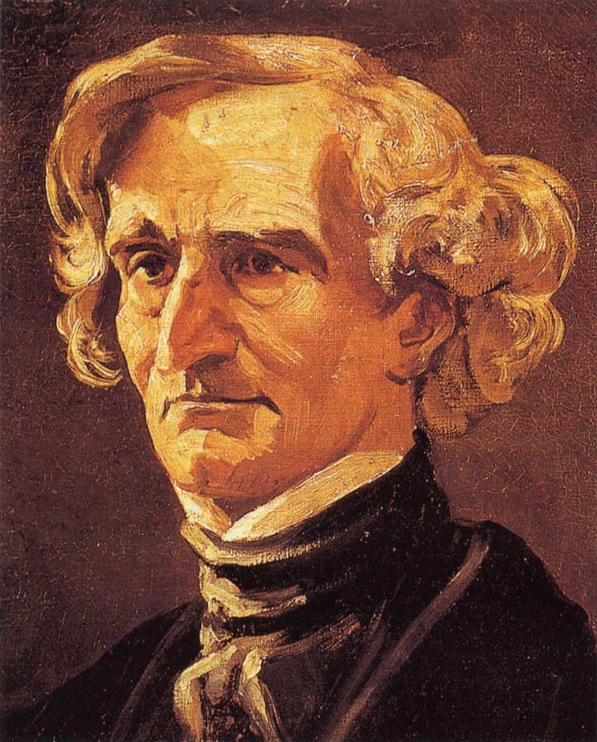
Berlioz: symphonie fantastique: movement I

Slide 2
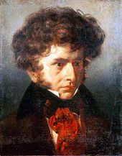
Hector berlioz
1803–1869
French composer
Highly influential in the development of Romantic music
Wrote on a large scale, increasing the size of the orchestra and showing innovative methods of orchestration as well as through his melodic and harmonic ideas.
In 1826 he enrolled at the Paris Conservatoire to study composition. It was here that he became familiar with the symphonies, string quartets and piano sonatas of Beethoven and this was an inspiration for his compositions.
His compositional output was large, and in addition to the highly renowned Symphonie Fantastique, other key works include the symphony for viola and orchestra, Harold in Italy.
He wrote large-scale choral works such as Grand Messe des Morts (Requiem) and operas which include Benvenuto Cellini and Les Troyens.
He also wrote his Treatise on Instrumentation, which had significant impact on the development of orchestral music throughout the Romantic period.

Slide 3
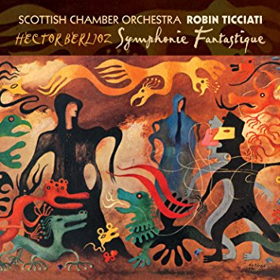
Symphonie fantastique
First composed in 1830 (but later revised)
Programme music
Tells the story of a talented artist with a lively imagination who has poisoned himself with opium in the depths of despair because of hopeless love.
Berlioz regarded this as an ‘instrumental drama’ and provided his own programme notes for each movement of the work (like an opera).
He writes:
‘The composer’s intention has been to develop various episodes in the life of an artist, in so far as they lend themselves to musical treatment. As the work cannot rely on the assistance of speech, the plan of the instrumental drama needs to be set out in advance. The following programme must therefore be considered as the spoken text of an opera, which serves to introduce musical movements and to motivate their character and expression.’

Slide 4
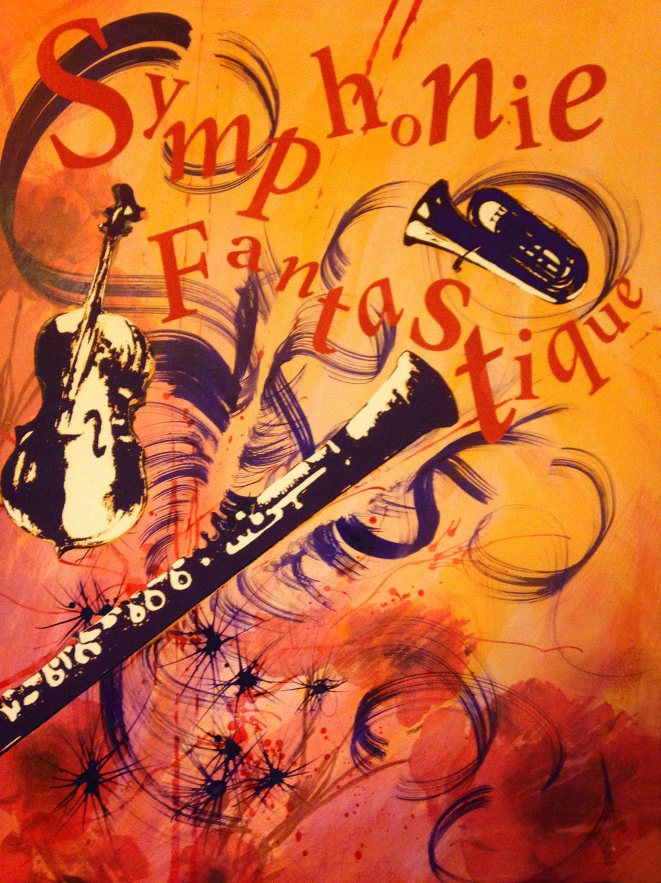
Symphonie fantastique
The Symphonie Fantastique is a highly original work of its time in terms of both its treatment of melody, rhythms and harmony and Berlioz’s ability to express moods and drama through music.
The symphony shows unity through the use of an idée fixe, a recurring theme, which acts as a structural foundation of the work. The piece is said to be autobiographical and represents Berlioz’s love of and obsession with the actress Harriet Smithson.
  Overall this piece is for 2 violins, a cello and strings

Slide 5
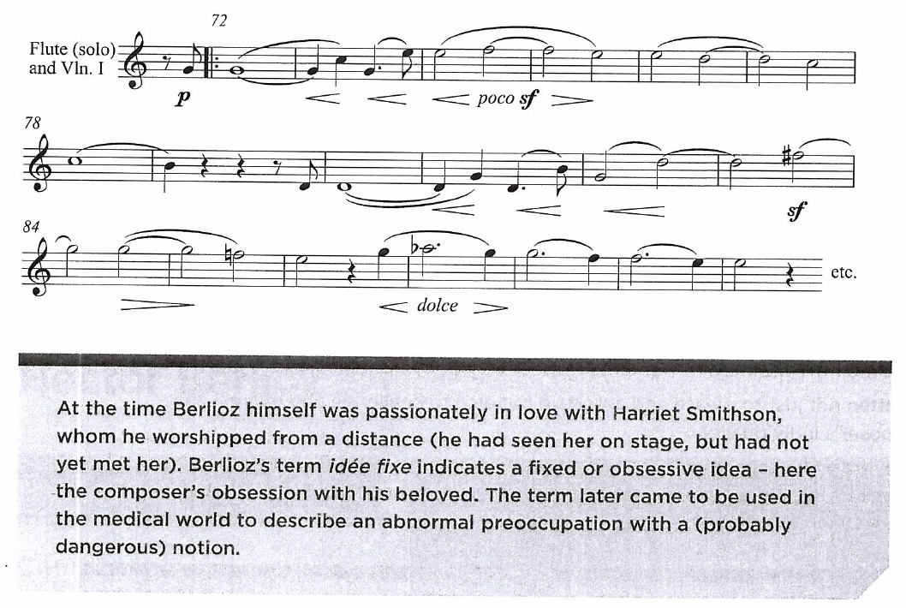
Idee fixe
  Overall this piece is for 2 violins, a cello and strings

Slide 6
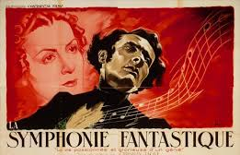
Symphonie fantastique
There are five movements, instead of the usual four movements that were conventional for symphonies at the time. Each movement is given a descriptive title by the composer.
1. Rêveries – Passions (Reveries – Passions)
2. Un bal (A Ball)
3. Scène aux champs (Scene in the Fields)
4. Marche au supplice (March to the Scaffold)
5. Songe d’une nuit du sabbat (Dream of the Night of the Sabbath)
The subject of Mvt 1 paraphrases Berlioz's various emotion states: Dreamy melancholy, brief episodes of unfocused joy and delirious passion, moments of fury and jealousy, returning tenderness, tears and consoling religious thoughts.

Slide 7
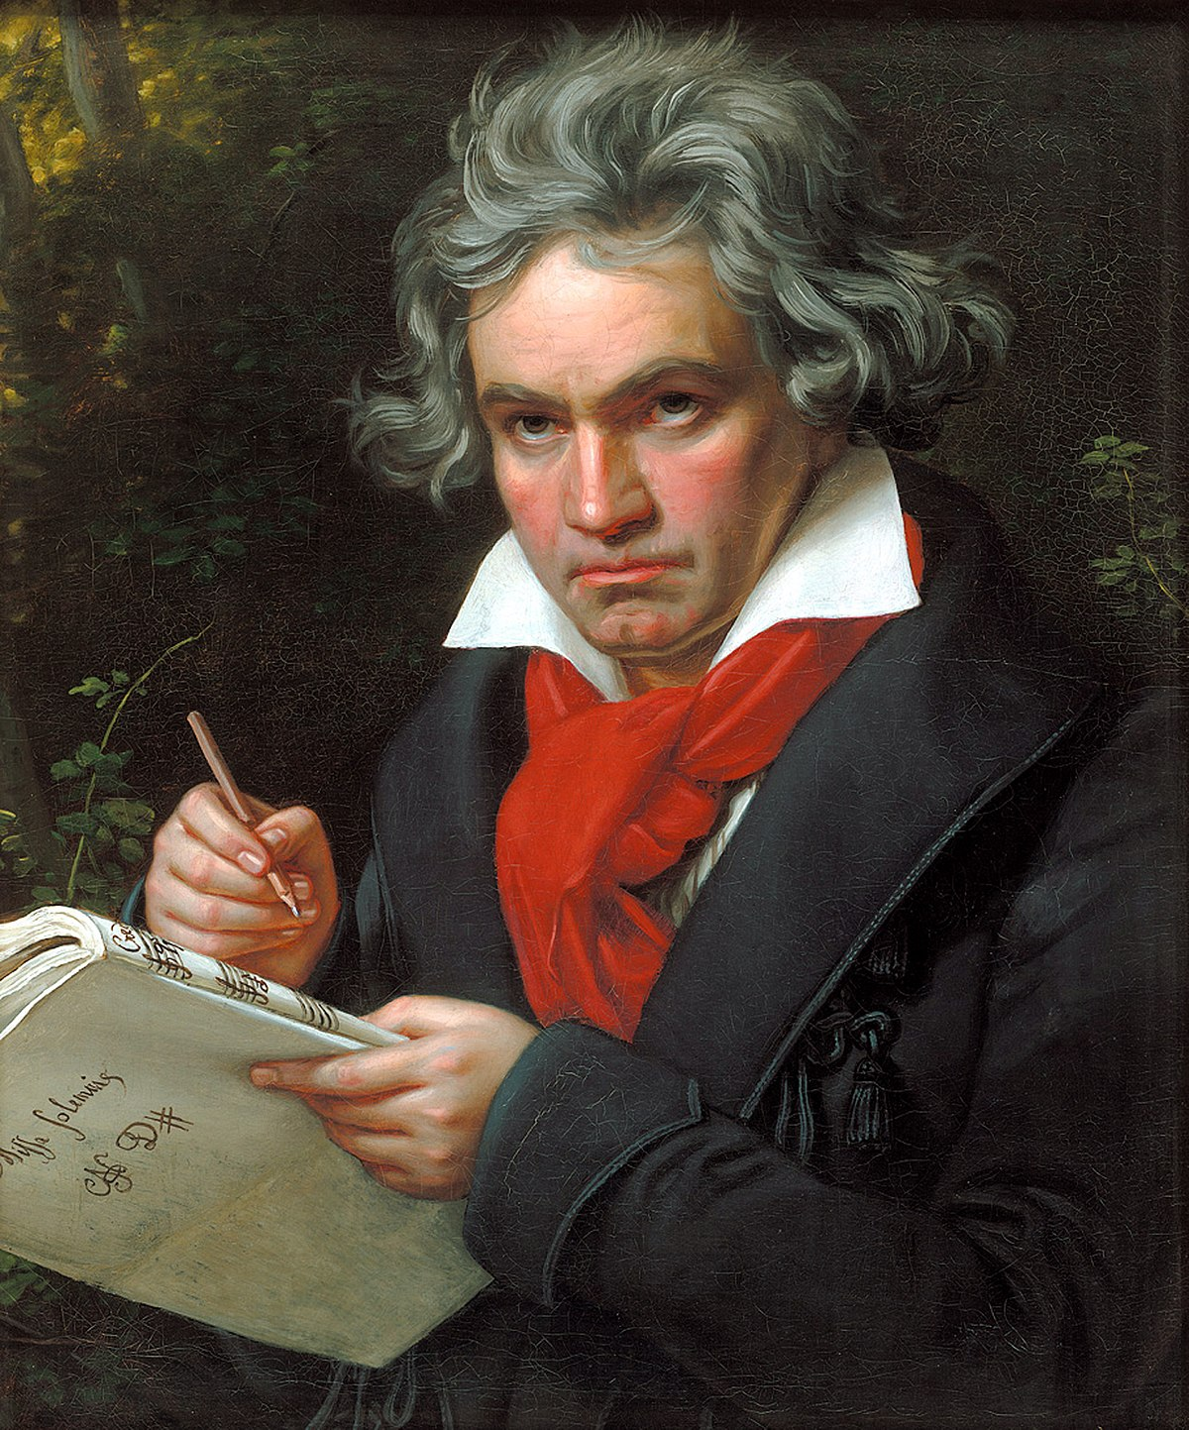
Beethoven &
the symphony
Berlioz thought of his work as symphony because it was a large-scale orchestra work with several movements, but he was well aware that he was breaking away from the traditional Classical symphony writing of Mozart and Haydn.
Beethoven however was to some extent a model as he had already expanded the symphony in length and weight and had widened its scope in terms of ‘subject matter’ – as in No. 6 Pastoral Symphony with its evocations of nature and its use of 5 movements.
  Overall this piece is for 2 violins, a cello and strings

Slide 8
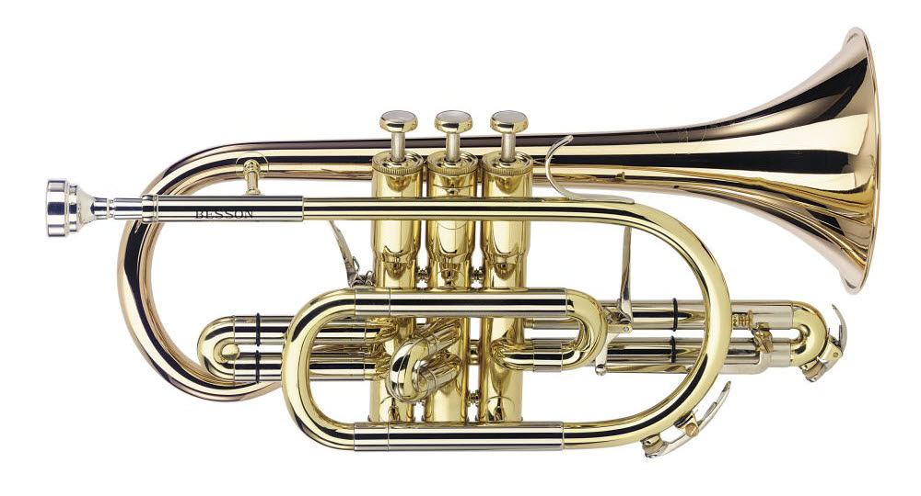
INSTRUMENTATION & RESOURCES
The Symphonie Fantastique requires an exceptionally large symphony orchestra, which was groundbreaking for its time (1830), and numerous instrumental additions to that of the standard orchestra.
The first movement is scored for:
Woodwind
Two flutes with the second flautist changing to piccolo in bar 409.
Two oboes
Two clarinets in B♭ (transposing instrument which sounds down a major second)
Four bassoons (rather than the normal two)
Brass
Four horns: horns I and II in E♭ (transposing instrument which sounds down a major sixth) and horns III and IV in C
Two trumpets in C, as well as
Two cornets à pistons in G (an early type of valved cornet that allowed chromaticism).

Slide 9
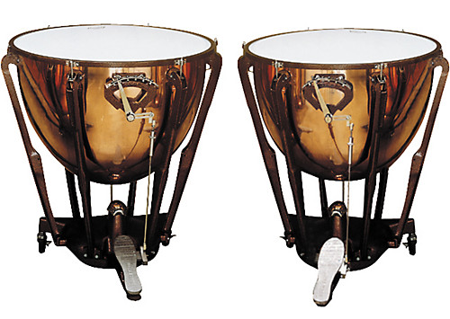
INSTRUMENTATION & RESOURCES CONTINUED
Percussion
Timpani (two, tuned to C and G, the tonic and dominant notes).
Strings (At least 60!)
First and second violins (he states at least 15 in each section)
Violas (at least 10)
Cellos (at least 11)
Double basses (at least 9).
The orchestra expands further in the proceeding movements, with two harps added in the second movement to represent the elegance of the dancing at ‘The Ball’.
The third movement has a significant solo role for cor anglais in a pastorale-style movement and additionally two timpani to represent a thunderstorm.
Snare drum, cymbals, bass drum, ophecleides (a type of keyed bass-bugle) appear in the fourth and fifth movements.

