Slide 1
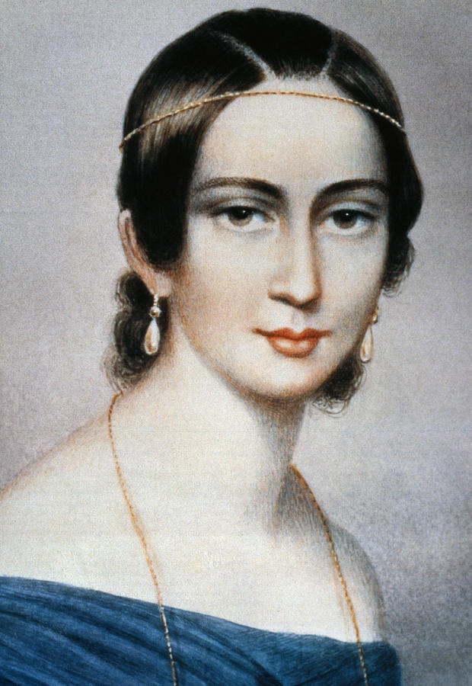
Clara schumann
Piano trio in g minor
op. 17, mvt 1

Slide 2
Clara schumann
1819-1896. Born in Leipzig.
Composer, concert pianist and teacher
The daughter of Friedrich Wieck, a renowned piano teacher – she received a good musical education.
As a highly respected composer-pianist she often performed her own works on the piano. She is often referred to as the ‘Queen of the Piano’ and was one of the first pianists to perform from memory.
She married Robert Schumann (very famous composer) against her father’s wishes. They had 8 children but only 4 survived. Her husband suffered mental illness. She had to support his ill health and provide most of the income for the family. ☹
She became lifelong friends with Johannes Brahms. He confided in her about his work and often he would change passages of his pieces in light of her feedback.

Slide 3
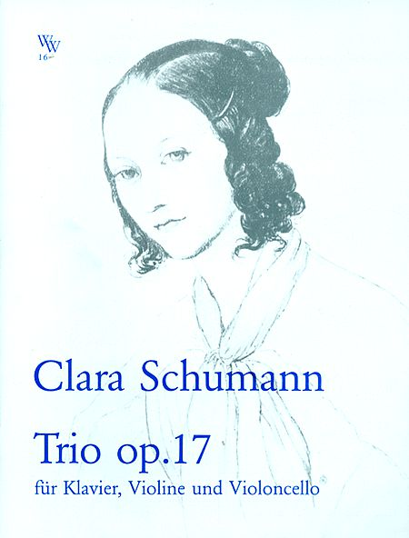
Piano trio in g minor, op. 17, mvt 1
Completed in 1846 and is one of her most famous works
Piano Trio = violin, cello and piano
Piano Trios were one of the most important forms of chamber music and were generally written in the Romantic period (approx 1800-1900)
Much chamber music was written for performance in the salons of the patrons and performers.
Composers in the Classical style, such as Mozart and Haydn, had
established the form, and Beethoven and Schubert developed
it further in the early Romantic style.
It is one of only a few multi-movement works written by Clara
Schumann. It follows the full four movement pattern of the
genre:
o Allegro moderato
o Scherzo and trio
o Andante
o Allegretto

Slide 4
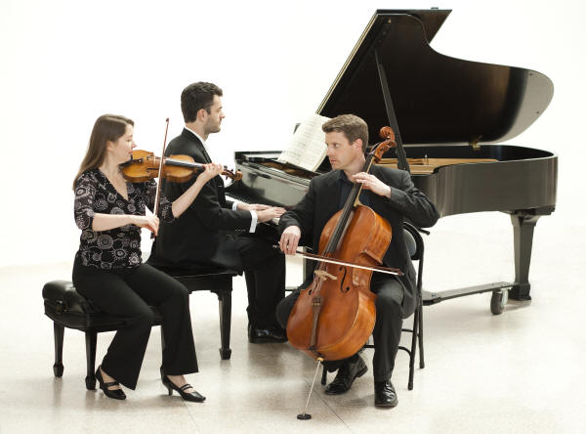
instrumentation
The instruments are given fairly equal roles in this movement, unlike many piano trios, where the piano dominates.
Although not without difficulty, none of the parts here are particularly virtuosic, perhaps being intended for performance by capable amateurs, as well as by professional musicians.
Violin and cello use double-stopping, both at loud dramatic moments (bars 284–286) and to fill in the texture during quieter passages (bars 73–77).
The violin plays mainly in the two octaves above its
lowest string, but it does have music that stretches
nearly another octave above this at times.
The cello uses both its resonant low range and its
powerful upper range, up to an octave above
middle C at times.
Overall this piece is for 2 violins, a cello and strings

Slide 5
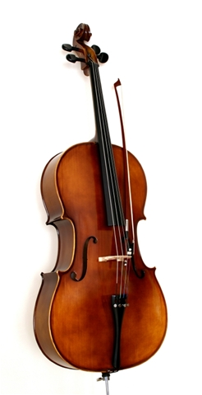
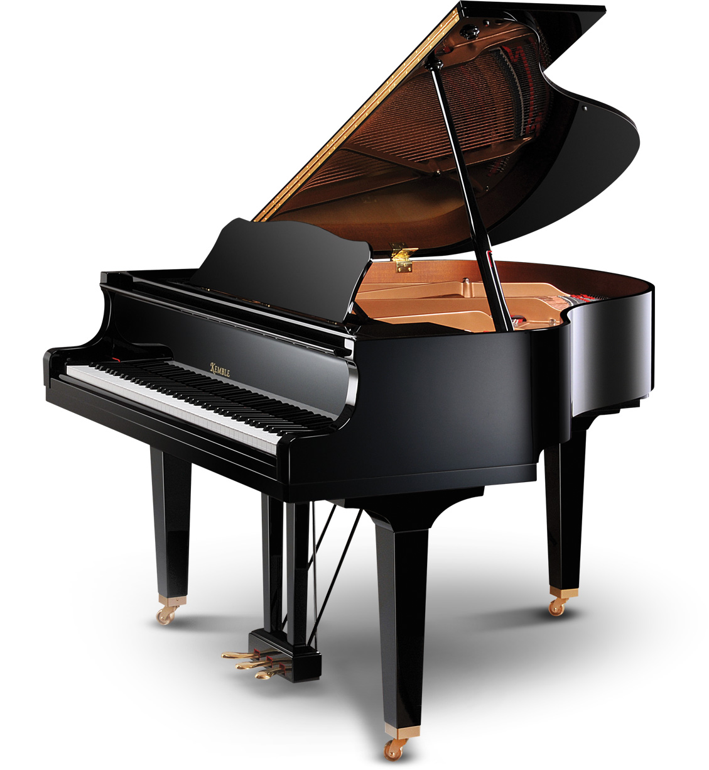
Instrumentation
The cello provides:
Support for the bass of the harmony at times, including pedal notes (bars 73–80).
‘Tenor-like’ mid-range parts to outline inner parts (bars 37–41).
Material high in its register (bars 134–138; note that the notation here is in the treble clef, but written an octave higher than it sounds).
The piano provides both melodic and accompaniment textures:
The writing is typical of the Romantic period, but is perhaps more intimate and less virtuosic at times than some of the works of Beethoven, for example.
Important melodic material is often presented in a single octave (without doubling) (e.g. bars 9–14).
The middle range of the keyboard is favoured, especially in the right-hand material – the highest note is the G two and a half octaves above middle C.
Schumann is always sensitive to the balance between the instruments, placing some of the piano material in a lower register to avoid masking the strings at times.

Slide 6
“I once believed that I possessed creative talent, but I have given up this idea; a woman must not desire to compose – there has never yet been one able to do it. Should I expect to be the one?”

