Slide 1
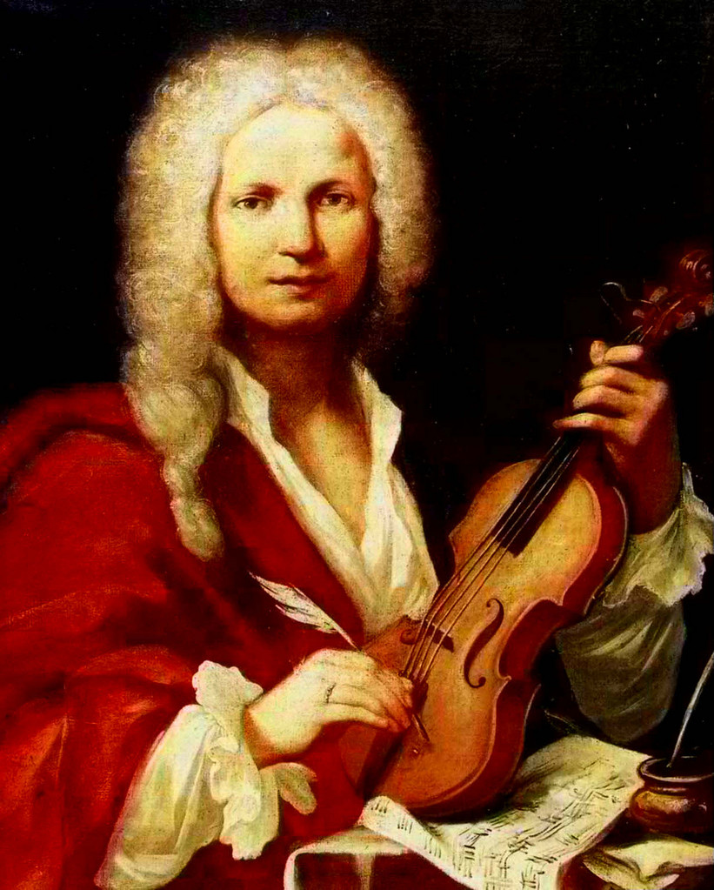
Vivaldi:
Concerto
in D minor,
op. 3 No. 11,
Rv 565

Slide 2
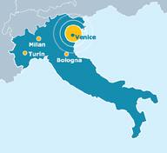
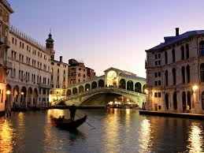
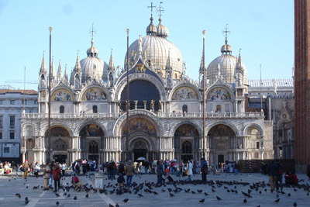
Antonio vivaldi
Venice,
Italy
Born in Venice, Italy in 1678
Son of accomplished violinist who worked at St Mark’s Basilica, a very important musical centre at the time
Virtuosic violinist and prolific composer
Became a violin teacher and Maestro de’ concerti at an orphanage for abandoned children. He was expected to compose pieces for the children to perform. Most of his major works composed here.
Wrote more than 500 concertos, most for solo instruments.

Slide 3
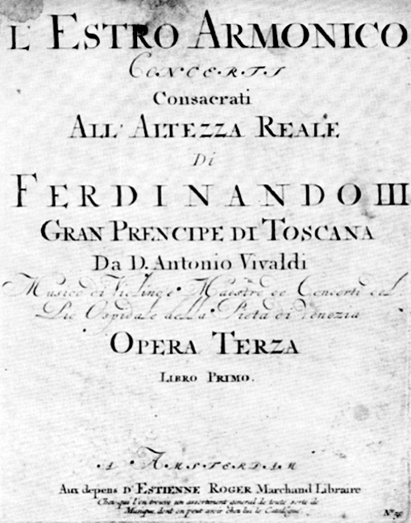
L’estro armonico
Literally meaning ‘harmonic inspiration’, L’estro Armonico was composed in 1711, this was one of the first sets of Italian concertos to be published outside of Italy and was designed to impress by its diversity of style and scoring.
It consists of 12 concertos divided into four groups of three.
We are studying concerto No. 11.
This concerto has 3 different movements:
Allegro – Adagio e spiccato – Allegro
Largo e spiccato
Allegro
L’Estro Armonico fascinated musicians throughout
Europe and helped to establish the model of the
18th century concerto.

Slide 4
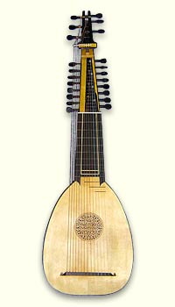
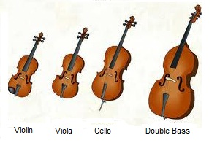
instrumentation
2 solo violins
1 solo cello
Ensemble violins & violas
Continuo part
This would include a bass line and a keyboard or plucked instrument. The bass instrument would play the given bass line and the chordal instrument would play the chords indicated by the figured bass. (The numbers placed under the stave). In this recording, an arch lute is used.
Overall this piece is for 2 violins, a cello and strings

Slide 5
What is a concerto?

Slide 6
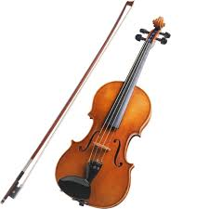
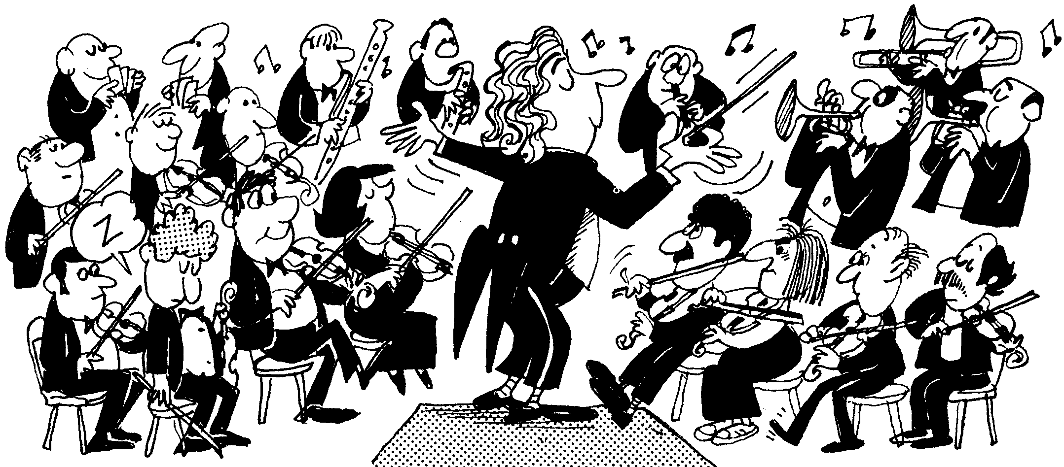
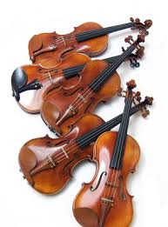
Concerto & concerto grosso
A concerto is a work for solo instrument plus larger ensemble.
A concerto grosso is a work for a group of soloists plus larger ensemble.
+
+

Slide 7
Concerto Grosso
Concertino
2 solo violins
1 solo cello
(Trio sonata group)
Ripieno
Ensemble strings

Slide 8
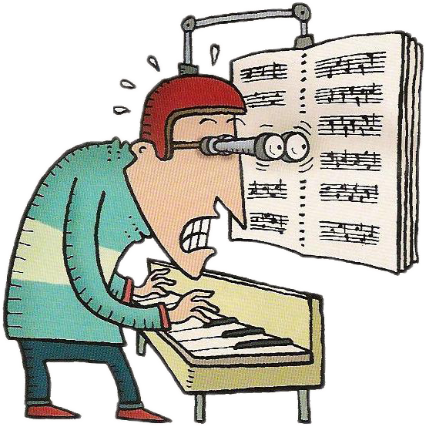
Reading The score
2 solo violinists on the top staves
Solo cello on the penultimate stave
The larger ensemble of violins and violas are placed on the middle staves
Continuo part on the bottom stave

Slide 9
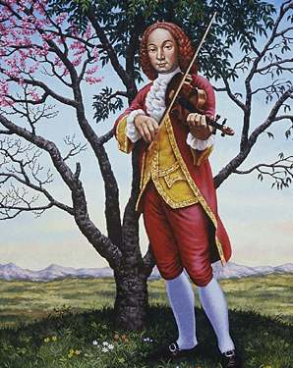
L’estro armonico
Vivaldi uses the traditional form of the concerto grosso as inherited by composers such as Corelli and Torelli, but in some ways he anticipated the solo concertos of the future.
This can be heard through the:
brilliant and technically demanding passages of the outer movements
dramatic opposition of the tutti and soloists
lyrical outpouring in the slow movements.

Slide 10
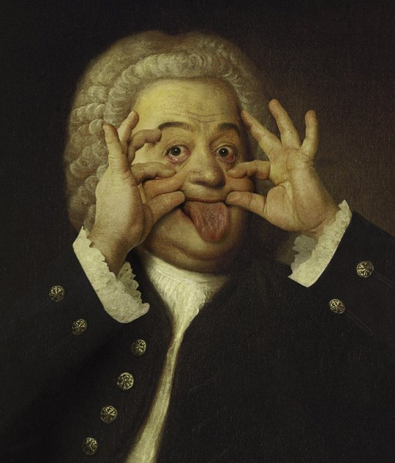
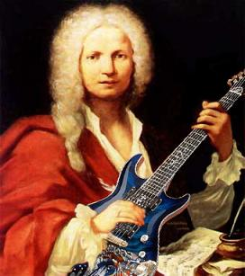
Did you know?
J.S. Bach studied Vivaldi’s concertos by making his own arrangements of them.
One of the most famous is Vivaldi’s Concerto Op. 3, No.8 – a concerto grosso for two violins and strings that Bach transcribed as a work for organ alone.

Slide 11
What can you remember?
Movement I:
Who wrote the piece we studied?
When was it written?
Which era of music was this piece written in?
What type of work are we studying?
What were the name of the two instrumental groups?
Which key is the work in?
Give two ways in which the composer helps establish the key
Which type of chord progression was heard towards the end of the section we studied?
Which other famous composer was inspired by the concerti written by this composer?

Slide 12
What can you remember?
SECTION 1 MVT 1
How could you describe the melody?
Which chord progression could be found?
What does ‘spiccato’ mean?
Which cadence did the section end with?
What is added to the majority of the chords?
SECTION 2 MVT 1
What were the names of some of melodic lines in a fugue?
What overall texture does a fugue create?
Which melodic feature happened a lot?!
Name one of the keys Vivaldi modulated to and how this is related to the tonic

Slide 13
Vivaldi:
WIDER
listening
I represent wider listening pieces. I don’t represent set works!

Slide 14
J.S. BACH
BRANDENBURG CONCERTO
NO. 4 IN G: MVT I

Slide 15
Where, when & why?
Bach wrote 6 Brandenburg concertos for the small court orchestra of Cöthen.
Cöthen was one of the many states into which Germany was then divided, and where Bach was director of music from 1717 to 1723.
Later Bach presented a score of the works to the ruler of the much larger state of Brandenburg hence their title. It is not know if the concertos were ever played at Brandenburg, but most were forgotten after Bach’s death in 1750.
Even after the rediscovery of Bach’s manuscripts in the 19th century performances were rare. It was not until the 20th century, when recording made the Brandenburg concertos available to a wide audience, that these works became established as some of the best-loved instrumental music of the Baroque period.

Slide 16
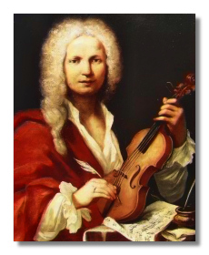
Where, when & why?
Brandenburg concerto No. 4 is modelled on the type of concerto that was perfected by the Italian composer Vivladi, who was just seven years older than Bach.
Bach studied Vivaldi’s concertos by making his own arrangements of them.
One of the most famous is Vivaldi’s Concerto Op. 3, No.8 – a concerto grosso for two violins and strings that Bach transcribed as a work for organ alone.

Slide 17
The listening test!

Slide 18
Bach What did you find out?

Slide 19
The essay question!

Slide 20
Question 6
ESSAY QUESTION
Evaluate the use of Vivaldi’s harmony and tonality in Concerto in D minor Op.3 No. 11.
Relate your discussion to other relevant works. These may include set works, wider listening or other music.
20 marks

Slide 21
What does ‘evaluate’ mean?

Slide 22
Edexcel say it means: ‘To make judgements against parameters and draw conclusions’.

Slide 23
Essay plan! What should I include in the essay?

Slide 24
Essay structure How should I write my essay?

Slide 25
Essay structure What to put in the introduction

Slide 26
L’estro armonico
Literally meaning ‘harmonic inspiration’, L’estro Armonico was composed in 1711, this was one of the first sets of Italian concertos to be published outside of Italy and was designed to impress by its diversity of style and scoring.
It consists of 12 concertos divided into four groups of three.
We are studying concerto No. 11.
This concerto has 3 different movements:
Allegro – Adagio e spiccato – Allegro
Largo e spiccato
Allegro
L’Estro Armonico fascinated musicians throughout
Europe and helped to establish the model of the
18th century concerto.

Slide 27
Example:
As you would expect from a piece in the Baroque era, Vivaldi uses functional harmony throughout the concerto. For example a perfect cadence can be found at the end of each movement helping establish the tonic key and define the structure. A tonic pedal can be heard at the very start of the first movement across the two solo violin parts. Again, this helps to establish the tonic key. The circle of 5ths progression can be found through the concerto (for example towards the end of the introduction of movement one). This very solid chord progression was common in music of the Baroque period. A chain of suspensions is used towards the end of the final movement to create tension as the work comes to an end. All of these features help to establish the key and produce interest in the harmony. These features can also be found in Bach’s Brandenburg Concerto in G No. 4 Mvt 1 which was written around 10 years after Vivaldi’s piece.
Vivaldi also uses chromatic harmony for example a diminished 7th chord near the start of movement 2 and a neapolitan 6th chord in section 1 of movement 1. These features help to create drama and variation in the harmony. Bach was inspired by Vivaldi so also uses these features in his piece.

Slide 28
HOW WILL I BE MARKED?

Slide 29
Let’s get writing!

Slide 30
Homework (for next Monday) Cecil Chaminade listening & research

