Slide 1
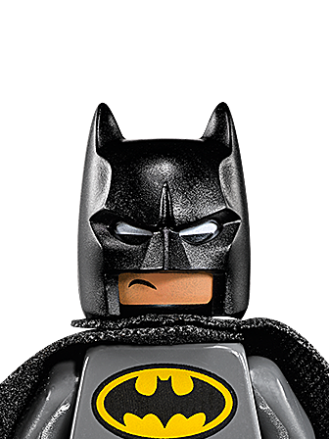
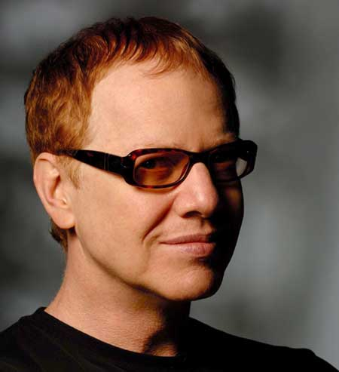
DANNY ELFMAN: BATMAN RETURNS

Slide 2
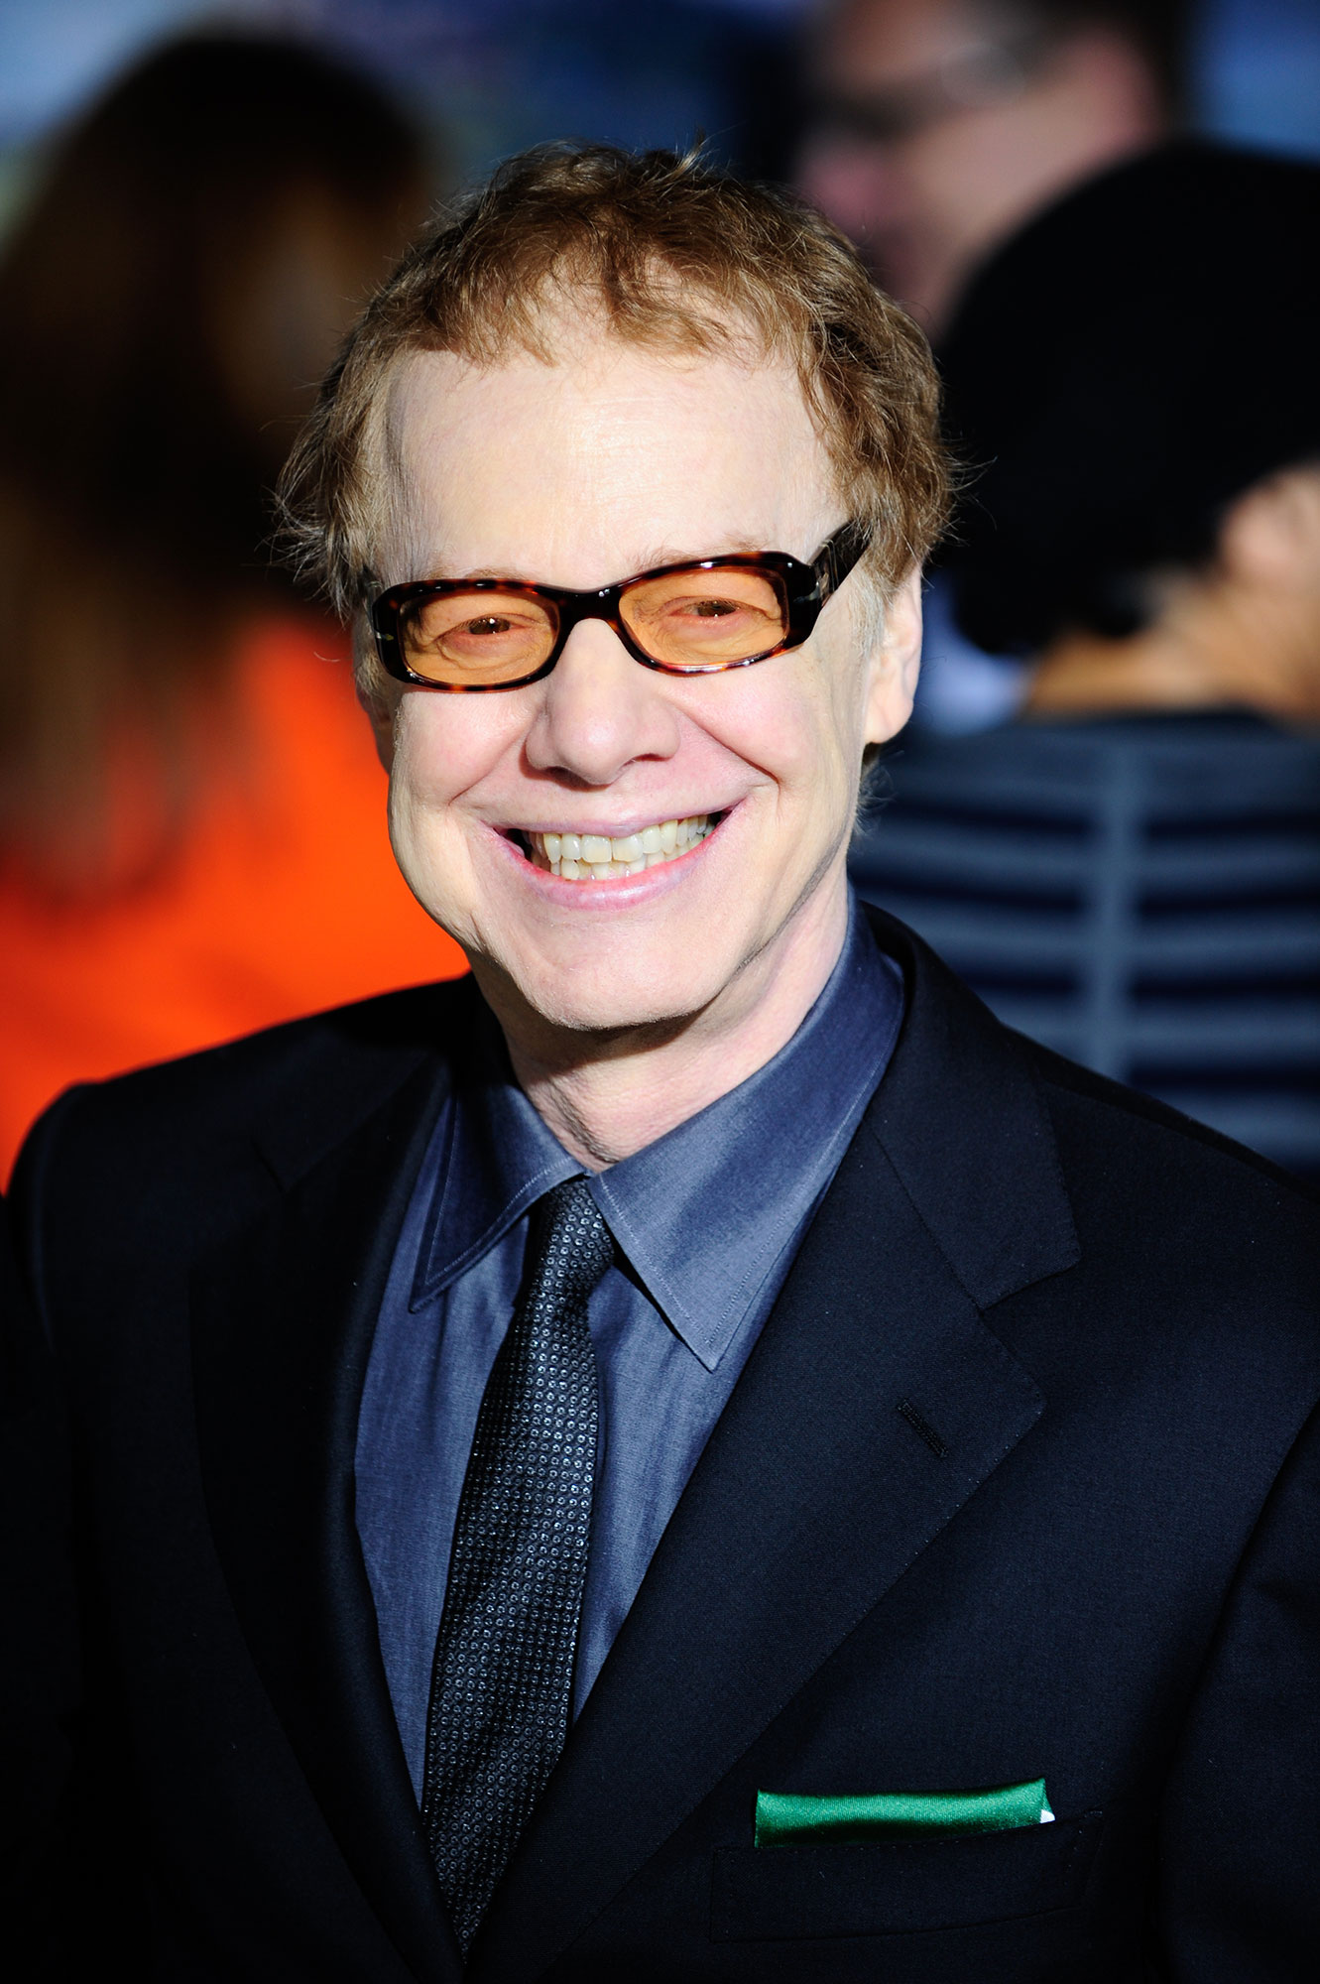
Danny elfman
Born in Los Angeles in 1953
No formal music education – learnt to write through being an avid cinema goer
Best know for his association with Tim Burton e.g. The Nightmare Before Christmas and Beetlejuice
His music is characterised by:
Dark orchestral scores often in minor keys
Melodies in middle of the texture often on brass, woodwind or strings in their lower registers
Like many film composers, his music is orchestrated by studio arrangers

Slide 3
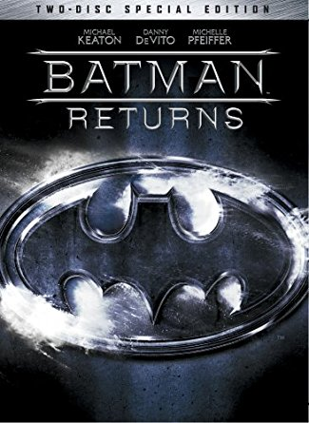
Batman returns
Released in 1992, sequel to Batman (1989).
Directed by Tim Burton
American film based on the comic-book superhero Batman, a mysterious figure who takes crime fighting into his own hands.
Storyline: Business tycoon Max Shreck teams up with Catwoman and Penguin in his plan to take over Gotham City.
This was a much darker adaptation of the cartoon character. Burton created a character with an almost dual personality – one that had the potential to be both villain and hero.

Slide 4
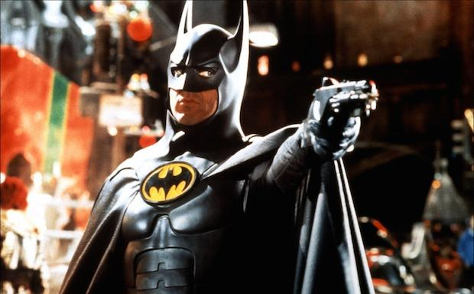
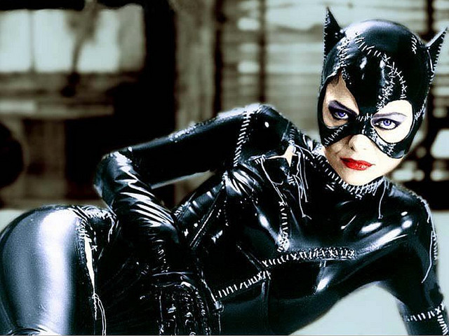
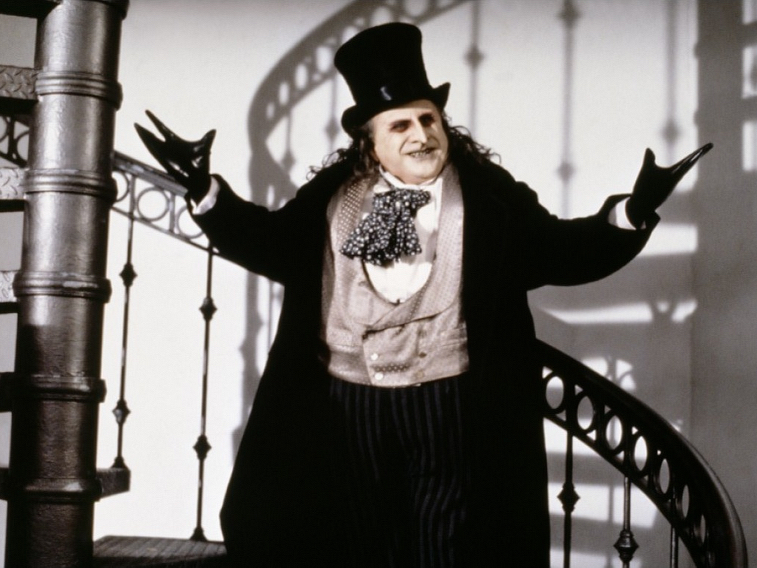
Batman returns
Elfman scores much of his music around leitmotifs then develops them throughout the score.
It is likely that Elfman took influence from composers such as Bernard Herrman (e.g. Psycho).
Each of the three main characters – Batman, Catwoman and Penguin – has their own theme. (Only the Batman and Penguin themes appear in the set work we are studying).
The Catwoman and Penguin themes are similar and could be argued that they are a variation of each other. However they are often given very different instrumentation to represent their character.

Slide 5
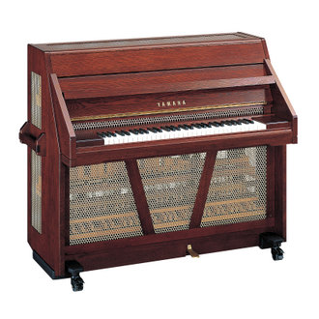
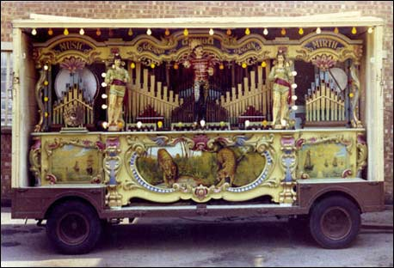
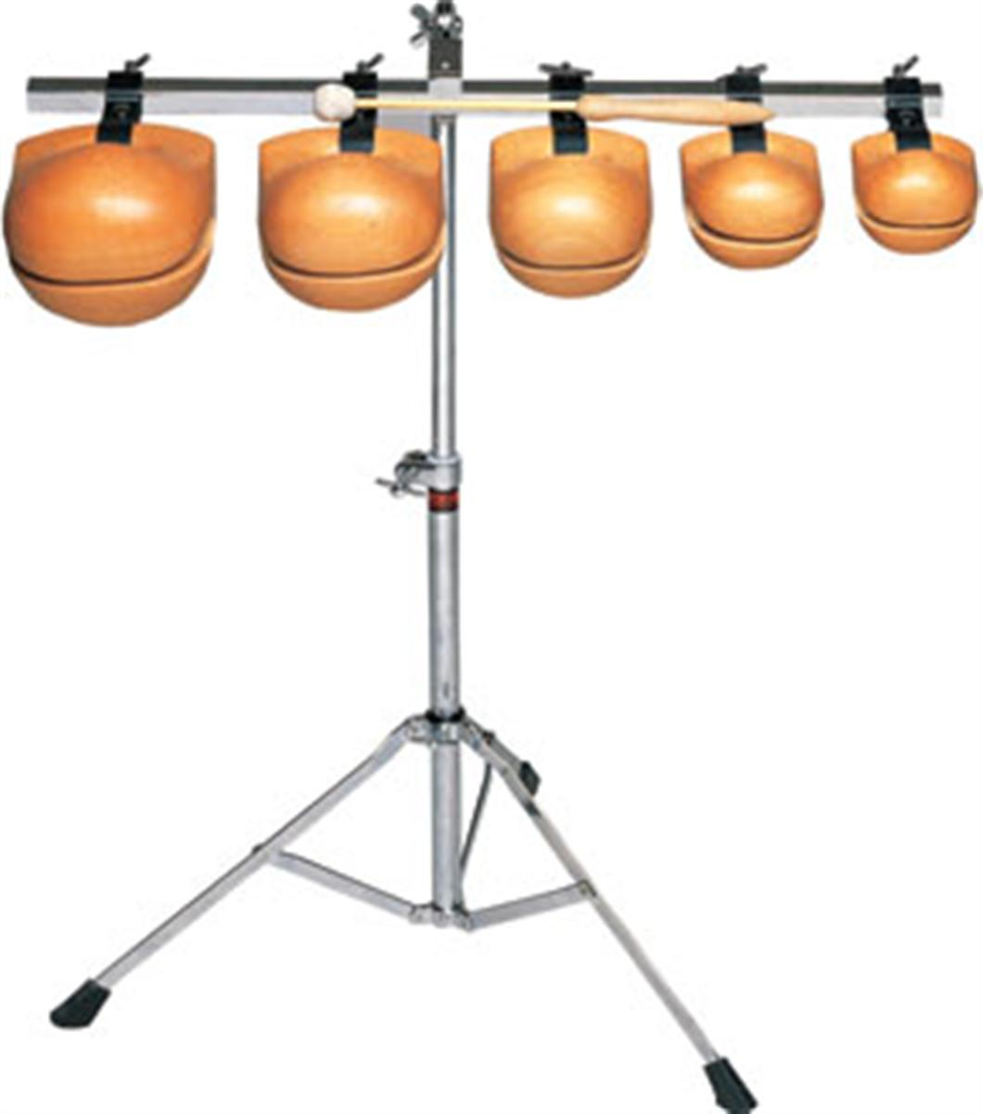
instrumentation
Elfman’s approach to scoring has a strong resemblance to classical film scoring and to that of John Williams (e.g. ET, Superman, Star Wars).
The main themes are written in a large orchestral score, including: pipe organ, harp, celeste, accordion, vibraphone, temple blocks, tubular bells, sleigh bells, xylophone, marimba, piano, fairground steam organ, synth choir and choir.

Slide 6
instrumentation
Elfman gives very detailed performance direction with regards to dynamics, articulation and phrasing.
The orchestral writing here includes many playing techniques:
Strings:
Arco
Pizzicato
Tremolo
Glissandi
Mutes (con sord)
Wind:
Oboe extreme vibrato
Stopped horns
Extreme lip trill in trumpet
Flutter tonguing
Percussion:
Cymbal and timpani rolls
Snare drum with snare off

Slide 7
Part 1 and 2 - https://www.youtube.com/watch?v=E_L04BPyxYo
Vs Circus - https://www.youtube.com/watch?v=muRQMY8JjrA
Rise and Fall - https://www.youtube.com/watch?v=wNWy3YmM3Kw

