Slide 1
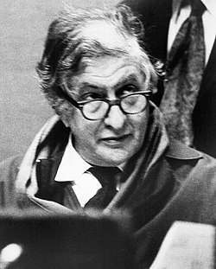
Bernard herrmann: psycho (various cues)

Slide 2
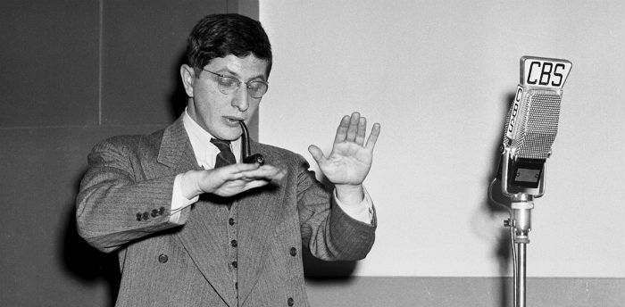
Bernard herrmann
1911-1975
Trained at New York University and Julliard School, before working in CBS Radio Theatre.
He has composed scores for Citizen Cane, Vertigo, North by North West, Farenheit 451 and Taxi Driver.
He collaborated with Alfred Hitchcock at MGM and Paramount Studios.

Slide 3
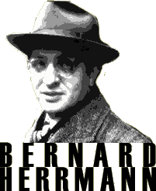
Bernard herrmann
Unusually, he took responsibility for the entire score and unlike many composers, he orchestrated his own works.
Therefore he is considered extremely innovative.
Another example of his innovation is his score for The Day The Earth Stood Still. It contained two theremins, electronic violin, bass and guitar, four harps, four pianos, percussion and brass!
His style in unusual in that he avoid leitmotifs or extended melodies and instead favours short motifs and frequent ostinati, often used to indicate obsession. He was not afraid of extreme dissonance an chromaticism.
Though most of his work is incidental music, he also wrote Sinfonietta (1935) from which he quoted a motif in course of Psycho and he also wrote the opera Wuthering Heights.

Slide 4
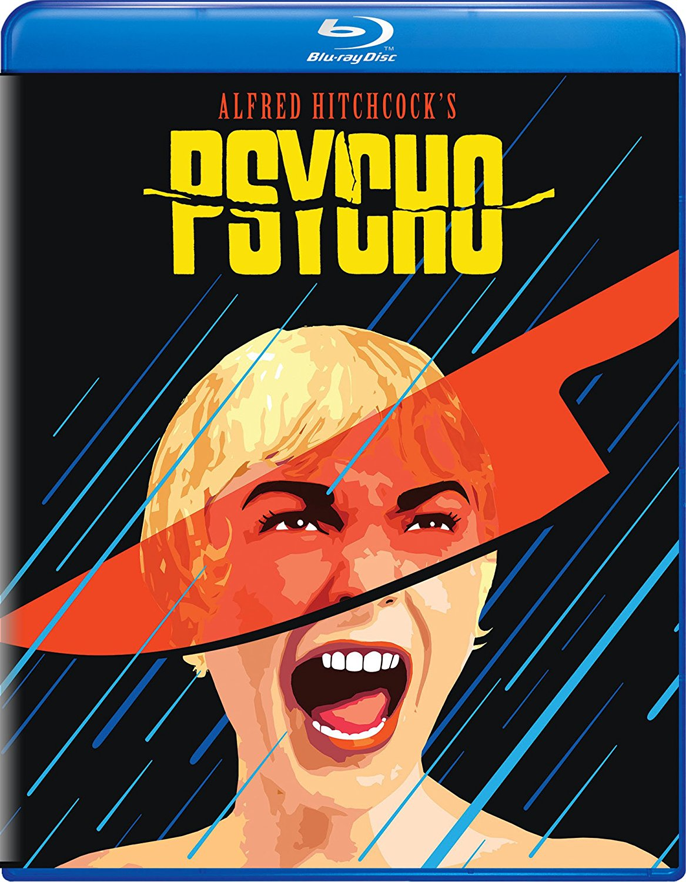
psycho
Released in 1960
One of Alfred Hitchcock's most famous films
Based on Bloch’s novel of the same name published in 1959
Opening scenes are of Phoenix, Arizona. It is set in a Gothic style motel and develops into a thoroughly bleak and chilling investigation of the mind of a murderer.
Filmed on a low budget in black and white, marking a radical departure from the opulence of Hitchcock’s previous films, it broke box office records. In part, this was due to skillful marketing and a ‘no late admission’ rule which led to lengthy queues outside cinemas, attracting further publicity.
It enjoyed enormous critical acclaim, and in no small measure can it’s success be attributed to the score. Hitchcock himself said that ‘33% of he effect of Psycho was due to the music’!

Slide 5
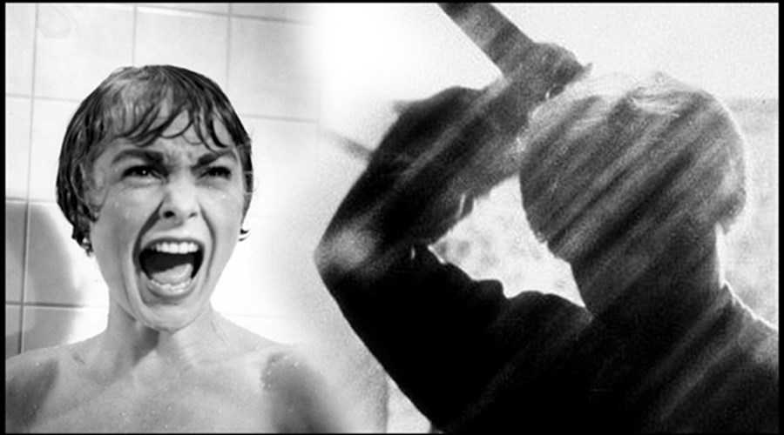
psycho
Working within the bounds of budget restrictions, Herrmann scored the music for strings only rather than a full orchestra or jazz band as Hitchcock originally requested.
The reduction of forces to a single family of instruments, reflected the monochrome on-screen images and this limitation is further intensified by the use of mutes throughout, except in the shower scene.
It is written for…
14 first violins
12 second violins
10 violas
8 cellos
6 double basses

Slide 6
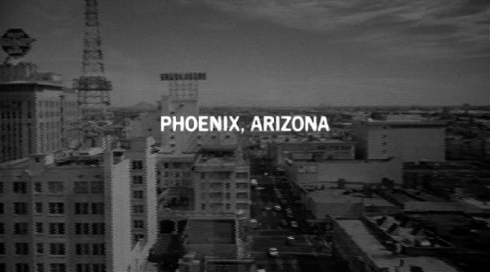
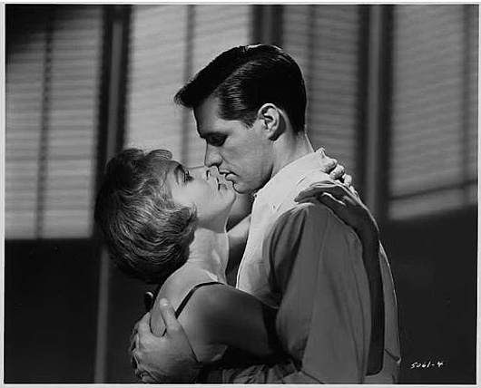
What’s happening in each cue?
PRELUDE (Titles)
The title sequence is by Saul Bass, an abstract design, consisting of interlocking horizontal bars moving back and forth, intending to suggest clues coming together. Its mechanical quality is underpinned by Herrmann’s relentlessly moving music.
THE CITY
Captions indicate time and place: Phoenix, Arizona; Friday December 11 at 2.43pm. The shot homes in on a hotel window, through which Marion Crane and Sam Loomis can be seen after making love.
MARION
This section incorporates a figure that anticipates Cue 14 (The Madhouse) and also the closing bars of the score where Herrmann quoted a motif from his Sinfonietta.
THE MURDER
Herrmann ignored Hitchcock's instruction not to compose music for this scene and instead produced one of the most celebrated cues in the history of the cinema.

Slide 7
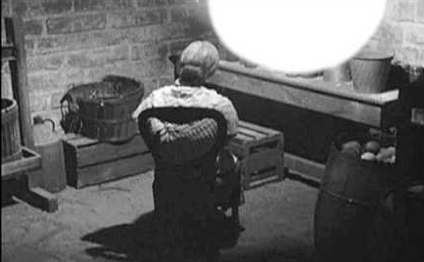
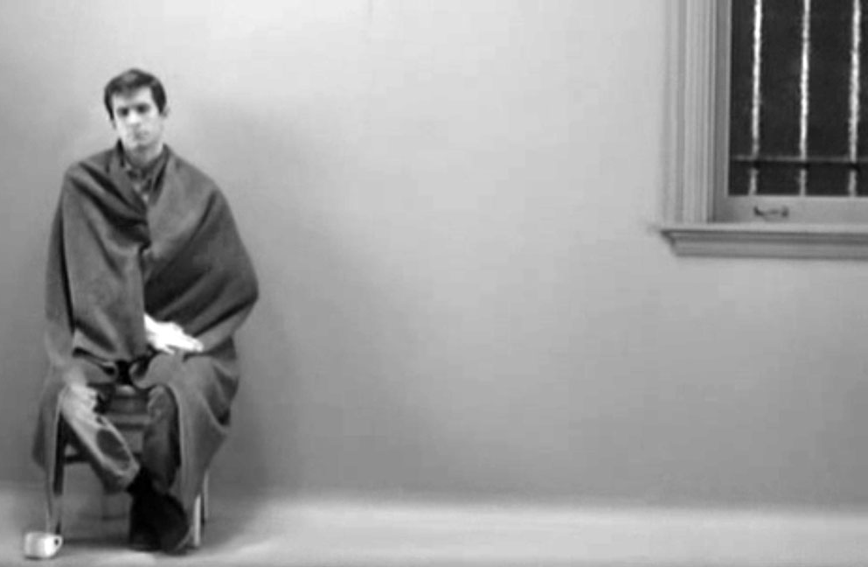
What’s happening in each cue?
THE TOYS
Marion's sister, Lila, searches for traces of Marion. She discovers toys in Norman’s room.
THE CELLAR
Lila rushes to the cellar
DISCOVERY
Lila find the clothed skeleton of Norman’s mother
FINALE
Norman is shown in a white-walled cell

Slide 8
WHAT CAN YOU REMEMBER?
Which set work are we studying?
Who is it by?
Which decade was it written in?
Which 3 musical features should you associate with the composer?
What happens on screen in Prelude, The City, Marion and The Murder?
What is unusual about the instrumental ensemble that was chosen?
Why was it chosen?

Slide 9
Today we will
Revise the cues we analysed last lesson
Prepare essay paragraphs on the cues we analysed last lesson
Analyse the remaining cues
If time….listening tests!
NEXT LESSON = Timed essay!

Slide 10
your first mission
In pairs, prepare an essay paragraph, regarding the cues we have analysed so far.
Structure & Tonality – Jonathan and Eyra
Harmony – Toby and Megan
Melody – Carmen and Matt T
Rhythm – Matt E and Darcie
Texture – Jess and Sophie
Resources – Harry and Rosie
What will a good essay
paragraph contain?

