Slide 1
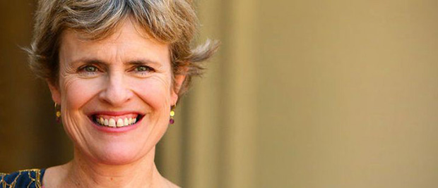
Rachel portman: the duchess

Slide 2
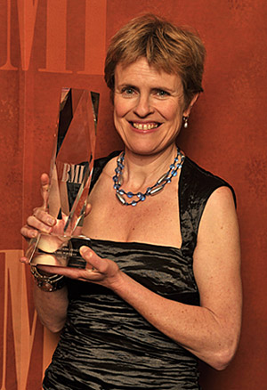
Rachel portman
Born in 1960.
From Surrey. Educated at Charterhouse School and Oxford University.
Written the scores for many films. She mainly write for adaptations of literary classics and costume dramas, notably Emma, Chocolat and The Cider House Rules.
She has also written the musical ‘Little House on the Prairie’ and an opera ‘ The Little Prince’.

Slide 3
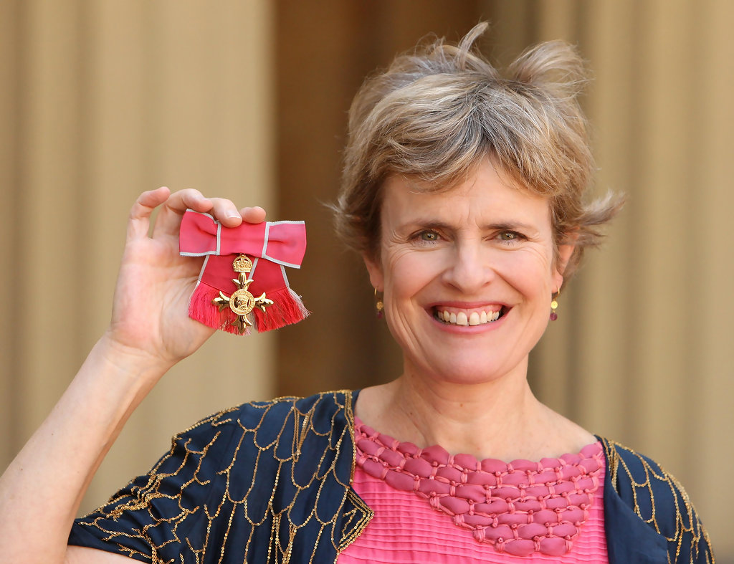
Rachel portman
She composes at the piano and orchestrates much of the music herself.
Her style often uses lush string based orchestrations, avoiding electronic instruments and synthesized sounds.
She won an Oscar for Best Original Score in the film Emma in 1996. She is the first female composer to win in this category.
She was awarded the OBE in 2010.

Slide 4
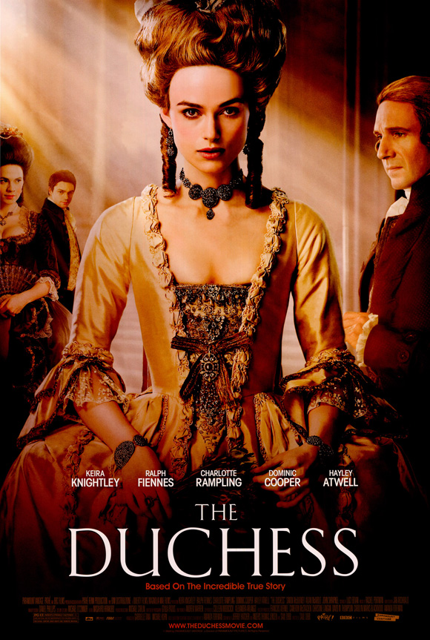
The Duchess
Historical romance, released in 2008
18th century costume drama based on Amanda Foreman’s biography of Georgiana Cavendish (1757-1806), Duchess of Devonshire.
It is a chronicle of the life of the aristocrat focusing on her loveless marriage, her friendship with Lady Bess Foster and her affair with the politician Charles Grey.

Slide 5
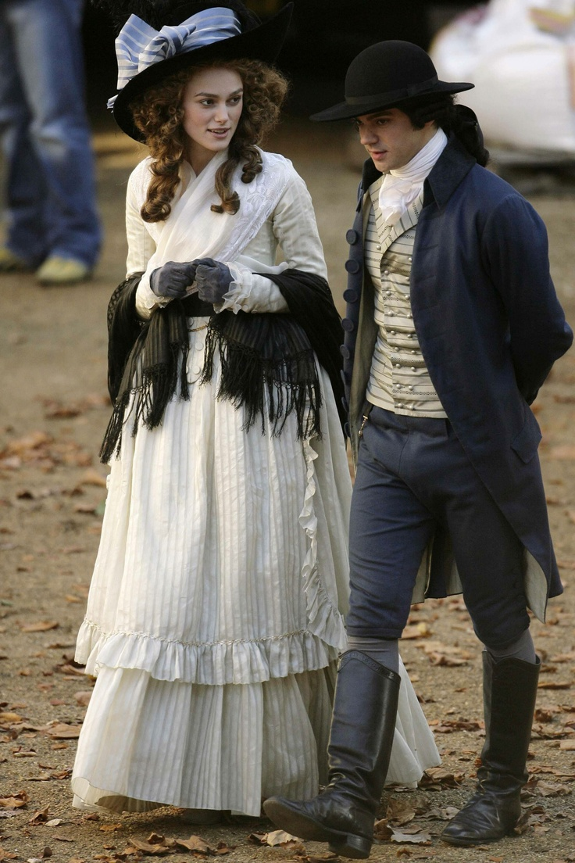
The Duchess
Although it is set in the late 18th century, the score is not slavish pastiche of the music of that period.
References are made to the styles of the time, but Portman’s music is a 21st century adaptation of those styles combined with familiar movie underscoring.
The score also contains movements by Beethoven and Haydn.

Slide 6
