Slide 1
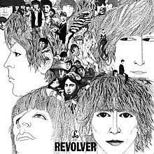
The beatles: revolver

Slide 2
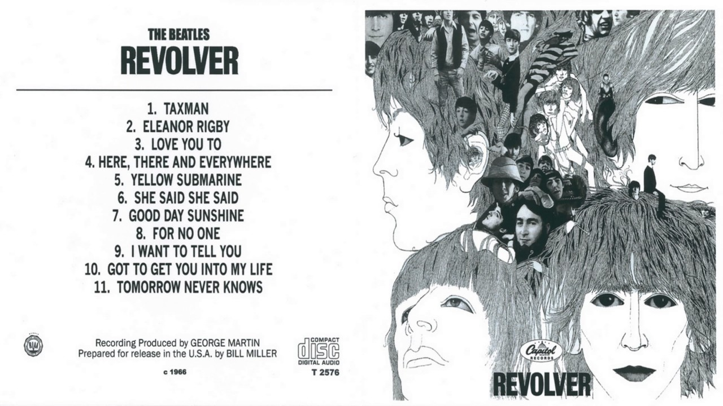
THE BEATLES
Their music embraces a wide range of stylistic elements, notably rock and roll, blues and folk music.
Their work was marked by a striking lyricism and flair for capturing situations through a perfect match of work and song.
Revolver was their seventh album and, standing more or less at the midpoint of their recording career, marked the start of a distinction new phase in their development.
Released in 1966, the same year as their final concert tour.
Produced by George Martin and recorded/mixed by Geoff Emerick.
Took 300 hours of studio time!
The title ‘Revolver’ refers to both to guns, and to the revolving gramophone record turntables.

Slide 3
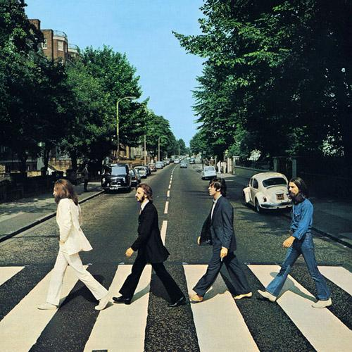
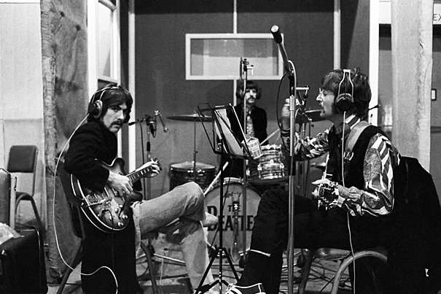
Recording in the studio
Recorded at Abbey Road Studios.
It differs from the preceding albums in that it was more studio-based, thus establishing fundamental, new approaches in the creation and production of popular music.
The use of the studio was built into the creative idea behind the album, rather than existing simply as a mean of preserving the performance for posterity.
Experimental production aspects included:
Automatic double tracking – previously, double tracking required the vocal part to be recorded for a second time, but this allowed two recordings of the initial take with one played a fraction of a second out of sync with the other, to give the effect of two parts
Variable tape speeds – recording at a faster tempo than was eventually heard on the disc
Use of tape loops – cutting and splicing end to end of a magnetic tape recording, resulting in a continuous loop. Technique developed by Schaeffer.
Playing recorded sounds backwards
Dubbed sound effects

Slide 4
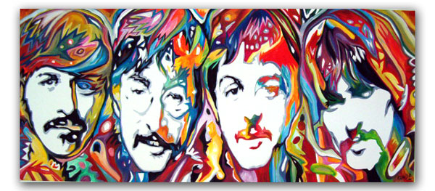
Why was this album notable?
Use of classical performance forces – besides the doubled string quartet in Eleanor Rigby, a French Horn is used on For No One
Indian influences – evident in the use of sitar and table on Love You Too and sitar in Tomorrow Never Knows
Avoidance of very free treatment of conventional popular music structures and further distancing of the band from their earlier ‘Merseybeat’ style
Widening of the range of subjected covered. Of the four numbers in this set work, only Here, There and Everywhere is a conventional love song.
Presence of Psychedelic elements the result of experimentation with LSD, reflected in increasingly colourful musical timbres
PSYCHEDLIC MUSIC – 1960s. Attempted to capture the mind-altering effects of hallucinatory drugs such as LSD. In the case of The Beatles, this aspect of their work was reflected in unusually colourful timbre and imagery and attempts to recreate meditative experiences. Ringo Starr later commented that drugs were taken, the ‘we never did to a great extent at the session – we were really hard workers’.

Slide 5
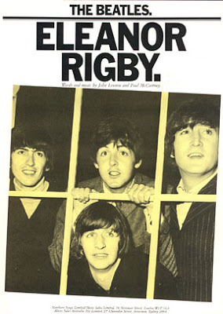
What is each song about?
Eleanor Rigby
This strikingly original song has to do with loneliness and futility. In place of the typical line-up of instruments, a string group was used, drawing on eight performers. This was not an octet as such, with eight independent parts, but a double string quartet.
Here, There and Everywhere
This exquisite romantic ballad was a favorite of both Lennon and its composer, McCartney, as well as George Martin. According to McCartney, it was inspired by Brian Wilson’s number ‘od Only Knows’ which appeared on the Beach Boy’s album Pet Sounds, the same year as Revolver.
I Want To Tell You
This number is by George Harrison, and according to Harrison himself, concerned ‘the avalanche of thought that are so hard to write own or say or transmit’. The song’s sense of frustration is evident in the markedly dissonant harmony.
Tomorrow Never Knows
This song was the first on the album to be recorded. Its text was assembled by Lennon and as based on The Psychedelic Experience: A Manual Base don the Tibetan Book of thy Dead by Timothy Leary, Richard Alpert and Ralph Metzner.

