Slide 1
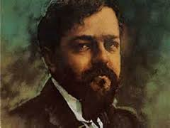
DEBUSSY: ESTAMPES, NO. 1 ‘PAGODES’ AND NO. 2 ‘LA SOIREE DANS GRENADE’

Slide 2
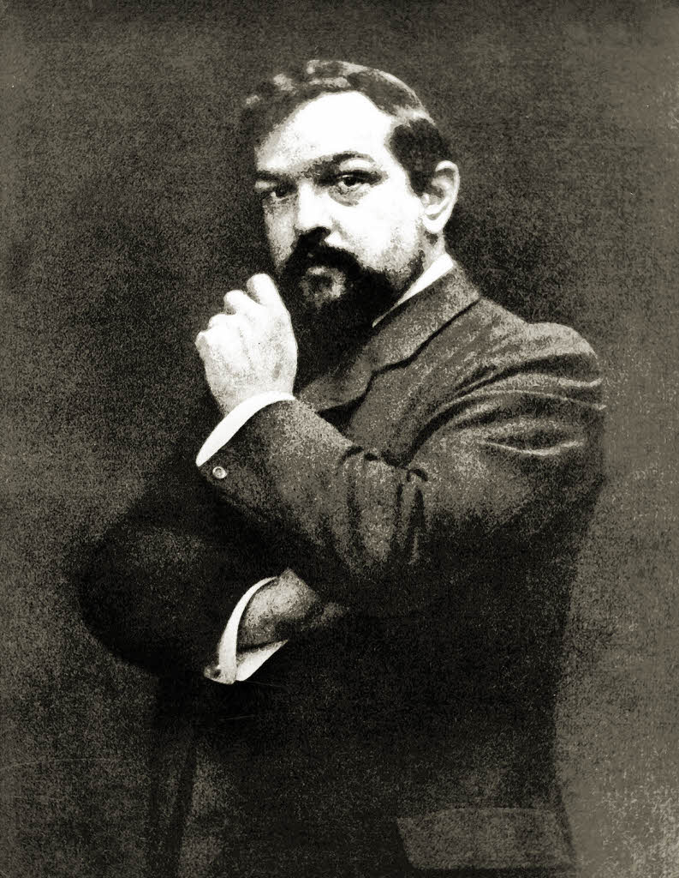
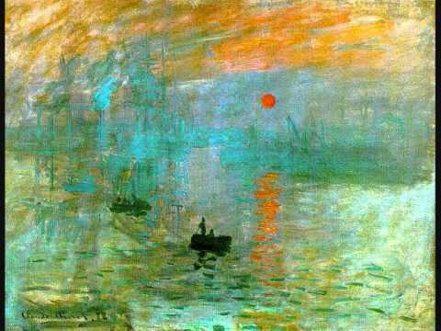
Claude Debussy
1862-1918
One of the most influential composers of the late 19th and early 20th centuries
Reacted against romanticism by composing in his own style
Impressionistic style - a movement that suggests the atmosphere and environment of the subject rather than attempting to be fully descriptive and programmatic.
Debussy’s music places more emphasis on colour and texture rather than a more direct expression of emotion, relying instead on allusion and understatement.

Slide 3
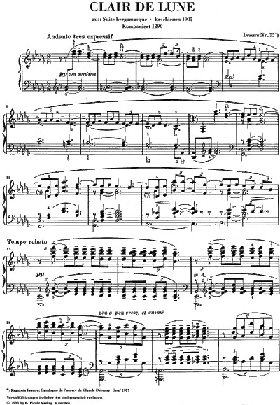
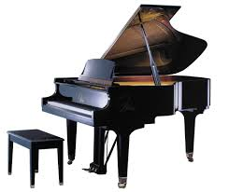
Claude Debussy
His piano writing often uses the extreme registers, with widely spaced chords and parallel movement and took a new approach to pedaling which produced subtle blending effects.
Several of Debussy’s piano pieces demonstrate that he was influenced by non-Western scales and instruments.

Slide 4
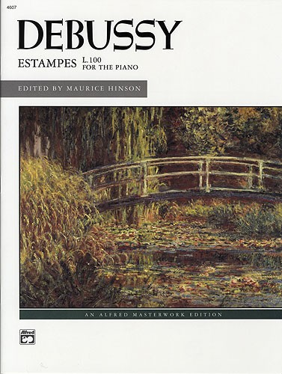
Estampes
Translates as ‘prints’.
Set of 3 pieces for piano composed in 1903
Impressionist style:
Short works/smaller pieces with short melodic phrases
Descriptive music – all 3 pieces have descriptive titles
Eastern music and western folk elements – e.g. pentatonic and modal melodies
Tonal schemes that avoid the tonic and dominant chords and traditional modulation patterns. The idea of keys is often avoided but music is not atonal.
Parallel chord movement.
Sustain pedal uses to produce mysterious sounds.

Slide 5
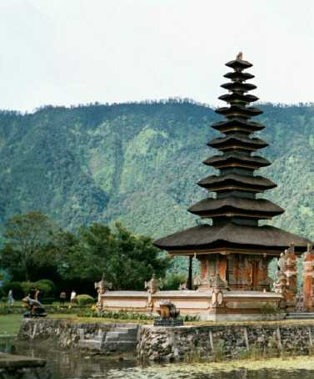
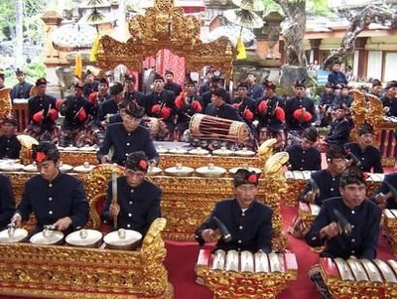
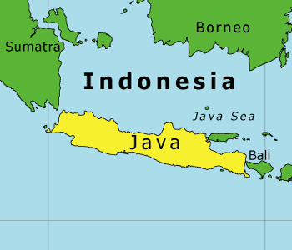
PAGODES
Influenced by Javanese gamelan music:
Gong like open 5ths and added note chords
Avoidance of regular triads
Pentatonic scales (known as Slendro in Java)
Ostinati
Varying speeds

Slide 6
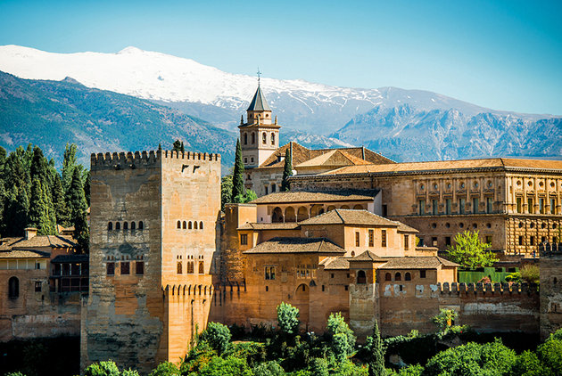
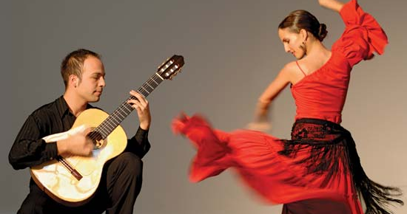
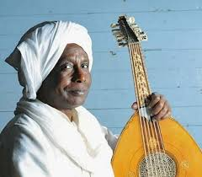
La Soiree dans Grenade
Debussy was attracted to the exoticism of Spanish culture.
Title means ‘An evening in Grenada’ – a town in southern Spain, in an area where centuries ago Moorish invaders from Morocco had settled.
Habanera rhythms – originally a Cuban dance. Bizet uses these rhythms in Carmen.
Habanera dance – slow in simple duple time with distinction dotted quaver, semiquaver, 2 quavers rhythm.
Staccato articulation is also common of the Habanera style.
Flamenco type spread chords in the piano are supposed to represent flamenco guitar playing.
The use of dissonance, the augmented 2nd interval, the free rhythm, irregular phrases and acciaccaturas = Moorish style.

