Slide 1
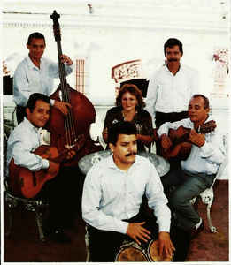
Familia Valera Miranda: Cana quema

Slide 2
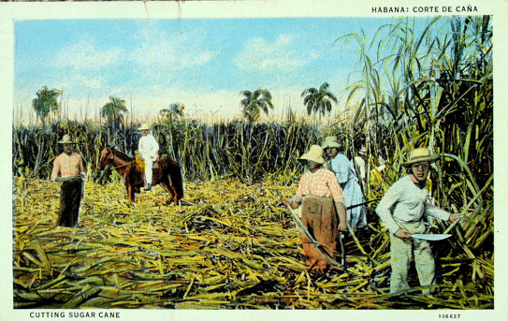
BACKGROUND
In the 19th century, African slaves were bought to Cuba by Spanish colonists to act as cheap manual labour for the thriving sugar industry.
As a result much Cuban music, is a fusion of West African and European (Spanish) influences:
African influences: complex rhythms, call and response textures, use of claves, bongos and congas
Spanish influences: tonality, functional harmony, melody, stringed instruments (cuatro, guitar and double bass)

Slide 3
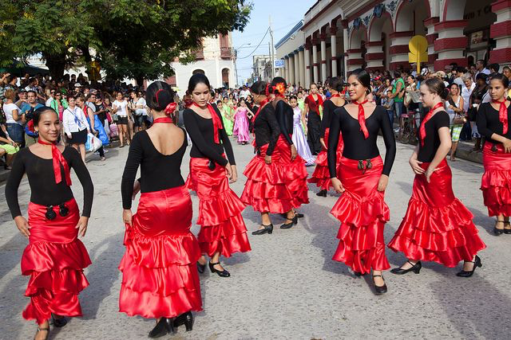
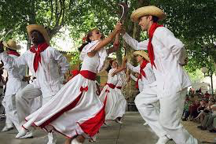
BACKGROUND
Cuban music is designed for dancing as well as listening. The rhythmic foundation is provided by the clave – repeated interlocking rhythms with a clear pulse.
The clave rhythm (not to be confused with the clave instrument) is made up of 1 or 2 bar patterns each played by a different instrument.
Different clave patterns are associated with different dances and styles of Cuban music.
The layered texture is made up of ostinati and often includes syncopation and cross rhythms like African drumming music

Slide 4
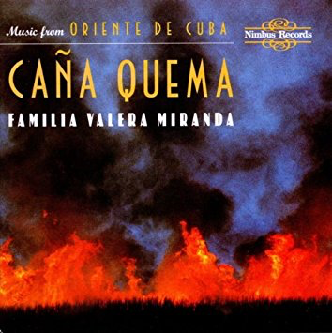
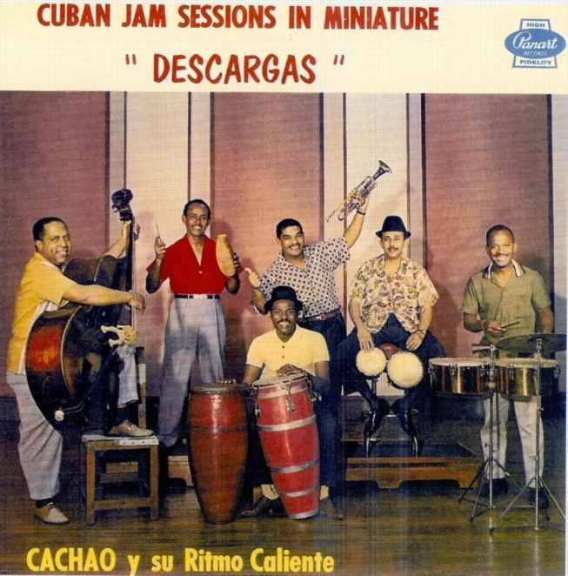
Cana quema
Both pieces date back to the early 20th century. They owe their origins to the descarga where musicians would meet and create songs collectively through improvisation.
Both songs refer to incidents from the Valera’s family history.
The album ‘Cana quema’ translates to ‘Cane burning’ and was produced in 1997.

Slide 5
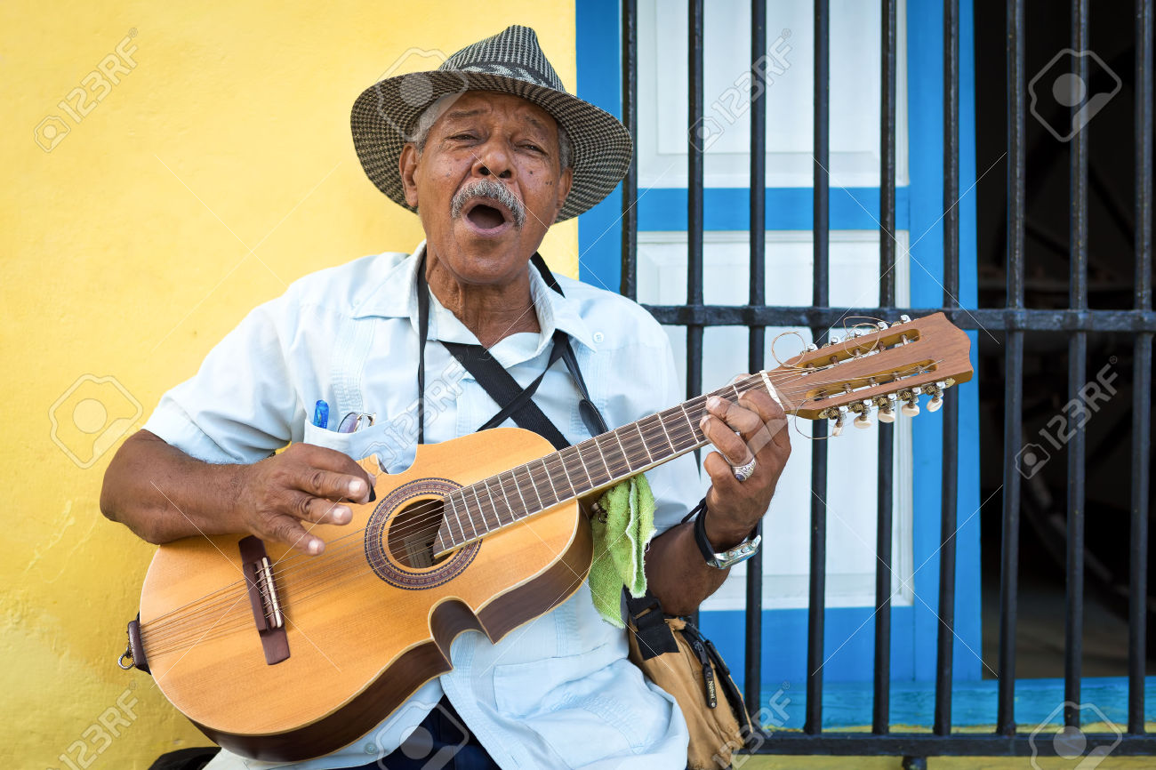
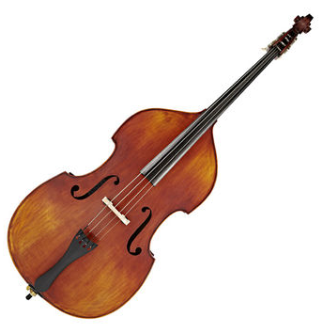
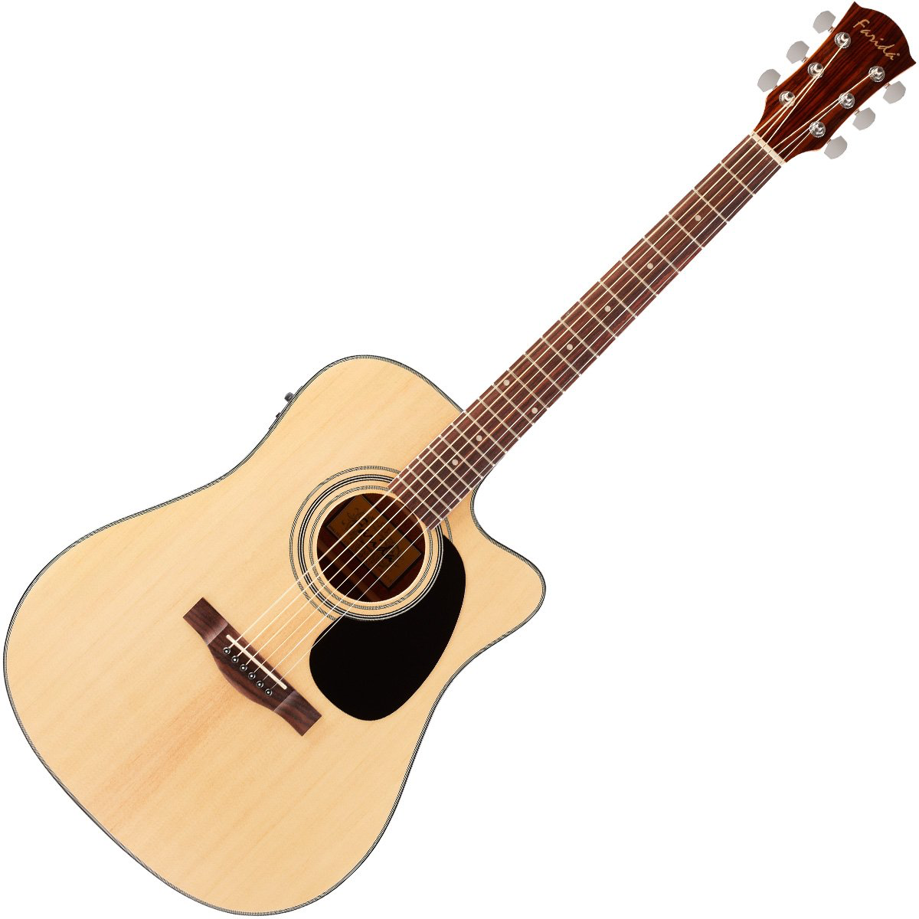
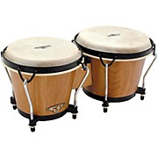
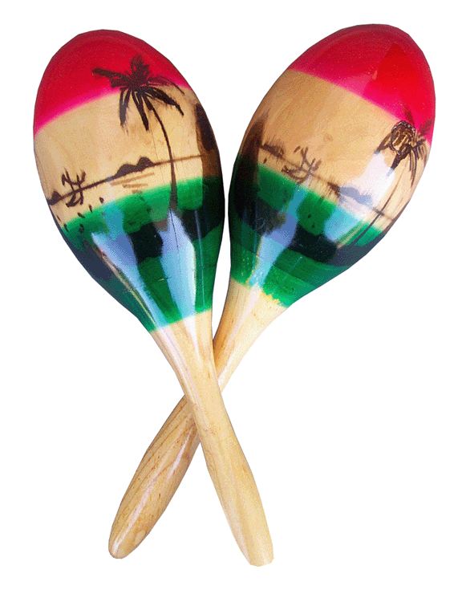
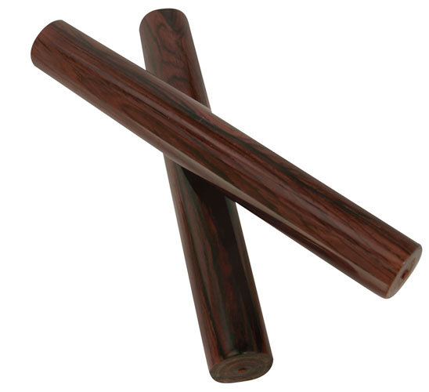
Instrumentation
It includes a guitar, a cuatro (a small 8 string guitar where the strings are tuned in pairs in octaves) and a small rhythm section of claves, double bass, bongos and maracas.
Each instrument has a fixed role and plays basically the same pattern throughout, apart from during some improvised elaborations.

Slide 6

Se quema la chumbamba
‘Our land is burning’
‘Se quema la chumbamba’ tells the story of a plot of land
(chumbamba) which caught fire. When the owner rushed to
tell his busy wife, she was not interested!
This piece is a son. In the 1920s sones became an important symbol of national identify in Cuba. Sones are usually in duple metre and are based on simple Eurpoean derived harmonic patterns (e.g. I-V-I-IV-V), starting with a strophic verse section and including 3:2 clave rhythms.
This piece uses a coro-pregon structure – a call and response between the lead singer and the coro (chorus), which is found in many Cuban genres.
The lead singer improvises both melody and lyrics which are called pregon.
The coro is sung by a group in a homophonic texture. The melody of the coro is normally fixed and doesn't’t change as it is repeated.

Slide 7

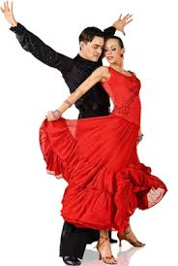
Alla va candela
‘There goes Mr Fire’
The lyrics of this song describe the excitement of falling madly in love and was written to mock one of the band members who had found a new partner!
The first section is a bolero, the second section is a son.
A Cuban bolero is in duple time, differing from the more familiar triple time Spanish bolero.
Boleros are associated with themes of love and tend to be very lyrical compared to sones.

