Slide 1
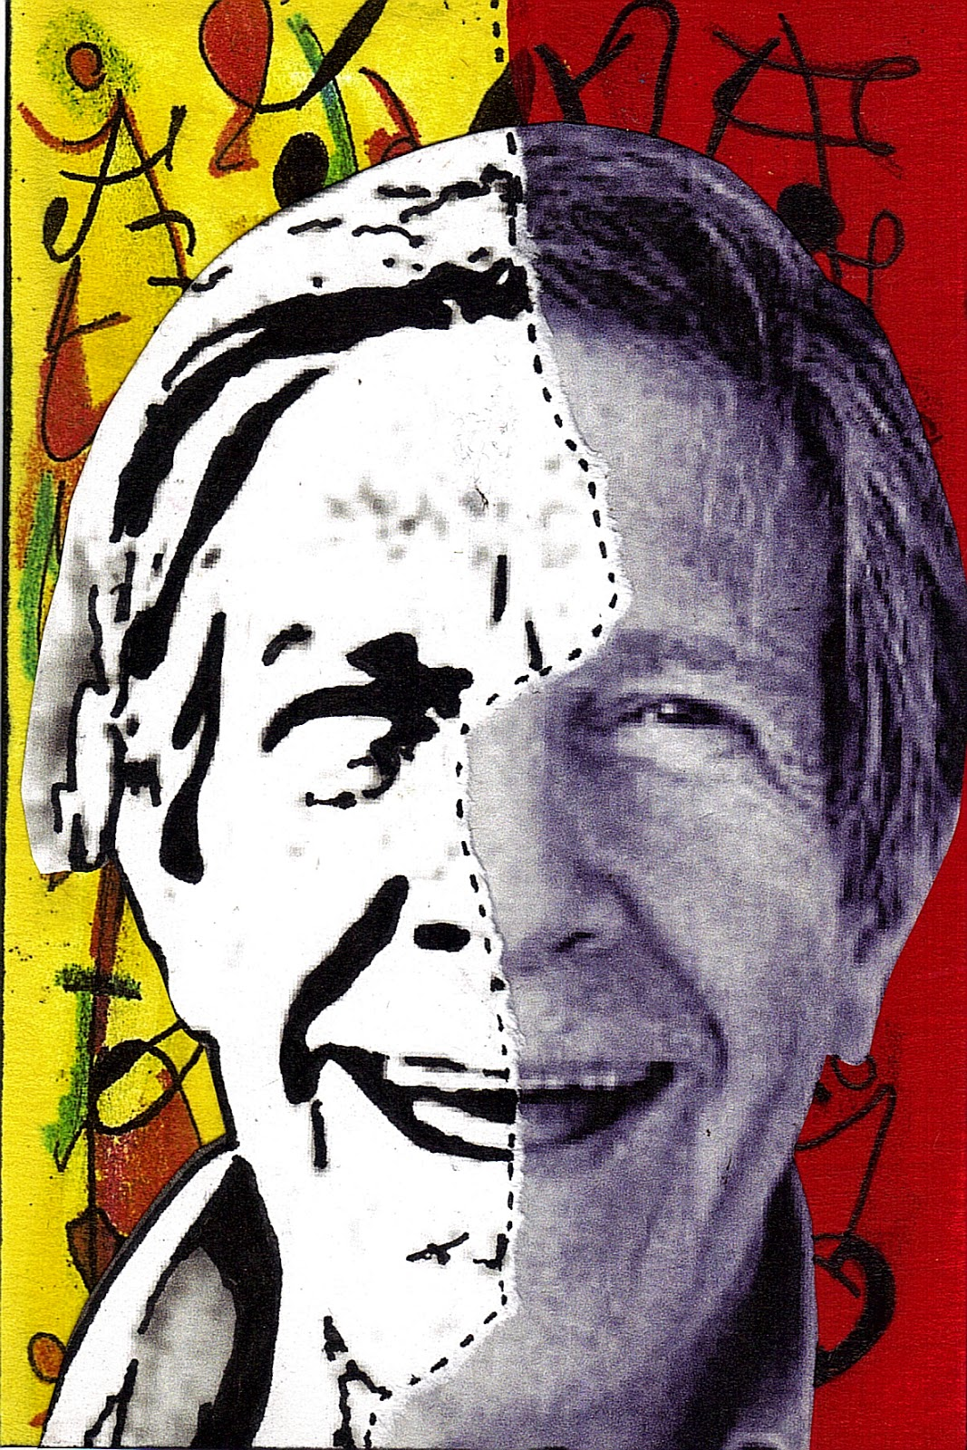
JOHN CAGE: THREE DANCE FOR TWO PREPARED PIANOS: NO. 1

Slide 2
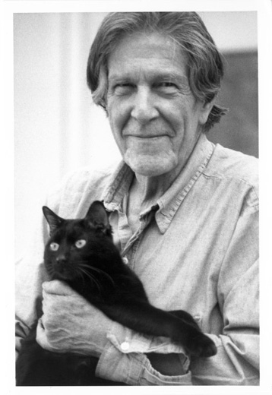
JOHN CAGE
1912-1992
One of the most influential American composers of the 20th century.
He is an experimental composer and inventor of the prepared piano.
Schoenberg described him as ‘an inventor of genius’.

Slide 3
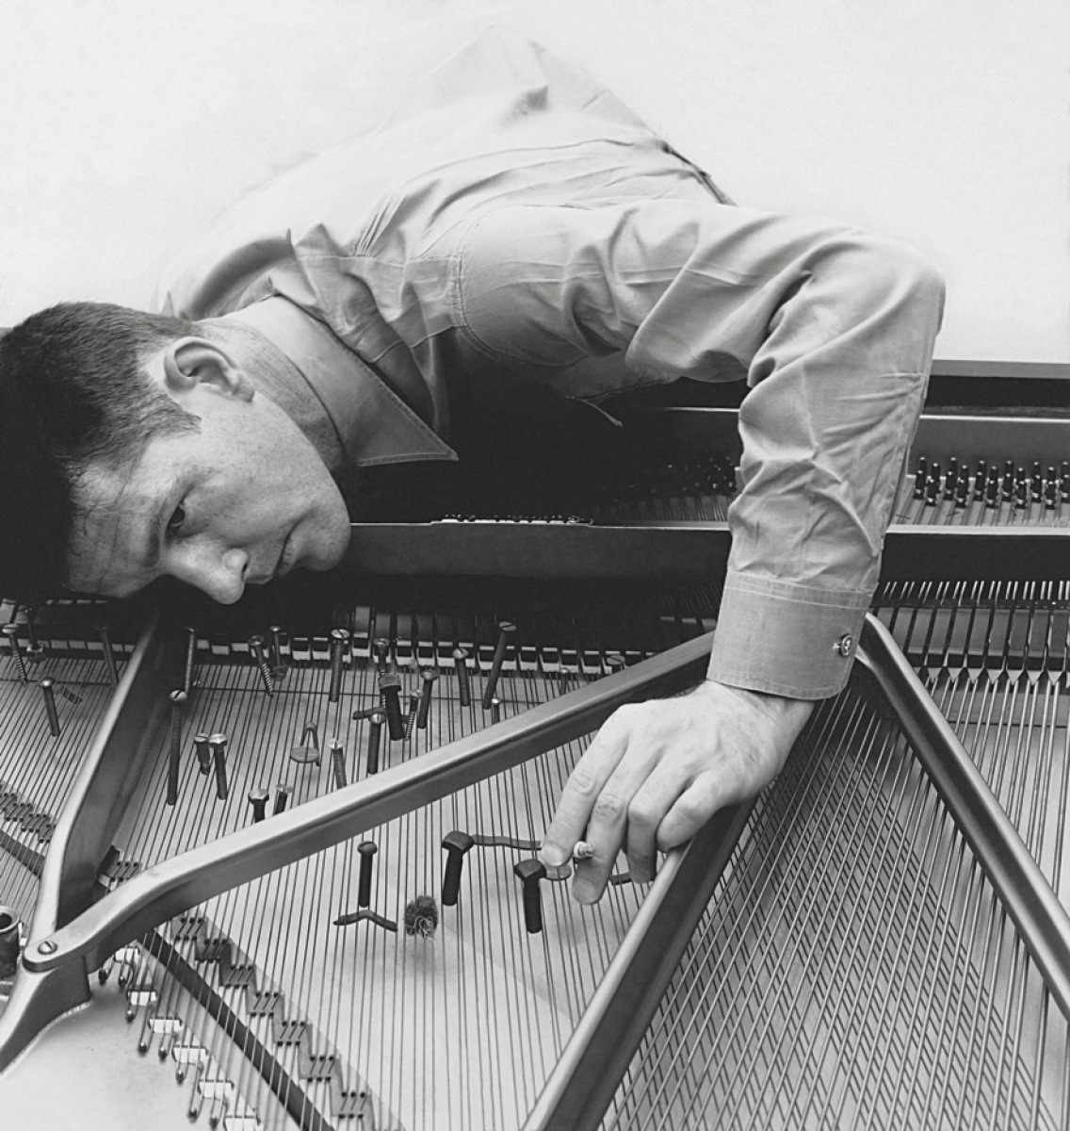
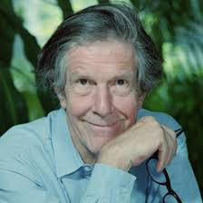
JOHN CAGE
Wrote much music for dance. Had a lifetime collaboration with choreographer and dance Merce Cunningham and worked as a director of music for various contemporary dance groups.
In 1940 he was asked at short notice to compose some music for a dance performance. A piano was available but Cage felt the instrument was inappropriate to the African character of the piece.
Cage was inspired by Henry Cowell, his former teacher, who wrote unusual piano music in which the piano strings were plucked, scratched and manipulated.

Slide 4
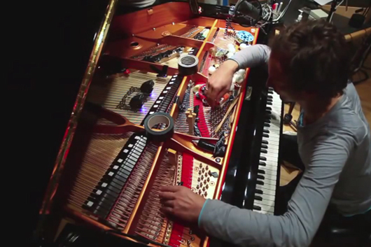
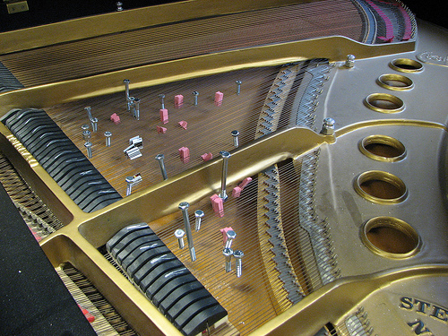
JOHN CAGE
With this in mind, Cage experimented with the inside of the piano and discovered that by placing a variety of objects between the strings the piano sounded more like a percussion ensemble.
He found a set of materials that worked best, less likely to fall between the strings or leap out from them.
These included screws, bolts, washers, nuts, rubber, plastic, cloth and wood.

Slide 5
THREE DANCES FOR TWO PREPARED PIANOS
‘Avant-garde’ style
Music that pushes the boundaries in new, developmental ways
Virtuoso work for two amplified prepared pianos.
Written for ballet performances in New York in 1945.
The 3 dances follow the normal fast – slow – fast pattern.
We are studying dance No. 1.
Preparations involve 36 notes on each piano, using a variety of materials.
As many as 6 objects can alter the sound of a single note.

Slide 6
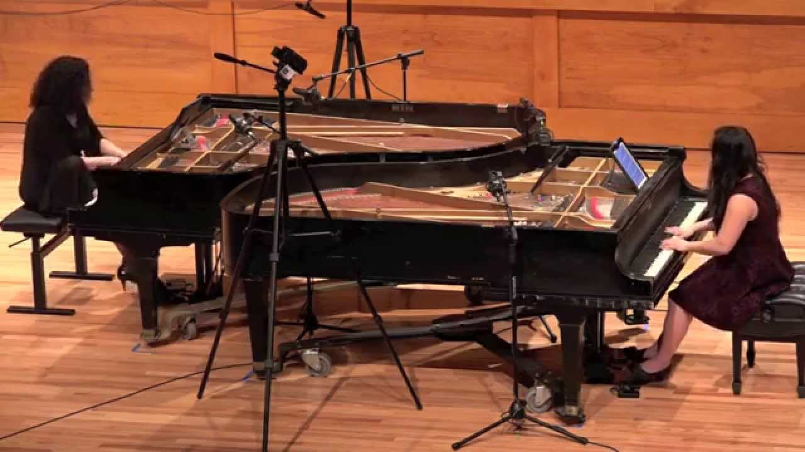
https://www.youtube.com/watch?v=N0-y8oNDLgU

Slide 7
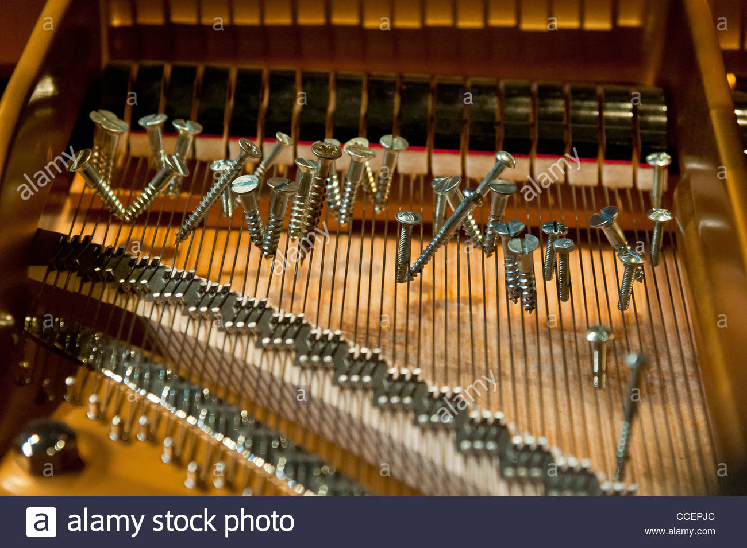
Tables of preparation
The tables shows which pitches are altered and how. Essentially there are 3 types of notes:
Those with objects (described by Cage as ‘mutes’) between all of the strings that produce a given note, creating a percussive sound of no clear pitch.
Those with objects between two out of three strings, resulting in a mixture of the original pitch with the prepared sound.
Those without mutes and that therefore sound normally.
‘Tone’ is the American word for note.
When reading the table, you need to be aware that pianos have three strings per note, reducing to two in the lower register (and just one for each of the very lowest notes).

Slide 8
THREE DANCES FOR TWO PREPARED PIANOS
Cage handwrote the score and did not follow the usual conventions of accidentals applying to a whole bar.
Piano 1 is written above piano 2 on the score.
The two pianos combine to sound like an orchestra of non-Western percussion instruments.
The preparation not only effects the timbre of the note but also the pitch.
Like Debussy, Cade was influenced by oriental/eastern music. The percussive sounds and fast interlocking patterns are reminiscent of the gamelan. Timbres sound like tuned percussion, metallophones and gongs.

Slide 9
Do not
prepare the college pianos!

Slide 10
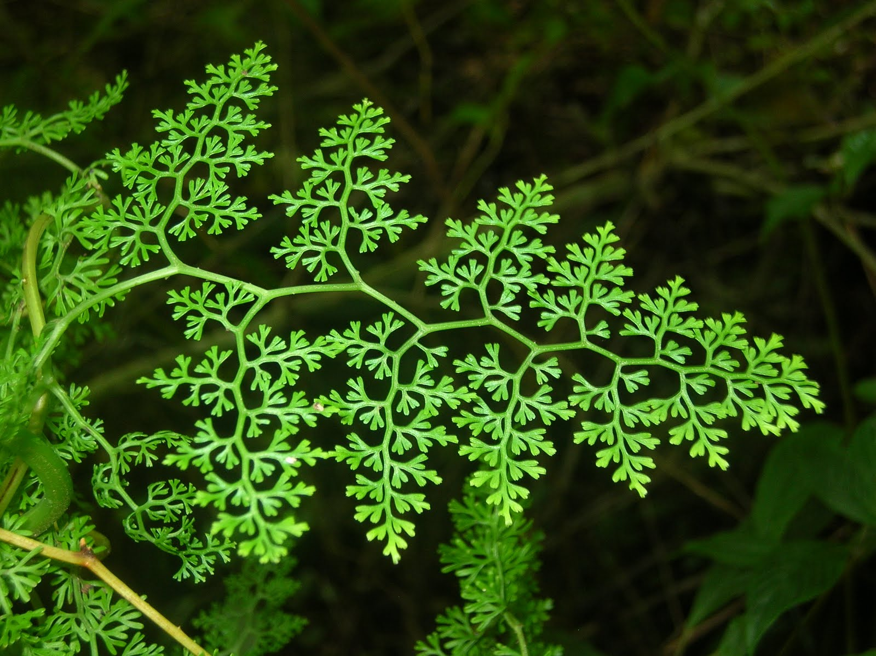
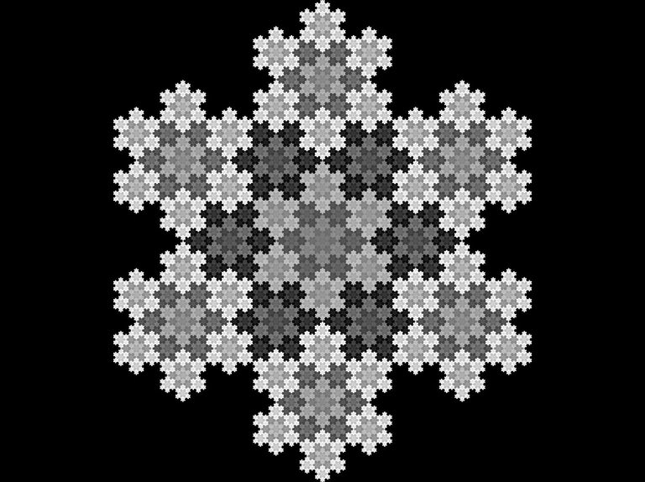
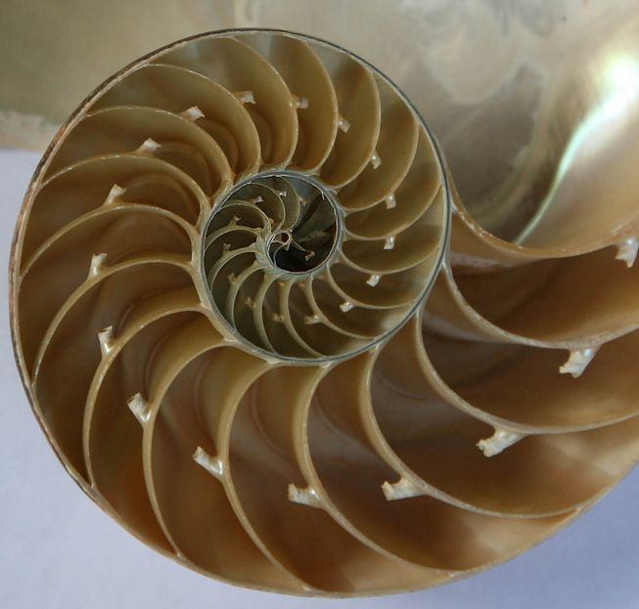
structure
Cage employed a highly original approach to structure based on mathematical proportions.
The same proportions on a small scale also control the large scale structure:
Micro-macrocosmic structure
This is like fractal structures, where each subdivision is a miniature version of the whole. This is often found in nature.
Influences:
Cage’s mathematical approach to structure has several precedents, although we cannot be sure by how much he was influenced by these. He may have been influenced by the medieval isorhythmic motets, or some of the music of J.S. Bach or Webern. Cage’s work with dancers certainly had an impact: he sometime shad to compose for dance whose structure was merely determined by the number of counts.

Slide 11
structure
Number of bars | Phrase number in score
2 | None, but 1 is implied at start
5 | 2
2 | 3
2 | 4
6 | 5
2 | 6
2 | 7
7 | 8
2 | 9
Dance No. 1 uses the following sequence of nine numbers, which add up to 30:
2,5,2 2,6,2 2,7,2
Each set of 30 bars (a ‘part’ or ‘section’) is divided into nine ‘phrases’, the lengths of which in bars correspond to the number above. See grid.
The rest of the movement has 8 more 30 bar sections, each subdivided into phrases in the same way. The boxed numbers on the score represent the sections. The final section is repeated.

Slide 12
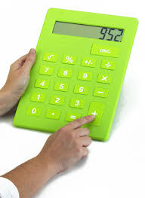
structure
Although we’re not studying them:
Dance No. 2 has the following phrase structure, adding up to 39 bars:
3,6,3 3,7,3 3,8,3
Dance No. 3 has the following phrase structure, adding up to 57 bars:
5,8,5 5,9,5 5,10,5
There are 30 parts in the Three Dances all together as follows:
Dance No. 1 – 9 sections, each 30 bars
Dance No. 2 – 10 sections, each 39 bars
Dance No. 3 – 11 sections, each 57 bars
The numbers 9, 10 and 11 therefore:
Occur as above on the grand scale
Occur on the small scale in Dance No. 1 – 2,5,2 = 9 2,6,2=10 2,7,2=11
These structures are not audible however!

Slide 13
Repetition within the structure helps to unify the music
REPETITION on large scale
Section 8 is repeated (called section 9) – helps to provide a solid ending
REPETITION on small scale
Piano 2, both hands – compare phrases 5, 11 and 17
Piano 1, LH and Piano 2, both hands – phrase 13 refers back to very beginning
Rhythmic patterns with a group of 3 quavers preceding groups of 2 quavers occur in Piano 1 in phrase 8 and Piano 2 in phrase 14
SECTIONS 8 AND 9 REITNRODUCE MOTIFS FROM SECTIONS 1 AND 2
Phrase 64, the rising 3 quaver motif from phrases 5, 11 and 17
Phrase 69, the motif originally used in Piano 2 at phrase 3
TERNARY FORM??? Sections 1 & 2 (A) use motifs absent from the middle 5 sections (B), but which reappear in sections 8 & 9 (A) . Could just be a coincidence…

