Slide 1
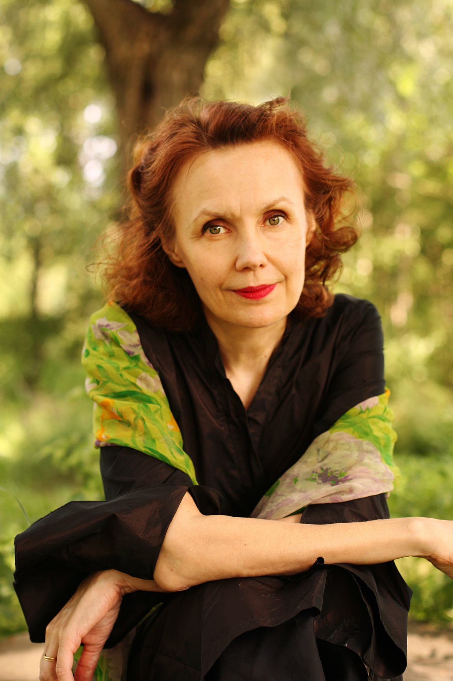
Kaija saariaho: petals for cello solo and optional electronics

Slide 2
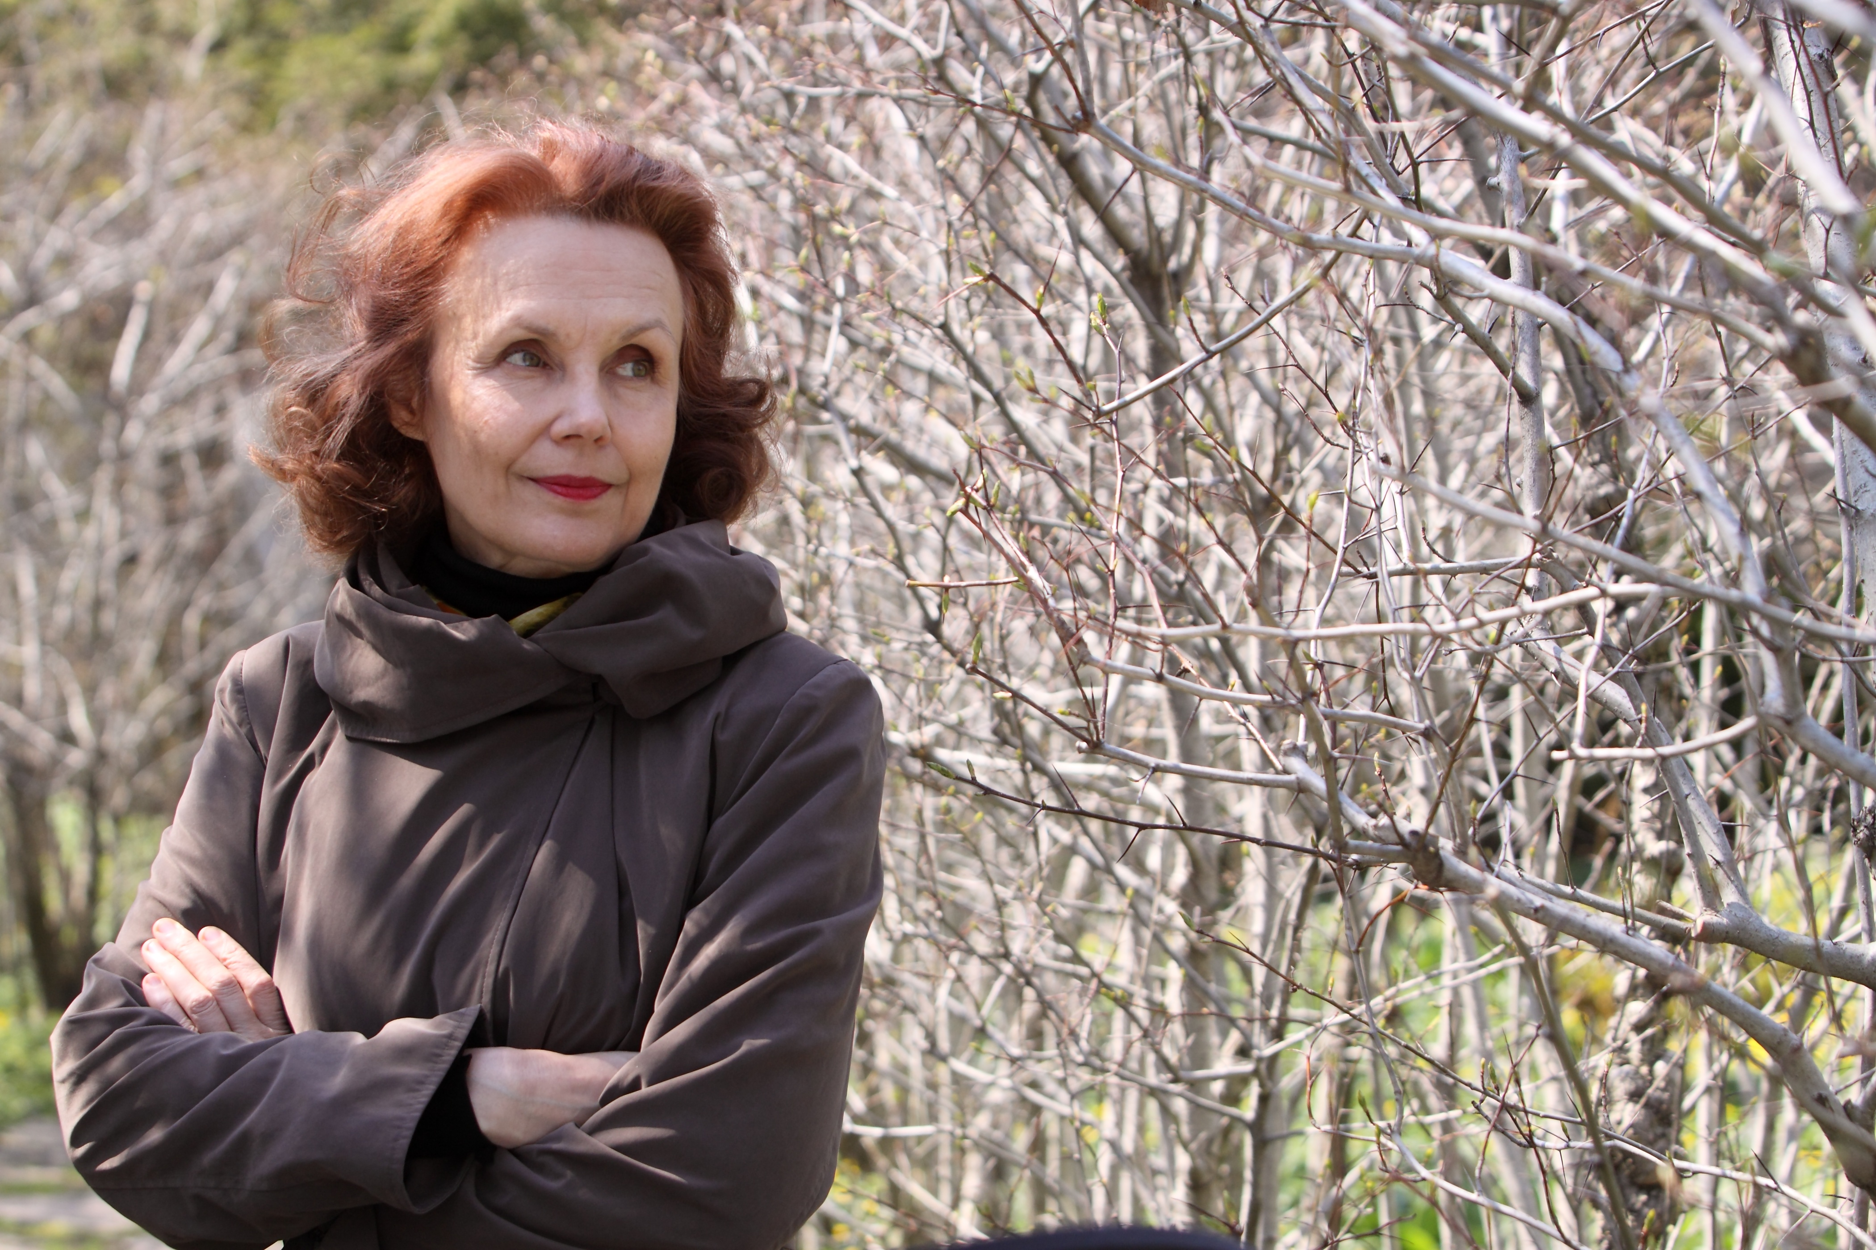
Kaija saariaho
Born in Helsinki, Finland in 1952
Was intrigued by the role of computers could play in composing
She developed techniques of computer assisted composition, working on tape and with live electronics
She became known for mixing electronic sounds with classical instruments, creating a seamless connection between the two worlds

Slide 3
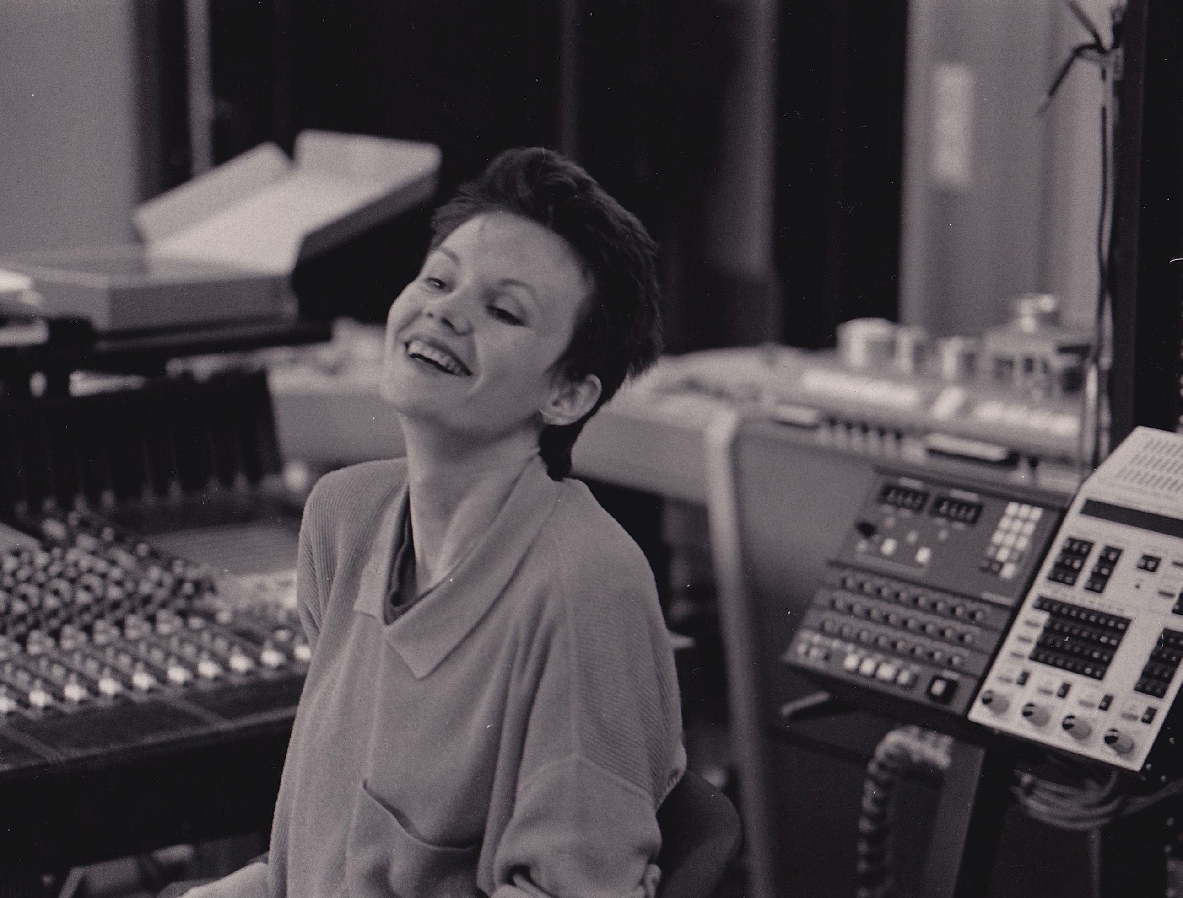
Kaija saariaho
This influenced her approach to orchestra writing which has an emphasis on the slow transformation of dense masses of sound in some works.
Her varied output has included works for ensembles, orchestra, opera houses, electronics and soloists.

Slide 4
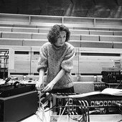
Her music/style
She has a distinct and original voice; her music is marked by its sometimes celestial atmosphere where timbre and colours are central.
Some of her compositions can be described as spectralist, a style of music pioneered by Grisey and Murail in the mid to late 1990s.
Murail wrote that the initial motivation of the spectralists was ‘to control the finest possible degrees of change’.

Slide 5
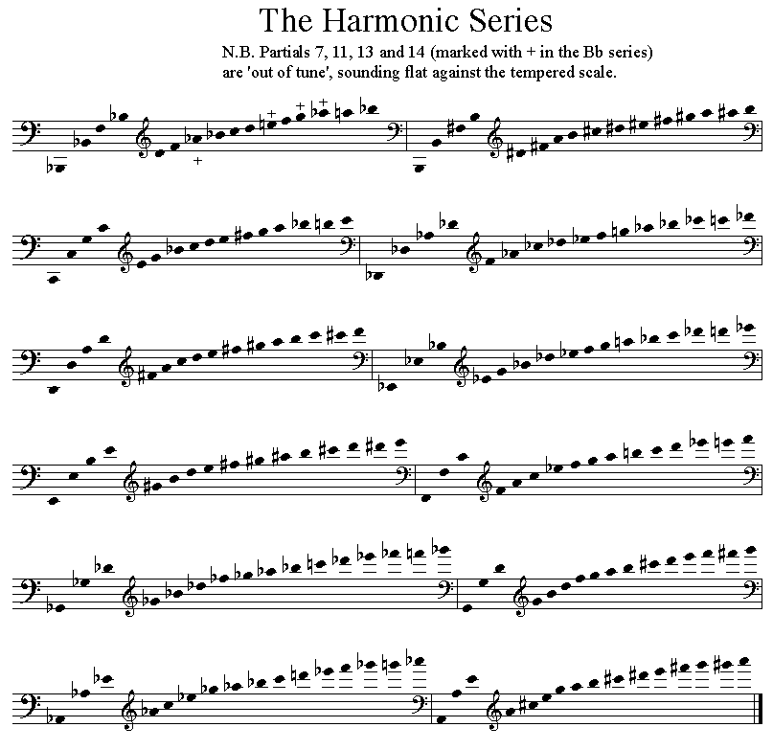
Her music/style
Spectral music is based on the computer analysis of the sound-spectrum. It focuses on the manipulation of the spectral features of sound and the potential of the harmonic series (or overtone series).
This analytical approach lead to her Saariaho’s use of detailed notation which uses harmonics, microintervals an a subtle continuum of sound extending from pure tone to unpitched noise.

Slide 6
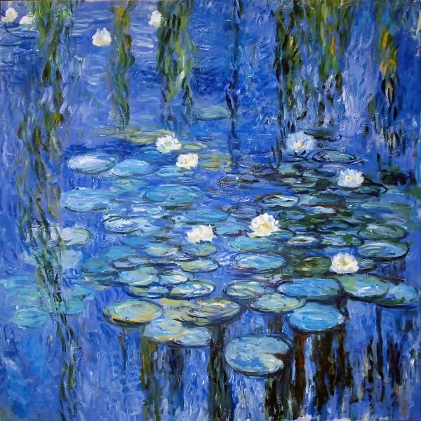
Petals for solo cello & optional electronics
Written in 1988
Takes musical material from Saariaho’s Nymphea (Waterlilly) for string quartet and electronics written in 1987. This was inspired by the Nympheas series of artworks by the Impressionist artist Monet and could be described as a spectral soundscape.

Slide 7
electronics
The score has parts for cello and electronics. Amplification is via the use of a microphone.
R stands for reverb and H stands for harmoniser.
Harmonisation alters the frequency of a signal thus changing the pitch. It adds pitches a quarter tone above and below the original pitch simultaneously.
Reverb is an effect whereby the sound is made to reverberate slightly (a little like an echo/sustain pedal on a piano)

Slide 8
electronics
Traditional hairpins (crescendo/diminuendo markings) are used to indicate increases/decreases in the amount of effect fedback through the system, expressed as a percentage. Dotted lines indicate that the current level is to be sustained.
Harmonisation tends to be used with increases in the amount of ‘noise’ brought about by the increased bow pressure.
Reverb tends to be used to support the quieter, lighter sounds, and to smooth over changes in slow passages of double stops.

Slide 9
The score
There are no bar lines, but each stave is numbered.
The cello part uses the bass, tenor and treble clefs and includes numerous instructions and expression marks which are explained at the start of the score.
Wedge shaped markings above the stave (e.g. staves 2-3) are an indication to apply additional bow pressure, which results in gradual transitions in and out of noise.
Individual notes are transformed through timbral and pitch based manipulations including glissandi, vibrato and harmonics.

Slide 10
sonority
There are lots of extended techniques which expand the palette of sound available.
Music use is made of:
Sul tasto - where the string is bowed near or above the fingerboard, producing an ethereal sound
Sul ponticello - where the string is played near or above the bridge, producing high overtones.
Both effects appear in stave 2.
N = normal bowing and cancels out previous instructions.

Slide 11
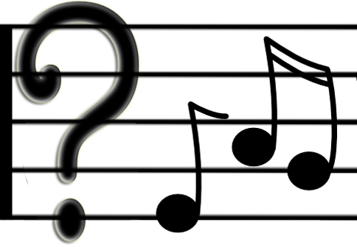
Chance music
Notice the use of indeterminacy.
With indeterminate music there is often much that cannot be predicted before performance.
Certain decisions in this piece are left to the performer – including the opening instruction about the first stave being at least 20 seconds long.
Therefore every performance of this piece is likely to be different.

Slide 12
sonority
The emphasis in Petals is on the sonic range explored rather than melody or harmony
The piece is made up of shifting soundscapes and much of the focus is on timbre.
A single note is made up of the fundamental note plus quieter frequency resonances or overtones
The timbre is partly determined by the relative strength of these overtones which can be altered by different ways of playing, such as changes in bow pressure, dynamics, and bowing techniques.
The overtones can be produced separately on string instruments by touching the string lightly at various points and producing glassy high notes of flute like purity. These are called false harmonics.

Slide 13
sonority

Slide 14
Melody & harmony
Microintervals, raising and lowering a note by a quarter tone, are created both by the cello (e.g. staves 4 and 5) and the harmoniser through pitch shifting (stave 2, 50%).
Although C is the primary pitch focus (staves 14-28) and the harmony changes and evolves gradually from stave 13, there is no clear harmonic goal as would be found in functional harmony.

