Slide 1
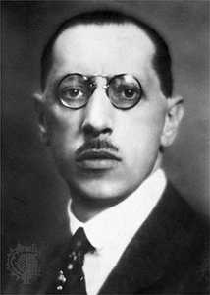
Stravinsky: the rite of spring: ‘introduction’, ‘les augures printaniers’ & ‘Jeu du rapt’

Slide 2
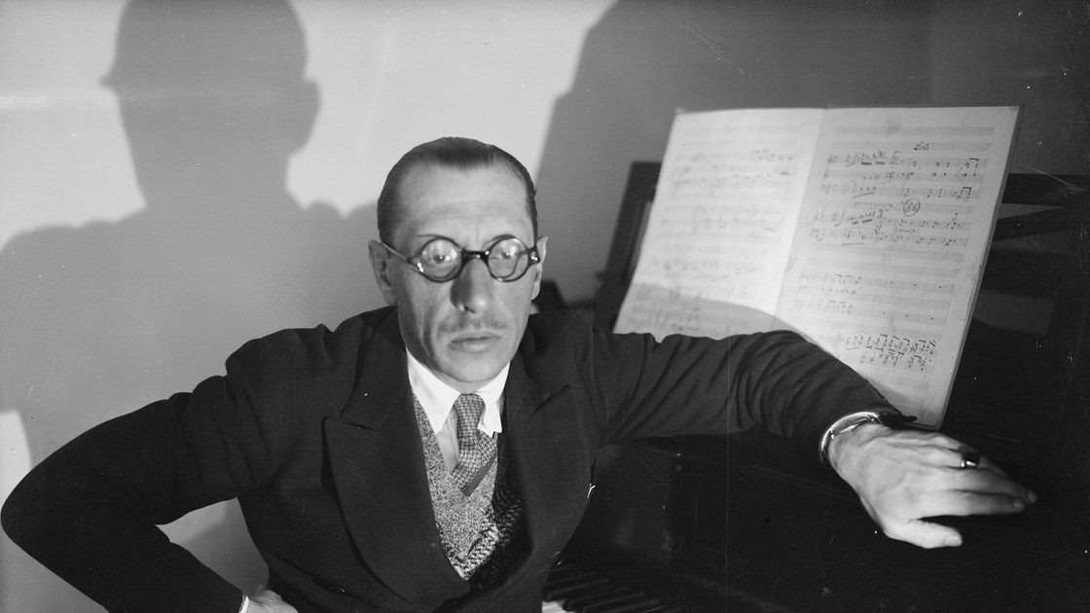
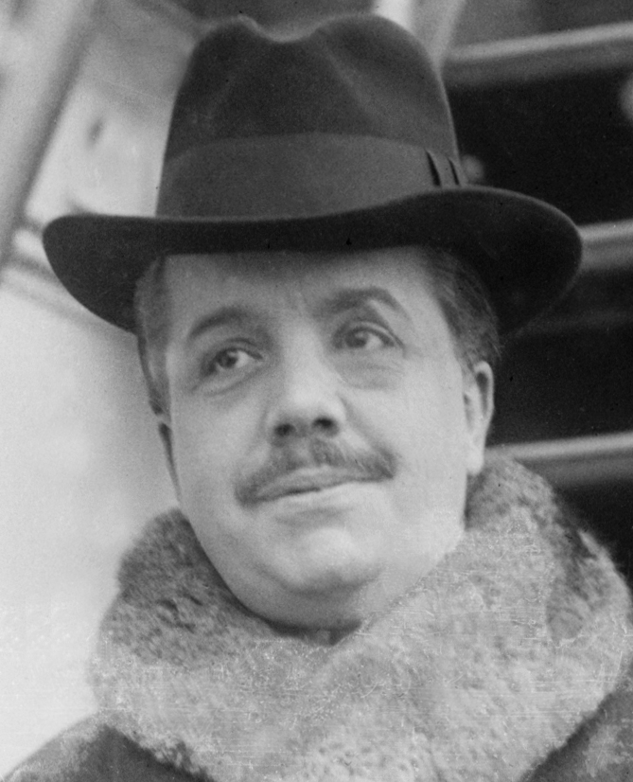
Igor stravinsky
1882-1971
Gave up his Law studies to study composition with Rimsky-Korsakov (the leading Russian nationalist composer of the time).
Wrote a number of orchestral works, notably Feu d’artifice (1908) which caught the attention of Diaghilev and led to a long lasting collaboration with the impresario.
Sergei diaghilev
1872-1929
Russian impresario who made Russian opera and ballet better known in the West through his Ballet Russes company
Enormously influential – also commissioned work from Debussy, Ravel & Strauss.
He also engaged with Bakst and Picasso to design sets and costumes for his shows.

Slide 3
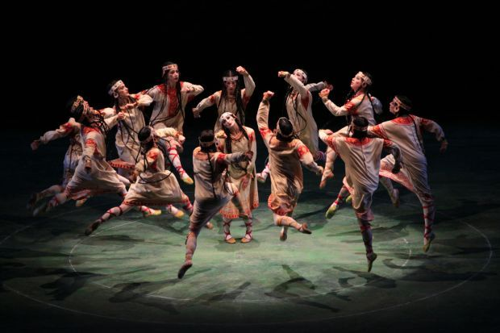
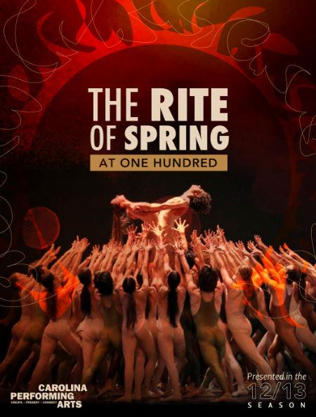
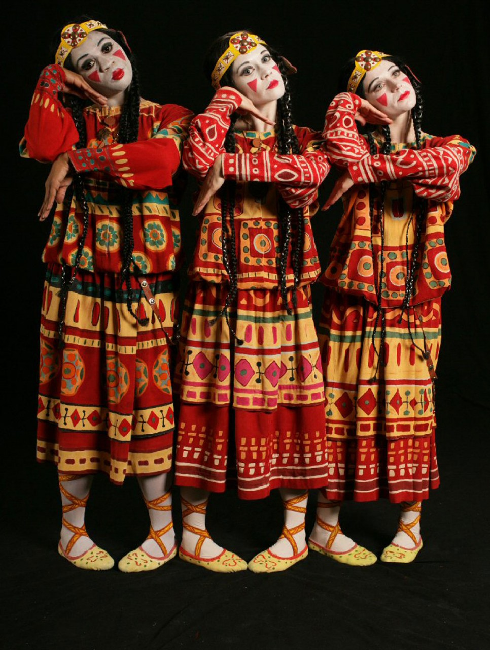
The rite
of spring
Regarded as one of the most significant works in the history of early 20th century music
Third of a series of ballet scores composed by Stravinsky for the Ballet Russes
Written in the Russian nationalist style adopted in his preceding works, The Firebird (1910) and Petrouchka (1911), both of which draw extensively on Folk music.

Slide 4
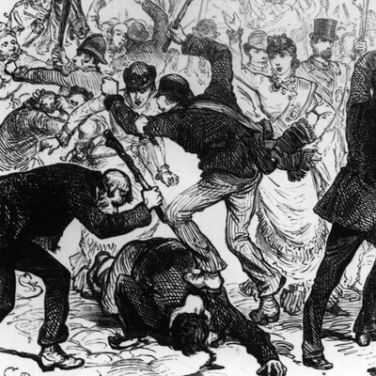
The rite
of spring
First performed on 29th May, 1913 at the Theatre des Champs-Elysees in Paris
It caused a riot and fist fights between different factions in the audience!!
The open dress rehearsal the preceding day, attended mainly by artist and musicians, had passed off without incident, but the fashionable audience at the official first night was provoked by both the music and choreography.
The audience did not like the dissonant harmony or the walking/stamping/heavy jumping of the choreography by Nijinsky.

Slide 5
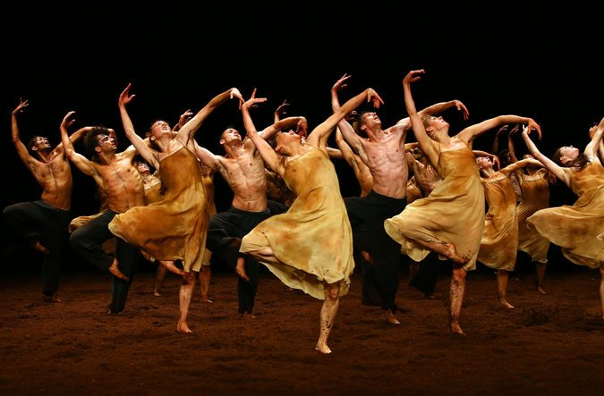
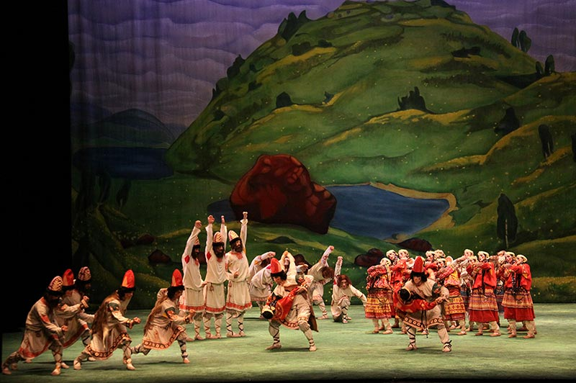
The rite of spring
The work has its origins in a dram or ‘fleeting vision’ Stravinsky had while finishing the orchestration of The Firebird in the spring of 1910.
It centred on a ‘young maiden dancing to the point of exhaustion before a group of men of fabulous age’.
The artist Roerich (1874-1947) played a major role in the development of the concept.
Diagheliv had previously used his designs for staging the Polovtsian Dances from Borodin’s Prince Igor, and by this time, he was regarded as Russia’s leading specialist on pagan antiquity.
He had produced impressive paintings of prehistoric scenes, including Yarilo’s Gully (1908) – Yarilo being the Slavonic sun god to whom the sacrifice is made of the end of The Rite.

Slide 6
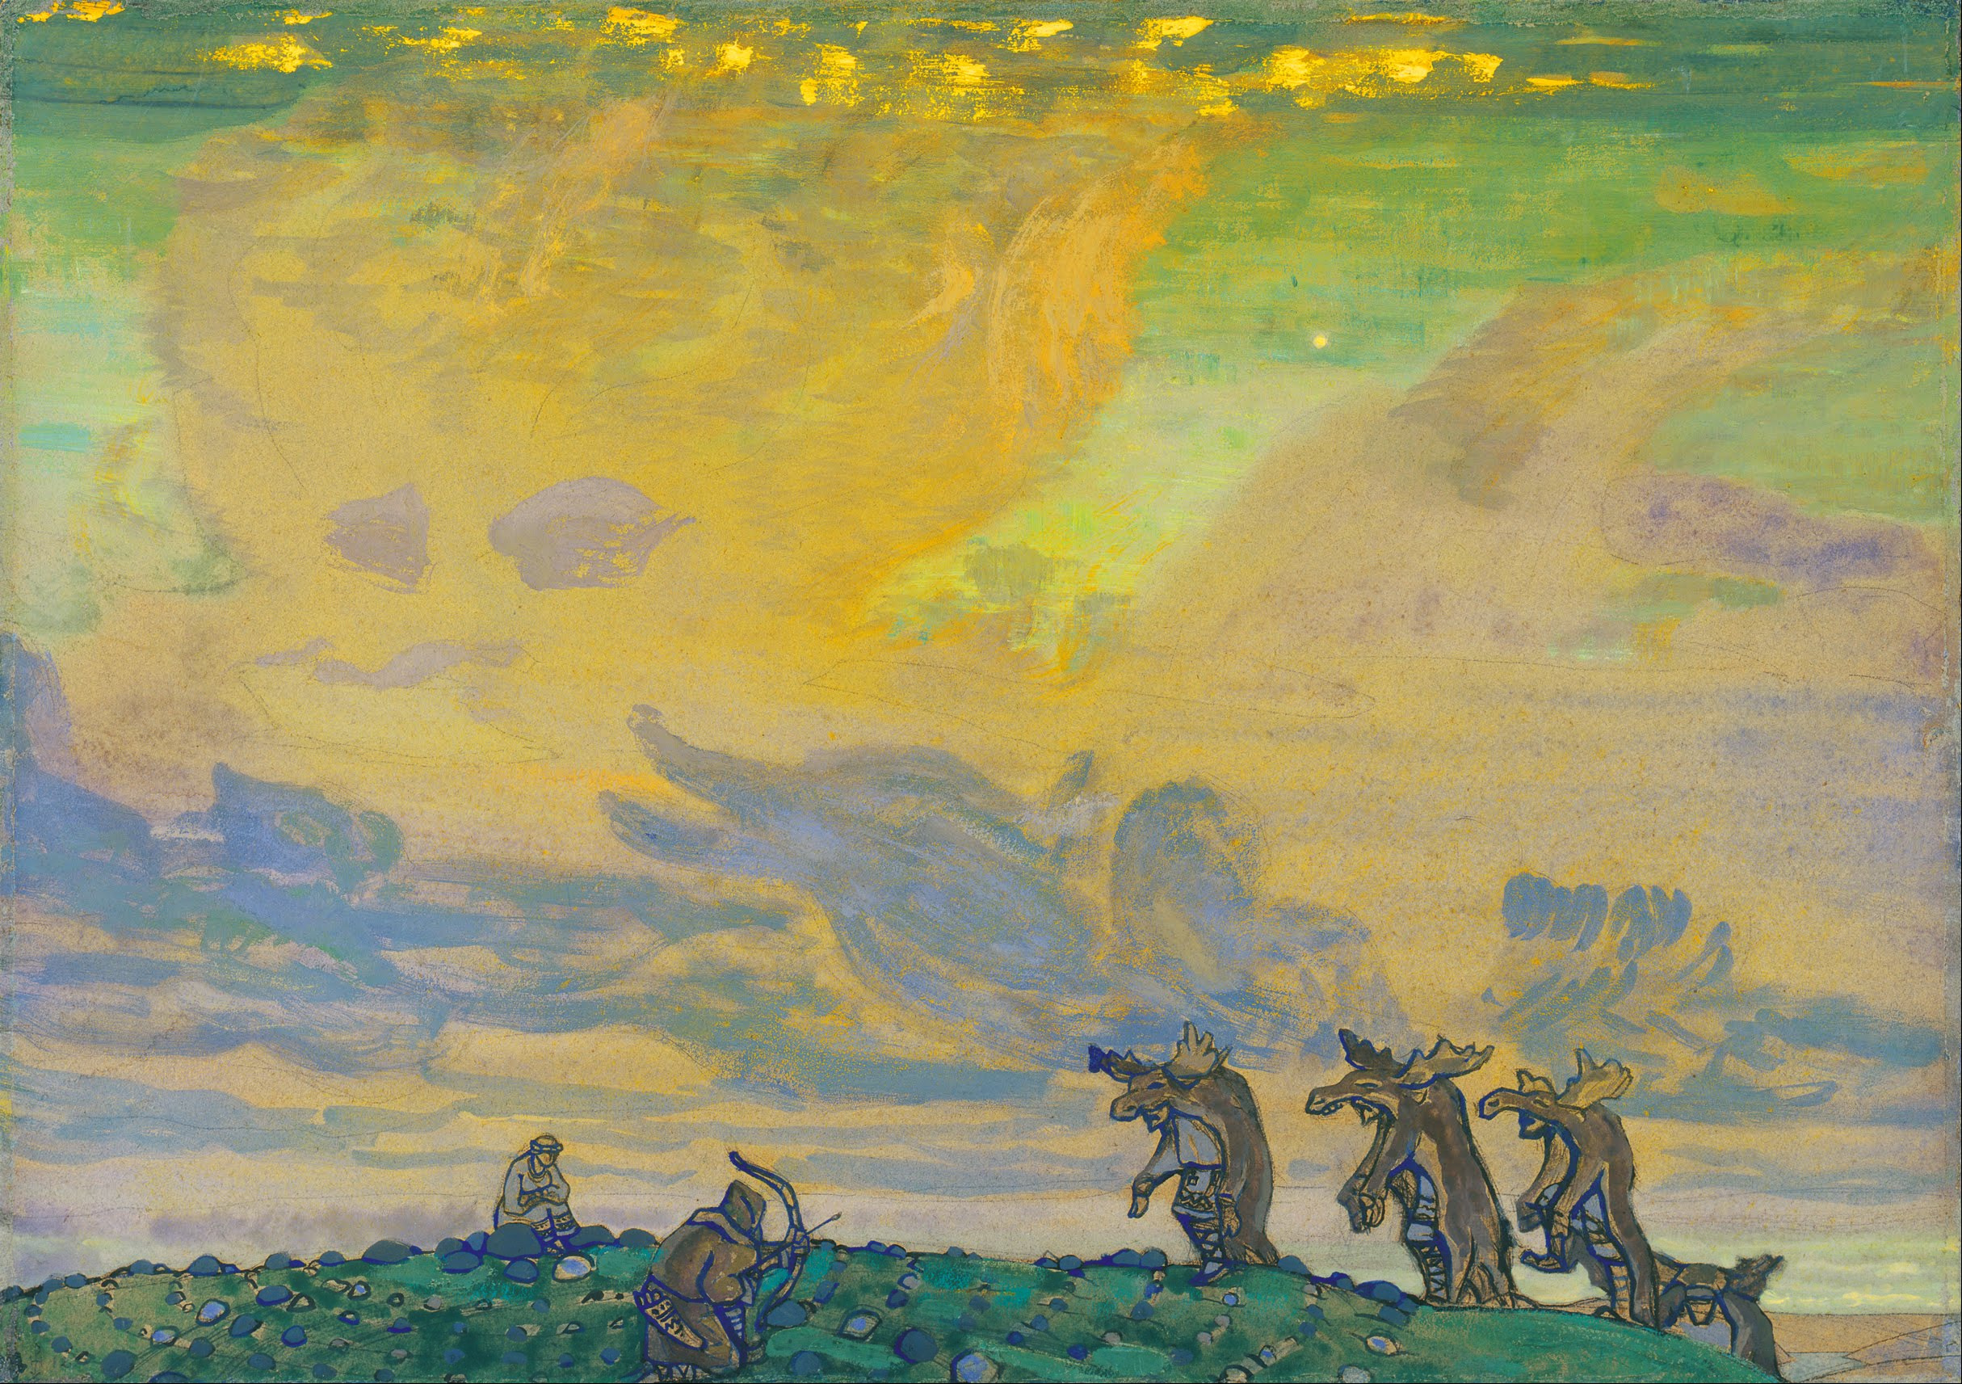
The rite of spring
Roerich and Stravinsky expanded the action backwards from the final scene (Stravinsky’s original dream), and the ballet came to comprise a series of ‘pictures from Pagan Russia’.
The prescribed extracts come from the opening of the first of the work’s two parts, the section initially entitled ‘The Adoration of Earth’.
Roerich said it ‘transports us to the foot of a scared hill, amid green fields where Slavonic tribes have gathered for their vernal games’.
An early synopsis by Stravinsky refers to a series of ancient Slavonic rituals reflecting the joy of spring: ‘The orchestral introduction is a swarm of spring pipes (dudki); later the curtain goes up, the are auguries, khorovod rituals and a game of abduction’.
Dudki = Polish and Russian for wind pipes Khorovod = a type of dance

Slide 7
The rite of spring
Another synopsis, given below, was sent to the conductor ahead of a performance in 1914:

Slide 8
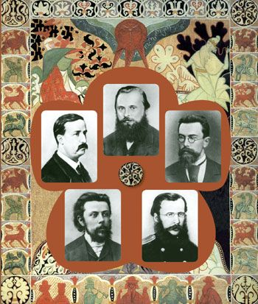
Russian nationalist style
19th century Russian composers showed a particular interest in the use of folk song in their works.
Prominent nationalist composers based in St Petersburg, known as ‘The Five’ or the ‘Mighty Handful’:
Balakirev
Borodin
Cui
Mussorgsky
Rimsky-Korsakov
The style differs fro German composers of the time, in a tendency to use varied repetition rather than motivic development, the use of structures composed of contrasting blocks of sound, a stress on the use of changing backgrounds (harmonic and instrumental) and a liking for colouristic effects in general.
Debussy spent some time in Russia in his early years and was influenced by Russian nationalist approaches.

Slide 9
instrumentation
This is written for an exceptionally large orchestra, with many transposing instruments (see below).
The ‘introduction’ and ‘Jeu du rapt’ sections do not have a key signature, and this is a conscious choice, not an indication that we are in C major. The transposing instruments are still written at transposing pitch in these movements, not concert pitch, despite sharing the blank key signature.

Slide 10
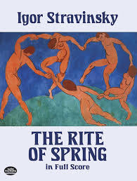
instrumentation
Quintuple woodwind
Three flutes, piccolo, alto flute (one of the flute players doubles on second piccolo. This is shown in the score by the words ‘Fl. 3 muta in Fl. Picc 2’, i.e. Flute 3 changes to piccolo 2).
Four oboes, cor anglais (it is normal to have two oboes).
Three clarinets, clarinet in D, bass clarinet. One of the clarinettists doubles on a second bass clarinet.
Four bassoons, double bassoon
Extra-large brass section (eight horns, five trumpets, three trombones, two tubas)
Large percussion section, including two timpani players and parts for tuned cymbals, tam-tam (large orchestral gong) and guiro, etc.
Standard string section.

