Slide 1
Group essay feedback– A level
Evaluate the belief that the balance of power between the executive and parliament has markedly shifted towards parliament. (30)
Share the information that you have with the rest of your group.
What is your conclusion to this question?

Slide 2
Group essay feedback– AS level
The UK Parliament is totally under the control of the executive today’. How far do you agree with this view of Parliament? (30)
Share the information that you have with the rest of your group.
What is your conclusion to this question?

Slide 3
In the news…
http://www.bbc.co.uk/news/uk-politics-43872520

Slide 4
What is the role of the eu & how does it affect the uk today?
Aim: to investigate the role and powers of the Eu
To consider the impact of the eu on Britain and the effects that the withdrawal from the eu may have on the uk

Slide 5
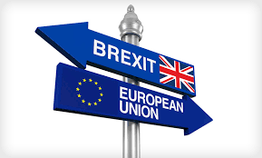
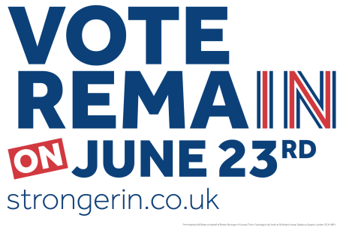
Brexit: the referendum
As we all know, the UK is in the process of exiting from the European Union. It joined in 1973 and on June 23rd 2016, the UK population voted 52%-48% in a referendum in favour of exiting the EU. The question was ‘Should the UK leave or remain in the European Union?’
What were the arguments from each side? Look at the different websites of each campaign organisation and summarise their arguments in the table on page 49.
What are YOUR views?

Slide 6
What is the European Union and what does it do?
The European Union was created in the aftermath of World War II, when the war torn countries felt the need to come together and never fight each other again. France and Germany came up with plans to co-operate and along with 4 other nations, pooled their coal and steel resources in 1950. It was an economic organisation, called the European Coal and Steel Community.
In 1957, the European Economic Community was created (EEC). Britain joined in 1973. Britain’s membership of the EEC was agreed by the British population in a referendum in 1975.
In 1992, the Maastricht Treaty was signed. This created the European Union as we now know it.
There are now 28 (soon to be 27!) members of the EU.
WATCH

Slide 7
What does the EU do?
Brainstorm as many things that you think the EU is responsible for….

Slide 8
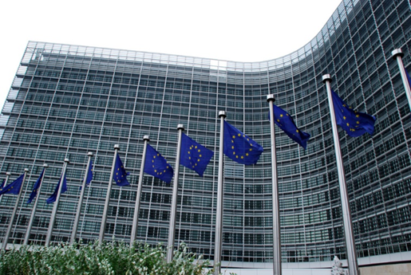
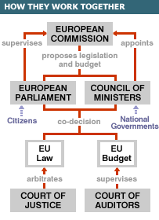
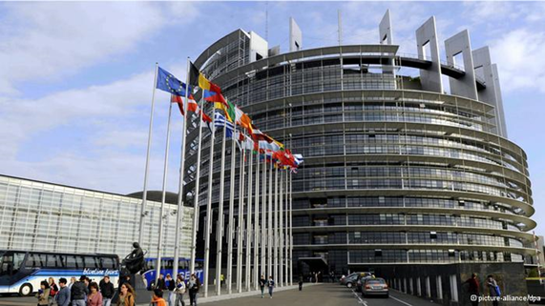
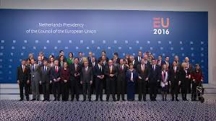
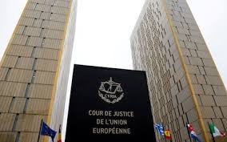
How does the EU work? The Institutions of the EU
Watch this, then use page 288 of the textbook and the video extracts to describe what each institution does. Add this information to the table on page 52 of your booklet

Slide 9
THINK: is there a ‘democratic deficit’ in the eu?
Some people argue that the being a member of the EU leads to a loss of democracy in each member state.
Highlight any DEMOCRATIC features or any UNDEMOCRATIC features of the EU in your notes.

Slide 10
What are the main functions of the EU?
Function | Does it achieve this? Explain your opinion and give examples of what the EU does/does not do.
It is a CUSTOMS UNION This means that the member states can trade with each other without any tariffs (taxes on goods or services being imported) or any other artificial restrictions and regulations. Individual member states cannot make special arrangements with external countries.
It is a SINGLE MARKET. There are four freedoms of the single market: Complete freedom of movement of goods Complete freedom of movement of services Complete freedom of movement of workers (labour) Complete freedom of movement of people across borders Goods and services must also be produced and sold under the same regulations in every member country

Slide 11
It is an ECONOMIC UNION The EU is responsible for the Economic development throughout the EU, especially for countries where the Economic income is low. There is a system of grants and agricultural subsidies paid for from the EU budget. Most member states use the same currency, the Euro.
It is a POLITICAL UNION The EU attempts to develop a common foreign policy and negotiate with foreign powers as a single unit. It also seeks to promote common policies on human rights, economic and social rights and international law enforcement.

Slide 12
What are the main functions of the EU?
Function | Does it achieve this? Explain your opinion and give examples of what the EU does/does not do.
It is a CUSTOMS UNION This means that the member states can trade with each other without any tariffs (taxes on goods or services being imported) or any other artificial restrictions and regulations. Individual member states cannot make special arrangements with external countries. | Yes – the customs union is fully operational
It is a SINGLE MARKET. There are four freedoms of the single market: Complete freedom of movement of goods Complete freedom of movement of services Complete freedom of movement of workers (labour) Complete freedom of movement of people across borders Goods and services must also be produced and sold under the same regulations in every member country | The European single market aims to break down all barriers to trading across the 500 million-person area by ensuring the “four freedoms”, sacrosanct to Brussels policymakers: free movement of goods, services, capital and -- most controversially -- labour. As an EU member, the UK has signed up to each of those freedoms which, as Brussels has repeatedly made clear, are non-negotiable. Being part of the single market gives UK businesses unfettered access to 500 million customers in all states within it and in turn allows UK consumers and companies to purchase goods and services from across the continent. It eliminates tariffs and reduces costs and administrative burdens by applying one set of rules across all member states. THE UK IS NOT SIGNED UP TO THE SCHENGEN AGREEMENT – therefore has border controls.

Slide 13
It is an ECONOMIC UNION The EU is responsible for the Economic development throughout the EU, especially for countries where the Economic income is low. There is a system of grants and agricultural subsidies paid for from the EU budget. Most member states use the same currency, the Euro. | Yes The UK has kept it’s own currency.
It is a POLITICAL UNION The EU attempts to develop a common foreign policy and negotiate with foreign powers as a single unit. It also seeks to promote common policies on human rights, economic and social rights and international law enforcement. | Winston Churchill originally wanted a ‘United States of Europe’. There have been many treaties that have strengthened the institutions of the EU , and many see the institutions as a ‘federal structure’ that is ready and waiting! However, this European dream is a dream: the power lies with the member states. There is no European army, although European countries co-operate and try to speak as one voice on defence matters. The EU acts collectively on the world stage

Slide 14
What has been the impact of the eu on Britain?
What is the impact of the EU on Britain?
UK Political Parties
Brexit
Public Policy
Pressure groups
Public Opinion
Economy
Working in small groups, produce a detailed A3 spiderdiagram. Make it interesting to look at and add the main points. Be creative!
Use the Heywood pages to help you, plus any resources online.
Each person should be responsible to finding out about one area.

Slide 15
Extension/hw specific eu policies
You need to be able to refer to at least two different EU policies and the effects that they have had on the UK.
There are plenty to choose from!
Research two EU policies.
Describe them and the effects that they have had on the UK.
Write up your findings on page 55 of your booklet.
Examples: Common Agricultural Policy, Common Fisheries Policy, regional development, immigration. Or have a look at https://europa.eu/european-union/topics_en for a full list of EU activities.

Slide 16
Hw
1) Complete your research on two EU policies.
2) Create a spiderdiagram on the possible effects that leaving the EU may have on the UK. Use pages 288 & 289 in the McNaughton textbook to help, plus research online. Consider the possible constitutional effects and political effects.

