Slide 1
Parliament
REVISION
1. Powers & Composition of the Commons & Lords
Functions of Parliament
How powerful is the Commons?
How could the Commons be strengthened?
How should the Lords be reformed?

Slide 2
Some typical questions
How effective is Parliament at performing its functions?
New A level: Evaluate the effectiveness of Parliament at performing its functions.
New AS: ‘Parliament is ineffective at carrying out its functions’ How far do you agree?
How effective is Parliament in checking executive power?
What should be done to make the House of Lords more legitimate?
How could the representative role of Parliament be improved?
How and to what extent has the influence of the House of Commons changed in recent years?

Slide 3
REMEMBER THE SYNOPTIC LINK….
AS students must refer to a topic in unit 1.
A level – must make references to other parts of course to get A/A*
A good one to refer to is ‘Representative democracy’ when discussing how representative Parliament is, the nature of each chamber - especially the House of Lords.
You could also refer to the voting system, FPTP.
There are other links to a unit 2 topic: the Constitution. Parliamentary Sovereignty is a pillar of the constitution.

Slide 4
New spec: what is the history of Parliament?
1265 Simon de Montford, established the first Parliament
1660s Glorious Revolution and Bill of Rights.
Strengthened Parliament v king.
Great Reform Act – extension of the franchise
Extension of franchise to all men and women over 30
1911 & 1949 Parliament Acts, reducing powers of House of Lords

Slide 5
Features
Bicameral – meaning there are two houses. The House of Commons is fully elected. The House of Lords is fully unelected. The Lords can debate and provide specialist advice. It can delay legislation, forcing the government to reconsider.
Fused - ‘Fusion’ of executive and legislative branches. The Cabinet and PM are drawn from Parliament
Government governs in and through the assembly or parliament
Executive and Legislature are bound together in a way that violates the doctrine of Separation of Powers
Government can dissolve the parliament
Parliament has reserve powers to vote out the Government

Slide 6
Two principles
1) Parliamentary Government:
The UK Parliament is the highest source of political authority. Political power may only be exercised if it is approved by parliament.
No strict separation of powers between the Executive and Parliament – fusion of powers.
Government must be accountable to Parliament.
Parliament may use reserve powers to issue a vote of no confidence in the Executive.

Slide 7
2) Parliamentary Sovereignty
UK Parliament is legally sovereign:
Parliament is the source of all political powers. It may delegate powers, but also may restore them.
Parliament may make any laws it wishes and they will be enforced by others.
It may not be bound be previous Parliaments, nor bind future Parliaments. Thus, laws cannot be entrenched.
Political sovereignty: in reality, this is has been lost by Parliament.
The Executive can dominate Parliament and other bodies have reduced this power…

Slide 8
Erosion of sovereignty
Parliamentary Sovereignty has been reduced in the following ways:
The EU EU Law is superior to UK Law. UK law must be changed to suit EU law. Joined in 1973, but exit will mean sovereignty is returned. (However, this was created by an Act of Parliament).
Executive growth Political power has been transferred to the Executive. The Miller Case clarified that this was only political sovereignty, not legal sovereignty.
Increased use of Referendums Not technically binding, but it is inconceivable that they would reverse decisions made by the ‘people’
Human Rights Act 1998 Despite the fact that this is not ‘binding’ on Parliament, Parliament does treat it as if it is partially codified.
Devolution – sovereignty has in practice been transferred to the devolved bodies, although technically Parliament can restore them. It is v unlikely that this will happen.

Slide 9
Difference between a parliamentary and presidential system
 | Parliamentary government | Presidential government
How are governments formed? | Governments are formed through parliamentary elections | Governments are separately elected.
How strictly is the separation of powers doctrine enforced? | There is an overlap of personnel and this is called a Fusion of powers. | Personnel are strictly kept separate and Separation of powers is strictly enforced.
Can government ministers also sit in the legislature? | Government cannot choose who sits in the legislature. The members of the legislature are elected directly. | Government is separately elected and cannot decide who sits in the legislature.
Can the legislature remove the government? | Yes – the legislature has the power of veto and can pass a vote of non confidence. | The legislature cannot remove the government (except in exceptional circumstances of illegal behaviour).
Who is head of government & who is head of state? | There is a separate Head of Government (the Prime Minister) and Head of State (Queen) | Presidents are both head of the Government and the State./

Slide 10
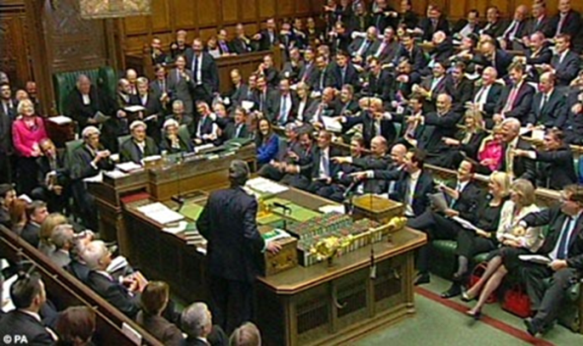
Composition of The Commons
The Commons consists of 650 MPs most of which are backbenchers.
Each MP is elected from a constituency of roughly 70,000, by FPTP.
Back benchers are MPs who do not have a ministerial post and/or who are not senior members of their party.
Frontbench MPs are prominent members of the political parties who sit on the benches in the centre of the chamber in front. They are made up of ministers (normally about 90) and leading members of the other parties (normally about 30 who are known as shadow ministers).
The Speaker is elected by all MPs and must become politically neutral. He or she chairs the Commons, keeping order and organizing the business of the House.
Legislative committees are formed for each proposed piece of legislation. They contain 15 – 40 backbench MPs and examine the laws and put forward amendments.
Departmental select committees are permanent and attached to departments. The normally contain about 11-13 members. Their chairs are elected by back bench MPs and they examine the work of government.
Whips offices contain respected MPs whose role is to inform MPs about the business of the house and ensure MPs turn up when required.

Slide 11
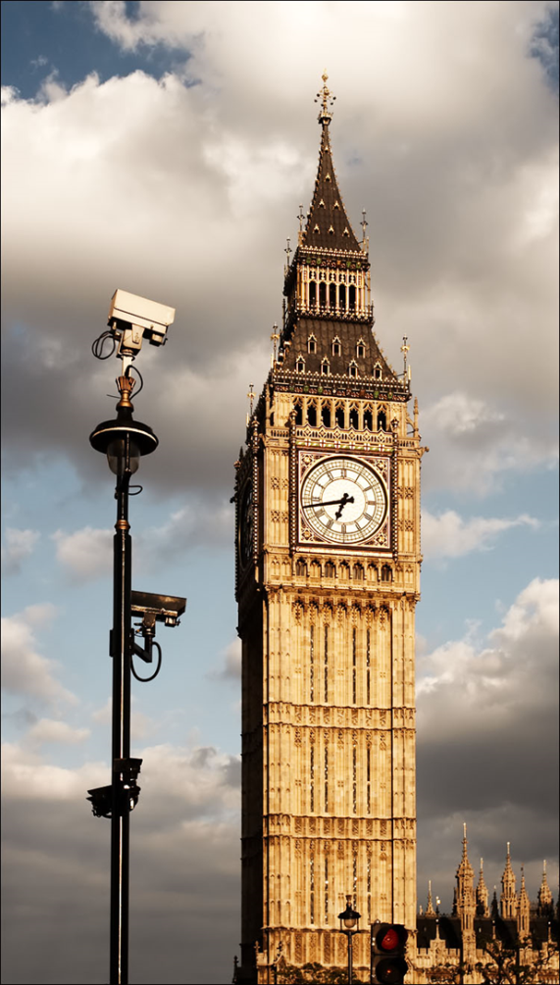
What are the functions of Parliament?
Legitimation: The people’s consent is given to laws passed in Parliament. Otherwise, it would be arbitrary government rule.
Legislation = The passing of laws in parliament. Most laws (unwritten common law is an exception) will be enforced by the authorities and courts only if they have been passed by parliament.
Scrutiny = They examine proposed laws to see they will be clear, effective and fair
Accountability - It calls government to account, forcing ministers to explain and justify policies.
Representation – It tries to ensure that all parliamentary constituencies and various sections of the whole community are properly represented, seeking to make sure that their interests are taken into account in government decisions.
Redress of grievances MPs as individuals take up grievances of individual citizens who feel they have been unfairly treated by a public body.
Deliberation – It may debate great issues of the day such as the conduct of military action, the direction of British foreign policy or moral and religious matters.
FOCUS on 4:

Slide 12
How do the functions compare?
House of Commons | House of Lords
Legitimation
Accountability | Accountability
Legislation | Legislation
Scrutiny of legislation | Scrutiny of legislation – very effective as there are many experts in the House Can DELAY legislation for a year
Representation of interests | Approval of secondary legislation
National debate | National debate

Slide 13
What are the relative powers of each house? ‘Evaluate the view that the HoC is a more important institution than the hol’
House of Commons | House of Lords
Approve / reject legislation. Legimitacy | Delay the passage of legislation for at least a year.
Dismiss a government through a vote of no confidence | Amend legislation (BUT CAN ONLY PROPOSE AN AMENDMENT, the HoC must vote on this)
Order ministers to answer questions on the floor of the house or to answer written questions, ask them to attend Select Committees | Order government ministers to the house (they must be peers). (No Select committees in Lords)
Amend legislation
Order debates on important issues of national importance | Debate issues of great concern.
Introduce Private Members Bills
Introduce matters of concern in a 10 minute rule debate or an adjournment debate

Slide 14
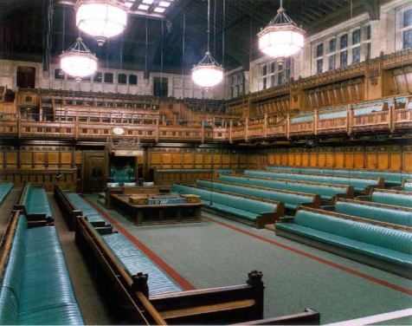
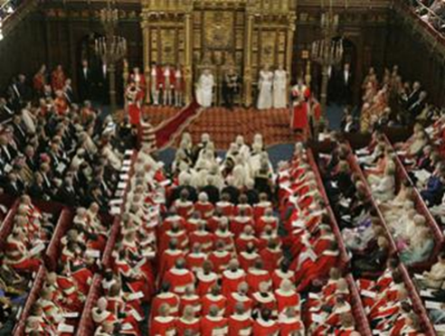
What are the relative powers of each house?
House of Commons only | Shared functions | House of Lords only
Granting popular consent to proposed legislation | Granting formal consent to legislation | Deliberating at length on important issues.
Refusing to approve items of legislation which are undesirable | Calling government to account | Providing specialist expert advice on proposed legislation.
Representing constituents | Scrutinising and amending legislation | Delaying legislation for up to a year.
Bringing attention to grievances | Debating key issues. | Forcing government to reconsider.

Slide 15
Describe the role of a backbench MP….
Take part in debates
Voting in divisions
Speaking in debates
Scrutinising legislation
Member of committee
Campaigning for issue
Redressing grievances

Slide 16
How effective are MPS in parliament?
Ineffective | Defence of the MP!
Lobby fodder or party hacks, only wanting to be promoted | There are many independent minded MPs who are willing to put own views across.
Backbenchers are powerless in the face of frontbenches. Little or no influence on legislation. Fail to hold the government to account | Less true today. Since 2010, there have been more attempts to defy the government and select committees are strong.
Rarely attend debates, suggesting lack of interest | Much MP work is carried out behind the scenes, often in committees
Long recesses or holidays | MPs use recesses to do constituency work
Self seeking and sometimes corrupt? Expenses scandal of 2009-10 | MPs have set up processes to control this. Have a paid salary that is modest compared with similar jobs.
MPs are often unknown in their constituencies | Many represent their constituents in a large way even if unknown to many.

Slide 17
Describe a select committee: the Public Accounts committee (PAC)
Public Accounts Committee
Most important select committee
Looks at how much money has been spent & if it value for money
Chair is from opposition, elected by MPs, independent and has high prestige
Members act independently
Reports are unanimous
HIGH PROFILE
The ‘Queen of select committees… that has a cleansing effect on all government departments’ (P. Hennessey). Has 800 staff working for it (national audit office).
date | Investigation | Conclusion & action
2016 | Google’s taxes | Google’s back payment of £130m was considered to be too low. HMRC asked to investigate
2015 | Cancer care in NHS | Critical of postcode lottery. Publicity prompted government to review policy.

Slide 18
DESCRIBE Departmental SELECT COMMITTEES:
The Culture, Media & Sport DSC hit the headlines when it interviewed Rupert Murdoch over phone hacking – and he got a custard pie in his face!
Other inquiries have been into FIFA, nuisance calls, future of the BBC, handling of press complaints.
Departmental Select Committees
19 committees
Scrutinise each department
Members elected by House of Commons
11-14 members
Governing party has a majority
Chairs are from any party
INDEPENDENT from party allegiance
Call witnesses: ministers, civil servants
Gain publicity

Slide 19
Examples of Select committee succesS:
date | committee | Investigation | Action
2018 | Culture, Media & Sport | Into alleged doping in cycling | Criticisms of team Sky
2016 | Work and pensions | Collapse of BHS and loss of pension fund | Company was reported to Pensions regulator
2016 | Business, Innovation & Sport | Into alleged bad working practises at Sports Direct | Company forced to pay compensation to employees for paying below minimum wage

Slide 20
Role of the opposition
The government in waiting
Calling the government to account
Defend interests of sections of society that are often ignored.
Ceremonial functions, eg visits of heads of state.
Organising opposition days in the House of Commons.

Slide 21
How effective is the COMMONs?
Effective | Not so effective.
Legitimacy - The UK’s system is stable, with widespread consent. Parliament provides strong legitimacy. Gov bills are scrutinised by Parliament and therefore accepted as having had public approval. | Respect has been undermined by recent scandals (expenses, cash for questions etc).
Legislation – Clear process of legislation with Public Bill Committees and both chambers having opportunity to add amendments. The house may reject legislation. | The procedures in Parliament in respect of passing legislation are ancient and can be deemed inefficient. Government legislation is passed through Parliament – little opportunity to change substance of bills, only make small amendments to detail. Private Member Bills are rarely passed. Public Bill Committees are weak & dominated by the executive. MPs are whipped.

Slide 22
HOW EFFECTIVE IS THE COMMONS?
Scrutiny of legislation has been very much improved since departmental select committees and legislative committees were introduced closely checking policy and investigating. | MPs are given relatively little time to scrutinise legislation. MPs may be whipped into party loyalty which makes them vote the way they should Select committee recommendations may be ignored.
Calling the government to account and checking executive power is something they can do. PMQs and QT; Liaison Committee questions PM twice a year. Role of Opposition. | Party loyalty and discipline means that many MPs are reluctant to challenge the government. The government rarely loses a major vote in the Commons. PM Question time has become something of a show.

Slide 23
HOW EFFECTIVE IS THE COMMONS?
Representation and redress of grievance is normally done well. Most MPs are keen to do a good job representing the interests of their constituencies. | The Commons is not socially representative. HoL is not elected, therefore not representative. Party loyalty means MPs tend to toe the party line and under FPTP commons does not reflect the vote. No effective mechanism for removing poorly performing MPs.
Deliberation, or debate is normally done well. Great issues are well attended and people can make good contributions. MPs take this role very seriously. | There is not enough time for proper discussion and debates on legislative proposals tend to divide along party lines.
Recruitment of future Ministers, demonstrating their abilities as an MP. | Being effective in parliament does not necessarily mean that they will be good ministers or be able to manage a department of state.

Slide 24
Composition of The House of Lords
Composed of 92 hereditary peers, 26 Archbishops and Bishops of the church of England, 630 Life Peers and a Lord Speaker – about 800 in total.
It has Frontbench and backbench peers, CROSSBENCHERS, public bill committees and whips offices.

Slide 25
Appointment of a life peer
Life Peers are appointed mostly on political grounds with each of the main parties having the privilege of regularly nominating a number of new life peers to replace those who have died.
Parties nominate new peers in proportion to their representation in the commons.
This means that in the new government more Conservatives will be nominated.
Most – but not all – party nominations are either retired politicians or current professional politicians who do not wish to be a constituency MP such as Lord Adonis.
In order to prevent total domination by the parties a number of life peers with no party allegiance are nominated each year and become Cross benchers.
Cross benchers are extremely independent.
Neutral life peers can be nominated by anyone, though they are normally nominated by existing peers and are ultimately appointed by the independent House of Lords appointments Commission. Most of them are prominent “life achievers such as Lord

Slide 26
The debate about the House of Lords
Lords Strengths | Lords Weaknesses
Many members of the Lords are more independent from party control than MPs. They can therefore be braver at standing up to the Government. | In its unreformed state, the Lords lacks democratic legitimacy.
Peers represent a wide variety of interests and expertise, being largely prominent citizens with specialist knowledge. | The powers of the Lords are limited by law. It has no power over financial matters and cannot veto legislation in the long term.
The Lords can delay legislation and so force compromises on the government.. | Its proposed amendments can be overturned by the Commons.
The Lords has more effective time to conduct debates and to scrutinise legislation. | Like the Commons the Lords has a limited role in developing legislation.

Slide 27
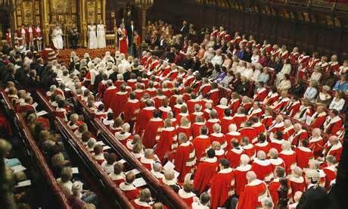
Why the house of lords is becoming more significant
When government majorities were large opposition in the Commons became weak and members of the Lords felt it was their duty to bolster opposition and challenge the Government.
At the same time the House of Lords began to become more professional. An increasing proportion of its membership began to take their role more seriously, attending regularly and making themselves specialists in certain fields.
The reform of the Lords in 2000 removing all but 92 hereditary peers gave Lords greater authority. It was still not democratic, but it was seen as more politically and socially representative.
There is a stronger ‘rights culture in the UK especially since the HRS and Lords contain many lawyers and human rights experts who have taken upon themselves the role of guardian of individual rights against an encroaching government.

Slide 28
Should the uk have an elected second chamber?
Reform | Advantages | disadvantages
Abolition | It would save money It would streamline legislation It would remove obstructions to efficient government. | An important check on government power would be lost. It would deny many worthy individuals the chance to share their expertise.
All appointed | Many useful, knowledgeable individuals can remain being drawn into politics. Membership could be managed to ensure a social balance. It would be more independent than an elected chamber. | It would be put too much patronage into the hands of party leaders. It would remain undemocratic.
Fully elected | Democratic Members would be accountable. The House would have more authority and legitimacy so could check the commons. If elected by PR would be more representative. | The House might become too influential so obstruct the government excessively. It might be unnecessary to have two elected chambers. The people are already not voting, more elections might increase apathy.
Hybrid | Could enjoy the advantages of both the main alternatives. | Would suffer from the same problems as the main two alternatives.

Slide 29
To what extent does the executive dominate parliament?
Vote of no confidence

Slide 30
Executive dominance depends on…
The size of a government’s majority in parliament
Party Unity – are MPs willing to rebel?
Rebellions:
Labour – during the 2nd and 3rd terms (NOT the first!) – Labour MPs rebelled 20% of time, some were very large. On 64 occasions 40 or more MPs voted against the government (uni top up fees – 74) Iraq War – 139 MPs. Iraq War rebellion was the largest rebellion by Labour MPs since the corn laws, March 2003. Largest rebellion in modern times. Labour MPs in the 2nd and 3rd governments were no longer sheep, they were very rebellious. Rebellions on foundation hospitals, smacking, faith schools, immigration, trial by jury, gambling etc. But despite the scale of these rebellions, Blair got to the end of the 2nd parliament without a government defeat.
Coalition government – MOST REBELLIOUS PARLIAMENT SINCE 1945. There were rebellions on 37% of votes. 159 conservatives rebelled and 42 lib dems. Tuition fees / referendum on EU / government defeat on military action opposing intervention in Syria (2013)
May – backbench rebellion on EU Withdrawlal Bill, amendment (309-305) defeat for gov. Requires final deal to be brought back to Parliament.
Coalition – although not relevant for now.
A reformed House of Lords - greater sense of legitimacy & greater willingness to vote against executive.
Blair government faced 353 defeats in HoL, Coalition: 100. Cameron in 2016 – 38. May – 3 in last week!

Slide 31
How Does Parliament check Executive Power?
The size of a government’s majority greatly affects Parliament’s relationship to Government and make them more vulnerable.
Party Unity is very important too – will MPs be willing to rebel?
The Government is held to account by:
Ministers in particular, justify their policies explaining why they were developed and what the effects are likely to be.
Obviously the opposition will be highly critical, but MPs of the Government’s party must take responsibility also.
Opposition parties may present the government with alternatives.
If there are serious errors it is the role of Parliament to expose mistakes.
Methods
Obviously through debate or when they vote. Back bench rebellions can defeat a government bill.
Questions to ministers. Prime Minister’s Question Time is an opportunity for making the Head of Government accountable as is the Liaison committee.
Select Committees of 11 – 14 MPs have the power to question and cross examine, Ministers, their civil servants and any witnesses they may call from external organisations. These MPs may spend many years on the committee and develop considerable expertise. Bill committees also check legislation carefully.
They have the power to veto government legislation and to dismiss a government with a vote of no confidence.
Public Accounts Committee can be critical of government financial management

Slide 32
How effective is Parliament in holding the executive to account?
Method | Effective | Ineffective
Voting | Ultimately the commons can vote against a government proposal, either a whole bill or an amendment. | It is normal for the government to enjoy the majority of MPs - so ideologically they will support the government, and they will see promotion chances if they do.
Debate | MPs can’t have expertise on every area under discussion and there are time constraints. | The lords again are better at this than the commons because they are prepared to give it more time.
Select Committees | The select committees are extremely active and independent and examine government business closely. | MPs are given too little time to scrutinise all proposed legislation and laws can be rushed through and MPs get whipped to pass them.
Liaison committee | The Prime Minister is questioned twice a year | PMQT is a farce. It certainly does not place a light on policy.
Reserve powers of Veto or dismissing the Government | Very powerful indeed. The Lords have been more likely to vote down legislation | But hardly ever used and when a government has a large majority it remains a distant threat. However, James Callaghan’s Labour Government was removed in March 1979 by a majority of one!

Slide 33
House of Commons Reforms
After 18 years in opposition to a Conservative government, the Labour party experienced the full force of executive power.
Their manifesto in 1997 promised that a Labour government would make parliament a more efficient law-making body, and to ‘make MPs more effective in holding the executive to account’.

Slide 34
Reforms to the House of Commons
Since Blair
Sitting times have changed and hours are now more ‘family friendly’ with fewer evening sessions. Parliament now does not sit on Monday mornings or Friday afternoons so MPs can get to and from their constituencies.
They can now carry over government bills so they don’t get shelved.
Summer recess is shorter.
PMQs were reduced to once a week on Wednesdays.
A Liaison Committee was introduce to scrutinize the PM twice a year.
Under Brown
Brown gave up some prerogative power and Parliament must now be consulted about declaring war or ratifying treaties.
Under the Coalition
A Backbench Business Committee was set up with a chair elected by MPs. The committee controls the debates in the main chamber on 27 days per year and may select any topic. Topics include such things as pensions or pay increases.
Also since 2010 the chairs of departmental select committees are elected by backbench MPs. This takes away power from party whips and leaders.
Petitions
Over a 100,000 people signing up can bring up a topic for debate.

Slide 35
What further improvements could be made?
MPs and Select Committees lack proper research facilities.
Party loyalty sometimes prevents genuine criticism
Parliament can be criticised for being unrepresentative
Scrutiny of legislation is weak
Passage of bills is guaranteed and ritualistic
Lack of opportunities for backbenchers to raise issues (PMBs rarely successful)
Little parliamentary time given over for genuine debate
Select committees remain weak
PM can threaten dissolution of parliament
Select Committees are regarded as all bark and no bite.
Solutions
Invest in better offices
Provide more resources and secretarial support.
Try to improve representation – get rid of FPTP
Get rid of yah boo culture
Streamline legislation (perhaps with committees examining proposed laws before they get debated.
Improve political education and be more inclusive
Solve the issue of an unelected house (one way or the other)

Slide 36
Some typical questions
How effective is Parliament at performing its functions?
New A level: Evaluate the effectiveness of Parliament at performing its functions.
New AS: ‘Parliament is ineffective at carrying out its functions’ How far do you agree?
How effective is Parliament in checking executive power?
What should be done to make the House of Lords more legitimate?
How could the representative role of Parliament be improved?
How and to what extent has the influence of the House of Commons changed in recent years?

Slide 37
REMEMBER THE SYNOPTIC LINK….
AS students must refer to a topic in unit 1.
A good one to refer to is ‘Representative democracy’ when discussing how representative Parliament is, the nature of each chamber - especially the House of Lords.
You could also refer to the voting system, FPTP.
There are other links to a unit 2 topic: the Constitution. Parliamentary Sovereignty is a pillar of the constitution.

