Slide 1
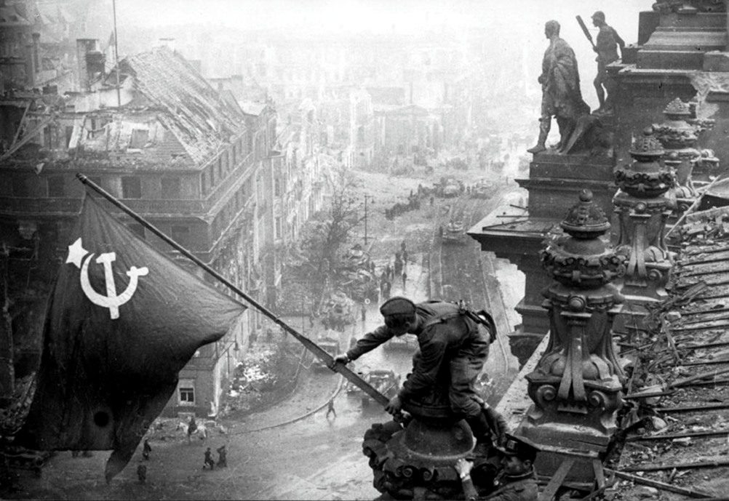
Defeat and Division –
Germany, 1939-49
Revision 30/04/18

Slide 2
Themes to revise (based on OCR spec)
Germany at War 1939-45:
The wartime economy and the impact of Allied bombing
Racial policy and the ‘Final Solution’
Impact of the war on the Home Front (morale, rationing, opposition and resistance)
Post-war Germany 1945-49:
The consequences for Germany of the defeat in 1945 & the emerging Cold War
The reasons for the division of Germany: the formation of Bizonia, economic and political developments in the Soviet zone, western policy and the DM, the Berlin Blockade

Slide 3
Economic policy
1939-42: Fritz Todt Armaments Minister
Limited mobilisation
Military expenditure x 2 (But GB x 3)
55% of the workforce in war-related projects
BUT
Aircraft production trebled in GB but rose by less than 25% in Ger
Ger had only 1/3 more tanks in 1941 than in 1940 & fewer than USSR
The war started prematurely, before many projects were due to be complete (many were not expected to be complete until 1942-3 when Ger already at war with USA & USSR)
The armed forces were determined to have the very best specifications possible so the drive for quality was pursued at the expense of quantity.
Autarky failed: attempts to produce oil & rubber artificially failed.
1942-45: Albert Speer Armaments Minister
A ‘production miracle’ (Overy)
Central Planning Board established for greater oversight – armed forces had to submit their requests to him
Concentration camp labour extended & female labour encouraged
Streamlined production to avoid anything not essential for the war effort.
Overall arms production trebled 1941-4 despite increasingly heavy bombing.
Aircraft production overtook the British in 1944.
Tank & aircraft production rose x 6 1941-44.
BUT
Germany did not start to mobilise her full potential for war production until after Stalingrad (1943) when it was already too late
He could not always counter the power of the local Gauleiter and SS at local level
Allied bombing had a significant impact but as Overy suggests, it placed a ceiling on production: without it, Ger may well have been able to outproduce GB.

Slide 4
Racial Policy: the Holocaust
Outbreak of WW2 1939: Invasion of Poland, 2 million more Jews, ghettoization, yellow star, confused policy
Persecution of the Jews before WW2: overall aim?
Victory over France 1940: Focus on emigration through Madagascar Plan, blocked by Royal Navy
Operation Barbarossa June 1941: Another 3 million Jews, Judeo-Bolshevik conspiracy, Einsatzgruppen
Intentionalism:
The Holocaust happened b/c Hitler wanted it to (it was intended from the start)
Structuralism:
It happened b/c of changing (military) circumstances, radicalisation as a result of Nazi structures, and Hitler left most of the details to others e.g. Himmler
Wannsee Conference 1942: Planned murder of European Jews, organised by Heydrich & Eichmann
Extermination 1942-45: Death camps established in Poland inc. Auschwitz, Sobibor, Treblinka; of 3 million Polish Jews only 4000 survived the war; 6 mil total

Slide 5
The domestic front: morale and opposition
Opposition groups:
Communist cells e.g. Red Orchestra survived into the war years but they were small & isolated & the RO was crushed in 1942
Individual Christian opponents spoke out more during the war e.g. Bonhoffer, Galen but the churches as institutions remained silent
White Rose group were motivated by genuine outrage at Nazi atrocities, but were isolated and their protest shortlived
Kreisau Circle were influential & planned to assassinate Hitler but were divided about aims and tactics and lacked popular support
Stauffenberg had support from army officers but was crushed
Anglo-American Bombing:
400,000 killed, 3.6 million houses destroyed. Hamburg bombing in 43 killed 40,000 civilians and created mass panic and civilians blaming Hitler. Dresden saw 35,000 deaths. In 1944 absenteeism at the Ford plant in Cologne rose to 25%, which was probably mainly due to bombing. BUT no widespread collapse in morale esp Berlin
Morale weakened esp in last 2 years of war, but not so significantly that the regime was endangered
The vast majority remained loyal to Hitler and the Nazi regime ultimately had to be defeated on the battlefield
Military events:
El Alamein (Nov 1942) and Stalingrad (Jan 1943) resulted in a blow to confidence. SD reports highlighted growing cynicism and criticism of the regime. Defeatism was made a criminal offence punishable by death. Fear of the advancing Red Army from 1944 & failure of VI/V2 rockets caused despair
Party membership declined
Use of cinema and propaganda:
Goebbels rallied the people at the Berlin Sportpalast calling for ‘total war’
The Adventures of Baron Munchausen (escapism) and Kolberg (war epic)
Overall few people questioned the war effort; even the churches supported
The vast majority stayed loyal to the regime esp Hitler; the Stauffenberg plot of 1944 was met with horror – no real alternative was envisaged

Slide 6
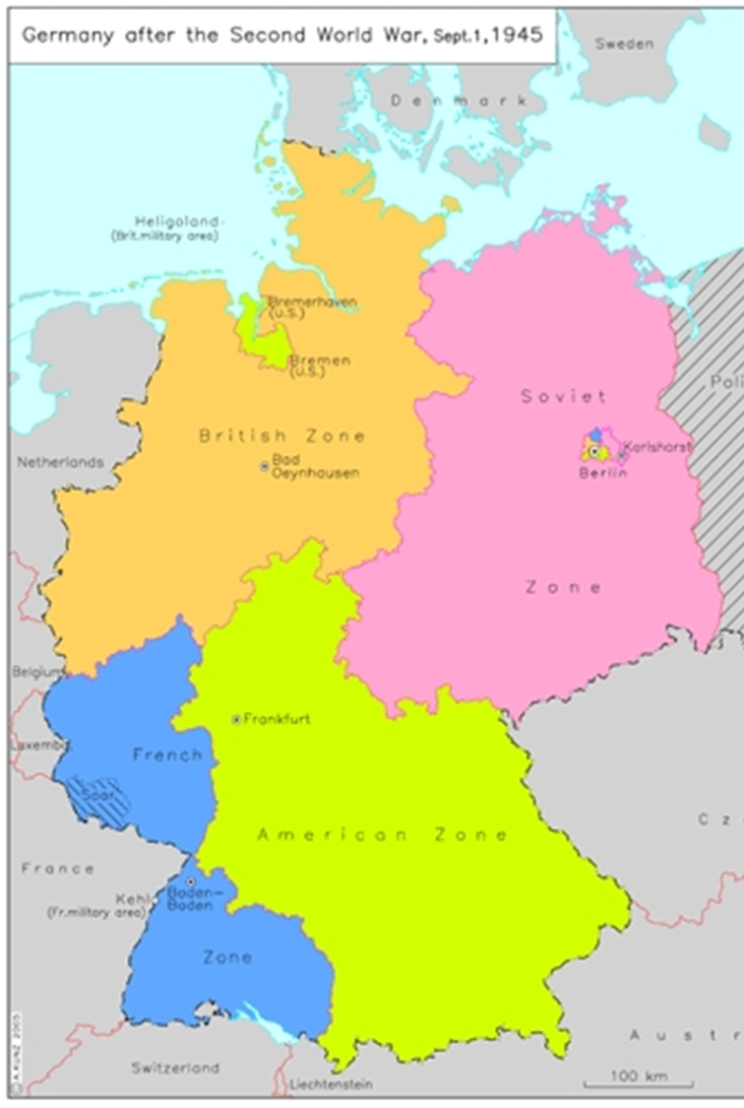
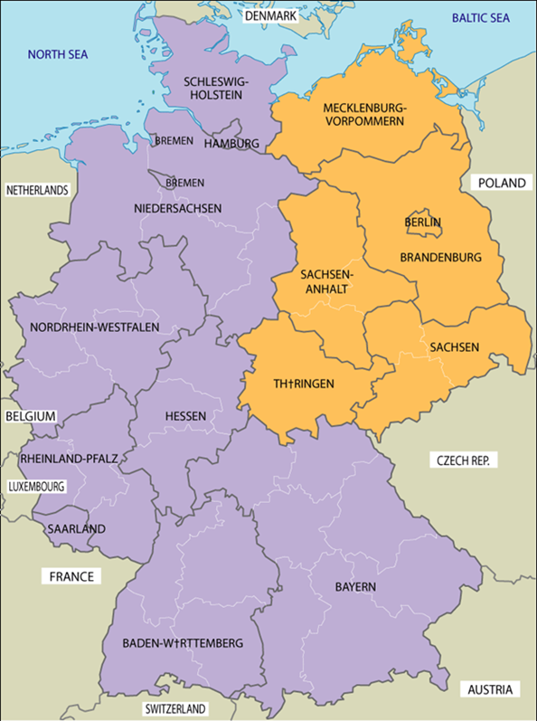
Why was Germany divided into 2 states by 1949?
4 occupation zones 1945-49
Berlin in Soviet zone (4 sectors)
Emerging differences in political & economic structures in Soviet zone compared to west b/c of attitude towards Germany & differing ideology (e.g. reparations)
Truman Doctrine 1946 & Marshall Plan 1947
Introduction of DM 1948
Berlin Blockade, 1948-49
FRG May 1949, GDR Oct 1949
Who was responsible: the west, the USSR, German politicians, or was division inevitable?

Slide 7
Why was Germany divided into 2 states by 1949?
Soviet Responsibility
The imposition of Communism & suppression of democracy (e.g. the SPD was forcibly merged with the KPD to form the SED in 1946) in the Soviet zone made the division of Germany inevitable.
The USSR withdrew from the Allied Control Commission in 1948 & broke off discussions on the introduction of a single currency for the whole of Germany.
The USSR planned to impose its own currency, the ostmark, on its zone & the whole of Berlin, West as well as East, in 1948 without consulting the Western powers.
The Communists boycotted the Berlin City Council election in 1948, knowing they would lose, & imposed their own candidate, Friedrich Ebert, as Mayor of East Berlin.
Stalin’s attempt in the Berlin Blockade 1948-9 to starve West Berlin into surrender made division inevitable.
In view of Stalin’s previous behaviour in Germany & Eastern Europe there was no reason to believe that his offer of a united democratic Germany in 1952 was sincere.
It was the Communists, not the West, who closed the border between East & West Germany in 1952 (Ulbricht did so on Stalin’s instructions) & between East & West Berlin in 1961.

Slide 8
Why was Germany divided into 2 states by 1949?
Western Responsibility
The Western powers introduced their own political & economic systems into West Germany, merging the US & British zones & introducing the Marshall Plan in 1947 (a programme of economic aid to capitalist countries which was clearly designed against Communism) without agreement from the USSR. This was in defiance of the agreements at Yalta & Potsdam.
At the Moscow Conference of the Council of Foreign Ministers in 1947 GB & the USA rejected Soviet proposals for a unified German state.
The Berlin Blockade was provoked by the introduction of the DM into West Germany & West Berlin without agreement; indeed 250 million DM were secretly smuggled into West Berlin. The introduction of the DM also provoked the Soviet withdrawal from the ACC.
The West’s determination to build up West Germany as an ally against Communism threatened the security of the USSR & made the division of Germany inevitable.
Stalin wanted a united neutral Germany but the West announced its decision to set up a separate West German state before the Berlin Blockade.
The FRG (West Germany) was set up before the GDR (East Germany), which was only set up in reaction to it.
Stalin proposed reunification in 1952 but this was rejected by the West.

Slide 9
Why was Germany divided into 2 states by 1949?
German Responsibility
German political leaders were quite prepared to work with the Allies who shared their political and economic objectives, at the expense of German unity
Ulbricht and the SED leadership could only really envisage a united Germany under a communist model.
In the western zones, the CDU leaders Adenauer and Erhard became increasingly committed to a partial German state which was capitalist and pro-Western (hence the rejection of the Stalin note in 1952)
General
The division was inevitable b/c of ideological differences, not just between the USSR & the West but also German politicians like Ulbricht & Adenauer.
It was caused by economic differences, some (Communism v capitalism) based on ideology, others based on national interest (the USSR wanted to keep Germany weak while the West wanted to revive her).

Slide 10
Revision & exam tips
Make it active not passive: note-taking, mind-maps, plans to past exam questions.
It’s worth revising exam technique too, especially the difference in approach between the essay questions and the interpretation questions.
Read the question carefully. Check the date boundary given. Ensure you know exactly what is being asked: do you need to reach a judgement about the extent of change/success? Do you need to look at reasons for something happening?
If it’s an interpretation question, ensure you read the full interpretation carefully and understand it before you start writing.
Always plan your answer and know what your conclusion is before you start writing it.
Always save enough time for a conclusion.
Remember to PEEL your paragraphs and reach judgements.

