Slide 1
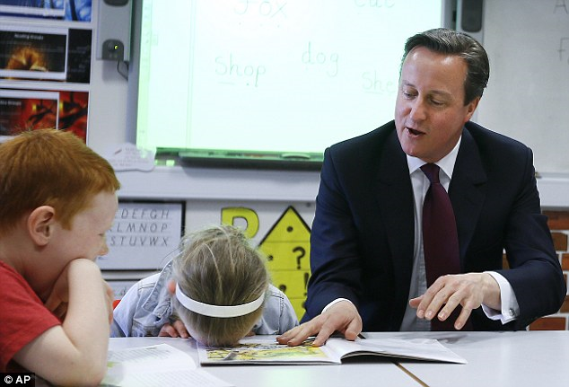
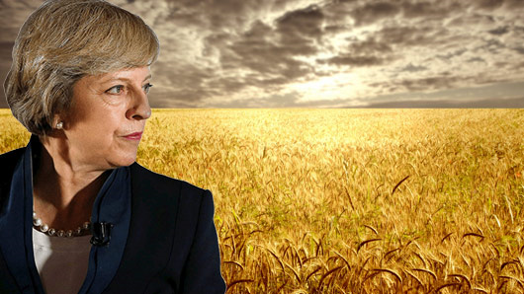
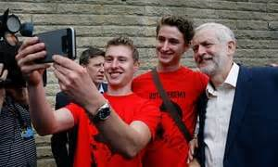
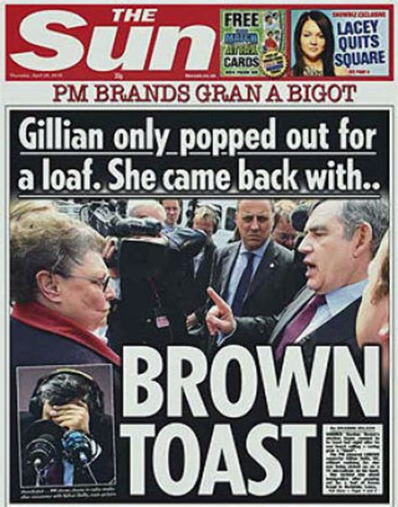
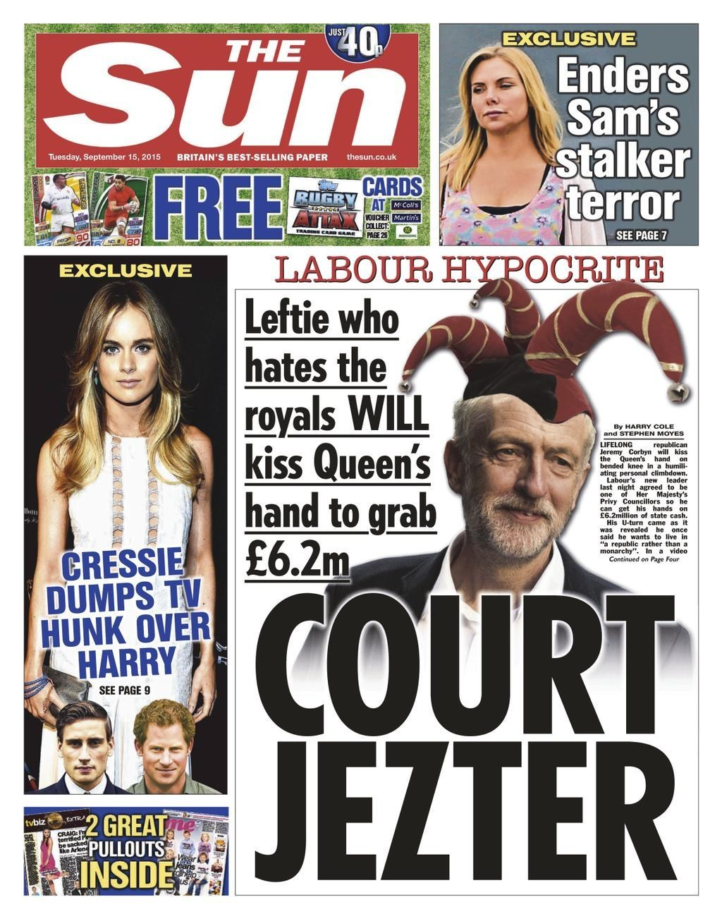
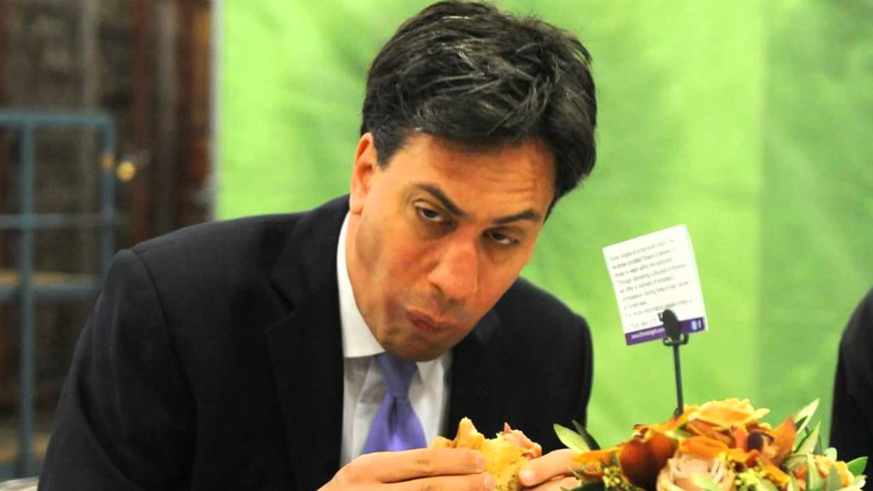
Voter Behaviour and the media- REVISION

Slide 2
Key terms
Abstention | Core voters | Deviant voting
Class & partisan dealignment | Valence issues | Governing competency
Expressive/Altruistic voting | Swing voters | Grey vote
Disillusion and apathy | Manifesto | Mandate
Economic voting | Swing/floating voter | Instrumental voting
Political opinion poll | Rational choice model | Salience
Social class | Tactical voting | Turnout

Slide 3
What factors can influence voter behaviour?
Try to jot down as many as you can on the handout provided…. You’ve got 1 minute!

Slide 4
What factors can influence voter behaviour?
Demographic factors (Class, age, gender, ethnicity, region)
Party Leaders
Valence issues
Events
Media (+opinion polls)

Slide 5
The four Types of voter
Deviant voters: Voters who do not vote the way we would expect based on their social characteristics, especially when it comes to class. Examples are working class supporters of the Conservative party or middle class/upper class voters opting for the Labour party. In the past many ‘Deviant’ Conservative voters were thought to be doing so out of ‘deference’ – i.e. working class voter deferring their support to those whom they considered to be their superiors. This is no longer the case, it is more due to other factors such as the economy or immigration. Floating (or swing) voters: A voter who tends to vote unpredictably in different elections and is liable to change the party which they vote for often. These may be voters who feel no particular ideological allegiance to any one party. An example would be someone who voted Conservative in 2015 and then Labour in 2017. More likely to vote Expressively or instrumentally. Tactical Voters: A voter who feels that their first-choice vote will be wasted because it is for a party that has no chance of winning the constituency, may choose to vote for their second choice. By doing this they may still have an influence on the outcome. Typically, supporters of the Lib Dems or Greens vote either Labour or Conservative to try to keep their least favourite party from winning. This is tactical voting. Voters who went for the Tories to avoid a Lab-SNP coalition in 2015, or people who voted for Louise Irvine in 2017 - NHA Core voters: Parties are often said to be pursuing a ‘core vote strategy’ at election time, i.e. appealing to a fixed base of support, often defined by socio-economic, regional or class identification. This would be defined as working class support for the Labour Party traditionally being seen as Labour’s core support. It can be more complicated than this, as different party leaders can shift the core support, i.e. Thatcher, although a Conservative won some core working class supporters due to some of her key policies, such as selling off council houses. The core vote for the Conservatives and Labour has arguably been eroded over the years, linked potentially to Partisan Dealignment.

Slide 6
The influence of valence issues on voting behaviour
Valence includes the image of the leader – but it’s also about how voters judge the parties on the most salient issues to them.
Valence issues can have a big effect on voting behaviour, especially when it comes to floating or swing voters who have no particular allegiance to party, who may be looking for a deciding factor on which way to vote. They might vote instrumentally or altruistically.
Valences issues can be defined as when most of the electorate hold similar views on an issue, they may decide to vote for one party or another based on how well they think the party and/or it’s leader will manage that particular issue, as well as on a judgement of how well the party managed it in the past. These are known as valence issues. This could be a particular issue such as national security, foreign policy or the economy. David Cameron played up to this, constantly referring to the Conservative government’s ‘long-term economic plan’ in 2015.
Valence can also refer to the general ‘image’ of a party and its leader, which may affect voting behaviour. Sometimes also called ‘competence voting.’ Theresa May entered into the 2017 general election arguing she could give the country ‘strong and stable leadership’’ but made several mistakes which made her seem indecisive, such as her U-turn on social care. Tony Blair created an image of youth and vitality in 1997, whilst Neil Kinnock was not as trusted by the electorate in 1992.
Governing competence is a key valence issue – voters often base their decision in voting on how competent they feel the outgoing government has been and the potential competence of the other parties. Gordon Brown had been attacked in the press in the run up to the 2010 election for his violent temper and poor relationship management with ministers and advisors.

Slide 7
What does ‘Demographics’ include?
Age
Class
Ethnicity
Region
Gender (probably not worth discussing in detail, however)

Slide 8
The influence of Class on Voting Behaviour
Traditionally in UK politics, class was the defining factor in how to determine how someone would vote, due to the strong class system within society. During the 1960, possible as many as 80% of people voted on class lines. Defined by AB Upper Middle Class) C1 (Middle class), C2 (skilled working class) and DE (working class).
The way one voted was part of their class identity and the parties established strong links in communities defined on class lines, i.e. working class communities in the East End of London.
However, in recent years, the UK has seen a progressive period of class dealignment. A trend in which progressively fewer people consider themselves to be a member of particular social class, and so class has a decreasing impact on their voting behaviour.
For example, in the past AB voters at the higher end of the social class classification would be more liable to vote Conservative, with 78% doing so in 1964.
In recent times this has declined dramatically, with only 40% of AB voters voting Conservative in 2010, with only small increases in 2015 and 2017.
This may be due to the advent of New Labour under Tony Blair, a more centrist middle-ground vision of Labour values, as well as the growth in strength of the centrist Liberal Democrats from the 1980s onwards.
However, class cannot be entirely written off as a factor influencing voting behaviour, as evidenced by continued working class support for the Labour party. Even centrist New Labour in 1997 received 59% of working class DE voter support, and in 2017 59% backed Corbyn.
Small Parties and Brexit – Class still matters – 64% of DE voters voted Leave in the referendum. 19% of DE voters voted UKIP in 2015 – this impacted Labour’s vote share in this category significantly.

Slide 9
The relationship between age and voting behaviour
The first aspect of the relationship is that the younger you are, the more likely you are to vote Labour. Winston Churchill once said “if a man is not a socialist by the time he is 20, he has no heart. If he is not a Conservative by the time he is 40, he has no brain.” These words still tend to reflect the pattern between age and voting behaviour today. At the 2017 general election, 18% of the 18-24 bracket voted Conservative compared to 67% for Labour. The older the voter, the less likely voting Labour becomes. In the 65+ age bracket, only 23% voted Labour in 2017. This suggests a strong link between age and voting behaviour.
The second key aspect of the relationship which is linked to the first is that the broadly Conservative-leaning 65+ age bracket shows high turnout figures in all elections, with 76% in 2010, 78% in 2015 and 71% in 2017. This is sometimes referred to as the grey vote, and is significant because it give a big advantage to the Conservatives who 59% of the 65+ bracket voted for in 2017, and UKIP (previously in 2015) who are most supported by the elderly. This suggests a strong link between age and voting behaviour.
The third key aspect of relationship can be seen in the fact that, statistically, the younger you are, the less likely you are to vote. Turnout amongst the 18-24 age bracket has been the lowest of any bracket in the previous three elections. In 2010, turnout in this bracket was at 44%, 2015 it was at 43% and 2017 it was at 54%. A likely cause is widespread apathy amongst young voters and a lack of political education. This is significant because it may make it difficult for more radical parties like the Greens to make an impact, and it may discriminate slightly against the labour Party.

Slide 10
Evaluate the view that the publication of opinion polls should be banned in the run up to elections (30)
Ban | Don’t Ban

Slide 11
Ban | Don’t Ban | Judgement?
Opinion polls may influence the way people vote based on nothing but popularity of a party amongst other voters. In an informed and advanced modern democracy, people should be making decisions based on the issues, not simply ‘band-wagoning’ on to a party which is doing well in the polls. | It would impinge the principle of freedom of expression. Banning something means restricting the public’s access to information and stifling debate. Shouldn’t the public have a right to see if a party is doing badly.
Opinion Polls have been proved wrong on countless occasions, and may mislead the public, making them change their vote based on inaccurate information. Some of the polls on 7 June 2017 (one day before the election) delivered Tory leads of seven points, 10 points, 12 points and 13 points. Turned out to be a 2-point lead! The last two polls before the Brexit referendum showed Britain remaining by 55% to 45% and 58% to 42%. This may have led to Remain voters staying at home and Brexit supporters making sure they voted. | Polls often get it close to exactly right, and polling is an evolving science, showing increasingly sophisticated and accurate results. Survation accurately predicted the result of the 2017 general election, calling a hung parliament, 2% lead for the Conservatives and they likely outcome of a deal with the DUP!

Slide 12
Ban | Don’t Ban | Judgement?
Arguably, Politicians should not be slaves to ever-changing public opinion as expressed in the polls. Politicians should campaign as conviction politicians, making policy as a result of detailed research and studies, not the whim of the les-informed, often emotive rather than rational, electorate. | Polls also help politicians gauge the most important issues for the public and form their policy positions on those issues. Lord Ashcroft's investment in individual 1,000-strong polls in marginal constituencies to help the Conservatives shape their message is another example of polls helping to shape a campaign (2015)
 | Polls can help smaller parties gain recognition in the UK’s two-party system dominated by Labour and the Conservatives. The Greens used polls showing them with strong support very effectively in their successful campaign to be included in the planned televised debates for the 2015 election.

Slide 13
Evaluate the extent to which the dominance of the two main parties in the UK political system is in decline (30)
In decline | Not in decline

Slide 14
Evaluate the extent to which the dominance of the two main parties in the UK political system is in decline (30)
Two-party dominance in decline | Not in Decline | Judgement (which side is stronger)
Partisan dealignment: There is a long-term trend of voters turning away from the two main parties. In 1974, 79% voted for the two main parties, whilst in 2010, just 67.6 per cent of all voters opted for Labour or the Tories. | 2017 General Election: The percentage of voters who supported either Labour or Conservative was 82.3%. Partisan Dealignment is (potentially temporarily) over. Theresa May might have failed to win a majority, but she got the Tories' highest share of the vote since 1983. Labour, meanwhile, did better under Jeremy Corbyn than it had done since 2001. It was the two parties' best combined performance since 1970.
Third party support has increased leading to multi-party politics in the UK. Growth in UKIP support (3.8 million votes in 2015 – 12.6% of the votes), Greens and LIB Dems in 2010s. SNP winning 56 seats in 2015. | There has been a collapse in third party support – support for UKIP and the Lib Dems have collapsed. While the Liberal Democrats won an extra three seats in 2017, their share of vote actually declined by 0.5 per cent. The SNP lost 21 seats and their vote share fell 13.1% from 2015. The Greens were down by 2.5% and, most calamitous of all, UKIP has shed nearly 3.3 of its 3.8 million 2015 election votes.

Slide 15
Two-party dominance in decline | Not in Decline | Judgement?
Voters see little difference between the Conservatives and Labour –they captured the middle ground (eg New Labour and Conservatives in 2000s under Blair and Cameron. Cameron called himself the ‘heir to Blair’ | The two main parties have clear ideological differences in 2017. They no longer operate in the centre ground. Corbyn and nuclear issue. Privatisation v nationalisation etc. (Look at your notes from Political Parties)
Neither of the two main parties won enough seats to form a majority government in 2010 and so a coalition between the Conservatives and Lib Dems occurred. Theresa May is now relying on the DUP to govern since 2017. | Young people have begun to vote in large numbers: turnout amongst 18-24 yr olds was 54%, up from 43% in 2015. This was bound to benefit the Labour party, as 69% of 18-24 year olds voted Labour in 2017

Slide 16
Evaluate the extent to which [insert factor] are the crucial factor in whether or not a political party is successful (30)
BE AWARE: At first glance this question looks like a question about political parties, but its actually asking you about reasons for success, i.e. at elections. Therefore, it’s about voting behaviour and comparing different factors on electoral success.
Can structure it as:
3 reasons why it’s party leaders vs. 3 other factors (media, valence, demographics)
If it’s a source question –

Slide 17
Structure if it’s a source – however, you have to link back to factor given in question in each point!
Introduction
Leader Important | Leader not Important (then mini judgement)
Media Important | Media not important (then mini judgement)
Valence issues Important | Valence issues not Important (then mini judgement)
Optional - Demographic Factors Important | Optional - Demographic Factors Important (then mini judgement)
Conclusion

