Slide 1
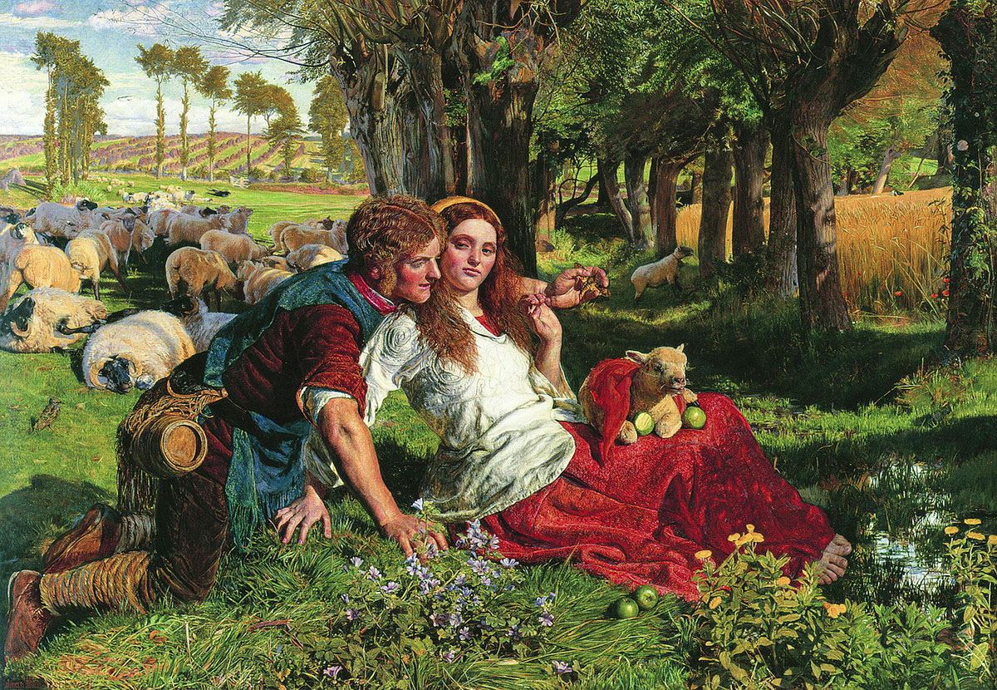
William Holman Hunt, The Hireling Shepherd, 1851, oil on canvas, 76 × 109 cm

Slide 2
Straying sheep
Cornfield
Death-head’s moth
Dead sheep
Poppies
Beer keg
Lamb
Hireling (hired) shepherd
Shepherdess
Apples

Slide 3
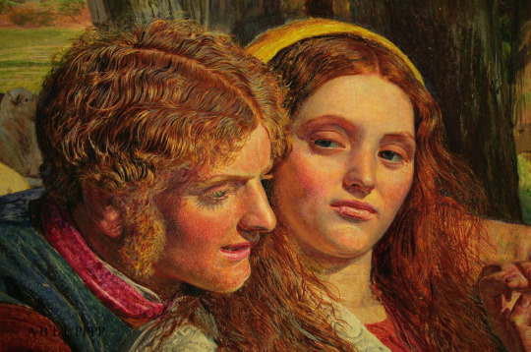
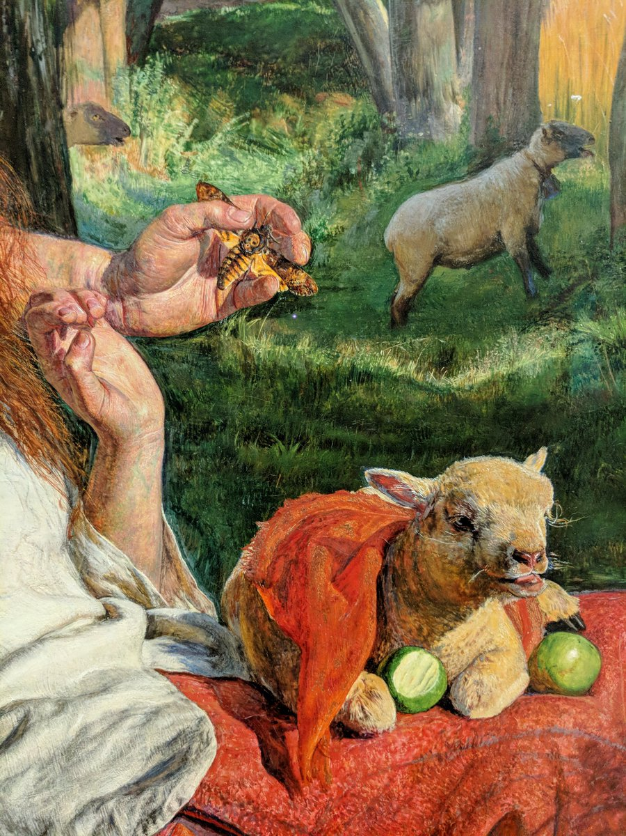
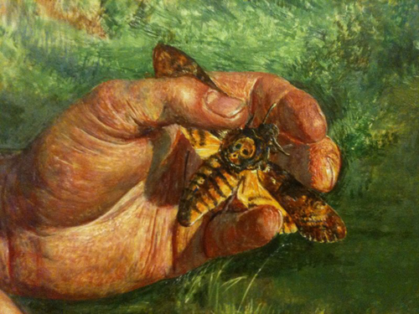

Slide 4
King Lear, Act 3, Scene 6:
Sleepest or wakest thou, jolly shepherd?
Thy sheep be in the corn;
And for one blast of thy minikin mouth,
Thy sheep shall take no harm.
When exhibited at the time, the above quote was included alongside the painting.

Slide 5
John 10:11: I am the good shepherd. The good shepherd lays down his life for the sheep. The hired hand is not the shepherd and does not own the sheep. So when he sees the wolf coming, he abandons the sheep and runs away. Then the wolf attacks the flock and scatters it.

Slide 6
Painted in Ewell, Surrey at the same time that Millais worked on his painting Ophelia. Hunt
exhibited the work at the 1852 Royal Academy Summer Exhibition. He received negative criticism, in particular for his portrayal of the figures which were described by one critic as rustics of the coarsest breed
What makes this painting Pre-Raphaelite?

