Slide 1
Biology Support Pack
EXAMPLE:
We will use this question in order to model how this resource can be used to access the key concepts of the Biology course, but also to highlight the dangers of giving surface level responses without the required depth and research
This pack is designed to support independent learning and consolidation over the summer holidays. It consists of a series of open questions, and together these will cover the entire course. By completing this pack you will ensure that you have a basic knowledge of every topic in the lower sixth course. This is a substantial piece of work and should take at least 20 hours.
The open questions within this pack are simply a guide and starting point for the necessary independent learning that goes with each topic. It is really important that you use them as prompts to direct your research and reading, and that you take time to look through your notes, the powerpoints available and any textbooks you have for each and every one of the questions contained within.
See the example opposite for an idea of how to get the best out of this resource. Your success in the upper sixth may depend on it.
Globular proteins | Fibrous proteins
Folded 3D shape Can have active site Tertiary structure | Strong Long structure (fibres) Many chains
Short, single statement answers. No evidence of reading. This answer is not much use in preparing for an A level exam question
This answer shows evidence of thought and research. The student has selected all of the A level specific concepts relevant, clearly by doing some background reading, and they have summarised them in a clear way. This student is now ready to face an A level question on this topic.
Globular proteins | Fibrous proteins
Tertiary structure (further folding of alpha helixes and beta pleats). Created specific 3D shape Huge variety because a change of 1 amino acid in the primary structure can alter the entire shape – can have many different roles. Binding site – active site in enzyme, receptors for hormones etc have specificity Can be soluble – conduct metabolic reactions in cytoplasm Can be membrane bound (receptors) | Long parallel chains, Unbranched chains in primary structure, secondary is tightly wound helixes, Lots of glycine allows close packing of multiple chains, further coiling in tertiary structure. Chains are joined together with disulphide bonds – giving strength (quarternary structure). No variability in structure, but forms long insoluble and strong fibres (bit like a rope). Structural function e.g. tendons.

Slide 2
AS Level Paper 1 and 2. A2 Level Paper 1 and 3 - Topics 1-4
Section 3.1: Biological Molecules
3.1.1 Monomers and Polymers
3.1.2 Carbohydrates
3.1.3 Lipids
3.1.4.1 Proteins
3.1.4.2 Enzymes
3.1.5.1 Nucleic acid structure
3.1.5.2 DNA Replication
3.1.6 ATP
3.1.7 Water
3.1.8 Inorganic Ions
Section 3.3 Organisms exchange substances with their environment
3.3.1 Surface area to volume ratio
3.3.2 Gas exchange
3.3.3 Digestion and absorption
3.3.4.1 Mass transport in animals
3.3.4.2 Mass transport in plants
Section 3.4 Genetic information, variation and relationships between organisms
3.4.1 DNA, genes and chromosomes
3.4.2 DNA and protein synthesis
3.4.3 Genetic diversity - mutations and meiosis
3.4.4 Genetic diversity and adaptation – natural selection
3.4.5 Species and taxonomy
3.4.6 Biodiversity
3.4.7 Investigating biodiversity
Section 3.2: Cells
3.2.1.1 Eukaryotic cells
3.2.1.2 Prokaryotic cells and viruses
3.2.1.3 Studying cells
3.2.2 Mitosis
3.2.3 Transport across cell membranes
3.2.4 Cell recognition and the immune system

Slide 3
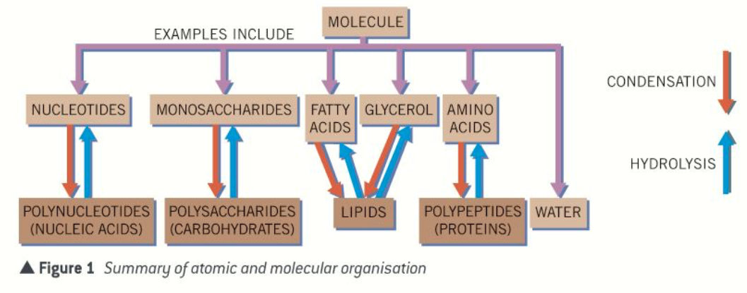
Topic 1: Biological Molecules - 3.1.1 Monomers and Polymers
What are the properties of carbon that make it so important in living organisms?
Can you give some examples of monomers?
Can you describe what a condensation reaction is?
Describe/explain the difference between a monomer and a polymer:
Can you give some examples of polymers?
Can you describe what a hydrolysis reaction is?

Slide 4
Topic 1: Biological Molecules - 3.1.2 Carbohydrates – monosaccharides and disaccharides
Can you describe how larger carbohydrates are made from monosaccharide monomers?
Can you list some common monosaccharides?
What are maltose, sucrose and lactose formed from?
Below outline the chemical tests for: Starch, reducing sugars and non-reducing sugars. Include details of any colour changes that occur
Can you describe how glucose has two isomers and draw the two different isomers?
Draw a diagram to show how a condensation reaction occurs between two monosaccharides to form maltose. Label the bond that forms.

Slide 5
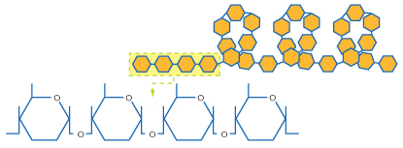
Topic 1: Biological Molecules - 3.1.2 Carbohydrates – polysaccharides
Can you describe how polysaccharides are formed?
Can you describe the relationship of structure to function of cellulose?
Can you explain how glycogen and starch are formed? Label the diagram.
Both glycogen and starch are large, branched and insoluble molecules. Explain why, linking to their function.
Can you explain how cellulose is formed? Label the diagram.

Slide 6
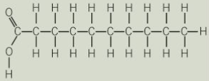
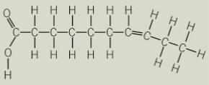
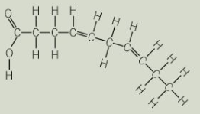
Topic 1: Biological Molecules - 3.1.3 Lipids
What are lipids?
Can you explain how triglycerides are formed? Draw a diagram to show this happening. Label the molecules involved, the type of reaction and the types of bonds formed.
Can you explain how the structure of triglycerides relates to their properties?
What are their roles?
Can you explain that the R-group of a fatty acid may be saturated or unsaturated? What do these terms mean?
Can you explain how phospholipids are formed? Draw a diagram to show this happening. Label the molecules involved and name the type of reaction. Label the hydrophilic and hydrophobic part of the molecule and explain what those terms mean.
Can you explain how the structure of phospholipids relates to their properties?
Can you describe how you would test for lipids?

Slide 7
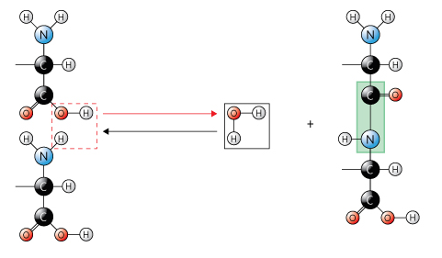
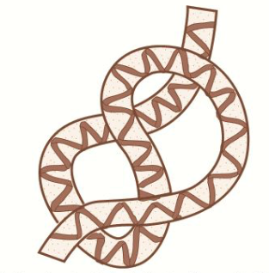
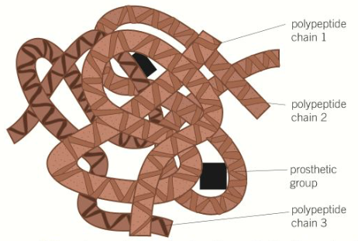
Topic 1: Biological Molecules - 3.1.4.1 Proteins
What is the general structure of an amino acid?
How does a polypeptide form?
Can you explain that a functional protein may contain one or more polypeptides?
How many different types of amino acid are there? How are they different?
Can you describe the relationship between primary, secondary, tertiary and quaternary structure, and protein function?
How do two amino acids form a dipeptide?

Slide 8
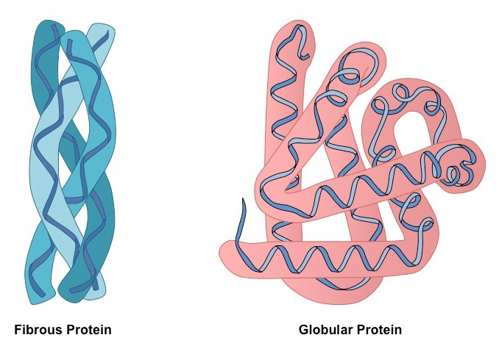
Topic 1: Biological Molecules - 3.1.4.1 Proteins
Explain the roles of proteins in living things:
Can you describe the role of hydrogen bonds, ionic bonds and disulfide bridges in the structure of proteins?
Link the structure of proteins to their functions. Do this for both globular and fibrous proteins.
Can you describe how you would test for proteins?

Slide 9
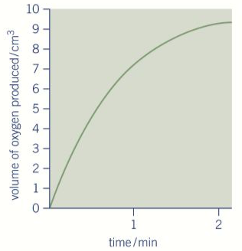
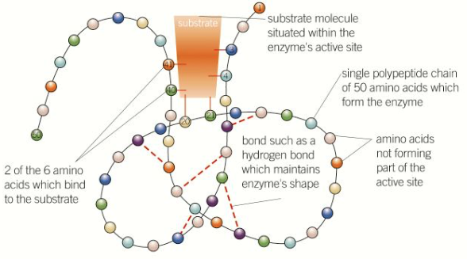
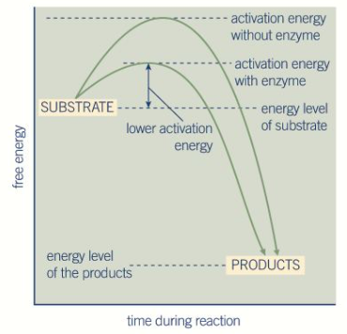
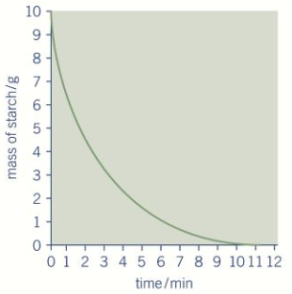
Topic 1: Biological Molecules - 3.1.4.2 Enzymes
Can you explain how each enzyme lowers the activation energy of the reaction it catalyses?
How does an enzyme’s structure relate to it’s function?
Describe how you could measure the rate of an enzyme-catalysed reaction and explain the results you would expect?
Can you draw a diagram to describe the induced-fit model of enzyme action ?

Slide 10
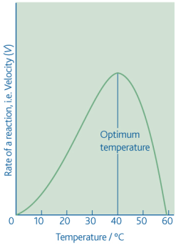
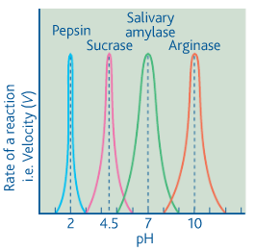
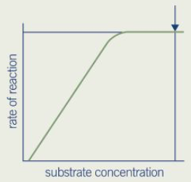
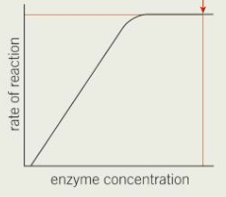
Topic 1: Biological Molecules - 3.1.4.2 Enzymes
How does the temperature affect the rate of an enzyme-controlled reaction?
How does the pH affect the rate of an enzyme-controlled reaction?
How does the substrate concentration affect the rate of an enzyme-controlled reaction?
How does the enzyme concentration affect the rate of an enzyme-controlled reaction?

Slide 11
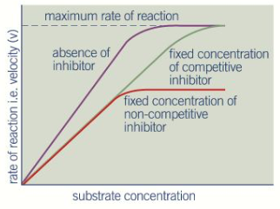
Topic 1: Biological Molecules - 3.1.4.2 Enzymes
Explain how a competitive inhibitor affects enzyme function (relate to the graph)
Explain how a non-competitive inhibitor affects enzyme function (relate to the graph)

Slide 12
Topic 1: Biological Molecules - 3.1.5.1 Nucleic acid structure
What are DNA and RNA and what are their functions?
Explain the complementary base pairing rules:
How is the structure of DNA related to its function?
What is the structure of a nucleotide? Draw and label a nucleotide.
What is a phosphodiester bond and how is it formed?
Can you compare and contrast the components of a DNA and RNA nucleotide:
Can you compare and contrast the structure of DNA and RNA molecules?
What is Chargaff’s rule and what does it tell us about the proportions of the different bases in DNA?

Slide 13
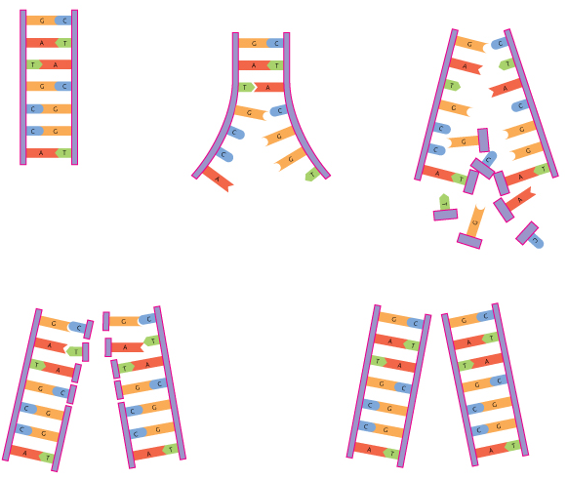
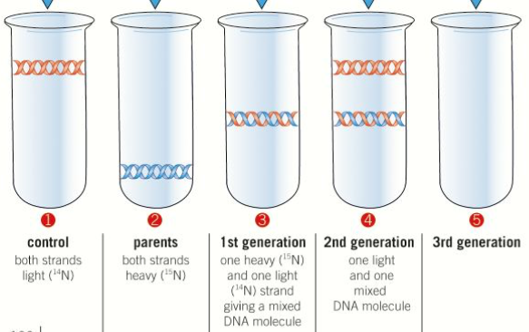
Topic 1: Biological Molecules - 3.1.5.2 DNA Replication
Can you describe the semi-conservative method of DNA replication?
Explain how this experiment proves that DNA replication is semi conservative

Slide 14
Topic 1: Biological Molecules - 3.1.6 ATP
Can you describe how a single molecule of adenosine triphosphate (ATP) is a nucleotide derivative?
Can you explain how ATP is converted to ADP? Include the type of reaction that it is and the enzyme that catalyses it.
Can you explain how ATP is resynthesised from ADP? Include the type of reaction that it is and the enzyme that catalyses it.
What three ways is ATP resynthesised?
Draw a labelled molecule of ATP:
Why is ATP suitable for its function?
What are the roles of ATP?

Slide 15
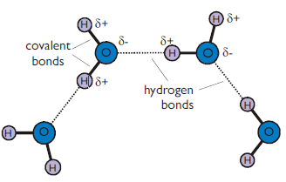
Topic 1: Biological Molecules - 3.1.7 Water and 3.1.8 Inorganic Ions
Draw a water molecule and explain what is meant by dipolar:
Explain how water hydrogen bonds:
Inorganic ions occur in solution in the cytoplasm and body fluids of organisms. Each ion has a specific role, depending on its properties.
Can you recognise the role of the following ions:
hydrogen ions and pH
iron ions as a component of haemoglobin
sodium ions in the co-transport of glucose and amino acids
phosphate ions as components of DNA and of ATP
What are the properties that are important in water? How are these properties linked the the polar nature of the molecule? What is the significance of these properties to living organisms and processes?
Try to use the following terms in your answer: solvent, specific heat capacity, latent heat of vaporisation, cohesion, metabolite, density, transparent.

