Slide 1
AS Level Paper 1 and 2. A2 Level Paper 1 and 3 - Topics 1-4
Section 3.1: Biological Molecules
3.1.1 Monomers and Polymers
3.1.2 Carbohydrates
3.1.3 Lipids
3.1.4.1 Proteins
3.1.4.2 Enzymes
3.1.5.1 Nucleic acid structure
3.1.5.2 DNA Replication
3.1.6 ATP
3.1.7 Water
3.1.8 Inorganic Ions
Section 3.3 Organisms exchange substances with their environment
3.3.1 Surface area to volume ratio
3.3.2 Gas exchange
3.3.3 Digestion and absorption
3.3.4.1 Mass transport in animals
3.3.4.2 Mass transport in plants
Section 3.4 Genetic information, variation and relationships between organisms
3.4.1 DNA, genes and chromosomes
3.4.2 DNA and protein synthesis
3.4.3 Genetic diversity - mutations and meiosis
3.4.4 Genetic diversity and adaptation – natural selection
3.4.5 Species and taxonomy
3.4.6 Biodiversity
3.4.7 Investigating biodiversity
Section 3.2: Cells
3.2.1.1 Eukaryotic cells
3.2.1.2 Prokaryotic cells and viruses
3.2.1.3 Studying cells
3.2.2 All cells arise from other cells
3.2.3 Transport across cell membranes
3.2.4 Cell recognition and the immune system

Slide 2
Topic 3: 3.3.1 Surface area to volume ratio
Can you describe the relationship between the size of an organism or structure and its surface area to volume ratio?
What is Fick’s law?
What are features of specialised exchange surfaces?
What things need to be transferred between an organism and its environment?
How is surface area to volume ratio calculated?
Compare the SA:Vol ratio of a 1cm³ and 6cm³ cube.
What is the relationship between surface area to volume ratio and metabolic rate?

Slide 3
Topic 3: 3.3.2 Gas exchange in single celled organisms & insects
How do single celled organisms exchange substances?
Describe the pathway of an oxygen molecule into a respiring cell in an insect’s body (use a diagram if necessary)
How do insects reduce water loss?
Explain how both abdominal pumping and fluid in the tracheoles can be used to control the rate of gas exchange in insects.

Slide 4
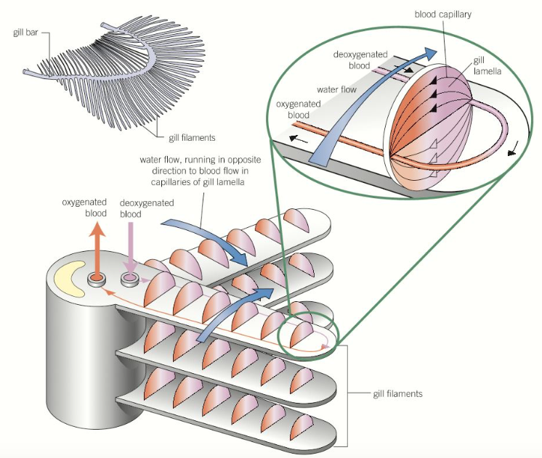
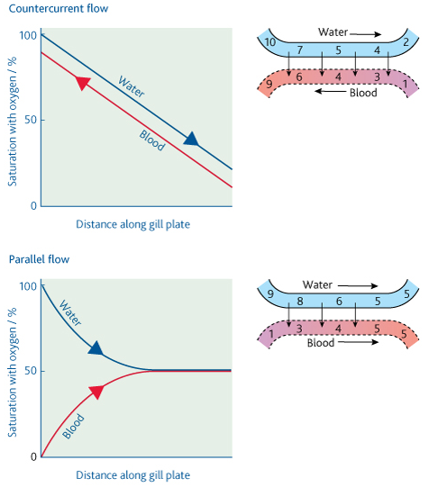
Topic 3: 3.3.2 Gas exchange in fish
How are fish adapted for efficient gas exchange?
Explain countercurrent flow and parallel flow:

Slide 5
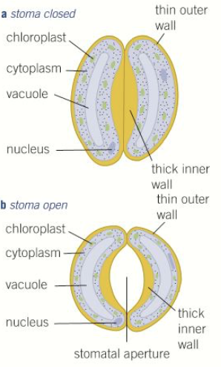
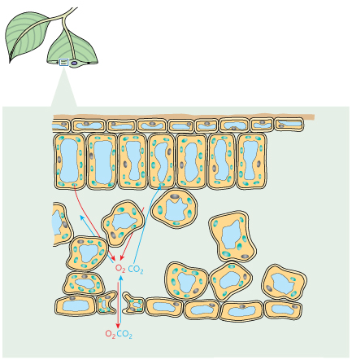
Topic 3: 3.3.2 Gas exchange in plants
How are plants adapted for efficient gas exchange?
Describe how the stomata open and close and explain why this happens:
What adaptations do xerophytic plants have to try and limit water loss?

Slide 6
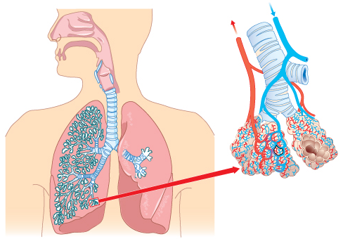
Topic 3: 3.3.2 Gas exchange in lungs
Can you label the structures of the human gas exchange system and give functions of the main parts?

Slide 7
Topic 3: 3.3.2 Gas exchange in lungs
Can you describe what happens during ventilation?
What is ventilation?
How do you calculate pulmonary ventilation rate?

Slide 8
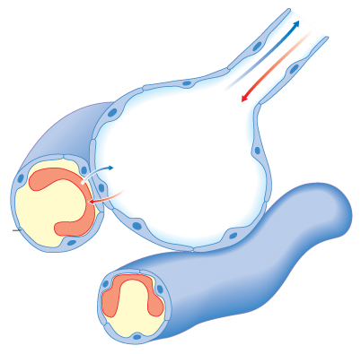
Topic 3: 3.3.2 Gas exchange in lungs
How are the alveoli adapted for efficient gas exchange?
For each of the listed diseases explain how they affect the rate of gas exchange (link back to Fick’s law):
Pulmonary Fibrosis
Emphysema
Asthma

Slide 9
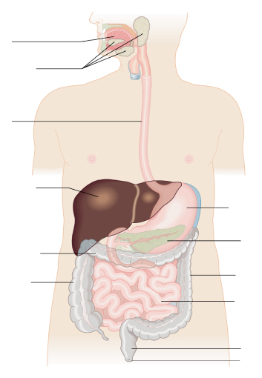
Topic 3: 3.3.3 Digestion and absorption
Can you describe the structure and function of the major parts of the digestive system?
What are physical and chemical digestion and where do they take place?

Slide 10
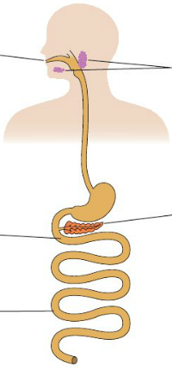
Topic 3: 3.3.3 Digestion and absorption
Describe the different stages of starch digestion, and explain how this large insoluble molecule ends up as individual glucose monomers
Can you describe digestion of lipids by lipase, including the action of bile salts in mammals?
Can you describe digestion of proteins by endopeptidases, exopeptidases and membrane-bound dipeptidases in mammals?

Slide 11
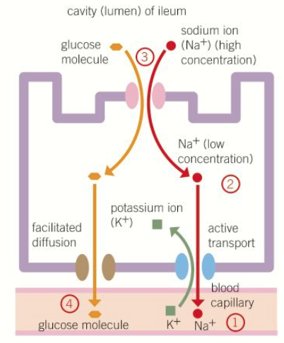
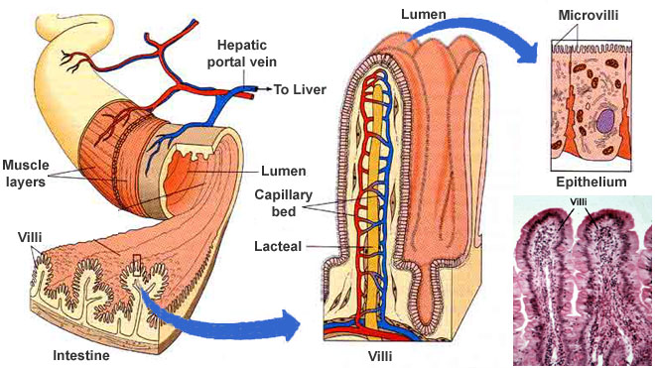
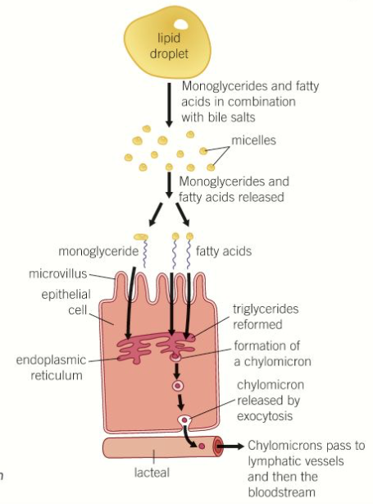
Topic 3: 3.3.3 Digestion and absorption
Can you describe the structure of the ileum and explain how it is adapted for the function of absorption?
Can you explain how co-transport allows the absorption of amino acids and monosaccharides?
Can you explain how triglycerides are absorbed?

Slide 12
Topic 3: 3.3.4.1 Mass transport in animals: Haemoglobin
What is the function of haemoglobin?
What are the differences between haemoglobins in difference organisms and what are the reasons for these differences?
What is the structure of haemoglobin?
Primary structure
Secondary structure:
Tertiary structure:
Quaternary structure:
What is meant by the loading and unloading of oxygen?

Slide 13
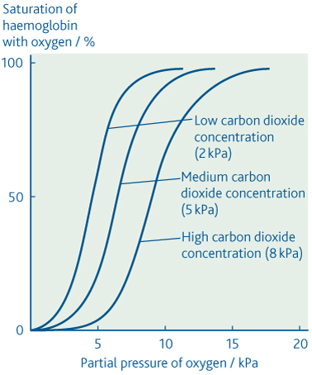
Topic 3: 3.3.4.1 Mass transport in animals: Haemoglobin
What are the main features of an oxygen dissociation curve?
Can you explain the Bohr effect using the graph to help?
What does a shift to the left mean?
What does a shift to the right mean?

Slide 14
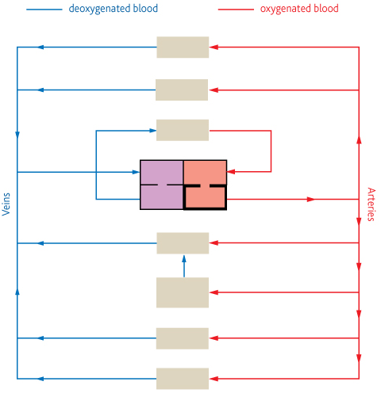
Topic 3: 3.3.4.1 Mass transport in animals: Circulatory system in a mammal
Why do organisms need a transport system?
Can you describe the general pattern of blood circulation in a mammal and label the following diagram of a mammalian circulatory system?
What are the features of this transport system?

Slide 15
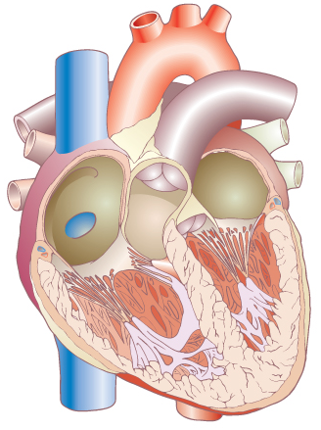
Topic 3: 3.3.4.1 Mass transport in animals: Heart structure
Can you label the structure of the heart?
Can you explain the double pump system?
How does the structure of the heart relate to its function?
How do we supply the heart muscle with oxygen?
What are risk factors associated with cardiovascular disease?

Slide 16
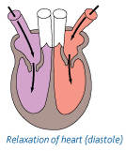
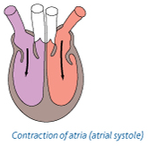
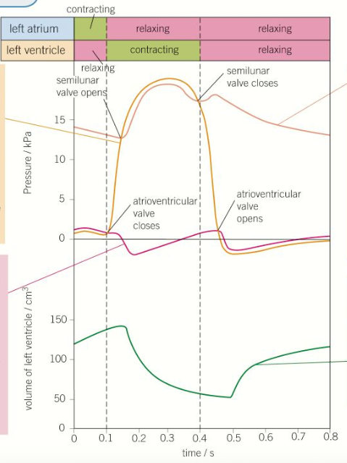
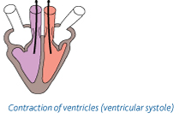
Topic 3: 3.3.4.1 Mass transport in animals: Cardiac Cycle
Can you explain the stages in the cardiac cycle and what happens at each stage:
Can you explain, using diagrams, how valves control the flow of blood?
How do you calculate cardiac output?
Can you describe the pressure and volume changes and associated valve movements during the cardiac cycle that maintain a unidirectional flow of blood?

Slide 17
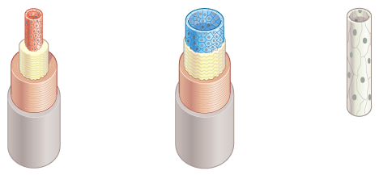
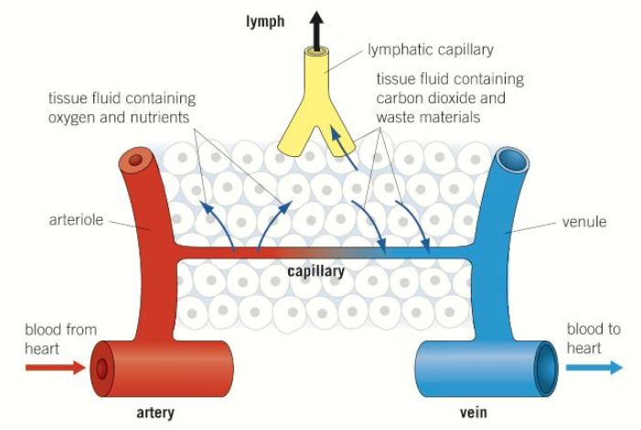
Topic 3: 3.3.4.1 Mass transport in animals: Blood vessels
Can you label the blood vessels and their structures. stating the function of the structure and how this relates to the function of the blood vessel?
How is the arteriole structure related to its function?
Can you describe the formation of tissue fluid and its return to the circulatory system?

Slide 18
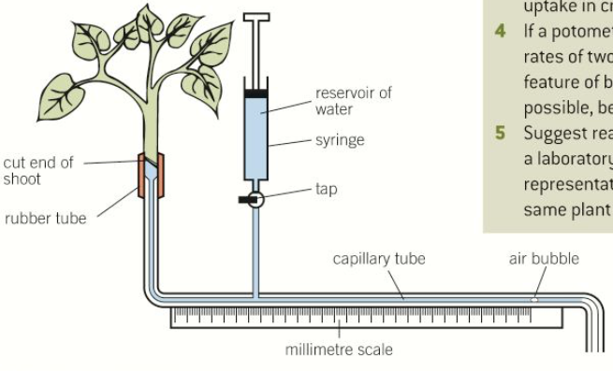
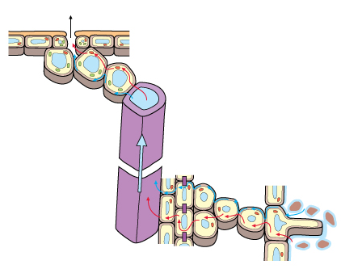
Topic 3: 3.3.4.2 Mass transport in plants: Xylem
What is transpiration?
What is the evidence for the cohesion-tension theory?
How would you use a potometer to measure water uptake?
How does water move through the leaf?
How does water move up the xylem?
What is the cohesion-tension theory?
How are root hair cells adapted for its function?
How are xylem vessels adapted for their function?

Slide 19
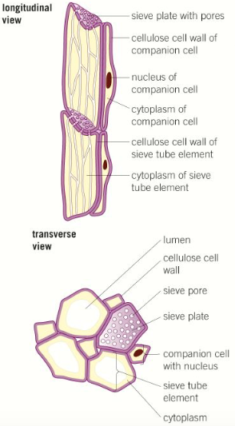
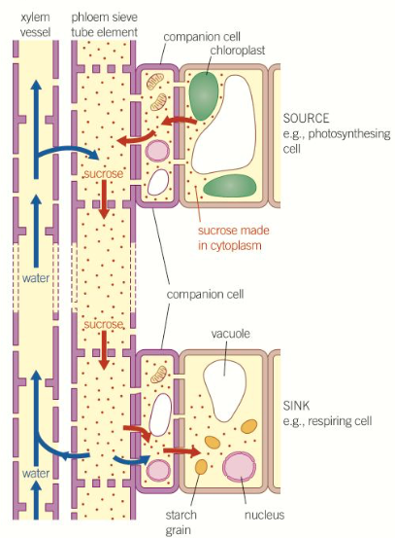
Topic 3: 3.3.4.2 Mass transport in plants: Phloem
What is the job of the phloem?
Can you explain the use of tracers and ringing experiments to investigate transport in plants?
Can you explain the mass flow hypothesis for the mechanism of translocation in plants?
Transfer of sucrose into sieve elements from photosynthesising tissue
Mass flow of sucrose through sieve tube elements
Transfer of sucrose from the sieve tube elements into storage or other sink cells

