Slide 1
AS Level Paper 1 and 2. A2 Level Paper 1 and 3 - Topics 1-4
Section 3.1: Biological Molecules
3.1.1 Monomers and Polymers
3.1.2 Carbohydrates
3.1.3 Lipids
3.1.4.1 Proteins
3.1.4.2 Enzymes
3.1.5.1 Nucleic acid structure
3.1.5.2 DNA Replication
3.1.6 ATP
3.1.7 Water
3.1.8 Inorganic Ions
Section 3.3 Organisms exchange substances with their environment
3.3.1 Surface area to volume ratio
3.3.2 Gas exchange
3.3.3 Digestion and absorption
3.3.4.1 Mass transport in animals
3.3.4.2 Mass transport in plants
Section 3.4 Genetic information, variation and relationships between organisms
3.4.1 DNA, genes and chromosomes
3.4.2 DNA and protein synthesis
3.4.3 Genetic diversity - mutations and meiosis
3.4.4 Genetic diversity and adaptation – natural selection
3.4.5 Species and taxonomy
3.4.6 Biodiversity
3.4.7 Investigating biodiversity
Section 3.2: Cells
3.2.1.1 Eukaryotic cells
3.2.1.2 Prokaryotic cells and viruses
3.2.1.3 Studying cells
3.2.2 All cells arise from other cells
3.2.3 Transport across cell membranes
3.2.4 Cell recognition and the immune system

Slide 2
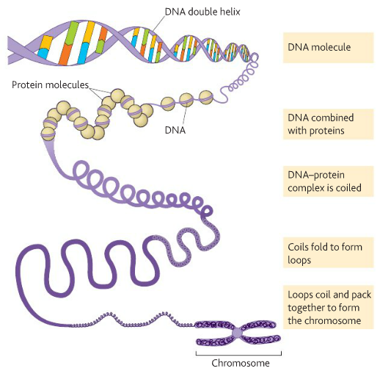
Topic 4: 3.4.1 DNA, genes and chromosomes
What is a gene?
What is an allele?
Can you distinguish between the DNA in prokaryotic cells and the DNA in eukaryotic cells?
Mitochondria and chloroplasts also contain DNA. Suggest what this tells us about their origin:
What is the genetic code?
Can you describe how a DNA molecule and its associated proteins form a chromosome?
What are the features of the genetic code?
Can you explain what is meant by homologous chromosomes?

Slide 3
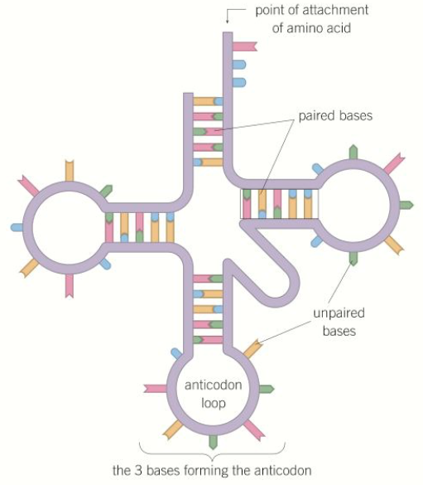
Topic 4: 3.4.2 DNA and protein synthesis
What is meant by the terms genome and proteome?
How does the structure of RNA differ from DNA?
Where would you find ribosomal RNA (rRNA)?
Can you describe the structure and function of messenger RNA (mRNA)?
Can you describe the structure and function of transfer RNA (tRNA)?

Slide 4
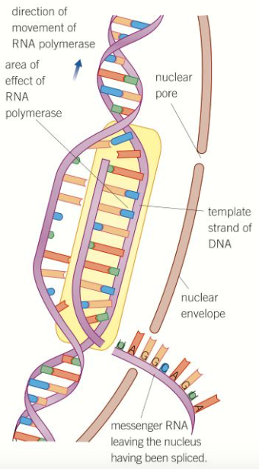
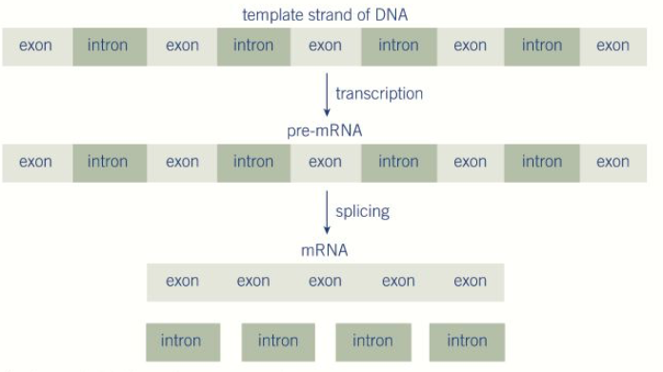
Topic 4: 3.4.2 DNA and protein synthesis
Can you explain what happens during transcription?
Can you explain what happens during splicing?
Remember this does not occur in prokaryotes!

Slide 5
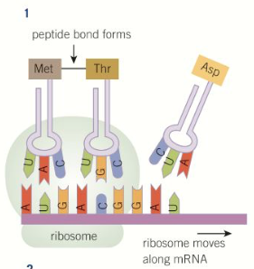
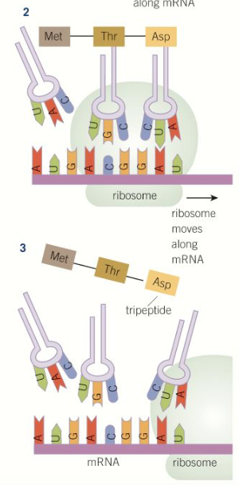
Topic 4: 3.4.2 DNA and protein synthesis
Can you explain what happens during translation?
What happens to a polypeptide after it has been translated at the ribosome? Think about the organelles it may travel to and how it may be modified.

Slide 6
Topic 4: 3.4.3 Genetic diversity - mutations
What is a gene mutation?
What is a substitution mutation and what could the possible effects be?
How and when do gene mutations arise?
Can you describe the effect of mutagenic agents?
Why is an insertion/deletion potentially a more serious mutation than a substitution?
What is a chromosome mutation?

Slide 7
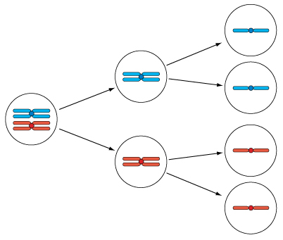
Topic 4: 3.4.3 Genetic diversity – meiosis
Why is meiosis necessary? What types of cells does meiosis result in?
How does meiosis create genetic variation?
Can you describe the process of meiosis?
How would you calculate the possible chromosome combinations following meiosis? And the number of possible chromosome combinations produced from the fertilisation of two gametes?
Can you explain the different outcome of mitosis and meiosis?

Slide 8
Topic 4: 3.4.4 Genetic diversity and adaptation – natural selection
What is genetic diversity?
Suggest how rats resistant to the poison warfarin have evolved in some cities.
What factors influence genetic diversity?
What is the founder effect?

Slide 9
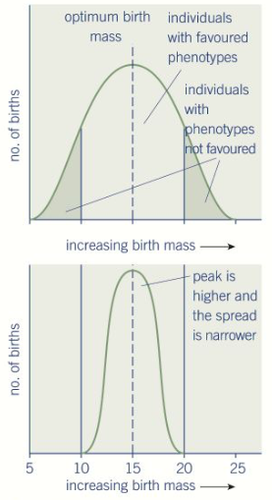
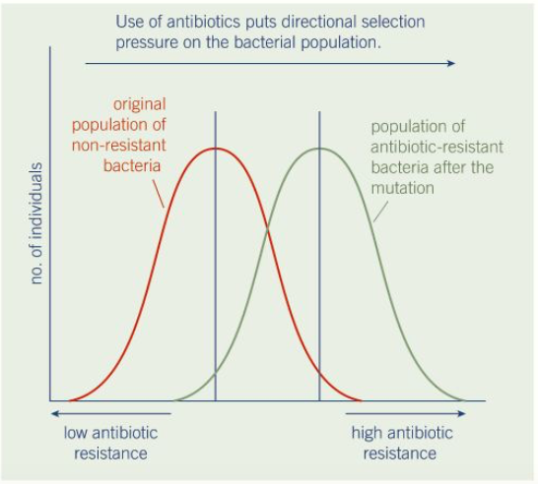
Topic 4: 3.4.4 Genetic diversity and adaptation – types of selection
Cab you describe directional selection, exemplified by antibiotic resistance in bacteria?
Can you describe stabilising selection, exemplified by human birth weights?

Slide 10
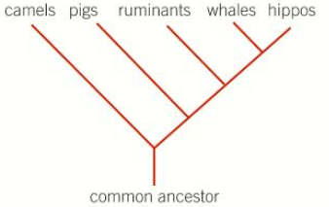
Topic 4: 3.4.5 Species and taxonomy
What is a species?
What is a hierarchy?
Can you explain how we organise the groups of species?
D
K
P
C
O
F
G
S
How are species named?
What are the principles of classification?
Artificial vs Phylogenetic classification:
What is phylogeny?

Slide 11
Topic 4: 3.4.5 Species and taxonomy
What are some difficulties of defining a species?
What is the role of courtship in ensuring successful mating?
How does courtship help members of a species recognise each other?

Slide 12
Topic 4: 3.4.6 Biodiversity
What is meant by biodiversity?
What is meant by species diversity?
What is meant by genetic diversity?
What is meant by ecosystem diversity?
Can you describe the impact of agriculture on species diversity?
What is a diversity index and how is it used as a measure of species diversity?
Suggest some examples of good farming practice and describe how they maintain diversity

Slide 13
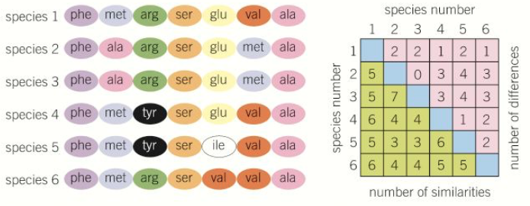
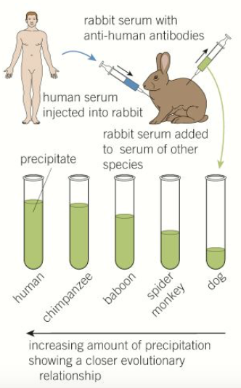
Topic 4: 3.4.7 Investigating biodiversity
How can you identify genetic diversity within, or between species by using the frequency of measurable or observable characteristics?
How can you identify genetic diversity within, or between species by using the amino acid sequence of the proteins encoded by DNA and mRNA?
How can you identify genetic diversity within, or between species by using the base sequence of DNA?
How can you identify genetic diversity within, or between species by using immunological comparison of proteins?
How can you identify genetic diversity within, or between species by using the base sequence of mRNA?

Slide 14
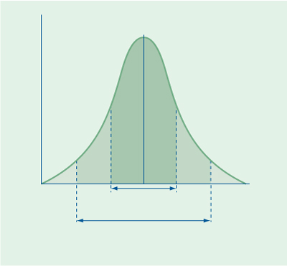
Topic 4: 3.4.7 Investigating biodiversity
How is variation measured?
What are the different types of variation and their causes?
What is sampling and why is it used?
How do we minimise the effect of chance when sampling?
What is the normal distribution curve?
How would you use Standard Deviation to work out if two mean values were truly different from each other?
How do you calculate the mean, mode and median?

