Slide 1
AS Level Paper 1 and 2. A2 Level Paper 1 and 3 - Topics 1-4
Section 3.1: Biological Molecules
3.1.1 Monomers and Polymers
3.1.2 Carbohydrates
3.1.3 Lipids
3.1.4.1 Proteins
3.1.4.2 Enzymes
3.1.5.1 Nucleic acid structure
3.1.5.2 DNA Replication
3.1.6 ATP
3.1.7 Water
3.1.8 Inorganic Ions
Section 3.3 Organisms exchange substances with their environment
3.3.1 Surface area to volume ratio
3.3.2 Gas exchange
3.3.3 Digestion and absorption
3.3.4.1 Mass transport in animals
3.3.4.2 Mass transport in plants
Section 3.4 Genetic information, variation and relationships between organisms
3.4.1 DNA, genes and chromosomes
3.4.2 DNA and protein synthesis
3.4.3 Genetic diversity - mutations and meiosis
3.4.4 Genetic diversity and adaptation – natural selection
3.4.5 Species and taxonomy
3.4.6 Biodiversity
3.4.7 Investigating biodiversity
Section 3.2: Cells
3.2.1.1 Eukaryotic cells
3.2.1.2 Prokaryotic cells and viruses
3.2.1.3 Studying cells
3.2.2 All cells arise from other cells
3.2.3 Transport across cell membranes
3.2.4 Cell recognition and the immune system

Slide 2
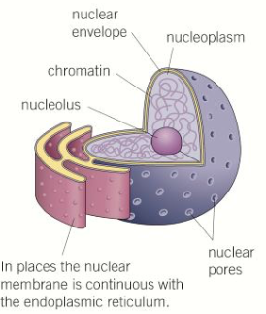
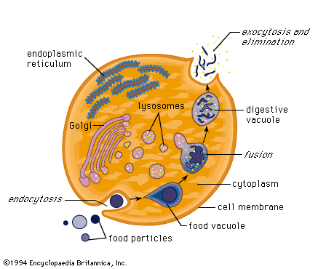
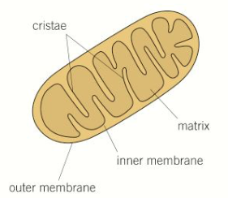
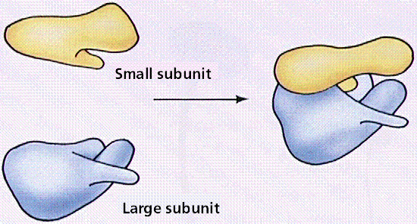
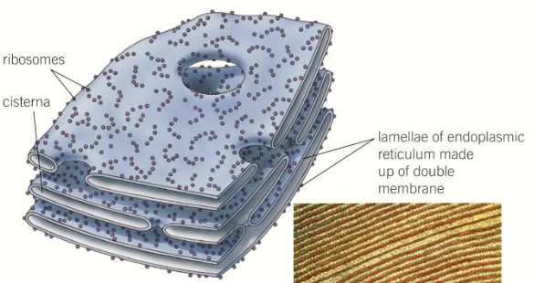
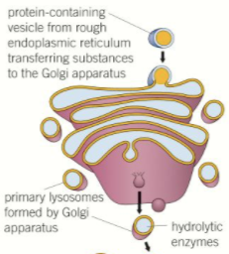
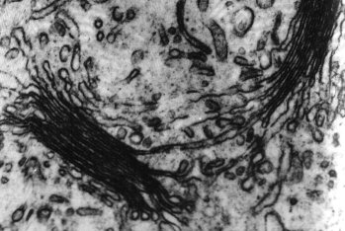
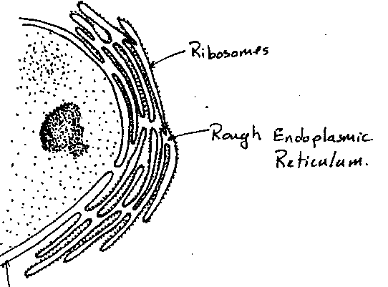
Topic 2: Cells - 3.2.1.1 Eukaryotic cells
Can you describe the structure of eukaryotic cells, including the:
Nucleus
Mitochondria
Golgi apparatus and Golgi vesicles
Can you describe the structure of eukaryotic cells, including the:
Lysosomes
Ribosomes
Rough endoplasmic reticulum and smooth endoplasmic reticulum

Slide 3
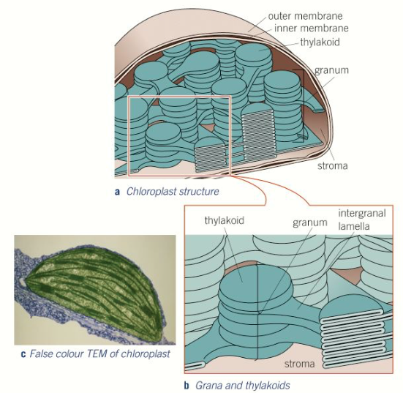
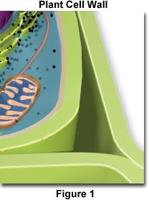
Topic 2: Cells - 3.2.1.1 Eukaryotic cells
Can you describe the structure of eukaryotic cells, including the:
Chloroplasts
Cell wall
Cell vacuole
Can you explain the adaptations of eukaryotic cells? Suggest organelles that you would expect to be numerous and well developed in the following cells:
Muscle cells
A sperm cell
Phagocytes
Liver cells
Describe any other specialised cells and suggest the cell ultrastructure you would expect them to have to carry out their function efficiently.

Slide 4
Topic 2: Cells - 3.2.1.1 Eukaryotic cells
What is cell differentiation and what are its advantages?
How are tissues are arranged into organs? Give some examples of organs.
How are cells are arranged into tissues? Give some examples of tissues.
How are organs arranged into organ systems? Give some examples of organ systems.

Slide 5
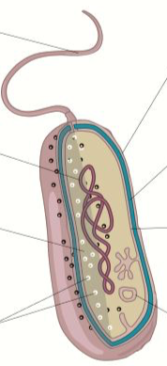
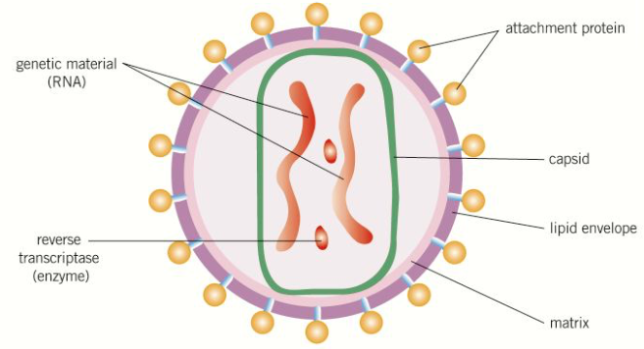
Topic 2: Cells - 3.2.1.2 Prokaryotic cells and viruses
Can you explain how prokaryotic cells differ from eukaryotic cells?
Label this prokaryotic cell and explain the role of each part:
Can you explain whether viruses are living or not and why?
Can you describe the structure of virus particles and explain the role of each part:

Slide 6
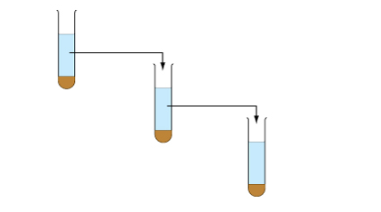
Topic 2: Cells - 3.2.1.3 Studying cells
Can you explain the difference between magnification and resolution?
Explain why a cold isotonic buffer is used in isolating organelles.
How do you calculate magnification and the size of the real object?
Explain how organelles are separated by ultracentrifugation (using the diagram below. Be sure to explain what is found in each pellet.
Unit | Symbol | Equivalent in metres
kilometre
metre
millimetre
micrometre
nanometre

Slide 7
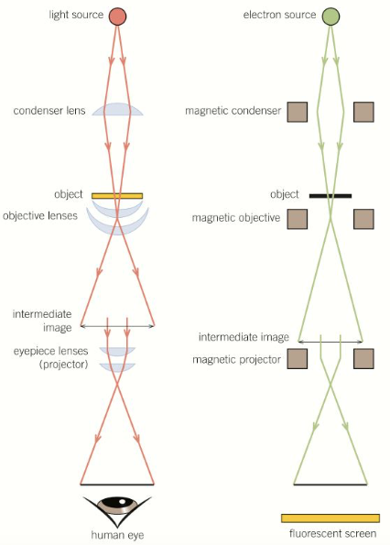
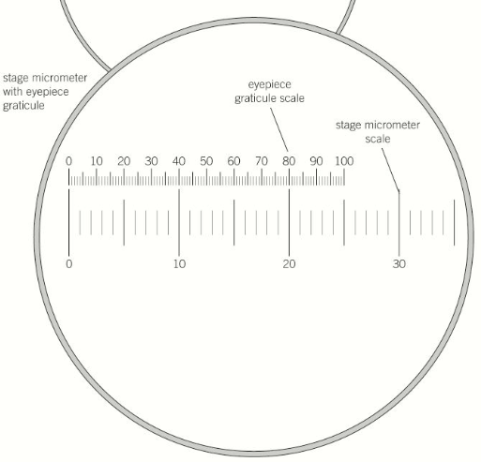
Topic 2: Cells - 3.2.1.3 Studying cells
Can you describe how a light microscope works and explain the limitations of it:
Can you describe how a transmission electron microscope works and explain the limitations of it:
Can you explain how you would use an eyepiece graticule to measure cells:
Can you describe how a scanning electron microscope works and explain the of limitations it:

Slide 8
Topic 2: Cells - 3.2.2 All cells arise from other cells – Mitosis
What happens in mitosis?
Can you describe and draw the appearance of chromosomes during interphase, prophase, metaphase, anaphase and telophase of mitosis?
Can you explain the role of spindle fibres?
What is mitosis important?

Slide 9
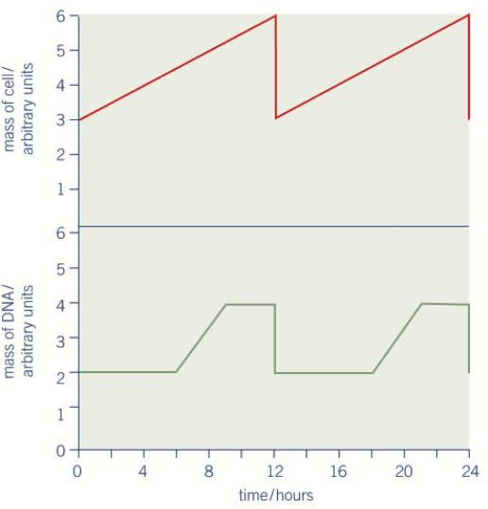
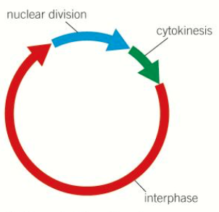
Topic 2: Cells - 3.2.2 All cells arise from other cells – Cell cycle
Not all cells, within multicellular organisms, retain the ability to divide.
Eukaryotic cells that do retain the ability to divide show a cell cycle.
Describe the three stages of the cell cycle:
What can uncontrolled cell division lead to? Explain why.
Some cancer treatments are directed at controlling the rate of cell division. How might they disrupt the cell cycle? What is the problem with these types of drugs?
How do prokaryotic cells divide?
How do viruses replicate?

Slide 10
Topic 2: Cells - 3.2.3 Transport across cell membranes – Cell-surface membrane
Explain the difference between channel proteins and carrier proteins.
Why are phospholipids present in cell membranes?
Why are proteins present in cell membranes?
Why are glycoproteins present in cell membranes?
Why are glycolipids present in cell membranes?
Describe different factors that affect the permeability of cell membranes and explain why they have this effect.
Why is cholesterol present in cell membranes?

Slide 11
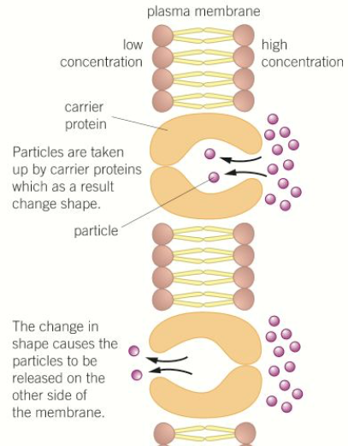
Topic 2: Cells - 3.2.3 Transport across cell membranes – Diffusion
What is diffusion? Draw a diagram to help you explain.
What is facilitated diffusion?
Why does simple diffusion happen?
What affects the rate of diffusion (think Fick’s Law)?

Slide 12
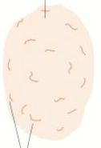
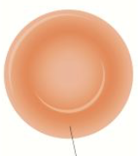
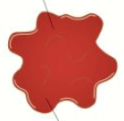
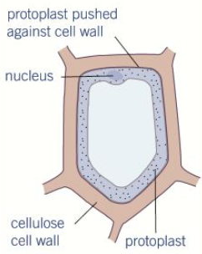
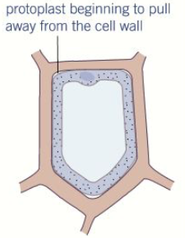
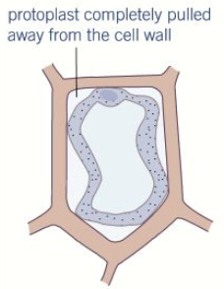
Topic 2: Cells - 3.2.3 Transport across cell membranes – Osmosis
What is osmosis? Draw a diagram to help you explain.
How does osmosis affect animal cells?
Explain what is meant by the terms solute, water potential and solution:
Why does osmosis happen?
How does osmosis affect plant cells?

Slide 13
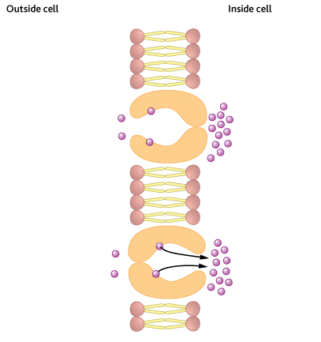
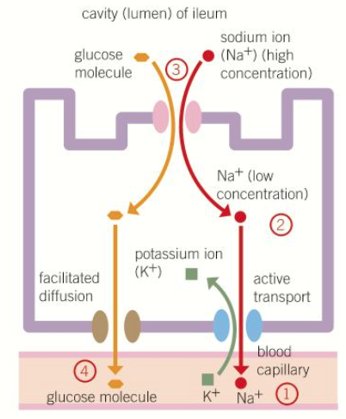
Topic 2: Cells - 3.2.3 Transport across cell membranes – Active Transport & Co-transport
What is active transport? What does active transport require?
How could cells be adapted for rapid transport across their internal or external membranes?
Can you explain specific adaptations of specialised cells in relation to the rate of transport across their membranes? E.g. Epithelial cells
Label the diagram to explain active transport:
What are the roles of diffusion and active transport in absorption?
What is co-transport? Use the diagram to explain how the process happens in the intestine:
How does oral rehydration therapy work?

Slide 14
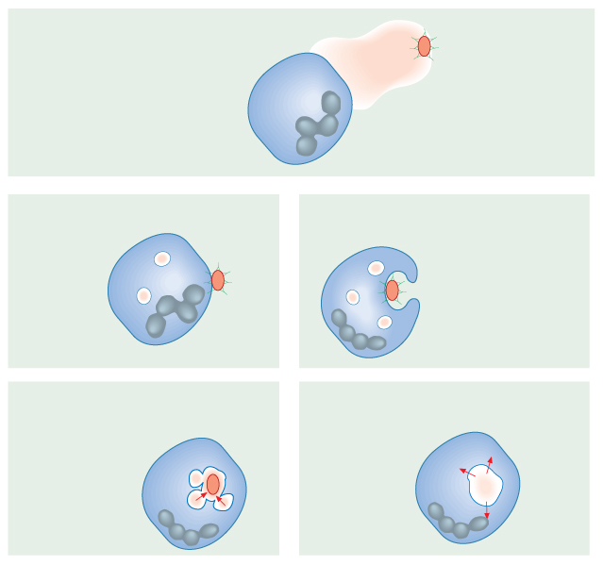
Topic 2: Cells - 3.2.4 Cell recognition and the immune system – Defence mechanisms & Phagocytosis
What are the main defence mechanisms of the body?
How does the body distinguish between its own cells and foreign material? Give some examples of foreign material.
What are non-specific responses?
Label the diagram to explain the process of phagocytosis:
What are specific responses?

Slide 15
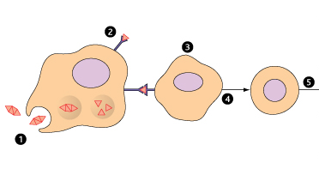
Topic 2: Cells - 3.2.4 Cell recognition and the immune system – T lymphocytes and cell-mediated immunity
What are the 2 different types of lymphocytes?
What is cell-mediated immunity? Use the diagram to explain the five steps:
Can you describe the response of T lymphocytes to a foreign antigen?
What is the role of antigen-presenting cells in the cellular response?
How do cytotoxic T cells kill infected cells?

Slide 16
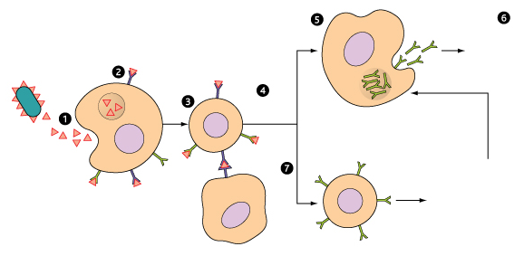
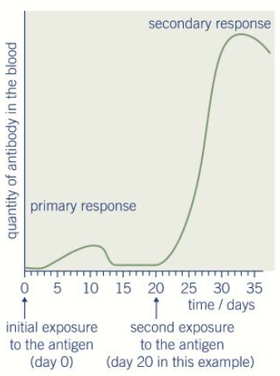
Topic 2: Cells - 3.2.4 Cell recognition and the immune system – B lymphocytes and humoral immunity
Can you describe the role of helper T cells (TH cells)?
What is humoral immunity? Use the diagram to explain:
Can you describe the response of B lymphocytes to a foreign antigen?
What are plasma cells? What type of immune response do they produce?
What are memory cells? What type of immune response do they produce?

Slide 17
Topic 2: Cells - 3.2.4 Cell recognition and the immune system – Antibodies
What is an antibody?
What are monoclonal antibodies? How are they produced?
How can monoclonal antibodies be used to target specific cell types?
Draw and label the structure of an antibody:
Can you describe the ethical issues associated with the use of monoclonal antibodies?
How can monoclonal antibodies be used in medical diagnosis?
Can you explain the formation of an antigen-antibody complex?

Slide 18
Topic 2: Cells - 3.2.4 Cell recognition and the immune system – Vaccination
What is passive immunity?
What is active immunity?
What are the differences between active and passive immunity?
What is a vaccination?
What are the features of an effective vaccination programme?
What is herd immunity?
Why does a vaccination rarely eliminate a disease?
Can you describe the ethical sues associated with the use of vaccines?

Slide 19
Topic 2: Cells - 3.2.4 Cell recognition and the immune system – H.I.V
Can you describe the structure of the human immunodeficiency virus (HIV) and its replication in helper T cells?
Can you explain how HIV causes the symptoms of AIDS?
Can you explain how antibodies are used in the ELISA test?

