Slide 1
A2 Level Paper 2 and 3 - Topics 5-8 – Required Practicals
Section 3.5: Energy transfers in and between organisms
3.5.1 Photosynthesis
3.5.2 Respiration
3.5.3 Energy and ecosystems
3.5.4 Nutrient cycles
Section 3.7: Genetics, populations, evolution and ecosystems
3.7.1 Inheritance
3.7.2 Populations
3.7.3 Evolution may lead to speciation
3.7.4 Populations in ecosystems
Section 3.6 Organisms respond to changes in their internal and external environments
3.6.1 Stimuli, both internal and external, are detected and lead to a response
3.6.1.1 Survival and response
3.6.1.2 Receptors
3.6.1.3 Control of heart rate
3.6.2 Nervous co-ordination
3.6.2.1 Nerve impulses
3.6.2.2 Synaptic transmission
3.6.3 Skeletal muscles are stimulated to contract by nerves and act as effectors
3.6.4 Homeostasis is the maintenance of a stable internal environment
3.6.4.1 Principles of homeostasis
3.6.4.2 Control of blood glucose concentration
3.6.4.3 Control of blood water potential
Section 3.8 The control of gene expression
3.8.1 Alteration of the sequence of bases in DNA can alter the structure of proteins
3.8.2 Gene expression is controlled by a number of features
3.8.2.1 Most of a cell’s DNA is not translated
3.8.2.2 Regulation of transcription and translation
3.8.2.3 Gene expression and cancer
3.8.3 Using genome projects
3.8.4 Gene technologies allow the study and alteration of gene function allowing a better understanding of organism function and the design of new industrial and medical processes
3.8.4.1 Recombinant DNA technology
3.8.4.2 Differences in DNA between individuals of the same species can be exploited for identification and diagnosis of heritable conditions
3.8.4.3 Genetic fingerprinting

Slide 2
Required Practicals
Can you describe how you would use chromatography to investigate the pigments isolated from leaves of different plants, eg, leaves from shade-tolerant and shade-intolerant plants or leaves of different colours:
Can you explain how you would investigate the effect of a named factor on the rate of dehydrogenase activity in extracts of chloroplasts:

Slide 3
Required Practicals
Can you describe how you would investigate the effect of a named variable on the rate of respiration of cultures of single-celled organisms:
Can you describe how you would investigate the effect of an environmental variable on the movement of an animal using either a choice chamber or a maze:

Slide 4
Required Practicals
Can you describe how you would produce a dilution series of a glucose solution and use colorimetric techniques to produce a calibration curve with which to identify the concentration of glucose in an unknown ‘urine’ sample:
Can you describe how you would investigate the effect of a named environmental factor on the distribution of a given species:

Slide 5
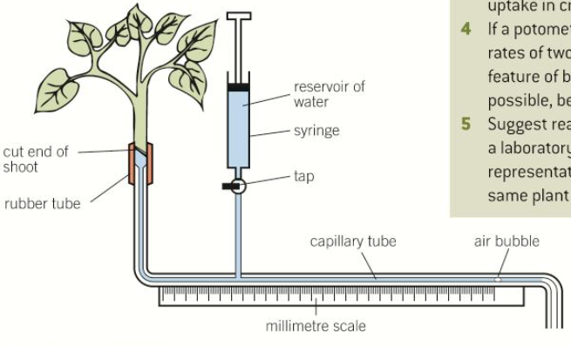
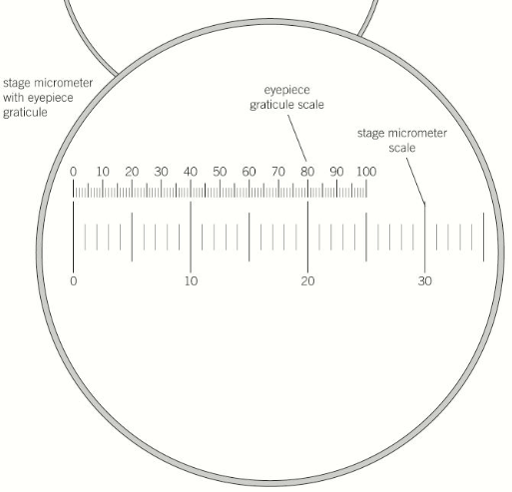
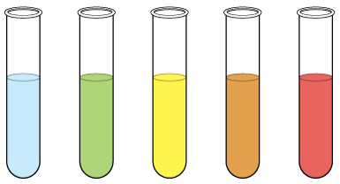
Required Practical Techniques – Can you give a brief overview of how you would do the following:
a) use appropriate apparatus to record a range of quantitative measurements (to include mass, time, volume, temperature, length and pH)
b) use appropriate instrumentation to record quantitative measurements, such as a colorimeter or potometer
c) use laboratory glassware apparatus for a variety of experimental techniques to include serial dilutions
d) use of light microscope at high power and low power, including use of a graticule
e) produce scientific drawing from observation with annotations
f) use qualitative reagents to identify biological molecules

Slide 6
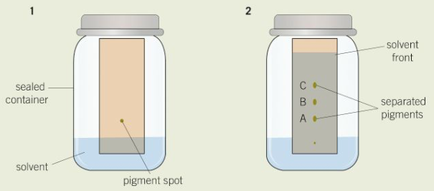
Required Practical Techniques – Can you give a brief overview of how you would do the following:
g) separate biological compounds using thin layer/paper chromatography or electrophoresis
h) safely and ethically use organisms to measure: plant or animal responses and/or physiological functions
i) use microbiological aseptic techniques, including the use of agar plates and broth
j) safely use instruments for dissection of an animal organ, or plant organ
k) use sampling techniques in fieldwork
l) use ICT such as computer modelling, or data logger to collect data, or use software to process data

