Slide 1
A2 Level Paper 2 and 3 - Topics 5-8
Section 3.5: Energy transfers in and between organisms
3.5.1 Photosynthesis
3.5.2 Respiration
3.5.3 Energy and ecosystems
3.5.4 Nutrient cycles
Section 3.7: Genetics, populations, evolution and ecosystems
3.7.1 Inheritance
3.7.2 Populations
3.7.3 Evolution may lead to speciation
3.7.4 Populations in ecosystems
Section 3.6 Organisms respond to changes in their internal and external environments
3.6.1 Stimuli, both internal and external, are detected and lead to a response
3.6.1.1 Survival and response
3.6.1.2 Receptors
3.6.1.3 Control of heart rate
3.6.2 Nervous co-ordination
3.6.2.1 Nerve impulses
3.6.2.2 Synaptic transmission
3.6.3 Skeletal muscles are stimulated to contract by nerves and act as effectors
3.6.4 Homeostasis is the maintenance of a stable internal environment
3.6.4.1 Principles of homeostasis
3.6.4.2 Control of blood glucose concentration
3.6.4.3 Control of blood water potential
Section 3.8 The control of gene expression
3.8.1 Alteration of the sequence of bases in DNA can alter the structure of proteins
3.8.2 Gene expression is controlled by a number of features
3.8.2.1 Most of a cell’s DNA is not translated
3.8.2.2 Regulation of transcription and translation
3.8.2.3 Gene expression and cancer
3.8.3 Using genome projects
3.8.4 Gene technologies allow the study and alteration of gene function allowing a better understanding of organism function and the design of new industrial and medical processes
3.8.4.1 Recombinant DNA technology
3.8.4.2 Differences in DNA between individuals of the same species can be exploited for identification and diagnosis of heritable conditions
3.8.4.3 Genetic fingerprinting

Slide 2
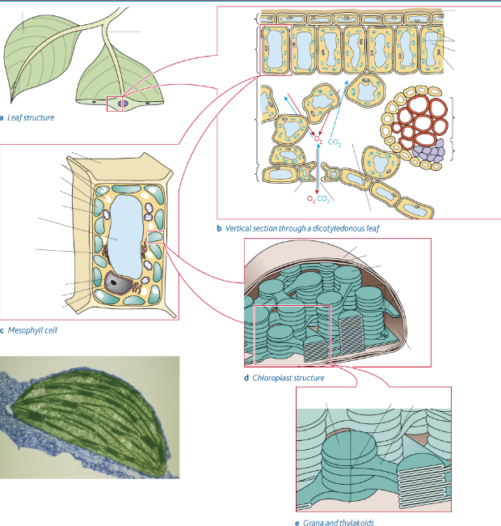
Topic 5: Energy Transfers – 3.5.1 Photosynthesis (p269)
How is the structure of a leaf adapted for efficient photosynthesis?
Can you give an outline of what happens during photosynthesis?
Can you explain how you would use chromatography to investigate pigments separated from leaves of different plants?

Slide 3
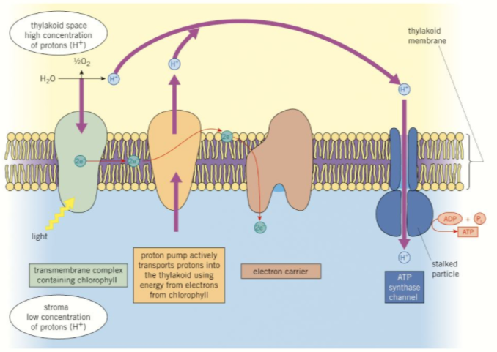
Topic 5: Energy Transfers – 3.5.1 Photosynthesis – Light Dependent Reaction (p271)
Can you describe oxidation and reduction?
How are chloroplasts adapted to carry out the light-dependent reaction?
How is ATP produced?
Can you describe the chemiosmotic theory?
Can you explain what happens during photolysis?
How would you carry out an investigation into a named factor on the rate of dehydrogenase activity in extracts of chloroplasts?

Slide 4
Topic 5: Energy Transfers – 3.5.1 Photosynthesis – Light Independent Reaction (p275)
Explain the steps of the Calvin cycle. Draw a diagram in your answer:
Explain the link between the Calvin cycle and light-dependent reaction:
How is the chloroplast adapted to carry out the light independent reaction?
Explain how Calvin used a lollipop to figure out the light independent reaction:

Slide 5
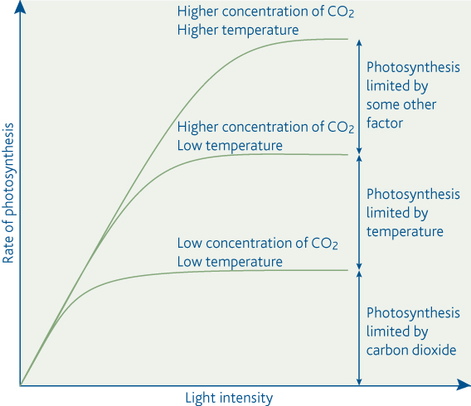
Topic 5: Energy Transfers – 3.5.1 Photosynthesis (p277)
How does light intensity affect the rate of photosynthesis? Draw a sketch graph.
Can you explain the law of limiting factors?
How does light intensity affect the rate of photosynthesis? Draw a sketch graph.
How would you investigate the effect of a factor on the rate of photosynthesis?
How does light intensity affect the rate of photosynthesis? Draw a sketch graph.

Slide 6
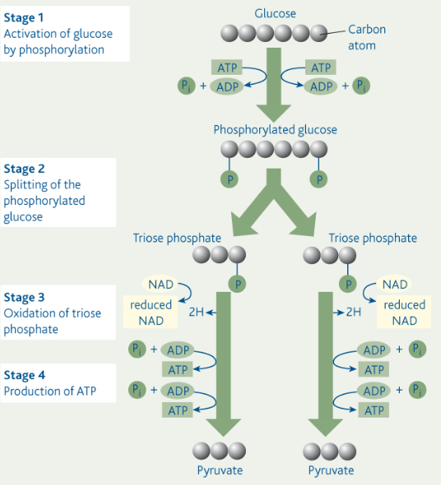
Topic 5: Energy Transfers – 3.5.2 Respiration – Glycolysis (p283)
What are the main stages of glycolysis?
Where does glycolysis fit into the whole process of respiration?
What are the products of glycolysis?

Slide 7
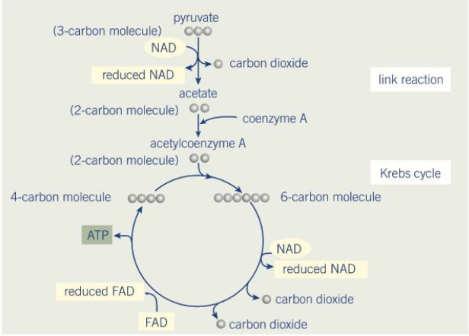
Topic 5: Energy Transfers – 3.5.2 Respiration – Link Reaction and Krebs Cycle (p286)
What happens during the link reaction?
What happens during Krebs cycle?
Why is the Kreb’s cycle so significant?
What are the coenzymes and why are they important?

Slide 8
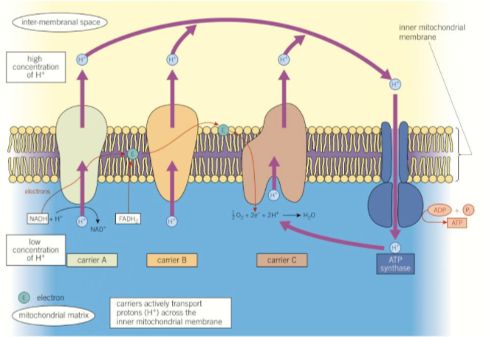
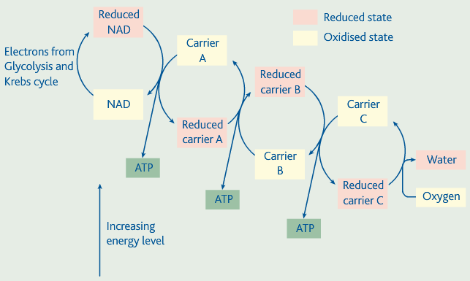
Topic 5: Energy Transfers – 3.5.2 Respiration – Oxidative Phosphorylation (p289)
What is the role of the mitochondria in respiration?
What is the role of oxygen in aerobic respiration?
What is the chemiosmotic theory?
How is ATP synthesised in the electron transport chain?
What are some alternative respiratory substrates?

Slide 9
Topic 5: Energy Transfers – 3.5.2 Respiration – Anaerobic Respiration & Practical (p293)
How is lactate produced in animals?
Can you explain how energy is released by anaerobic respiration?
Can you contrast the energy yields from aerobic and anaerobic respiration?
How is ethanol and carbon dioxide produced in plants and some micro-organisms?
How would you investigate the effect of a named variable on the rate of respiration of cultures of single-celled organisms?

Slide 10
Topic 5: Energy Transfers – 3.5.3 Energy and ecosystems (p298)
Can you explain how energy enters an ecosystem?
Can you explain what biomass is? And how it is measured?
Can you explain how the following organisms obtain their energy and nutrients:
Producers:
Consumers:
Saprobionts:
How is energy transferred between the organisms in the ecosystem?
Can you explain what is meant by the following terms:
Food chain:
Trophic level:
Food webs:

Slide 11
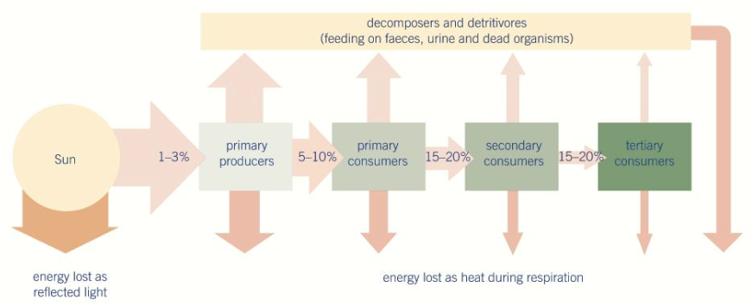
Topic 5: Energy Transfers – 3.5.3 Energy and ecosystems (p298)
What percentage of energy is transferred from one trophic level to the next:
Can you explain how energy is lost along a food chain?
Why are food chains usually limited to 5 trophic levels?
How can you calculate the efficiency of energy transfers?
Percentage efficiency =
What is meant by Gross Primary Productivity (GPP) and Net Primary Productivity (NPP)? How can they be calculated?
How do farming processes like intensive rearing reduce energy losses?

Slide 12
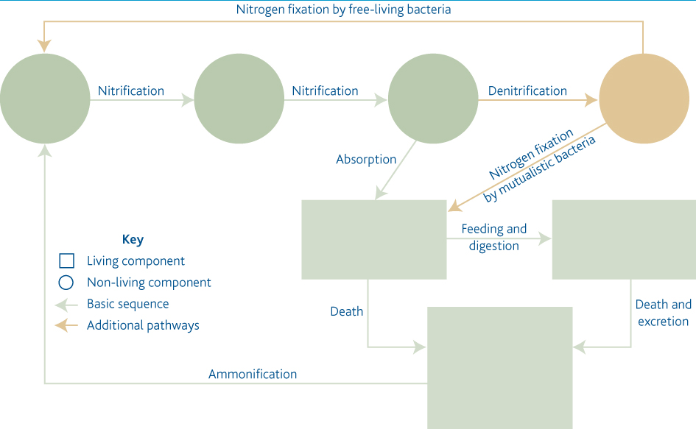
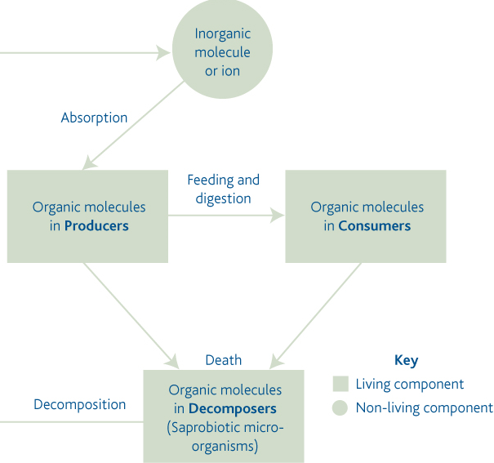
Topic 5: Energy Transfers – 3.5.4 Nutrient cycles (p306)
Can you explain the basis of all nutrient cycles using the following diagram?
Can you use this diagram to explain what happens in the Nitrogen cycle?
Can you describe what happens in each stage of the nitrogen cycle:
Ammonification: Nitrogen fixation:
Nitrification: Denitification:

Slide 13
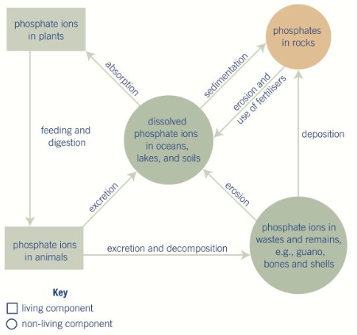
Topic 5: Energy Transfers – 3.5.4 Nutrient cycles (p309)
Can you explain what happens in the phosphorus cycle?
Can you explain the role of mycorrhizae in nutrient cycles?
Can you explain why fertilisers are needed in agricultural systems?
What are the different types of fertilisers?
Can you explain the role of saprobionts in decomposition?

Slide 14
Topic 5: Energy Transfers – 3.5.4 Nutrient cycles (p313)
Why do fertilisers increase productivity?
What happens during eutrophication? How would this affect the environment?
What are some environmental effects of adding fertilisers?
What happens during leaching?

