Slide 1
A2 Level Paper 2 and 3 – Topics 5-8
Section 3.5: Energy transfers in and between organisms
3.5.1 Photosynthesis
3.5.2 Respiration
3.5.3 Energy and ecosystems
3.5.4 Nutrient cycles
Section 3.7: Genetics, populations, evolution and ecosystems
3.7.1 Inheritance
3.7.2 Populations
3.7.3 Evolution may lead to speciation
3.7.4 Populations in ecosystems
Section 3.6 Organisms respond to changes in their internal and external environments
3.6.1 Stimuli, both internal and external, are detected and lead to a response
3.6.1.1 Survival and response
3.6.1.2 Receptors
3.6.1.3 Control of heart rate
3.6.2 Nervous co-ordination
3.6.2.1 Nerve impulses
3.6.2.2 Synaptic transmission
3.6.3 Skeletal muscles are stimulated to contract by nerves and act as effectors
3.6.4 Homeostasis is the maintenance of a stable internal environment
3.6.4.1 Principles of homeostasis
3.6.4.2 Control of blood glucose concentration
3.6.4.3 Control of blood water potential
Section 3.8 The control of gene expression
3.8.1 Alteration of the sequence of bases in DNA can alter the structure of proteins
3.8.2 Gene expression is controlled by a number of features
3.8.2.1 Most of a cell’s DNA is not translated
3.8.2.2 Regulation of transcription and translation
3.8.2.3 Gene expression and cancer
3.8.3 Using genome projects
3.8.4 Gene technologies allow the study and alteration of gene function allowing a better understanding of organism function and the design of new industrial and medical processes
3.8.4.1 Recombinant DNA technology
3.8.4.2 Differences in DNA between individuals of the same species can be exploited for identification and diagnosis of heritable conditions
3.8.4.3 Genetic fingerprinting

Slide 2
Topic 6 – Responses - 3.6.1.1 Survival and response (p326)
Can you define a stimulus and response?
Stimulus → __________ → __________ → __________ → response
How would you investigate the effect of an environmental variable on the movement of an animal using either a choice chamber of a maze?
What is a taxis?
Can you explain the difference between a positive and negative taxis, some different examples and give an example of an organism that has each one and why?
What is a kinesis?
What is a tropism?
What are the different types of tropism?
Can you explain the difference between a positive and negative tropism?

Slide 3
Topic 6 – Responses - 3.6.1.1 Survival and response – Plant growth factors (p328)
What stimuli do plants respond to?
Can you describe plant growth factors like IAA?
Explain how phototropism works in flowering plants:
Explain how gravitropism works in flowering plants:
Can you explain the role of IAA in elongation growth?
Can you explain some parts of experiments that discovered the role of IAA in tropisms?

Slide 4
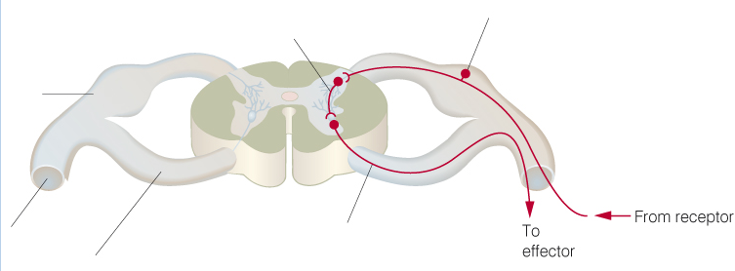
Topic 6 – Responses - 3.6.1.1 Survival and response – A reflex arc (p334)
How is the nervous system arranged?
Can you explain the roles the sensory, intermediate and motor neurones play in a reflex arc? Explain what happens in a reflex arc when you touch a hot object:
Nervous system
Brain
Sensory nervous system
Why are reflex arcs important?
Voluntary nervous system

Slide 5
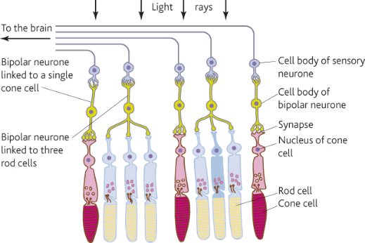
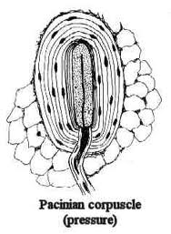
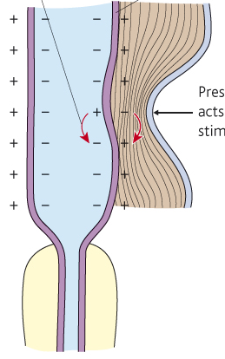
Topic 6 – Responses - 3.6.1.2 Receptors (p337)
What are the main features of sensory reception?
Can you describe how receptors work together in the eye?
Can you describe the structure and function of a Pacinian corpuscle and how it works?
 | Rod | Cone
Shape
Number
Distribution
Visual acuity
Sensitivity in low light conditions

Slide 6
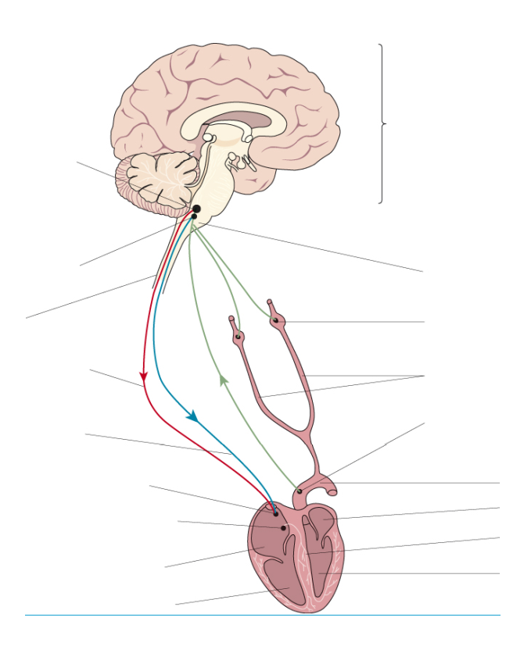
Topic 6 – Responses - 3.6.1.3 Control of heart rate (p340)
What effect does the sympathetic system have on heart rate?
What effect does the parasympathetic system have on heart rate?
How is the resting heart rate controlled and modified?
How is heart rate controlled?
What role do chemoreceptors play in controlling heart beat?
What role do baroreceptors play in controlling heart beat?

Slide 7
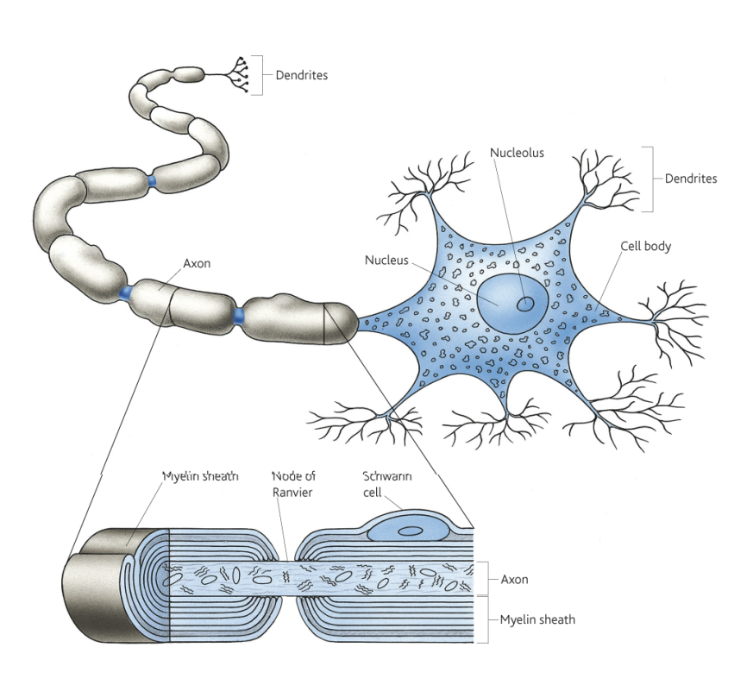
Topic 6 – Responses - 3.6.2.1 Nerve impulses (p346)
Can you explain how nervous transmission works?
Can you describe the structure of a myelinated motor neurone?
Can you explain how hormonal transmission works?
Can you distinguish between nervous and hormonal co-ordination?
 | Hormonal | Nervous
Communication by: | Chemicals called hormones
Transmission by: | Blood system
Speed of transmission |  | Very rapid
Travel to: |  | Specific parts of the body
Response is: | Widespread
Response is: |  | Rapid
Response is: | Long lasting
Effect may be: |  | Temporary and reversible
Can you draw a diagram and state the function of:
Sensory neurone:
Intermediate neurone:
Motor neurone:

Slide 8
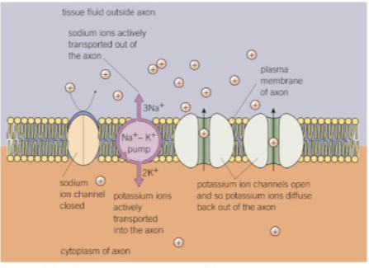
Topic 6 – Responses - 3.6.2.1 Nerve impulses (p350)
Can you explain the nature of the resting potential?
Can you explain how a resting potential is established in a neurone?
Can you explain what an action potential is? Use the diagram to explain what is happening at each stage:

Slide 9
Topic 6 – Responses - 3.6.2.1 Nerve impulses (p354)
Use diagrams to explain how an action potential passes along an unmyelinated axon:
Use diagrams to explain how an action potential passes along a myelinated axon:

Slide 10
Topic 6 – Responses - 3.6.2.1 Nerve impulses (p354)
What factors affect the speed of conductance of an action potential and how?
What are the purposes of the refractory period?
What is meant by the refractory period?
What is meant by the all or nothing principle?

Slide 11
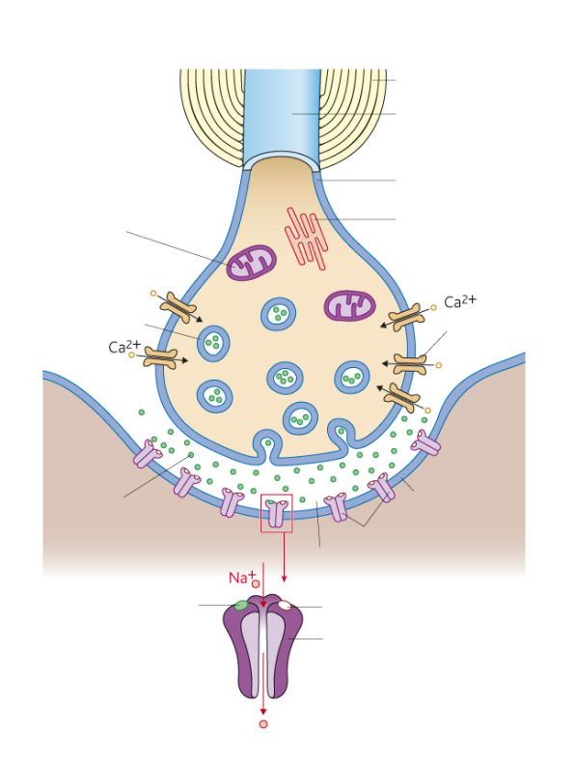
Topic 6 – Responses - 3.6.2.2 Synaptic transmission (p360)
What is the structure of a synapse?
What are features of synapses?
Unidirectionality:
Summation:
Spatial:
Temporal:
Inhibition:
What functions do synapses perform?

Slide 12
Topic 6 – Responses - 3.6.2.2 Synaptic transmission (p364)
Can you explain how information is transmitted across a synapse? Draw diagrams to help you explain.
What is a cholinergic synapse? Where would you expect to find them?
Give some examples of ways drugs could affect synapses:

Slide 13
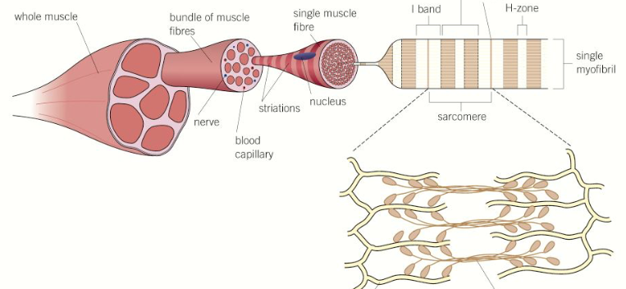
Topic 6 – Responses - 3.6.3 Skeletal muscles are stimulated to contract by nerves and act as effectors (p367)
Can you describe the gross and microscopic structure of a skeletal muscle?
Why do the myofibrils appear striped? How are actin and myosin arranged within a myofibril? Why do the light bands appear lighter and dark bands appear darker?
Can you describe the neuromuscular junction and explain how it is adapted to its function?
Can you compare and contrast the neuromuscular junction with a synapse?
Can you explain the adaptations of slow-twitch muscle fibres?
Can you explain the adaptations of fast-twitch muscle fibres?

Slide 14
Topic 6 – Responses - 3.6.3 Skeletal muscles are stimulated to contract by nerves and act as effectors (p370)
Can you explain what is meant by antagonistic muscles and how they operate?
Explain the sliding filament theory of muscle contraction. Use diagrams in your answer:
Can you summarise the evidence that supports the sliding filament mechanism of muscles contraction? Draw a diagram of the sarcomere of a relaxed and contracted muscle to help your answer.
What is energy needed for in muscle contraction?
How is this greater demand for ATP met?

Slide 15
Topic 6 – Responses - 3.6.4.1 Principles of homeostasis (p378)
What is homeostasis?
Draw a flow diagram to explain how control mechanisms work:
Why is it important?
Explain how control mechanisms are co-ordinated:
Negative feedback:
Positive feedback:

Slide 16
Topic 6 – Responses - 3.6.4.1 Principles of homeostasis (p380)
Explain how body temperature is regulated in ectotherms:
Explain how endotherms conserve and gain heat in response to a cold environment:
Explain how body temperature is regulated in endotherms:
Draw a diagram to summarise how body temperature is regulated in endotherms:
Explain how endotherms lose heat in response to a warm environment:

Slide 17
Topic 6 – Responses - 3.6.4.2 Control of blood glucose concentration (p386)
How do hormones work?
Explain the second messenger model – use diagrams to help you explain and adrenaline as an example hormone.
What is the role of the pancreas in regulating blood glucose concentration?
What is the role of the liver in regulating blood glucose concentration?
What factors influence blood glucose concentration?

Slide 18
Topic 6 – Responses - 3.6.4.2 Control of blood glucose concentration (p386)
How do insulin and the ℬ cells of the pancreas regulate blood glucose concentration?
How do glucagon and the ⍺ cells of the pancreas regulate blood glucose concentration?
Complete this
to summarise how
blood glucose
concentration is kept
constant:
To increase
To decrease
Detected by…
Detected by…
Blood glucose
Blood glucose
Response…
Response…
How does adrenaline regulate blood glucose concentration?
Normal blood glucose level
90mg100cm⁻³ blood
Blood glucose
Blood glucose

Slide 19
Topic 6 – Responses - 3.6.4.2 Control of blood glucose concentration (p391)
What is diabetes?
What are the two main types of diabetes?
Type 1 (insulin __________________):
Type 2 insulin __________________):
How do they differ?
How is each type of diabetes controlled?
Type 1:
Type 2:
How would you produce a dilution series of a glucose solution and use colorimetric techniques to produce a calibration curve which you could then use to identify the concentration of glucose in an unknown urine sample?
What are some symptoms of diabetes?

Slide 20
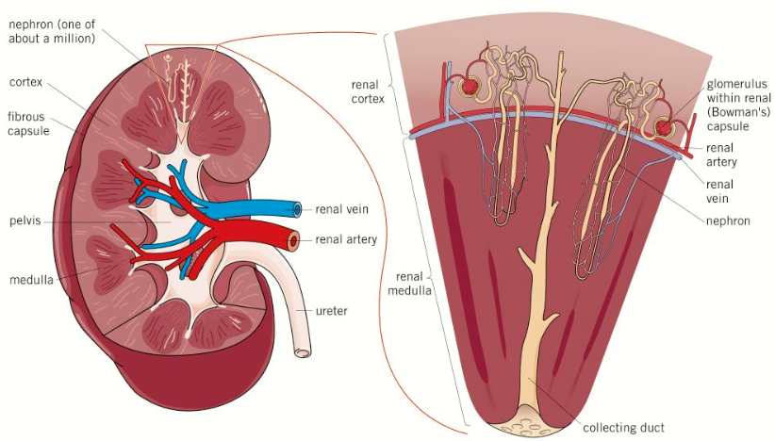
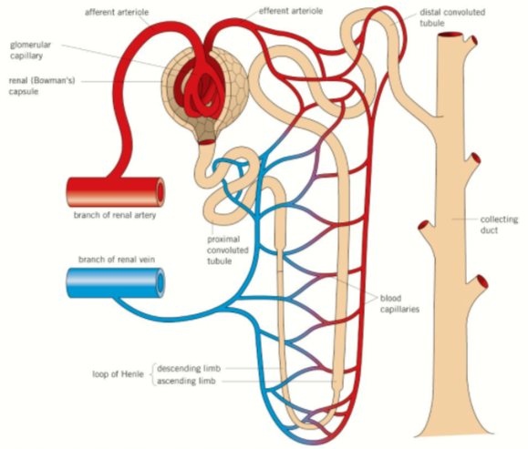
Topic 6 – Responses - 3.6.4.3 Control of blood water potential (p394)
What is the structure of the mammalian kidney?
What is the structure of a nephron?

Slide 21
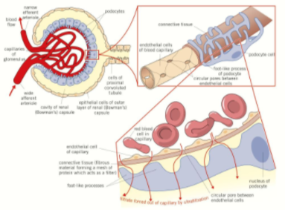
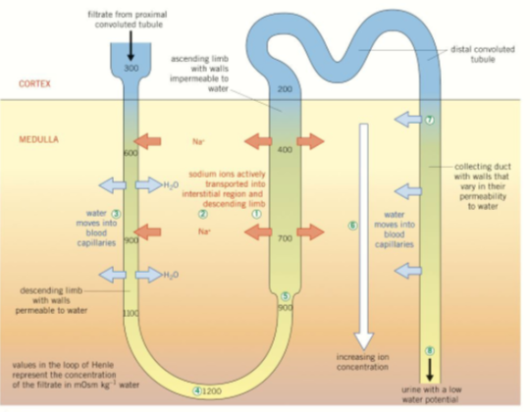
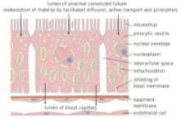
Topic 6 – Responses - 3.6.4.3 Control of blood water potential (p394)
What is ultrafiltration and how does it produce glomerular filtrate?
How is a gradient of sodium ions in the medulla of the loop of Henle maintained?
How is water reabsorbed by the proximal convoluted tubule?
What is the role of the distal convoluted tubule and collecting duct?

Slide 22
Topic 6 – Responses - 3.6.4.3 Control of blood water potential (p394)
How is the water potential of the blood regulated?
What is the role of the hypothalamus, posterior pituitary and antidiuretic hormone (ADH) in osmoregulation?
Hypothalamus:
Posterior pituitary:
Antidiuretic hormone (ADH):
Draw a diagram to summarise how water potential of the blood is regulated:

