Slide 1
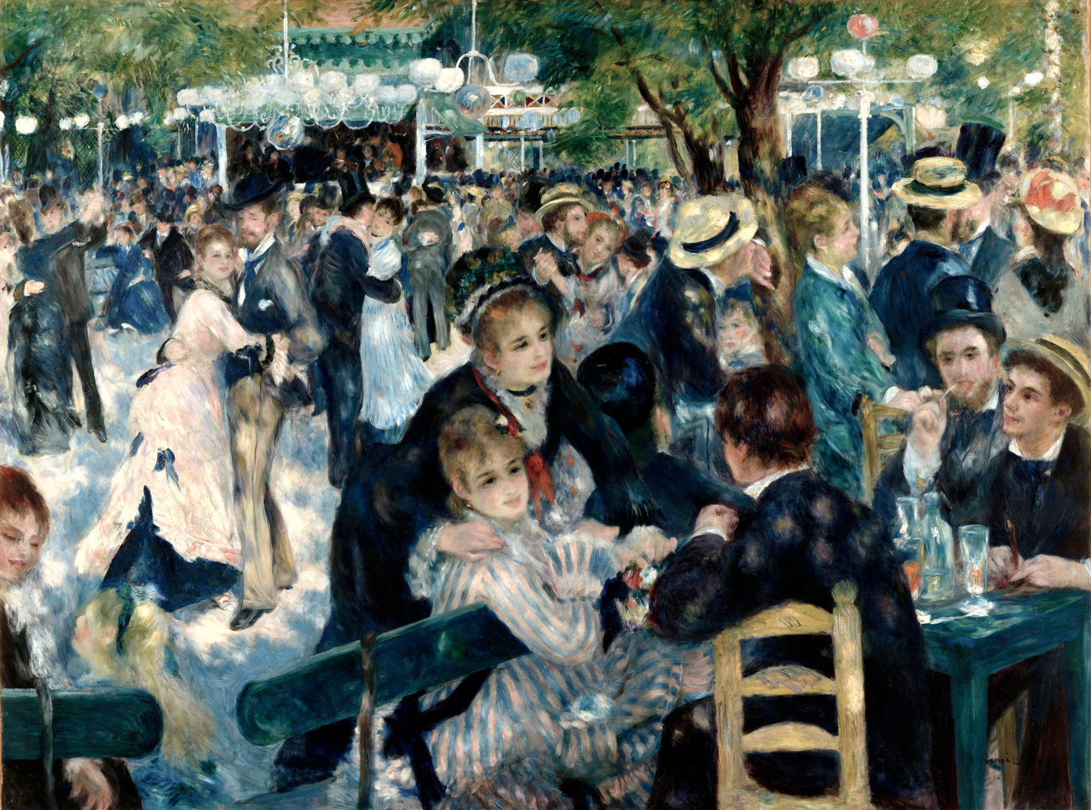
Pierre Auguste Renoir, Bal du Moulin de la Galette, 1876, 131x175cm

Slide 2
What makes this work Impressionist?
Painted outdoors
A scene of contemporary French life
Shadows are shown as patches of blue
Paint is applied in dabs and gestural
strokes
Forms are sketched with no hard outlines
Bright spots used
to show highlights
and sunshine
Forms appear soft
and hazy
Renoir depicts a scene of leisure showing a crowd of people dancing and socialising in an open-air dancehall as sunlight falls on the figures.

Slide 3
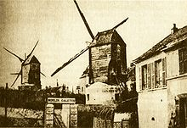
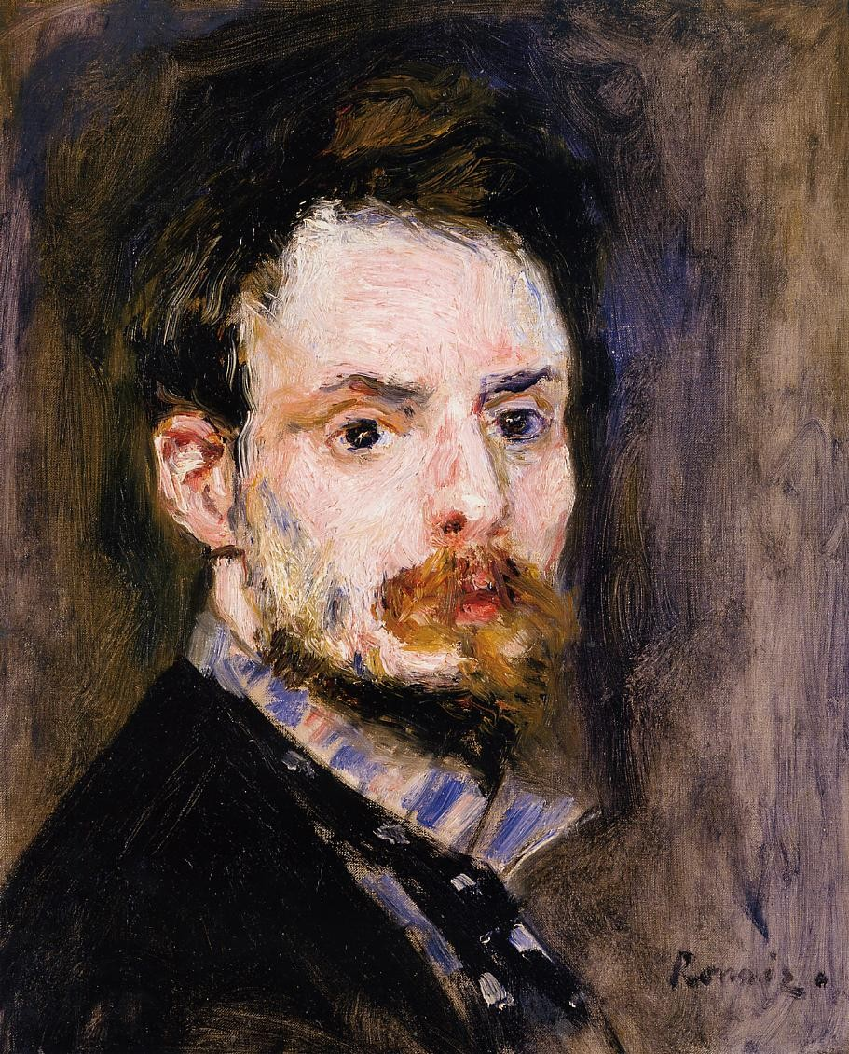
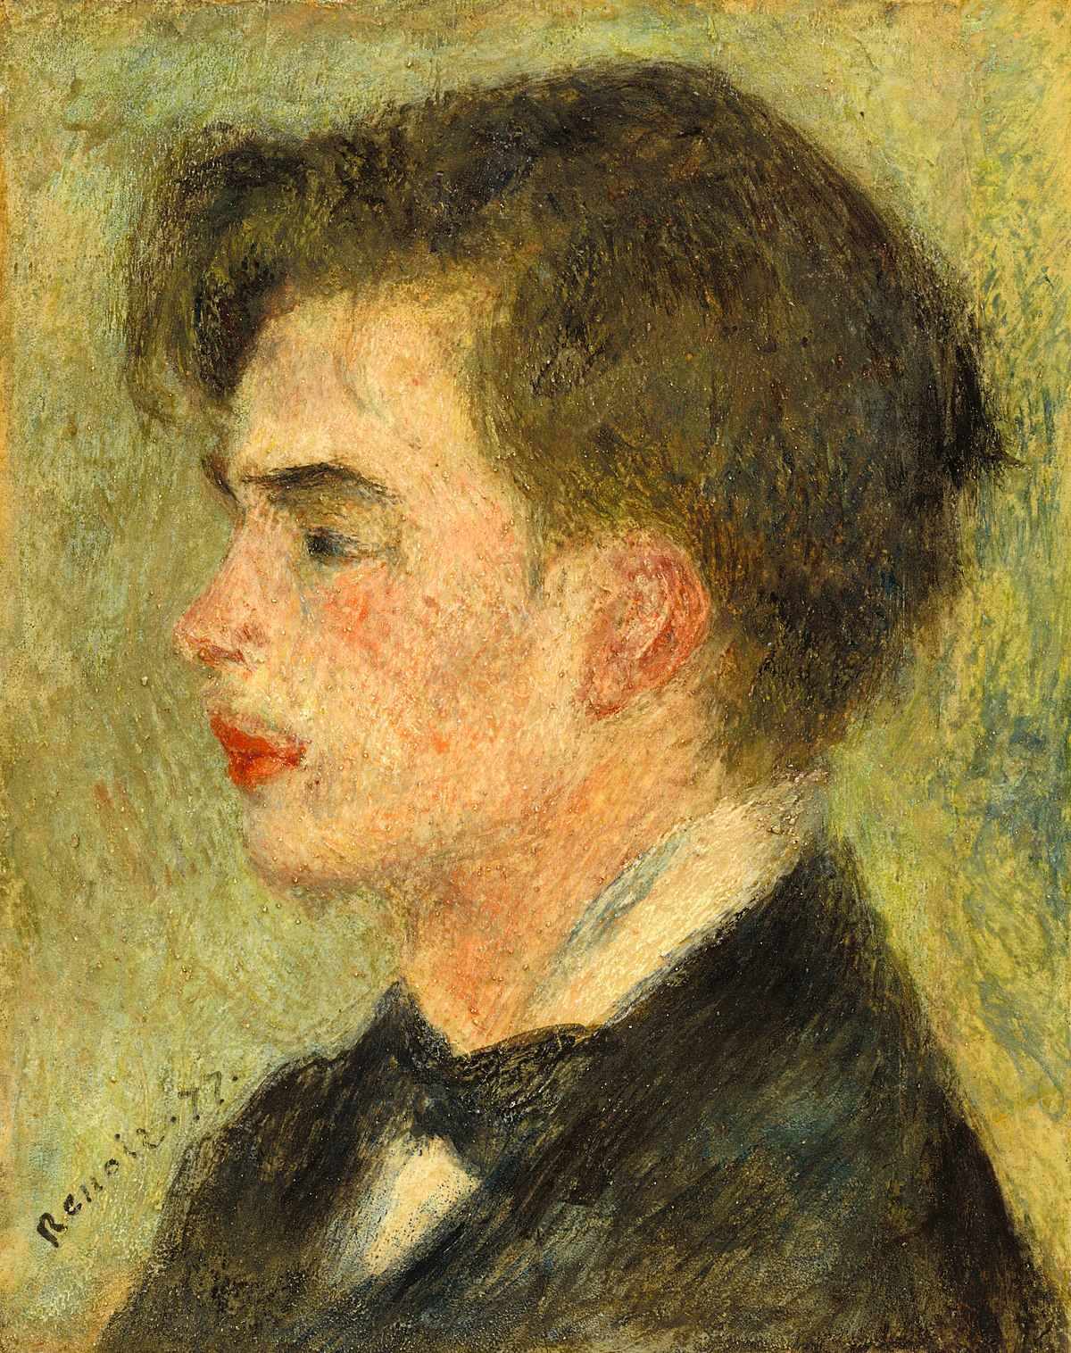
The Moulin de la Galette in the 1800s
Georges Rivière, art critic and friend
of Renoir.
Renoir, Self-Portrait

Slide 4
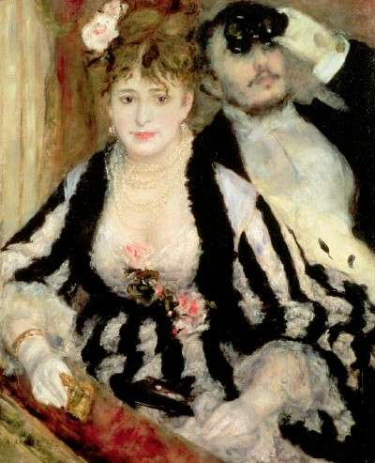
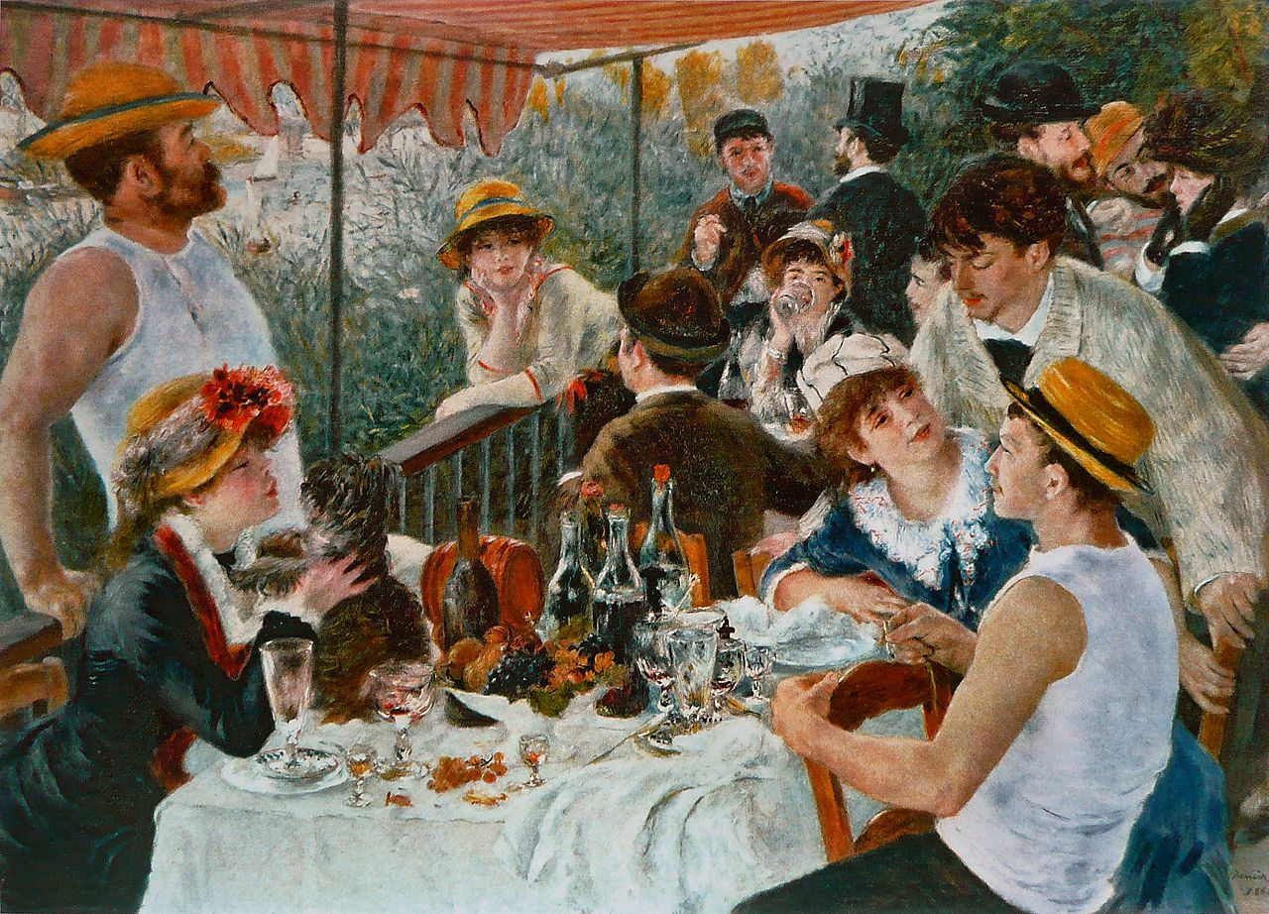
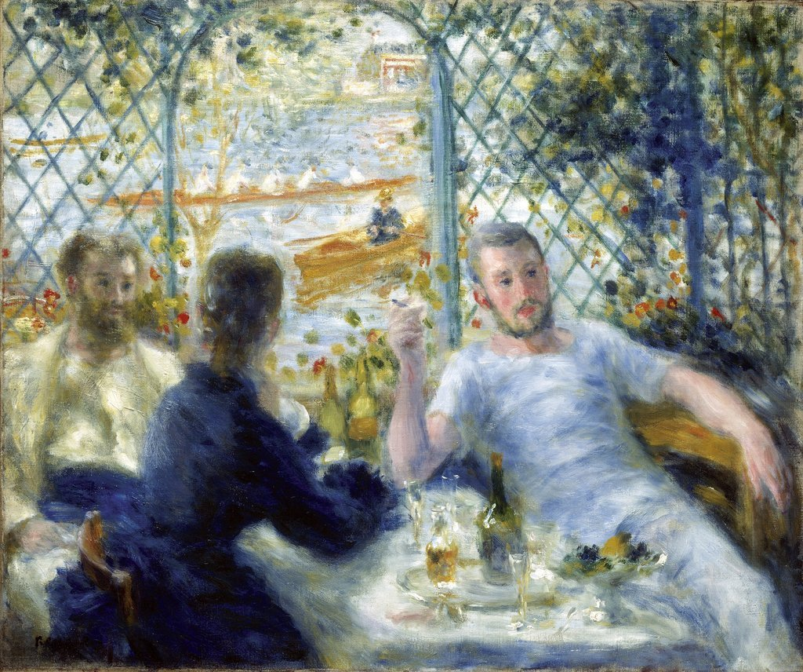
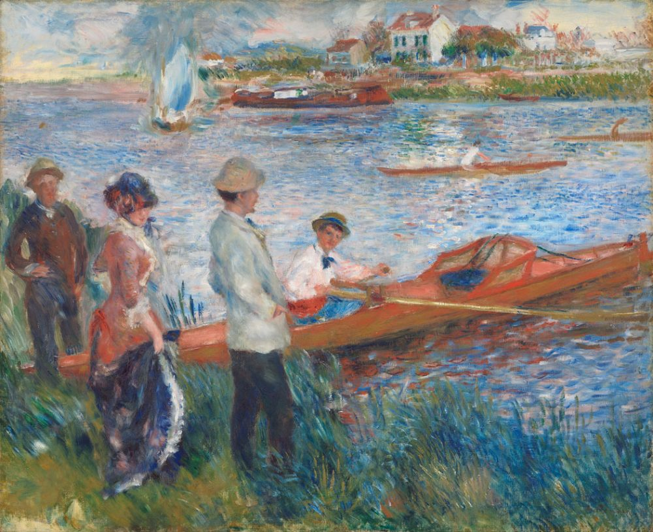
Renoir and scenes of Parisian leisure

Slide 5
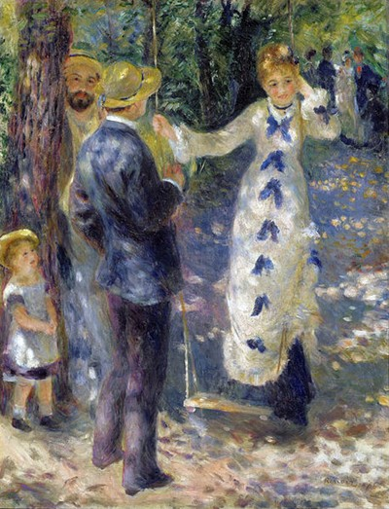
Renoir painted ‘The Swing’ at the same time as
‘Bal du Moulin de la Galette’, in the garden of the
house he rented in Montmartre. The same models
appear in both works.
What similarities do they share in terms of subject matter, technique etc?
https://artsandculture.google.com/asset/dance-at-le-moulin-de-la-galette/rQEx7CtGiKE3yg
SmartHistory: https://www.youtube.com/watch?v=o6amlRsb1n4

