Slide 1
What is analysis?
Teaching business skills

Slide 2
What is analysis?
Analysis assesses the causes and consequences of an issue and explains the likely impact and reaction of the firm.
Good analysis involves developing arguments.
A good way to develop your arguments is to discuss your points in a ‘chain’ using connectives. Connectives are words such as “therefore….” and “as a result….is likely to happen”, and “because ……”.
Point
Because
Leading to
Therefore
Why is that likely to happen?
What are the impacts of this?
Further discussion of the impact
e.g. what are the knock on effects?

Slide 3
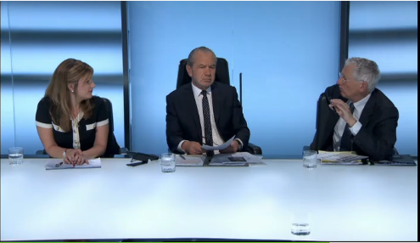
What is analysis?
Watch this extract from The Apprentice on e-stream.
Lord Sugar and the losing team analyse the cause and effects of the mistakes in the task.
Notes:
Ask students to listen out for the causes and effects highlighted in the video.
Teacher note: Watch on e-stream (using chrome) from 44:10
Demonstrates Lord Sugar as well the losing team analysing what when wrong and the consequences (i.e. causes and effects).
Watch until the firing is done.
If link doesn’t work: The Apprentice 12/14 Fast Food Chain on e-stream

Slide 4
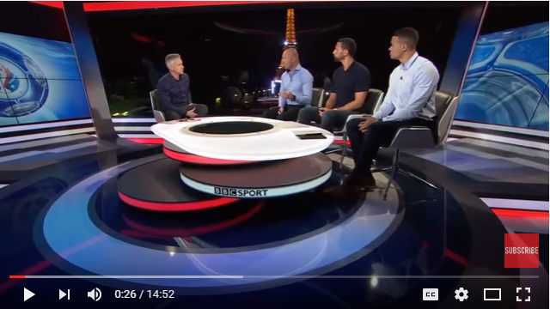
What is analysis?
Watch this post match analysis of England’s loss to Iceland.
What are the causes and effects that the panel highlight?
Notes:
Teacher note: Another example of analysis (looking at causes and effects of England's loss to Iceland in Euro 16).
Ask students to listen out for the causes and effects highlighted in the video.
Watch as much or as little as you see fit. Analytical all the way through.

Slide 5
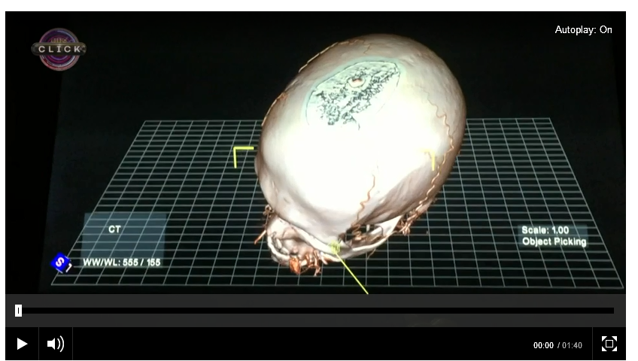
What is analysis?
Listen carefully to the points regarding the possible consequences of a this new 3d tool for Surgeons.
Where do you see chain analysis?
Notes:
Teacher note:

Slide 6
Trigger words for analysis
The question is likely to start with the commands:
Analyse …
Explain …
Why …
Examine …
Consider …
How …
For example: Explain the benefits of T.K. Maxx conducting market research
Or, How will Mr Smith’s business be affected by the fall in the value of the £?

Slide 7
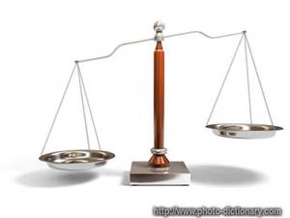
Balanced Arguments
If you are asked to analyse, don’t just look at one side of the argument, even if you firmly believe it to be the best argument.
Instead, analyse both sides of the argument to provide balance.
Example: Look at several benefits of conducting market research to T.K. Maxx; analyse the pros and cons of the fall in the £ for Mr Smith’s business.

Slide 8
Practice
Once you understand more about Business you’ll be able to see what the consequences, or ‘knock-on effects’, of Business decisions and issues are likely to be. You will be able to explain why something happened and the significance of the events and decisions that took place.
Until then, let’s practice with other topics …….

Slide 9
Explain why sales of ice cream tend to be higher in the summer months.

Slide 10
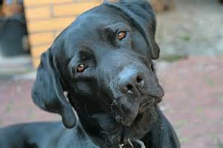
Analyse the implications of getting a dog?

Slide 11
What happens if you don’t know enough about a topic to analyse it?
If you don’t know your stuff your analysis will fall apart – an examiner will know instantly. You have to know your Business theory to be able to construct good analyses.
This is what happened when the president of Canada was asked a question about Quantum Computing in a recent press conference: click for video
It is vital you know your stuff.

Slide 12
Analysis and Evaluation
Evaluation means to judge or to make a decision. And to justify why that judgements or decision has been made.
This could be a conclusion to a question or some form of choice being made.
A thorough, balanced analysis, based on excellent subject knowledge, leads to good judgements and decisions.
It stands to reason you need to have a good understanding of topics before you can do this. This is why evaluation questions have the highest marks.

Slide 13
Trigger words for evaluation
Evaluate …
Discuss …
To what extent …
Assess …
What is the significance of …
Which …

Slide 14
Try these. Remember to analyse as well as evaluate.
Which is best?

Slide 15
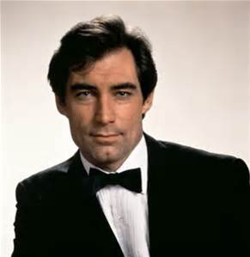
Who was the best James Bond?

Slide 16
Discuss; after 14 years, 5 movies and a great deal of loot, is it time for Johnny Depp to stop being a pirate.
If you don’t know anything about this, what are you going to do to answer the question?

Slide 17
Who should be the next Doctor Who?
Don’t know? What will you do to be able to get the answer right?

Slide 18
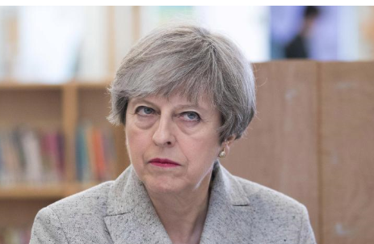
Should 16year olds be allowed to vote?
General Election
BREXIT
Police Commissioner

Slide 19
Plenary
What is analysis?
What makes a good analysis?
What is evaluation?
What makes a good evaluation?
What do you do when you don’t know what to do?

