Slide 1
To apply or not to apply?
The difference could be 25% of your marks (more than 2 grades)

Slide 2
L2 - Application
The clue is:
If the question asks about a specific business or individual(s) then you must apply your answer in context.

Slide 3
L2 - Application
Using the businesses name from the case does not necessarily mean that you are answering in context
You will need to make your knowledge of business terms, ideas and concepts relevant to the case study
You need to make reference to specific details from the case material

Slide 4
Question Examples
Explain the benefits to Mike…. (6)
Suggest ways in which Lizzie and Tony might improve (8)
Explain two benefits to The ToneZone (4)

Slide 5
L2 - Trigger Phrases
This is significant to the business because…
The theory that is relevant to this case is… because…
In this case this means that… because…

Slide 6
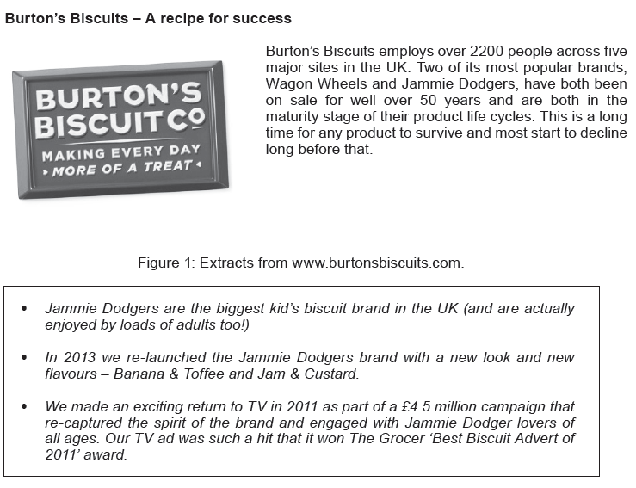

Slide 7
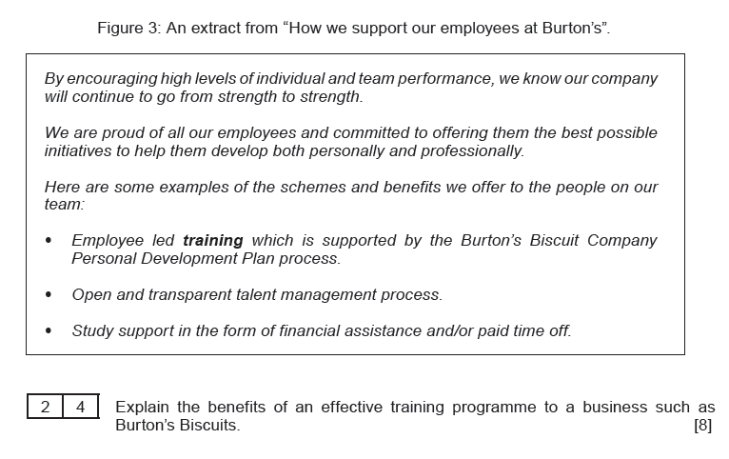

Slide 8
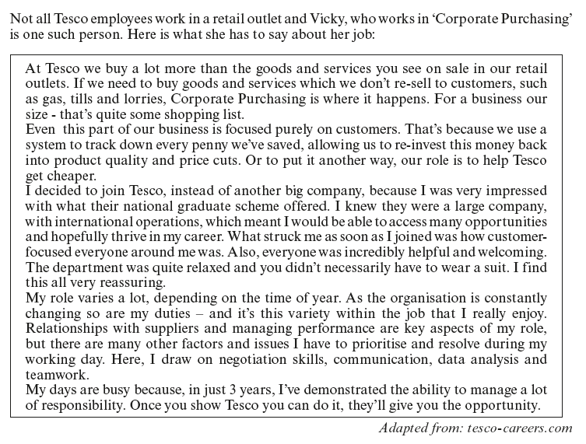
Now explain the benefits of an effective training programme for Tesco?
Notes:
BS2 Summer 2013

Slide 9
Now explain the benefits of an effective training programme for:
A hairdressers that is about to open its second salon?
A budget airline?
Godalming College?

Slide 10
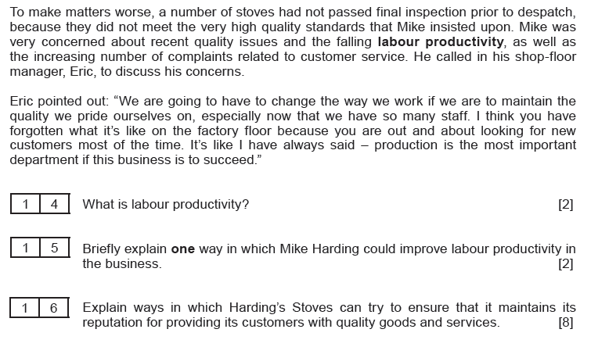

Slide 11
Now explain the ways in which the following businesses can try to ensure that they maintain their reputation for quality goods and/or services:
Tesco
A hairdressers that is about to open its second salon?
A budget airline?
Godalming College?

