Slide 1
Market Data
Types of markets
Market data

Slide 2
Market Data Starter: key terms
What is a market?
A ‘place’ where buyers and sellers come together
A set of arrangements that allows buyers and sellers to exchange goods and services
What is competition?
Rivalry between businesses offering products in the same market

Slide 3
Learning Objectives
Explain what is meant by market and competition
Identify different types of markets
Analyse and interpret market data, including market size, market share and market trends

Slide 4
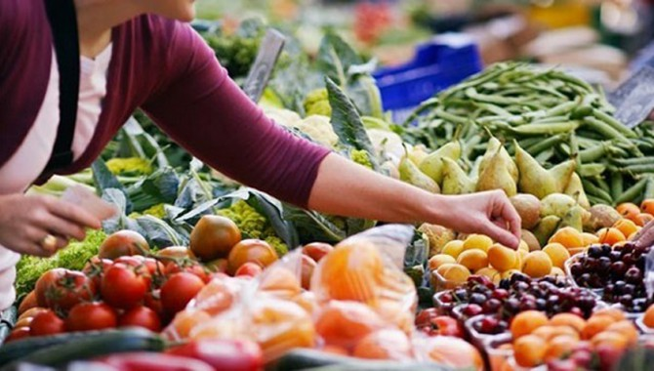
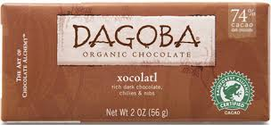
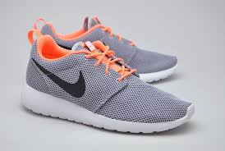
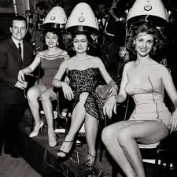
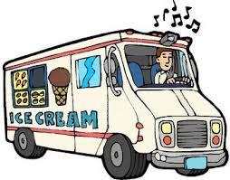
Identify the type of Market
Global or Local?
Mass or Niche?
Trade or Consumer?
Product/Service
or Seasonal?

Slide 5
Types of markets
Mass or niche?
Mass:
Niche
Local, national, global?
Trade (B2B) or Consumer (B2C)?
Product or Service?
Constant sales or seasonal?
Targets its advertising at the whole market
Economies of scale can be taken advantage of
Low cost operation, widespread distribution
Set up costs can be high and competition fierce
Targets specific segments of the market
Higher price can often be charged
Need to fully understand the needs and wants of niche
Concentrate on strengths
Lower start up costs
Can disappear quickly due to changes in economic conditions
Mass market businesses can target the niche

Slide 6
Market Share
The size of a market may be measured by value (e.g.£) or by quantity (e.g. volume: units or kgs), and usually refers to the sales of all the businesses in the market
The share of a market a business has is used as a measure of success
Market share is calculated by:
Market share is usually measured as a percentage
For example. The 2012 January-March UK car sales were 563,556 of which Ford UK sold 82,848 cars. What is the market share of Ford UK?
Answer = (82,848 / 563,556)*100 = 14.7%
The business sales | x 100 = %
Total market sales

Slide 7
Reasons to increase market share
Increased profitability
Increase sales in a stagnant industry
Increased bargaining power
Economies of scale
Reputation

Slide 8
Reasons not to increase market share
Firm is near its production capacity
Overall profits in decline due to increase advertising spend or by reducing prices
Price war
Threat from a niche competitor
Competition issues (Competition Commission)

Slide 9
Ways to improve market share
Product
Price
Place
Promotion

Slide 10
Market growth
Market growth measures the increase in value of a whole market, not just the sales of any individual firm within the market.
Market growth is usually measured as a percentage, and calculated as:
For example. The 2012 March UK car sales were 372, 835 compared to 366, 243 cars for the same period in 2011. What is the change in market growth?
New value – Previous value | = %
Previous value
372, 835 - 366, 243 | x 100 = +1.8%
366, 243

Slide 11
What drives market growth
Increase in real incomes
Fashion
New technology
Health concerns
Effective marketing

Slide 12
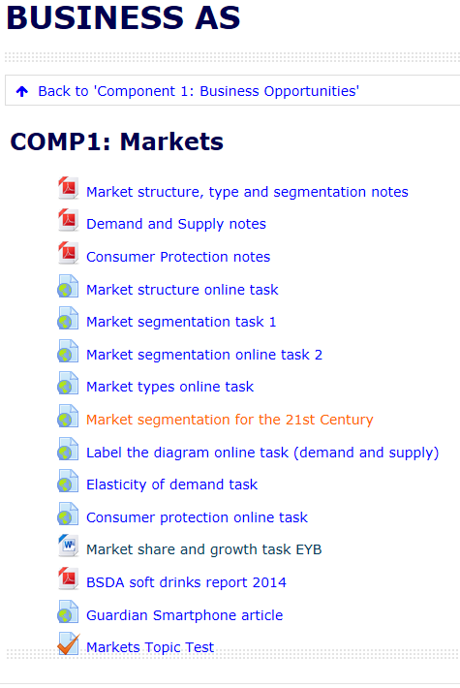
Activity
Complete the market size, growth and share worksheet on GoL.
You will need to use the BSDA soft drinks report and the Guardian Smartphone article.
Extension: Use the internet to select appropriate industries (e.g. car production, supermarkets, mobile phones) and analyse their market size, share and growth)

Slide 13
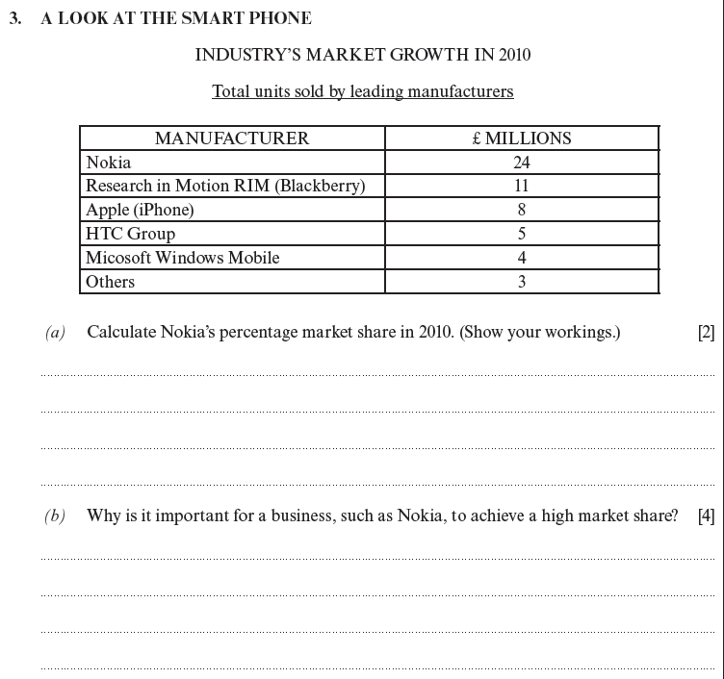
Past Paper question

Slide 14
Summary – 3:2:1
List 3 reasons to increase market share
List 2 drivers of market growth]
List 1 type of market

