Slide 1
The 4 P’s: PRODUCT

Slide 2
Elements of a successful product
Design of the product
Reliability, safety, convenience of use, fashion, aesthetics, durability, legal requirements
New product development

Slide 3
Development of new goods and services
Every new product or service passes through certain stages before it is launched
generation of ideas
analysis of ideas and feasibility testing
product development and testing the prototype
test marketing
launch

Slide 4
Influences on the development of new goods and services
Key factors influencing the development of new products are:
technology
competitors’ actions
entrepreneurial skills of managers and owners

Slide 5
Technology and the development of new goods and services
Can improve the quality of existing products
Can lead to development of totally new products
May bring products into new segments
Can lead to more cost-effective production.
Allows goods to be made to individual specifications.
Can improve business awareness of consumer tastes.

Slide 6
Competitors’ actions and the development of new goods and services
The introduction of a new product by a competitor may encourage a business to introduce its own new product (me-too)
New products from competitors can give ideas for a new product to a business.
Changes in consumer tastes may be detected through the actions of a competitor.

Slide 7
Entrepreneurial skills of managers & owners
Identifying an opportunity. A skilled entrepreneur can be the first person to spot a gap in a market.
Organisations may encourage and reward employees who come up with innovative ideas that lead to new products.
Spending on research and development can lead to new inventions.

Slide 8
Other factors leading to the development of new goods and services
market research
personal experience
personal need and inventiveness
environmental awareness

Slide 9
Unique selling points (USPs)
unique selling point/proposition: a feature of a product or service that allows it to be differentiated from other products
In developing a new product or service, many firms will attempt to differentiate it from those of competitors.
If a firm can improve customer awareness and goodwill by making its product different from rival products, it can increase both its sales volume and its price.
Loyal customers are also less likely to stop buying the firm’s product.

Slide 10
Unique selling points (USPs)
Select two products and explain the way or ways in which they achieve a unique selling point (USP).
Indicate which USP is most likely to add value.
Explain your reasoning.

Slide 11
Product portfolio analysis
Very few firms rely on one product
In a multi-product firm (e.g. Kellogg’s), the range of products is its product portfolio
Firms plan their product range to spread their risks
If one product has low sales, it may be supported by other, more successful products
An example of the way in which a business can carry out product portfolio analysis is the Boston matrix.

Slide 12
The Boston matrix: introduction
Boston matrix: a tool of product portfolio analysis that classifies products according to the market share of the product and the rate of growth of the market in which the product is sold.

Slide 13
The Boston Matrix
Looks at market share and market growth
A product with a high market share is clearly in a strong competitive situation.
A product in a high growth market should have opportunities for future growth.

Slide 14
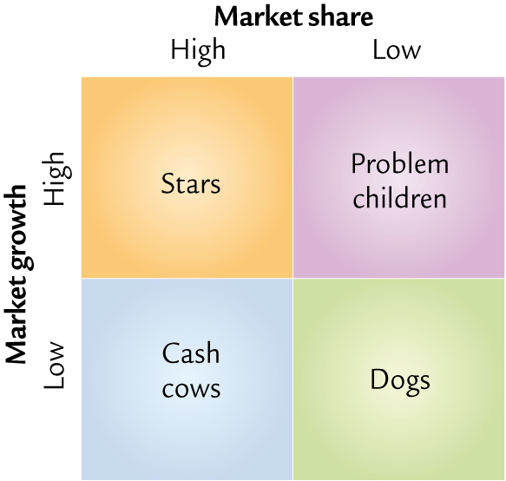
The Boston Matrix

Slide 15
Stars? Cash cows? Problem children? Dogs?
In small groups compile a list of ten products. Categorise them under the four headings above
Your ten products must include at least two stars, two cash cows, two problem children and two dogs.

Slide 16
The Boston Matrix Dogs
Are they worth persevering with?
How much are they costing?
Could they be revived in some way?
Is it cost effective to support such products?
How much would it cost to remove from the market?

Slide 17
The Boston Matrix Problem Children
What are the chances of these products securing a hold in the market?
How much will it cost to promote them to a stronger position?
Is it worth it?

Slide 18
The Boston Matrix Stars
Huge potential
May have been expensive to develop
Worth spending money to promote
Consider the extent of their product life cycle in decision making

Slide 19
The Boston Matrix Cash Cows
Cheap to promote
Generate large amounts of cash – use for further R&D?
Costs of developing and promoting have largely gone
Need to monitor their performance – the long term?
At the maturity stage of the product life cycle?

Slide 20
Product portfolio analysis: conclusion
Ideally a firm will want a portfolio of cash cows and stars
However, in the long term these products may decline, so new products with a low market share but in high growth markets will be ideal replacements
The Boston Matrix is just a generalisation. Cash cows can lose money and dogs can be very profitable in the right circumstances
Overall the Boston Matrix says relatively little about a PRODUCT and should not be used without reference to other factors, such as profitability

Slide 21
Product life cycle
the stages that a product passes through during its lifetime
development
introduction
growth
maturity
decline

Slide 22
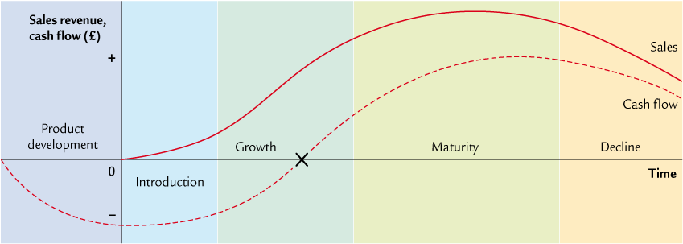
Product life cycle

Slide 23
Strategic use of the product life cycle
In theory, a firm should aim to have as many products in ‘maturity’ as possible, as these are the products that should generate most profit.
However, to achieve this in the long run a firm needs to have a policy of new product development, so that it has products in the introduction and growth stages which will eventually enter maturity.
Conclusion
Firms attempt to have a balance of products under development and in the introductory and growth stages, financed by the profits generated by their mature products.

Slide 24
Extension strategies
The main focus of the product life cycle is to keep products at their peak: that is, in the maturity stage.
This is achieved through extension strategies
extension strategies: methods used to lengthen the life cycle of a product by preventing or delaying it from reaching the decline stage of the product life cycle.

Slide 25
Extension strategies
Think of three products or services in the maturity stage of the product life cycle
Suggest different ways (extension strategies) that might be used (or have been used) to keep these products in the maturity stage of the product life cycle

Slide 26
Examples of extension strategies
attracting new market segments
increasing usage among existing customers
modifying the product
changing the image
targeting new markets
promotions, advertising and price offers
Provide one real-life example of each of these types of extension strategy (excluding examples given previously)

