Slide 1
Developing a product Range
2.1 Selecting Products

Slide 2
Product range
A complete portfolio of products that a company manufactures and/or markets so that they can appeal to different market segments.
http://www.bing.com/videos/search?q=product+range+ford+video&FORM=HDRSC3#view=detail&mid=E4208E3649D2648D8929E4208E3649D2648D8929

Slide 3
Why Businesses alter their ranges?
http://www.businessdictionary.com/videos/?2014-la-auto-show-highlights-518539647

Slide 4
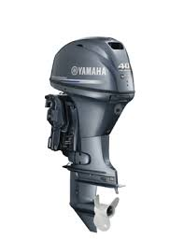
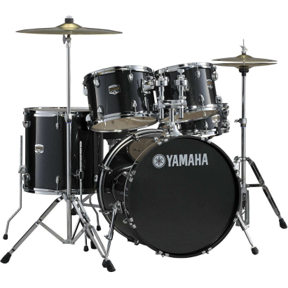
Yamaha

Slide 5
Product Portfolio
Key Term:
A collection of products a firm produces.
Eg Yamaha
Coca Cola ?

Slide 6
Coca Cola in the UK
Aquarius
Caffeine-free Diet Coke
Canada Dry
cherry Coke
Coca-Cola
Coca-Cola Cherry Zero
Coca-Cola light
Coca-Cola Zero
Cresta
diet Canada Dry
Diet cherry Coke
Diet Coke
diet Fanta
diet Kia Ora
diet Lilt
diet Oasis
diet Schweppes
Dr Pepper zero
Dr Pepper*
Fanta
Fanta Zero
Five Alive
glacéau vitaminwater
Illy *
Innocent
Kia Ora
Lilt
Lilt Zero
Malvern
Monster *
NESTEA *
Oasis
POWERADE
POWERADE ZERO
Relentless
Roses
Schweppes
Sprite
Sprite Zero
This Water
Vanilla Coke

Slide 7
Coca Cola un the USA
Aquapure
Aquarius
Bacardi Mixers *
Bacardi Premium Mixers *
Barq's
Barrilitos
Beverly
Bright And Early
Caffeine-free Barq's
Caffeine-free Coca-Cola
Caffeine-free Diet Coke
Cascal
cherry Coke
Chippewa
Citra
Coca-Cola
Coca-Cola Black Cherry Vanilla
Coca-Cola Cherry Zero
Coca-Cola Zero
Coca-Cola Zero Caffeine-Free
Cumberland Gap
DANNON *
DASANI
Delaware Punch
diet Barq's
Diet cherry Coke
Diet Coke
Diet Coke Black Cherry Vanilla
Diet Coke with Lime
Diet Coke with Splenda
Diet Fuze Tea
diet Inca Kola
Diet Master Pour
Diet Northern Neck
Diet Sprite
Diet Sprite Zero
Dr Pepper*
Evian *
Fanta
Fanta Sugar Free
Fanta Zero
Five Alive
Flavor Rage
Fresca
Fruitopia
Full Throttle
FUZE
FUZE TEA
Georgia
glacéau fruitwater
glacéau smartwater
glacéau vitaminenergy
glacéau vitaminwater
glacéau vitaminwater zero
Gold Peak
H2OK
Hi-C
Honest Ade
Honest Fizz
Honest Kids
Honest Tea
Honest Tea Zero
Illy *
Inca Kola
Java Monster*
Jericho
Kinley
Krest
Lift
Master Chill
Master Pour
Mello Yello
Mello Yello Zero
Mezzo Mix
Minute Maid
Minute Maid Enhanced
Minute Maid Fruit Falls
Minute Maid Juices To Go
Minute Maid Light
Minute Maid Orchards
Monster *
Northern Neck
NOS
Odwalla
Peace Tea *
Pepe Rico
Pibb Xtra
Pibb Zero
POWERADE
POWERADE PLAY
POWERADE ZERO
Red Flash
Schweppes
Simply
Southern Sun
Spring!
Sprite
Sprite Zero
Sugar Free Full Throttle
Sugar Free NOS
Sugar Free Sprite
Sunfill
Surge
TaB
Vanilla Coke
Vanilla Coke Zero
VAULT
Vault Zero
Vegibeta
Vegitabeta
Worx Energy *
Zico *
Aquapure
Aquarius
Bacardi Mixers *
Bacardi Premium Mixers *
Barq's
Barrilitos
Beverly
Bright And Early
Caffeine-free Barq's
Caffeine-free Coca-Cola
Caffeine-free Diet Coke
Cascal
cherry Coke
Chippewa
Citra
Coca-Cola
Coca-Cola Black Cherry Vanilla
Coca-Cola Cherry Zero
Coca-Cola Zero
Coca-Cola Zero Caffeine-Free
Cumberland Gap
DANNON *
DASANI
Delaware Punch
diet Barq's
Diet cherry Coke
Diet Coke
Diet Coke Black Cherry Vanilla
Diet Coke with Lime
Diet Coke with Splenda
Diet Fuze Tea
diet Inca Kola
Diet Master Pour
Diet Northern Neck
Diet Sprite
Diet Sprite Zero
Dr Pepper*
Evian *
Fanta
Fanta Sugar Free
Fanta Zero
Five Alive
Flavor Rage
Fresca
Fruitopia
Full Throttle
FUZE
FUZE TEA
Georgia
glacéau fruitwater
glacéau smartwater
glacéau vitaminenergy
glacéau vitaminwater
glacéau vitaminwater zero
Gold Peak
H2OK
Hi-C
Honest Ade
Honest Fizz
Honest Kids
Honest Tea
Honest Tea Zero
Illy *
Inca Kola
Java Monster*
Jericho
Kinley
Krest
Lift
Master Chill
Master Pour
Mello Yello
Mello Yello Zero
Mezzo Mix
Minute Maid
Minute Maid Enhanced
Minute Maid Fruit Falls
Minute Maid Juices To Go
Minute Maid Light
Minute Maid Orchards
Monster *
Northern Neck
NOS
Odwalla
Peace Tea *
Pepe Rico
Pibb Xtra
Pibb Zero
POWERADE
POWERADE PLAY
POWERADE ZERO
Red Flash
Schweppes
Simply
Southern Sun
Spring!
Sprite
Sprite Zero
Sugar Free Full Throttle
Sugar Free NOS
Sugar Free Sprite
Sunfill
Surge
TaB
Vanilla Coke
Vanilla Coke Zero
VAULT
Vault Zero
Vegibeta
Vegitabeta
Worx Energy *
Zico *

Slide 8
Why do you think Coca Cola has so many different brands?
In a multi-product firm (e.g. Kellogg’s), the range of products is its product portfolio
Firms plan their product range to spread their risks
If one product has low sales, it may be supported by other, more successful products

Slide 9
The Boston Matrix

Slide 10
The Boston Matrix: a tool of product portfolio analysis that classifies products according to the market share of the product and the rate of growth of the market in which the product is sold.

Slide 11
Product Portfolio Analysis - Conclusion
Ideally a firm will want a portfolio of cash cows and stars
However, in the long term these products may decline, so new products with a low market share but in high growth markets will be ideal replacements
The Boston Matrix is just a generalisation. Cash cows can lose money and dogs can be very profitable in the right circumstances
Overall the Boston Matrix says relatively little about a PRODUCT and should not be used without reference to other factors, such as profitability

Slide 12
Product Portfolio Analysis - Conclusion
Other factors that should be considered:
The exact meanings of high and low market share.
The exact meanings of high and low market growth.
The size of the market.
The definition of the market.
How profitable is the product?
Consumer opinions and loyalty.

Slide 13
Product life cycle

Slide 14
Product Life Cycle – What is it?
The product life cycle is a theoretical model which represents the stages in the life of a product and the sales that are achieved at each stage.
The product life cycle measure the change in sales of the product that occurs over time (sales are not constant)

Slide 15
Introduced in 1923.
3 million produced every day
But how has this company avoided decline in their sales?

Slide 16
Extension Strategies.

Slide 17
Extension Activities
Re-Packaging
Discounting
Re-Branding
Expanding Abroad

Slide 18
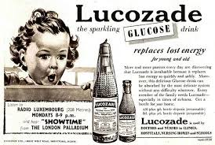
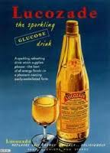
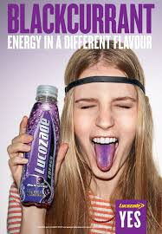
Introduced around 1910 as a drink for malnourished patients at hospital

Slide 19
Lifecycle and profits

