Slide 1
Product and market orientation

Slide 2
Product orientation
This is where a business focuses on the production process and the product itself
e.g. Dyson

Slide 3
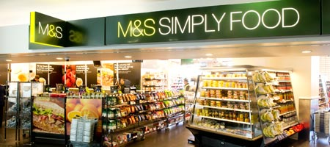
Market orientation
This is where a business continually identifies, reviews and analyses consumers’ needs
e.g. M&S, Proctor & Gamble, Virgin

Slide 4
What does approach depend on?
Nature of product
Policy decision
View of those in control
Nature and size of market
Degree of competition

Slide 5
asset lead marketing
A business that is asset-led is responsive to the needs of the market.
However, it takes into account it own strengths and weaknesses when producing a product or service.

