Slide 1
5 Stages in the Product Life Cycle
Definition: A theoretical model which describes the stages that a product goes through
Product development
Introduction
Growth
Maturity
Decline / extension strategies
Theory can be applied to a:
Product category
Style
Brand or model
Each stage of the Cycle has an implication for:
(a) Net cash flow, (b) Profit and (c) Marketing strategy

Slide 2
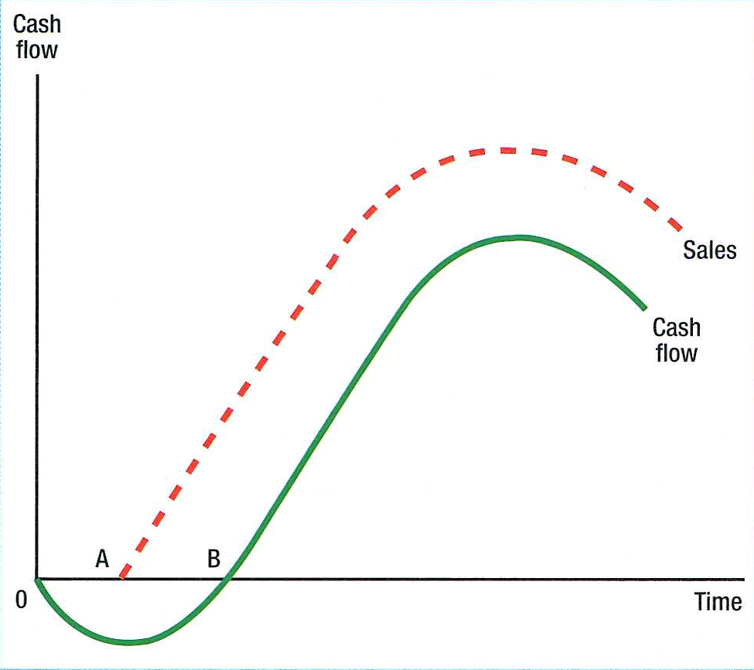
Product Life Cycle and Cash Flow Cycle
Development
Introduction
Growth
Maturity
Decline
Positive
Negative
Cash flows out of the business to pay for product development (R&D, market research, factors of production) and during Introduction (above-the-line & below-the-line marketing). If the product is successful cash flow will become positive as the sales revenue (quantity x price per unit) is greater than total costs (fixed costs + variable costs)

Slide 3
1. Development Phase
Research & development phase: Often complex. Absorbs significant resources (opportunity cost). May not be successful. May involve long lead time before sales are achieved (e.g. pharmaceuticals – 10 years, motor cars – 7 years).
Product development: CAD, CAM is shortening development time. Evaluation at each stage may still result in the project being scrapped. Cost of development rises as launch approached (e.g. patents, government agencies approvals). Test and Pilot stages before full launch.
Causes of elimination before product launch: Inadequate demand. Competitors actions. Change in the external environment. Production problems. Government action. Business aims change. Life Cycle forecast to be too short.

Slide 4
2. Introduction Phase
New product launched: Low level of sales and capacity utilisation. High unit costs – teething problems occur. Cash flow usually negative. Distributors may be reluctant to take the new product. Extensive promotion to inform and persuade consumers.
Strategies at the introduction phase: This stage makes special demands on the marketing function. Aim – to encourage customer ‘adoption’. High promotional spending to create awareness and inform people. Pricing strategy – penetration or skimming. Limited focused distribution. Demand from consumers who are ‘early adopters’.

Slide 5
3. Growth Phase
Expanding market: But competitors arrive. Fast growing sales. Increase in capacity utilisation. Product gains market acceptance. Cash flow may become positive. As capacity utilisation rises unit costs fall.
Strategies at the growth phase: Advertising to promote brand awareness. Increase in distribution outlets – intensive distribution. Go for market penetration and (if possible) price leadership. Target the majority of potential buyers. Continuing high promotional spending. Improve the product – new features, improved styling, more options.

Slide 6
4. Maturity Phase
Rate of growth slows: Competitors enter the market = intense competition + fight for market share. Capacity utilisation high. High market share equals high profit – as price premiums per unit competed away. Cash flow should be strongly positive. Weaker competitors start to leave the market. Price and profits may start to fall.
Strategies at the maturity phase: Defend market share. Product differentiation and product improvements. Production capacity rationalised. Pricing based on competitors. Promotion seeks to differentiate. Persuasive advertising. Intensive distribution with incentives. New market segments explored. Repositioned product through developing new uses.

Slide 7
5. Decline Phase
Rate of growth becomes negative: Falling sales. Market saturation. Decline in profits and weaker cash flows. More competitors leave the market. Decline in capacity utilisation – switch capacity to alternative uses.
Reasons for decline: Technological advances. Changes in consumer taste and fashion. Increased competition. Economic circumstances. Damaging publicity. Product side effects. Government action.
Strategies at the decline phase: Maintain market share. ‘Harvest’ by spending little on marketing the product. Rationalise by deleting product variations. Price cutting to maintain competitiveness. Promotion to retain loyal customers. Distribution narrowed.
Strategies to reduce the rate of decline: Increase promotion. Focus on the profitable segments. Reduce prices. Change distribution channels. Product improvement. Re-position the product.

Slide 8
Extending the Product Life Cycle
Consider any / all of the following: Change price. Change promotion. Change product – restyle. Change distribution – online. Develop ne market segments. Find new uses for the product. Re-position the product.
Product culls: Elimination of the non-profitable products that have no other use (e.g. key customer requires them). Weak products take management time and may be create negative cash flow.
Product Life Cycle is short if: The rate of technological change is rapid. There is a high degree of innovation in the market. Customers’ tastes are changing rapidly. The product is a fashion item. The product is badly marketed.

Slide 9
Discussion 1of2
Is decline inevitable?: This is the assumption. But some classic products have a long life cycle and no apparent signs of decline. These are exceptions to the rule, e.g. Corn Flakes, Coca Cola.
Uses of the Product Life Cycle?: To forecast future behaviour of sales. To be a tool of analysis to assist in the formulation of marketing strategies. As a device to achieve the aims of the business, i.e. manipulate the product marketing. To identify deviations from the norm. To aid the analysis of the firm’s product portfolio.
A balanced portfolio is a business goal: Product portfolio refers to the mix of products produced by a single firm. Preferable to have products at different stages of their Life Cycle. There is a benefit to cash flow and management resources can be allocated to where the need is most pressing.

Slide 10
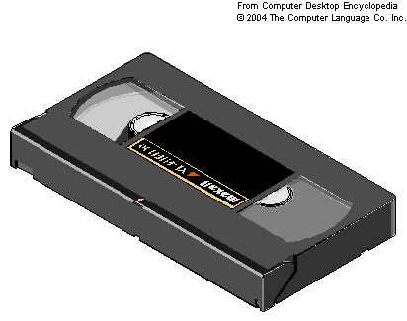
Discussion 2of2
Criticisms of the Product Life cycle: The shape and duration of the cycle varies. Strategic decisions can change the Life Cycle. It is difficult to recognise exactly where a product is on its life cycle. Life cycle cannot be reliably predicted. Decline is not inevitable? Assumes consumers will not revert to previous behaviour. Determinism – it can become a self fulfilling prophecy.
Product Life Cycle of the VHS video:
1976 | Competing video systems launched: VHS (JVC and Victor) and Betamax (Sony)
1980s | VHS-Betamax war. VHS’s advantages of longer playing time and liberal licensing system gave it the edge.
1984 | Toshiba formulates a plan for Digital Video Disc
1987 | Betamax concedes defeat
1996 | First film released on DVD
2003 | US DVD rentals surpass VHS
2004 | Hollywood studios stop releasing films on VHS

Slide 11
Light bulb Life cycle

Slide 12
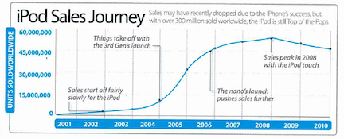
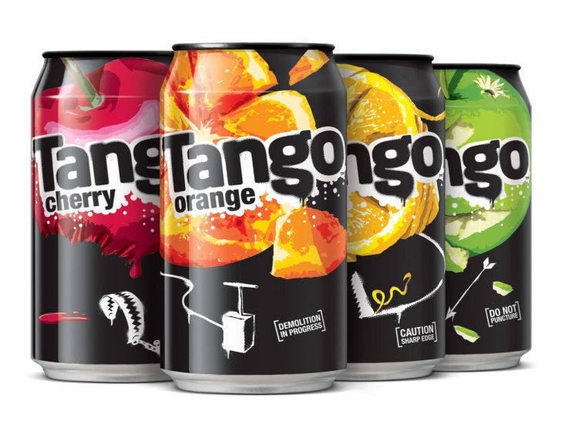
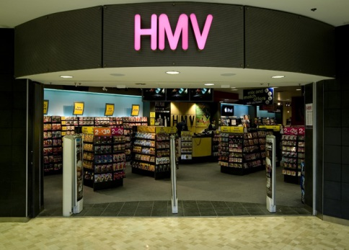
Product Life Cycle: extension strategies
Rescue the MP3 player, how?
Rescue TANGO, how?
Rescue HMV, how?

