Slide 1
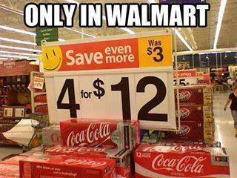
What pricing strategy?

Slide 2
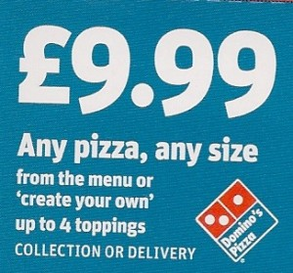
What pricing strategy?

Slide 3
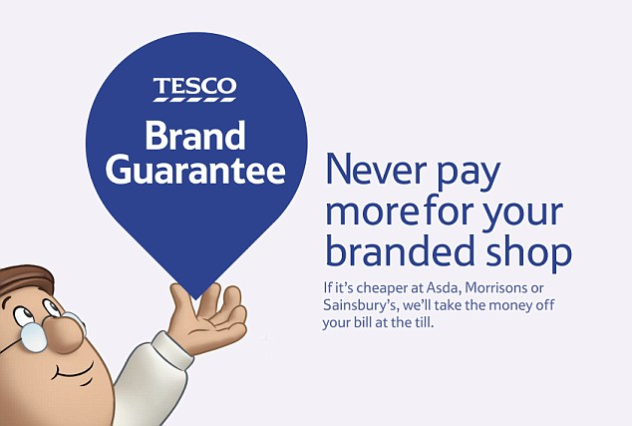
What pricing strategy?

Slide 4
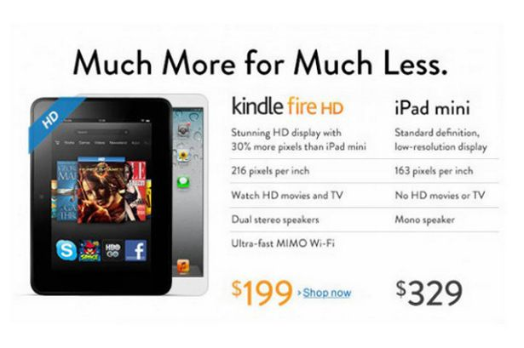
What pricing strategy?

Slide 5
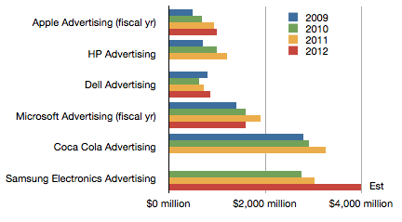

Slide 6
Homework
Common work 2, see back of handout (Promotion)
Due 18/03/16

Slide 7
What is promotion?
The process of communicating with customers or potential customers
To provide customers with information
To increase sales or market share
To give products an image
To establish a corporate image
To enable long term planning to take place (life cycles)

Slide 8
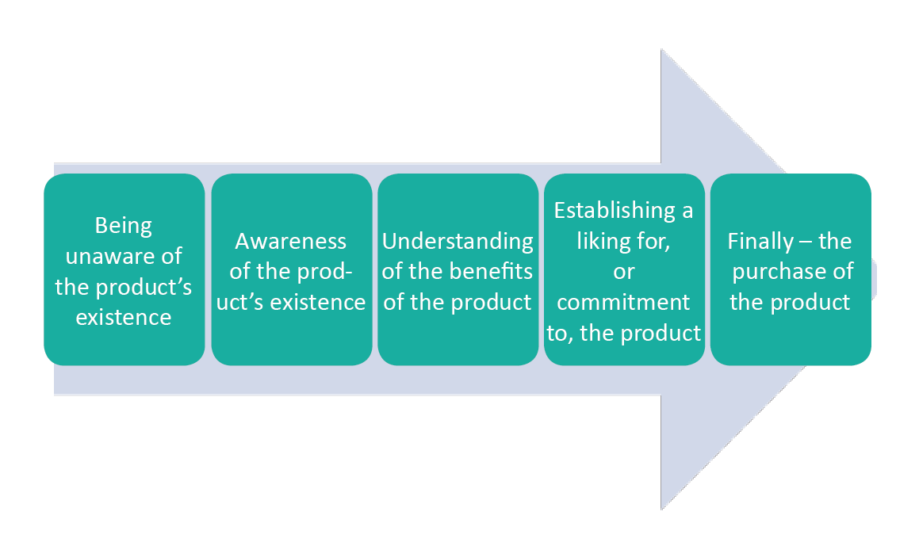
Stages of promotion

Slide 9
Promotion
Above the line
Promotion through independent media which allows a business to reach audience easily
e.g. advertising, TV, Radio, Cinema, Newspapers, Posters
Below the line
Methods over which a business has direct control
e.g. Public Relations (PR), merchandising, sponsorship, direct marketing, personal selling, competitions

Slide 10
Choice of media? Depends upon…
Above the line
Advertising, TV, Radio, Cinema, Newspapers, Posters
Target market
Cost
The reach of the media
The type of product
The amount of information to be conveyed

Slide 11
Typically used for:
Below the line
Public Relations (PR), merchandising, sponsorship, direct marketing, personal selling, competitions
Short term promotions (special offers)
B2B promotion
Providing information
Where personal selling is required

Slide 14
Tasks
Complete Question 2
Complete Tutor2u marketing quiz
Extension: Complete homework: Common work 2 (Anna Lever)
All questions are in the handout provided

