Slide 1
What am I? (Boston Matrix recap)
I have a low market share and low market growth. I am a …..?
I have low market share and high market growth. I am a …..?
I have high market share and high market growth. I am a ….?
I have high market share and low market growth. I am a ….?

Slide 2
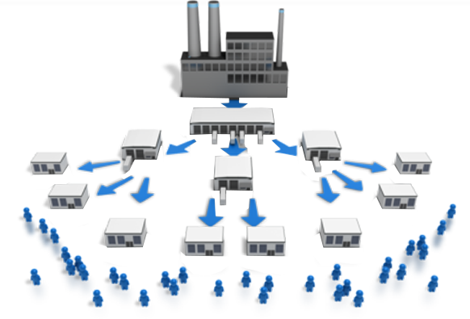
Business Functions: Marketing
Using the marketing mix: Place

Slide 3
Learning Objectives
Explain what is meant by place
Explain the different distribution channels used by businesses
Explain what is meant by multi channel distribution
Explain the importance for a business of selecting the most appropriate distribution channel/s
Evaluate the impact of selecting the right distribution channel/s on a business and its stakeholders

Slide 4
Marketing Mix - Place
Definition:
To make products available in the right place at the right time in the right quantities
Where shall we sell our products?
What methods shall we use to distribute the goods to the final consumer?
In some instances, place is obvious, in others more complex – i.e. when trying to achieve an image or develop a brand.

Slide 5
Why place is important
Goods and services must be accessible.
Place can also be used to establish brand identity.
Some goods are now distributed through a wider range of outlets than ever before = high level of consumption.
Place can be fought for and existing distribution channels protected. Manufacturers will give retailers discounts if their brand is given price of place on supermarket shelves.

Slide 9
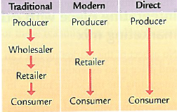
Methods of distribution
Distribution channels: Channels or routes through which a product passes in moving the producer to the consumer.
DISTRIBUTION CHANNELS IN CONSUMER MARKETS are constantly evolving in response to technology, competition, consumer tastes and government legislation.
A producer (manufacturer) provides the good or service.
Using a wholesaler:
Traditionally a wholesaler provides a service to the producer by storing bulk shipments, taking the risk of selling onwards and providing cash flow.
And provides to the retailer the service of storing, bulk breaking and mixing products ready for “on demand” delivery.
Direct Selling:
Consumers are the individuals (or businesses) that purchase the finished product for their own use. The distribution channel must meet their needs and lifestyles. As consumers have less leisure time, convenience has become more important (e.g. Direct channels).
Manufacturer to retailer: The retailer, when very large (e.g. supermarkets) can provide to the producer the services of the wholesaler & therefore cut them out (e.g. Modern). In addition, retailers provide to customers some or all of the following services; convenience, advice, financial assistance & after sales support .

Slide 10
https://www.youtube.com/watch?v=ALoo4vrKKUw

Slide 16
Multi-channel distribution
It can make sense to use a combination of distribution channels
Apple sets up its own shops in major cities. It also sells through a huge range of retailers and, of course, has an online presence
In adopting such a strategy Apple is maximising as many of the advantages as it can from each distribution channel chosen

Slide 17
Factors influencing the method of distribution
The size of the retailer: large retailers will want to by pass the wholesaler.
The type of product: perishable products being sent to a limited number of retailers may be better of bypassing wholesaler.
Technology: more products being sold on the internet
The geography of the market: in remote area, less likely to be cost effective for a producer to deliver directly.
The complexity of the product: may need direct contact with the producer.
The degree of control desired by the manufacturer
Notes:
Read through notes

Slide 18
Activities
Use the ‘Chapter 6 – Place’ note at the top of the list in the Marketing – Place section on Godalming Online.
Use the notes and the lesson slides on Godalming Online to consolidate key information and create a one side of A4 revision sheet which includes
What is meant by place
The different distribution channels used by businesses and brief benefits / drawbacks of each
What is meant by multi channel distribution (with a suitable example to demonstrate)
The factors influencing the method of distribution
Information should be laid out in a revisable format, focusing on key information and with images / diagrams to support
You can create electronically or hand written.
2. Fully answer the Sigma 3 place questions a (i) and a(ii) using correct exam technique (on Godalming Online)

Slide 19
Plenary
Plenary
‘Businesses without an internet sales presence are doomed to failure’
Do you agree with this statement? Why / why not?

