Slide 1
TR = selling price x quantity
Profit = TR – TC
FC & VC
FC = Salaries & Rent VC = Raw materials & Commission
Contribution = selling price – VC (per unit)
BE = FC / contribution per unit
Net cash flow = cash inflows (income) – cash outflows (expenditure)
Outflows = Salaries & Interest on loan Inflows = Cash sales & Bank loan
Income, Expenditure, Profit
Net Profit = (net profit/sales revenue) x 100

Slide 2
Decisions about the marketing mix & new technology

Slide 3
The marketing mix will differ in different contexts
Local vs national vs global
Perfect competition vs monopolistic competition vs oligopoly
Goods vs services
Niche vs mass markets
B2B vs B2C
Notes:
Discussion point – in pairs - give each a bullet point. Students need to think of a business for each context and identify and explain how their marketing mix will differ and why?

Slide 4
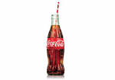
The importance of global marketing and global brands
Brand = name, term, sign, symbol, design or any other feature that allows consumers to identify the goods and services of a business and to differentiate them form those of competitors.
McDonald’s ‘golden arches’; Nike ‘swoosh’; Adidas three stripes; Virgin V; coke bottle

Slide 5
What are the reasons for branding?
CREATE CUSTOMER LOYALTY A barrier to entry for competitors
DIFFERENTIATE THE PRODUCT Gives a clear product identity when there is similarity in design
PRICING FLEXIBILITY Creates price inelastic demand. Customers pay higher prices
TRUST Customers re-purchase because they trust the product
BRAND IMAGE To attract customers through the ‘classic’ or ‘quirky’ positioning

Slide 6
Impact of branding
Notes:
https://www.youtube.com/watch?v=JKIAOZZritk

Slide 7
Why might businesses market their products internationally?
PROFIT: Prices may be higher, costs lower and markets less competitive
SPREAD RISK: Less vulnerable to changes in the economic conditions in one market
EXTEND PRODUCT LIFE CYCLE: Products that maybe in decline in one market can be re-launched in a new one
LEGAL: There maybe fewer restrictions on labour, environmental issues and products such as alcohol, tobacco, pharmaceuticals

Slide 8
Why are global brands considered ‘gold dust’ to a business?
BENEFITS Economies of scale; marketing, operational, managerial, financial
RE-PURCHASE Wherever customers travel the brand can be purchased
E.g. a Big Mac is a Big Mac no matter where you are in the world!

Slide 9
Why is the overseas market different?
POLITICAL Instability can result in investments being ‘written off’, e.g. Zimbabwe, Russia
CULTURAL Understand differences in language, colour, body shape, gender and ‘bribes’
LEGISLATION Differences in product labelling and safety, environment impact, advertising
ECONOMIC GDP, average income, distribution of income, taxation
SOCIAL Demographics, role of women, educational attainment, religion, attitudes
BUSINESS PRACTICE Whether to customise products to the market, accounting practices, transportation networks, media opportunities, market structures and competitors

Slide 10
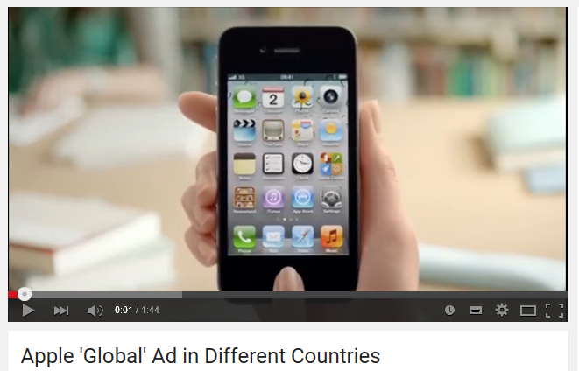
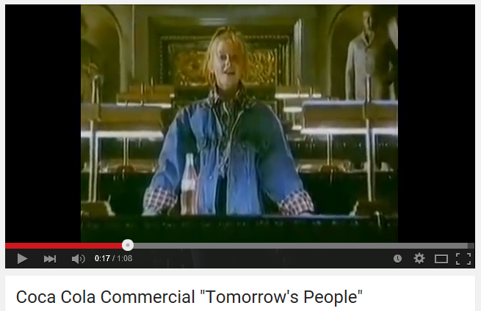
Understand the importance of global marketing and global brands
Notes:
Videos to demonstrate same advertising in different countries
Apple - https://www.youtube.com/watch?v=MoE9XxXUatA
Coca Cola – link takes you to page where can play the different versions from around the world (same ad apart from the opening child)
https://www.youtube.com/results?q=coca+cola+tomorrow%27s+people+around+the+world

Slide 11
Activity - evaluate the marketing mix in different contexts
Identify a global brand.
Analyse how their marketing varies from one country to another (relate specifically to the 4Ps in the marketing mix)
Explain the reasons for this.
Investigate the problems the business is likely to have when involved in global marketing.
Notes:
Individual task – then put in pairs to compare their answers / findings.

Slide 12
Plenary
How might the marketing mix be adapted to meet the different needs of consumers in the global marketplace?

Slide 13
New technology and marketing

Slide 14
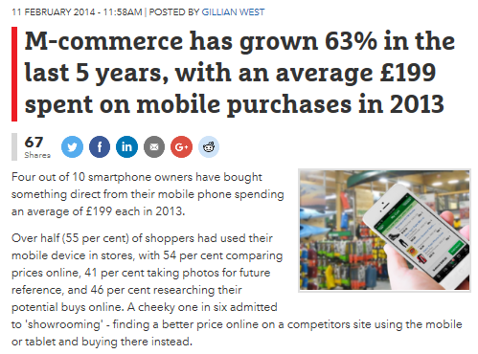
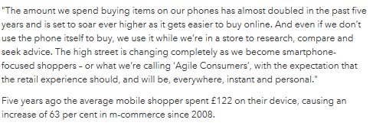

Slide 15
Explain how new technology is used in marketing
Each of the 4 Ps has to change and evolve to meet the demands of this new method (i.e. the internet) of reaching customers.
Clicks and bricks
Social media
M-commerce
E-tailing
Pricing and the internet
Notes:
Students should come up with examples of businesses who use this type of technology

Slide 16
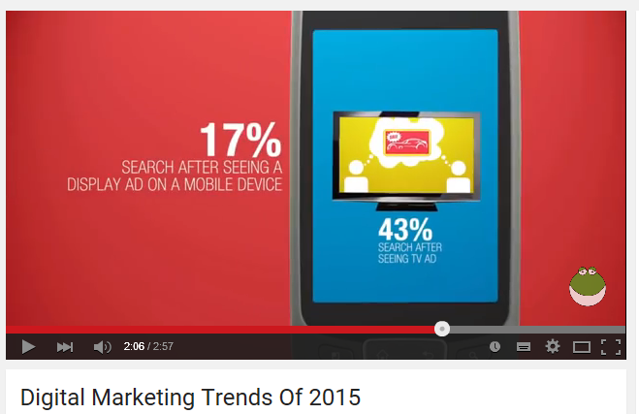
M-commerce / Mobile Marketing
Notes:
https://www.youtube.com/watch?v=l_Ei7CxXwuo

Slide 17
Explain the impacts of new technology on existing businesses such as high street retailers.
Identify the benefits and drawbacks of new technology on a retail fashion business (e.g. Superdry, New Look) or a supermarket
Advantages | Disadvantages
Can reach a global market (even if only a small business) | Fierce competition
Reduce costs by not having to be close to consumers (may close stores or locate stores in cheaper areas) | Dependent on efficient delivery services
Longer opening hours | Costs of ensuring the site is safe for consumers to use and data is protected.

Slide 18
The impact of new technology on the marketing mix
Businesses involved in e-tailing or using new technology need to consider the impact on their marketing mix.
Product | Price | Promotion | Place
USP | Competitive pricing Skimming/penetration | Will revolve around use of the internet (e.g. email alerts, cookies etc) | More choice. There may be no need for the business to close to it’s customers

Slide 19
Activity – Evaluate the impact of new technology on the marketing activities of a business and its stakeholders
Carry out research online to find out what new technology is available to small and large scale businesses to help them market their products and services.
Write up your findings and relate to a specific small / large business.
15 minutes
Choose a business and investigate how new technology helps their marketing effort.
Evaluate the impact(e.g. better targeting, costs savings, greater impact, improved access to potential consumer)
30 minutes
Notes:
In pairs

Slide 20
Plenary
Explain the impact of new technology on the marketing mix

