Slide 1
Cash Flow Forecasting
Cash is King!
Discuss......
Business Finance

Slide 2
Starter
Think-Pair-Share
How would you define ‘cash flow’?
Come up with two examples of ‘inflows’ and two examples of ‘outflows’?

Slide 3
Learning Objectives
Explain what is meant by cash flow
Explain what is meant by a cash flow forecast
Construct, calculate and interpret cash flow forecasts

Slide 4
Key Terms
Cash flow: the continuous movement of cash in and out of the business
Cash flow forecast: showing the expected flows of cash in and out of a business
Cash flow statement: shows an historic view, showing the actual flows of cash in and out of the business

Slide 5
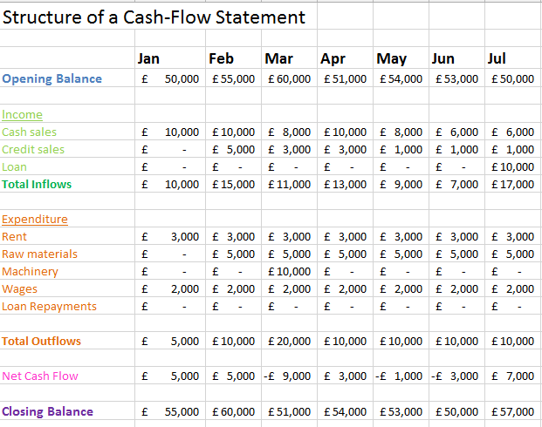
Cash Flow Forecast Structure

Slide 6
Purpose of cash flow forecasting
To anticipate potential shortages of cash
To examine and possibly adjust the timings of receipts and payments in order to avoid problems
To arrange financial support

Slide 7
Benefits of cash flow forecasting
An accurate cash flow forecast will allow a firm to get a clear idea of how the business is doing - and how it is likely to perform in the future
Allows managers to be able to specify times when the business may need additional funding, such as when cash outflow exceeds inflow
Inconsistencies in performance can be identified, predicted and remedied
Changes in inflows and outflows resulting from major new investments can be accurately assessed

Slide 8
Problems of cash flow forecasting
Inaccurate market research (e.g. sampling errors or interviewer bias)
Changing tastes (fashion and tech)
Competitors (actions cannot be predicted)
Economic changes (changes to inflation, economic growth, unemployment)
Uncertainty (estimation of costs, the longer the time scale the less accurate the forecast is likely to be)
Drawing up the cash flow forecast takes up managers time

Slide 9
Activities
Read the Cash Flow Forecasting Handout highlighting key points.
Complete the questions on page 4 of the handout by interpreting the CFF on page 2.
15 minutes
Complete the CFF for Andrew Nut and Albert Spanner. Carefully read the case studies and construct their forecasts.
30 minutes
Notes:
5 minutes going through answers for Activity 1 – 5 minutes for activity 2
Extension: knowledge questions on page 210 of HJR

Slide 10
Plenary
Complete the Cash Flow Forecasting summary sheet

