Slide 1
Profit and Loss Accounts

Slide 2
What is it?
A profit and loss account is a statement that shows a firms’ sales revenue over a trading period and all relevant cost.
Profit is made when sales are greater than costs
Loss is when costs are greater than sales
Making a profit is a key business objective

Slide 3
Gross Profit
There are two types of profit:
Gross profit – this is the difference between sales revenue and the cost of making or purchasing the goods sold
Gross profit = sales revenue – cost of goods sold
Gross profit is an indicator of how efficient the firm is at making and selling it product.

Slide 4
Net Profit
After calculating gross profit you then remove all other expenses and overheads. This results in net profit.
Net profit = gross profit – (expenses and overheads)
Net profit is an indicator of how efficient a firm is overall at managing it costs.

Slide 5
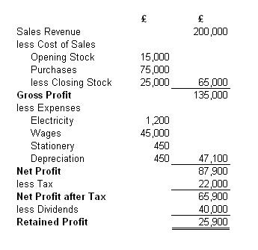
Example

