Slide 1
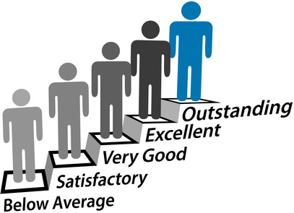
Performance Management

Slide 2
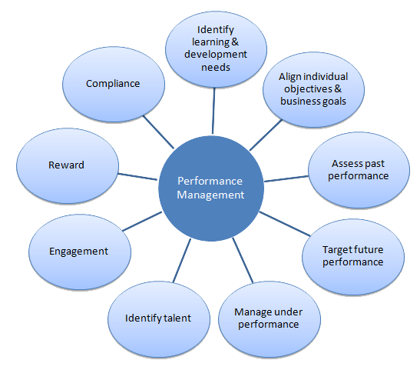

Slide 3
performance review (appraisal)
What is it?
An attempt by the business to find out the qualities, usefulness and or worth of it’s employees
Regular meetings in which the staff members performance is analysed
Why does a business carry out staff appraisal?
https://www.youtube.com/watch?v=IkYUDQCYGHA

Slide 4
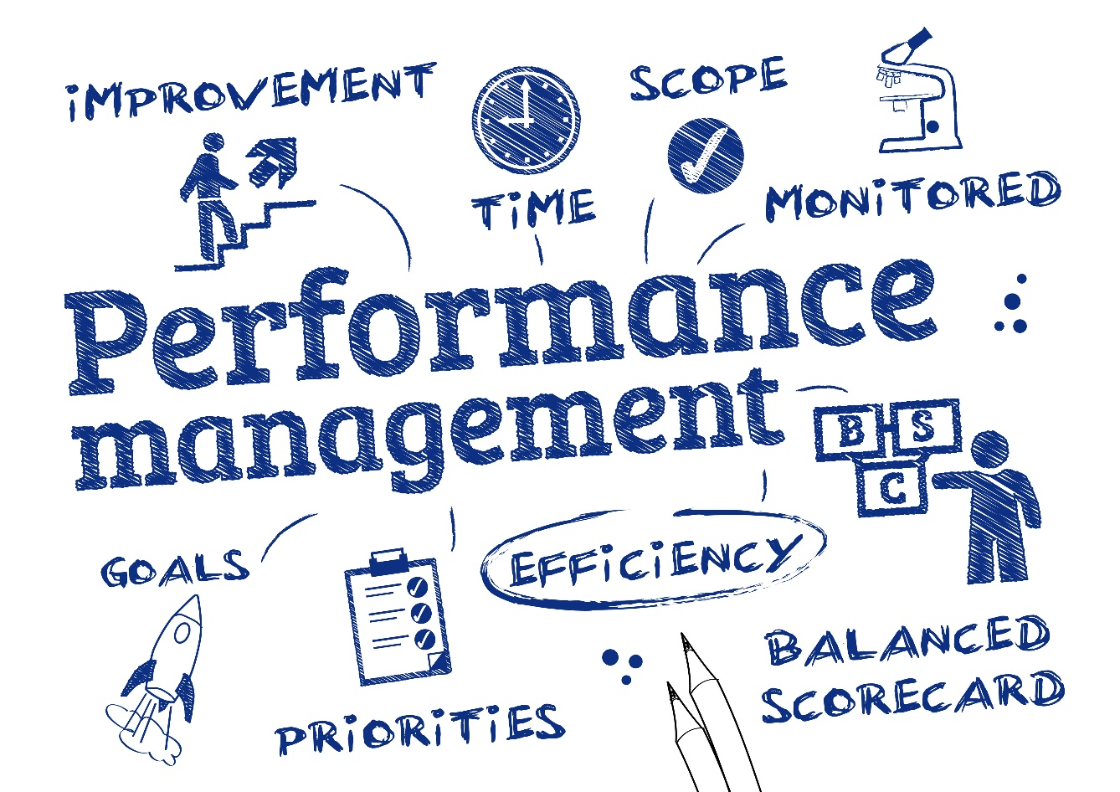
Staff Appraisal: How is performance analysed?
An employee may be judged on a range of tasks completed, such as:
Number of complaints
Performance of subordinates
Management of budget
Customer service

Slide 5
Staff Appraisal: Superior's Assessment
Most appraisals are carried out this way
Benefit: the supervisor usually has an intimate knowledge of the tasks that a worker has performed and how well they’ve done them
Drawback: difficult for the supervisor to remain impartial

Slide 6
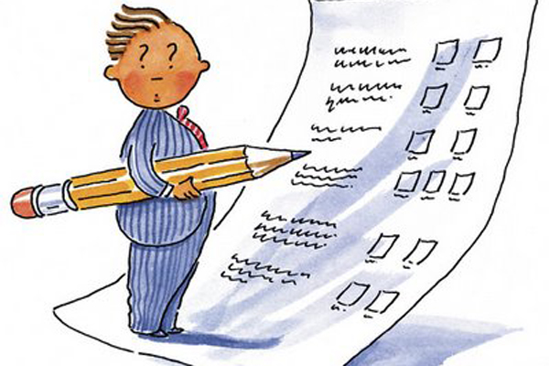
Methods of appraisal: Self-assessment
The process of having the employee:
Reflect on their own performance
Record their progress
Suggest targets for future
Perhaps the most important benefit is self-reflection - ‘How can I improve?’

Slide 7
Methods of appraisal : Peer-assessment
The process of having employees of similar levels of responsibility critically comment upon performance of a co-worker and perhaps suggest methods of improvement
Arguably more reliable and valid as peers have a more comprehensive view of the employee’s job performance

Slide 8
Methods of appraisal: 360 degree appraisal
The appraised staff member receives feedback from people whose views are considered helpful and relevant e.g. fellow workers, line managers, junior staff, team members, customers and suppliers
It also includes self-assessment to give a complete appraisal of the individual (360 degree)
This method should provide a full picture of performance and it may help a business when making decisions when related to the performance of the individual

Slide 9
Benefits and Drawbacks to the Business
Benefits
Drawbacks
Motivates staff
Improves performance
Allows the setting of achievable targets
Identifies training needs
Identifies potential
Enables achievable bonuses to be earned
Causes tension in the workplace
Puts workers under pressure to improve
Places too much power in the hands of line managers

