Slide 1
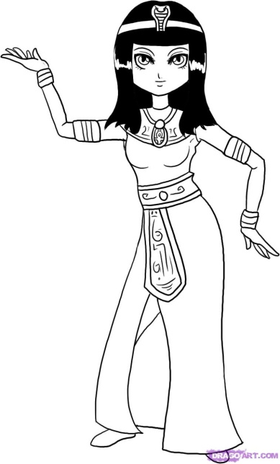
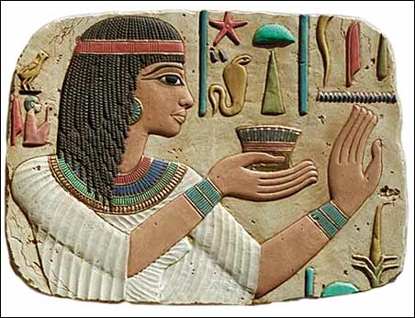
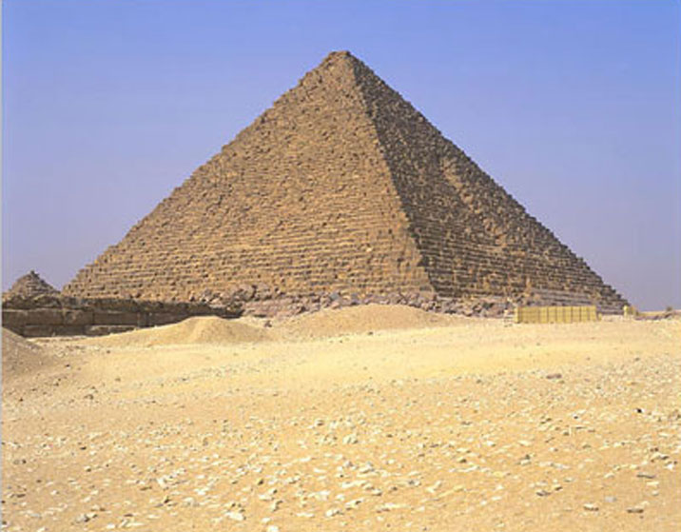
Organisational Structures: key terms & examples

Slide 2
Keywords
To answer questions on the topic of organisational structures you must be able to make accurate use of these keywords
Delegation
Span of control
Responsibility
Hierarchy
Organisational structure
Chain of command
Authority

Slide 3
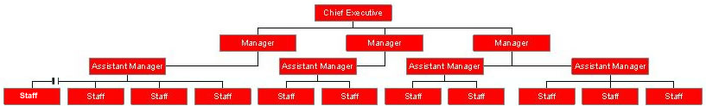
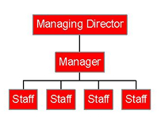
Organisational Structures:
  the way in which a business is organised
Hierarchy: the order or levels of management of a business, from the lowest to the highest type
‘Tall’ type Organisational Structure
‘Flat’ type Organisational Structure

Slide 4
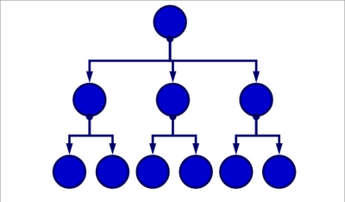
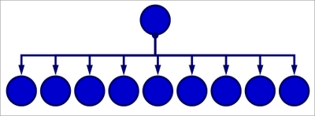
Span of control
How many people directly controlled by a manager

Slide 5
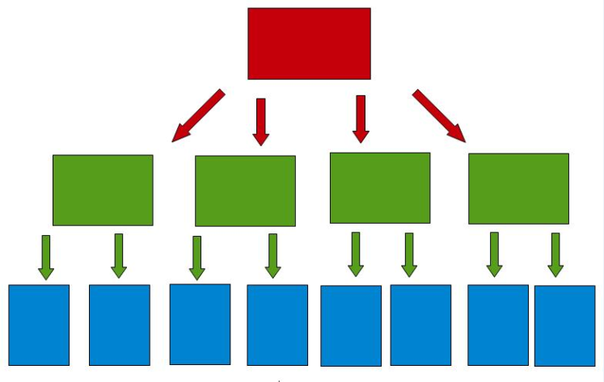
Chain of Command
The way authority and power are passed down in a business

Slide 6
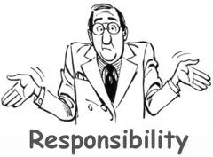
Authority and responsibility, is there a difference?
A manager can delegate authority to a subordinate.
However, responsibility must remain with the manager
MD
Manager
Employee
Employee
Manager
Employee

Slide 7

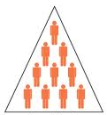
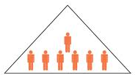
Delayering
The levels of an organisation are called layers. Delayering is removing layers of management from the hierarchy of an organisation

Slide 8
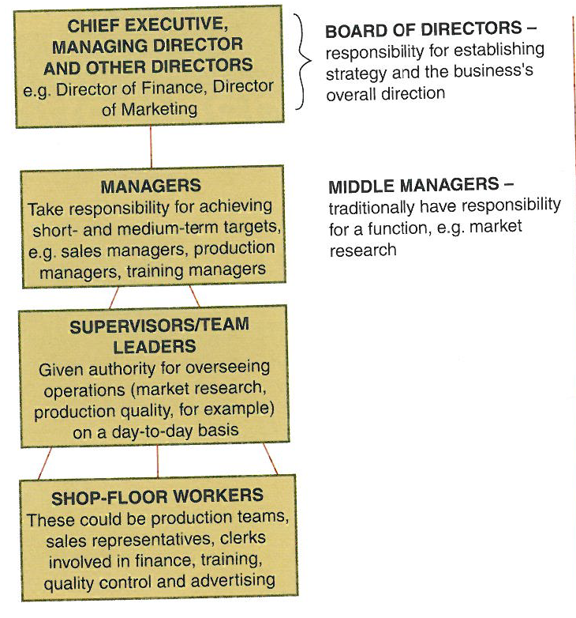
Communication in an organisation
Communication can pass down, up and across an organisation; for example between managers .
How much communication takes place will depend on the leadership style

Slide 9
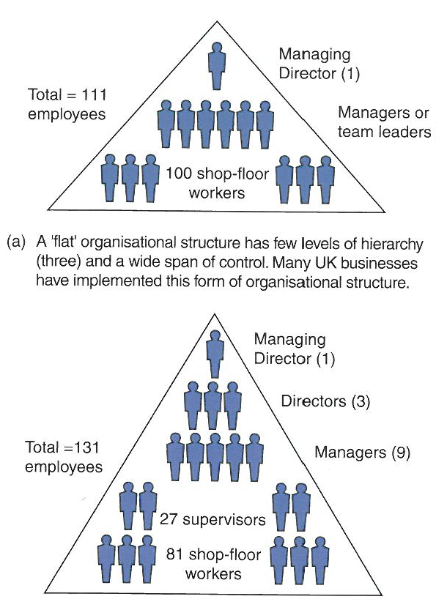
Communication in an organisation
A ‘flat’ organisational structure has few levels of hierarchy (3) and a wide span of control. Many UK businesses implemented this form of structure , e.g. retail, transport
A traditional ‘tall’ structure with 5 layers of hierarchy and a narrow span of control, e.g.; manufacturing

Slide 10
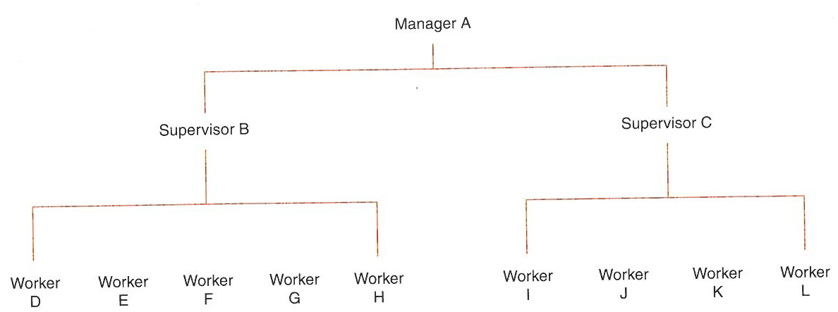
Span of control: an example
Manager A has a span of control of two. This is because the two supervisors B and C are the only employees directly responsible to this person. Supervisor B has the widest span of control – five workers are responsible to this person

Slide 11
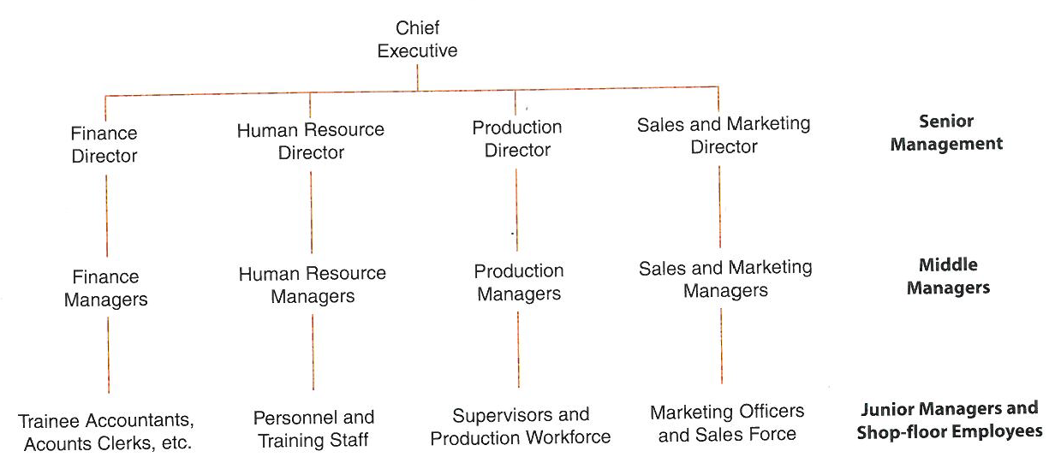
Functional organisation
A ‘traditional’ organisation structure organised around the 4 business functions, with communication typically down and up the organisation, and seldom across, which can be a disadvantage. However, it does promote ‘excellence’ within the functional areas which is an advantage.

Slide 12
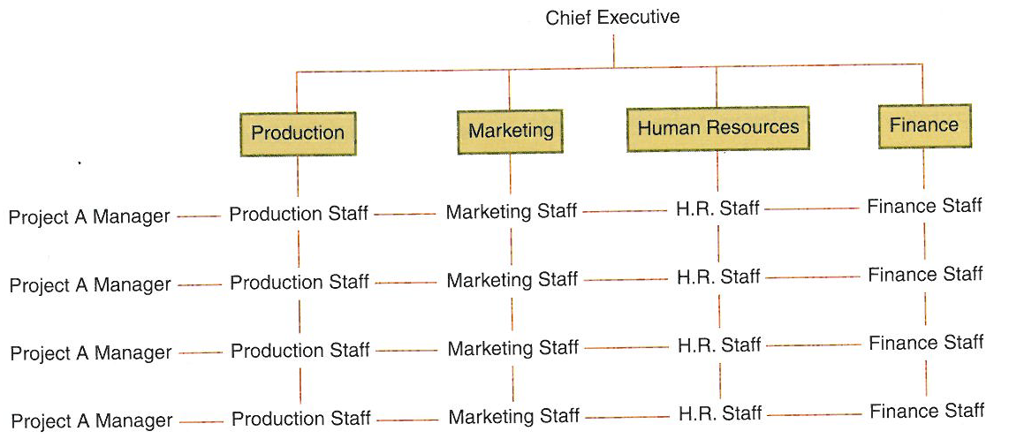
Matrix organisation
Matrix organisations are task orientated . Through combining a vertical chain of command operated through departments and horizontal organisation by project / product teams it aims to overcome the problems of a functional organisation

Slide 13
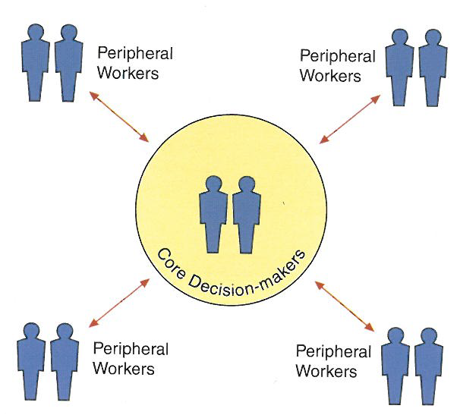
Entrepreneurial organisation
Entrepreneurial structures are suited to markets where rapid decisions are essential and where organisations are small enough to be controlled by a few trusted employees, e.g.; news organisations in the media business

Slide 14
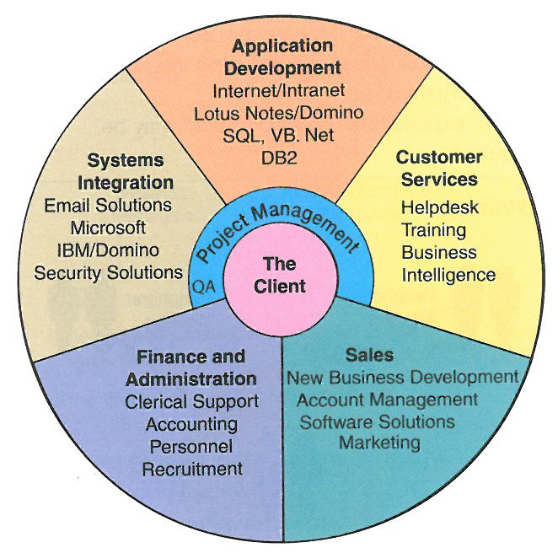
Informal organisation
This is a common structure for the ‘profession’(lawyers, accountants, software programmers) where members operate as a team. The ‘professionals’ receive support from a ‘pool’ of administrative skills (e.g. finance) when required.

Slide 15
Factors determining Organisational structures
Internal
Growth of the business. Perhaps from an entrepreneurial to a matrix to manage better
Nature of the product. E.g. creative functions tend to short spans of control, where as production functions to wide spans of control
Skills of the workforce. More highly skilled perhaps less supervision and vice versa
Culture of the organisation. Contrast a ‘Google’ with the ‘Police’
Objectives of the business. A matrix may suit a growth objective, but an entrepreneurial may suit an excellence objective
External
Competitive industry. A focus on cost control; outsourcing, delayering, wide spans of control
Technology. E.g. computers, bio science industries in which firms respond with matrix organisations that can make and break and not get ‘stuck’ in hierarchies

Slide 16
More on Business Structure
Centralisation
Managers keep control
Decisions are made in the interests of the whole business
Costs can be cut by standardising purchasing and so on
Strong leadership
Decentralisation
Empowering and motivating
Freeing up senior managers’ time
Better knowledge of those closer to customers
Good staff development

Slide 17
Conclusion
Every structure has its advantages and disadvantages
but, there is not a ‘perfect’ solution for ever
Over time, as firms grow or shrink and change their products, the structure may have to change
– and people usually react poorly to change,
- so expect profit to deteriorate in the short-term
A successful organisational structure is one that helps the firm achieve its objectives

