Slide 1
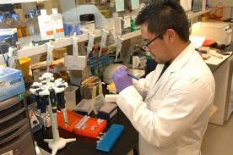
Operations Management:
Research and Development

Slide 2
R&D Key terms
Invention: the discovery of something new
Innovation: the commercial exploitation of invention
Research: an investigation (enquiry and discovery) used to generate new business ideas
Development: changing new ideas into commercial propositions

Slide 3
QUESTION:
Which industries spend the most on R&D?

Slide 4
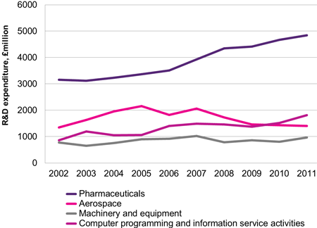
UK R&D expenditure

Slide 5
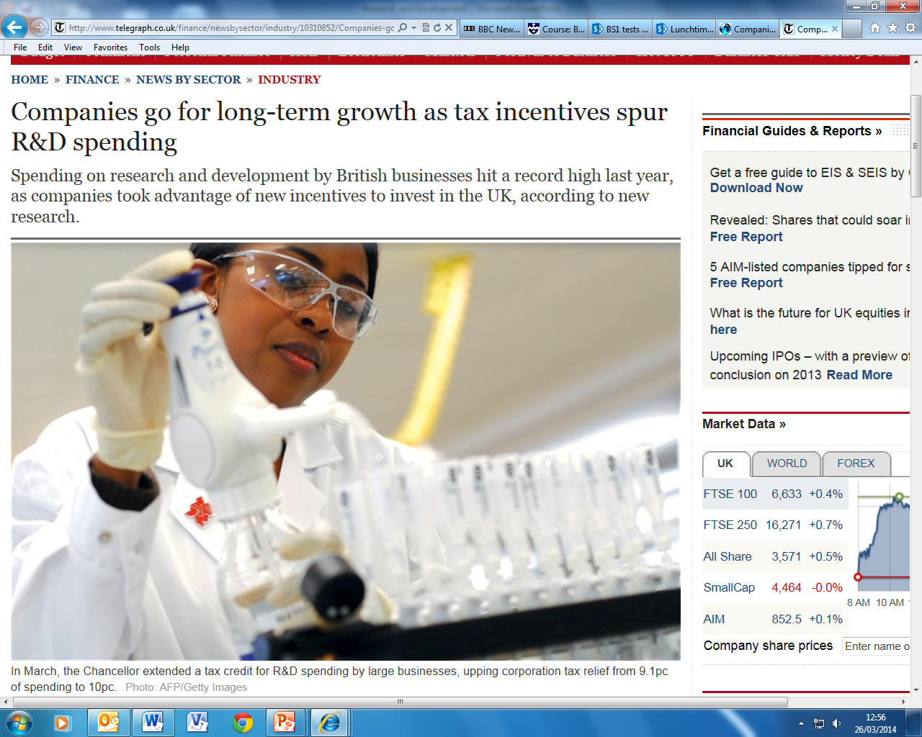

Slide 6
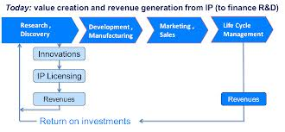
Process of R&D
Idea generation
Idea screening & concept testing
Product design brief prepared
Prototypes made & tested (may be discarded, adapted or adopted)
Test marketing
Patents / other IP protection
Full scale production
Launch (supported by promotion)
Notes:
From Times case studies

Slide 7

Purpose of R&D
Solving problems
Developing new products/materials
Improving quality
Reducing costs

Slide 8
QUESTION: Why is R&D so important to some companies?

Slide 9





Benefits of R&D
Developing unique products (USP)
Provides competitive advantage
Provides long term income
Premium prices
Identifies new opportunities
Motivation for staff
Enhances reputation
Notes:
From Times case studies

Slide 10
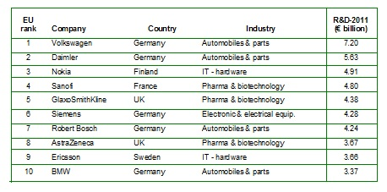
R&D Investment by company – Top 10 – How much?
?

Slide 11
R&D Investment by company – Top 10 – How much?

Slide 12
Challenges and costs of R&D
High financial costs, hard to estimate
Long timescales
Uncertain outcomes
Conditions may change during the R&D process
Reactions of rival companies
Possibility of failure and the associated impact on reputation
Notes:
From Times case studies

Slide 13
Activity: Wolfson case study
Turn to HJR Page 539 Question 1, and answer:
[from textbook]
[from textbook]
[from textbook]
Outline two factors that might influence the amount a business spends on R&D
What risks might Wolfson face with their R&D spending

Slide 14
Prof Brian Cox R&D discussion
3D printing
Nestle R&D in Singapore

