Slide 1
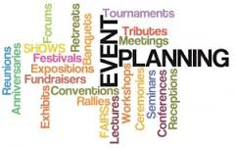
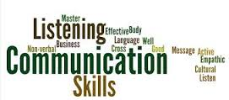
Learning Aim A: p1 Explore the role of an event organiser
A2: Different skills needed by an effective event organiser

Slide 2
Objectives and key terms
To be able to explain the different skills needed by an effective event organiser
Key terms
Multi tasking: when more than one task is being performed at a time
Rapport: a good relationship between people, with good communication and an understanding of the way each other is working
Empathy: being able to understand the feelings of others

Slide 3
Skills required to be an effective event organiser
Organisational (personal skills required are prioritisation, following procedures, attention to detail, organising stored information)
Problem solving
Time management
Negotiation
Communication
Interpersonal
For each of the skills, you should be able to relate it to task an event manager completes for which these skills are important
For example:
Organisational: making sure everything is running on time, notes are taken etc.
Problem solving: revising plans (e.g. in the case of bad weather) etc.

Slide 4
P1 Explain the role and skills required to be an effective events planner
Open your 4.1 assignment document
Add a new subheading: Skills required to be an effective events planner
Explain each of the six skills individually – you will write two paragraphs for each skills.
Paragraph 1 = generally explain the skill / Paragraph 2 = give examples from Guest speaker (see document) e.g. when would attention to detail have been used when organising the Cannes film festival event – why are these skills important to the successful running of the event?
Organisational skills: prioritisation, attention to detail, following procedures, organising stored information, keeping files, the importance of double checking
Problem solving skills: liaising with attendees, potential revision/rearrangements of event outcomes, arising issues (being creative, quick to respond, empathetic to situations, assertive enough to make changes, knowledgeable on alternative arrangements)
Time management skills: using a diary or schedule, planning each day, allowing time for interruptions, avoiding distractions, setting goals, delegating to others, multi-tasking
Negotiation skills: looking for mutual benefit, being fair, developing relationships/rapport – need to be clear, prepared, confident when discussing terms, good at listening
Communication skills: Verbally = be clear in language used, speak at appropriate pace and volume. Written communication = good spelling and grammar, clearly structured, avoid jargon. Must always adjust communication depending on who you are speaking to. Asking for help when needed. Listening to others.
Interpersonal skills: optimistic, calm, confident, relaxed, positive, good rapport with others, appropriate levels of empathy
Notes:
User the resources linked on GOL as well as pages 199 – 205 of the text book

