Slide 1
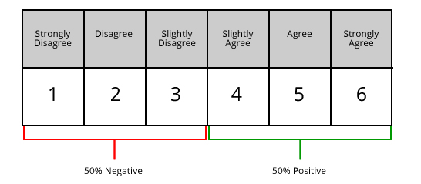
Learning Aim A: Explore the role of an event organiser
P2 / M1 / D1: Skills audit
Notes:
Images http://www.cambridgebusinesstraining.com/skills_audit.html

Slide 2
Objectives and key terms
Investigate own skills in the form of a skills audit (P2)
Analyse own skills against those required by an event organiser, highlighting areas for development (M1)
Fully justify how own skills match those of an event organiser (D1)
Key terms
Respondent: someone who is giving feedback i.e. the person answering the questions
Response rate: the number of people that have responded to a questionnaire either ron paper or online. The more people that reply, generally,
Observer: the person that watches the event organiser
Observee: the event organiser, the person being watched

Slide 3
Skills auditing
It is important that the event organiser gets feedback on all elements of the process of running the event.
Event organisers use lots of different methods to get feedback
These include:
Rating using different scales such as Likert Scale and Semantic differential scale
Observation
Questionnaires
Appraisal

Slide 4
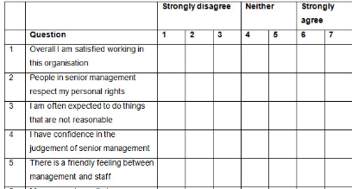
Likert Scale
Likert scaling asks respondents to tick the box which they think accurately describes their response to the statement
Event organisers can get feedback on how they performed using this scale. Asking respondents to make judgements helps the organiser to make improvements in the future.

Slide 5
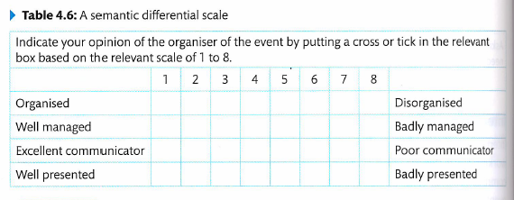
Semantic differential scale
Semantic differential scaling is another way that questions can be asked of an event’s attendees about the performance of the organiser.

Slide 6
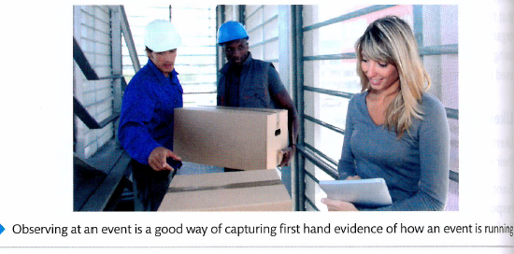
observation
An observation is another way of gaining feedback
An observation is when a person is asked to watch what the event organiser is doing and make judgements about their performance.
Observation is a good way to see how someone is performing in real time.
The observer will write down what the event organiser is doing well and also where they need to improve.

Slide 7
questionnaire
After an event, attendees are often sent questionnaires asking them to give feedback on the event.
Paper based questionnaires are lesson common now as they can be expensive and time consuming to collect and analyse.
Online questionnaires may have a lower response rate but they are easy for respondents to complete and organisers to analyse.
Questionnaire design is VERY important. It is important questions are:
Not leading
Easily understood
Balances in their approach, for example yes/no
Asking for the correct feedback
Clear
Tested before they are used at the event
Aware of cultural differences that my influence the responses.
Notes:
https://www.thoughtco.com/constructing-a-questionnaire-3026540

Slide 8
Appraisal
Performance appraisal lets the event organiser know what went well and whether their skills have been used effectively.
A performance appraisal may be carried out after each event or on a regular basis, such as six monthly or annually.
Appraisals identify short and long term goals that event organisers can work towards to improve their skills for the future.
There are many different ways to conduct appraisals. The most common methods are:
Superior assessment
Self assessment
Peer assessment
360 degree appraisal

Slide 9
P2 Investigate own skills in the form of a skills audit
Open your 4.1 assignment document
Add a new subheading: Skills audit
Carry out research into the different skills audit collection methods and write a brief description of each method
Choose one of the skills audit methods to conduct an audit of your own skills.
Prepare a detailed skills audit showing your existing skills with some explanation of how you gained/developed those skills.

Slide 10
M1 Analyse own skills against those required by an event organiser, highlighting areas for development
Revisit the skills that are required by an event manager work you completed previously (from P1 work)
Now compare your existing skills to the skills required by an event organiser.
Write a paragraph for each of the following points:
Which skills do you already have? Do you think your skills are at the right level required to be an event organiser?
Which skills do you not have? How could you develop those skills? (Make specific suggestions as to HOW you could improve or gain those skills (e.g. courses, responsibilities in your part time work etc.).
What are your key strengths and weaknesses and how would this affect your ability to be an effective event organiser? (Make links with the tasks that event organisers carry out when organising an event and your strengths / weaknesses will help / hinder your ability to do the tasks/organise the event)

Slide 11
D1 fully justify how own skills match those of an events organiser
Write a conclusion to your skills audit which justifies the following:
HOW your skills match those of an event organiser (use examples of how you gained those skills and how they could be applied to organising an event).
The viability of the plans you have made to develop the skills you don’t have (i.e. what makes suitable methods for developing those skills to the correct level required?)

