Slide 1
Nugent & Barton Construction Company case study (January 18) How to plan your answers

Slide 2
Activity 1 PLAN
Marks Scheme – use throughout:
Data Analysis (12 marks)
Use figures, statistics, ratios
Key principles of management (12 marks)
Theories, types, skills
Suggest ALTERNATIVE approaches (12 marks)
For every decision you make, what alternatives did you discount and why?
Structure and Presentation (8 marks)
Logical structure, business terminology, relevant principles and concepts
What does HR Planning involve?
Why is HR Planning important to NBCC?
What actions could be taken to improve competitiveness?

Slide 3
What does HR Planning involve?
Matching the workforce to the needs of the business. They need to know in advance if they have enough workers for every job. If they don’t they need to recruit and select new staff or train (reskill/upskill) existing staff.
Why is HR Planning important to NBCC?
Application to the case study – the building industry is complex and building a housing estate requires many different trades and skills and they all have to be scheduled to come to site at the right time and in the right order. (Groundworks, diggers, bricklayers, plumbers, electricians, roofers etc). Managers also needed – project management, site management, surveyors)
Planning and scheduling every task and matching a worker to the job is critical to ensure success.
What actions could be taken to maintain competitiveness and success?
3 x recommendations? Some ideas
They could reduce their training budget and refocus it so that training offered was relevant training only and linked to the job in hand
They could plan for more environmental aware projects and start training staff on this
They could reinstate the apprenticeship scheme and keep the best ones to reduce the number of self employed workers
They could do a skills audit of their self employed staff so that future selection was dependent on being appropriately qualified
They could apply for accreditation for a Quality Award based on the level of investment that they currently make

Slide 4
Activity 2 PLAN
Marks Scheme – use throughout:
Data Analysis (12 marks)
Use figures, statistics, ratios
Key principles of management (12 marks)
Theories, types, skills
Suggest ALTERNATIVE approaches (12 marks)
For every decision you make, what alternatives did you discount and why?
Structure and Presentation (8 marks)
Logical structure, business terminology, relevant principles and concepts
6 slides with speaker notes
Explain the training and development approaches that NBCC could use
Recommend methods that NBCC could use to measure the effectiveness of training and development initiatives

Slide 5
Explain the training and development approaches that NBCC could use
Internal On-the-job training really appropriate for practical trades such as bricklaying. Learning by doing. Cost effective as it is in house training although it does require a good trainer and more experienced builders may require training to make the best of them as mentors
Apprenticeships they could reinstate this system as although it is costly in terms of meeting specific criteria and a mentor and supervisor are needed, the benefits are that the apprentice learns the trade and how the company works and would be in a good position to continue as a permanent employee. They could become a registered Apprenticeship Training Agency
External Off-the-job Training NVQs for specific skills to fill the skills gaps identified by a skills audit and make sure that the company has the right skills for the jobs that they have taken on.
External Off-the-job Training managers could attend courses on sustainable construction so that they are ready for future development of the company and that they understand the standards that they will have to meet in the future and can make sure that the workforce have the appropriate skills and knowledge.

Slide 6
Recommend methods that NBCC could use to measure the effectiveness of training and development initiatives
Appraisal – based on the IIP model of Plan, Do, Review, the effectiveness of training matched to target setting should be SMART and therefore measurable. Training costs money – so a business will want to know if the training was effective, was it money well spent? Donald Kirkpatrick 1959 identified 4 aspects to measure the effectiveness of training (reaction, learning, behaviour, results)
Staff retention figures – these are better than industry norms but may improve further as the flexibility of the workforce improves with targeted training
Absenteeism data – common causes of absenteeism are poor motivation and not feeling happy with the work – targeted training should improve this and investment in staff can be a form of motivation (Herzberg) as can training to take on further responsibility
Skills audit – identify missing skills which should reduce year on year following appraisal and training cycles

Slide 7
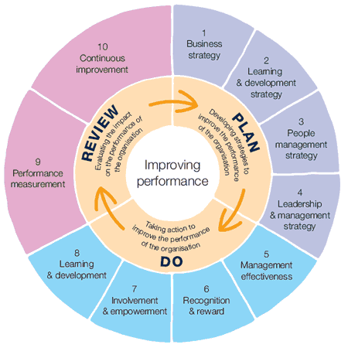
Useful links
https://www.goconstruct.org/routes-into-construction/useful-qualifications-to-get-into-construction/
www.citb.co.uk
www.fmb.co.uk
Investors in People award (IIP)
Notes:
The Four Levels
Donald Kirkpatrick, Professor Emeritus at the University of Wisconsin and past president of the American Society for Training and Development (ASTD), first published his Four-Level Training Evaluation Model in 1959, in the US Training and Development Journal.
The model was then updated in 1975, and again in 1994, when he published his best-known work, "Evaluating Training Programs."
The four levels are:
Reaction.
Learning.
Behavior.
Results.
Let's look at each level in greater detail.
Level 1: Reaction
This level measures how your trainees (the people being trained), reacted to the training. Obviously, you want them to feel that the training was a valuable experience, and you want them to feel good about the instructor, the topic, the material, its presentation, and the venue.
It's important to measure reaction, because it helps you understand how well the training was received by your audience. It also helps you improve the training for future trainees, including identifying important areas or topics that are missing from the training.
Level 2: Learning
At level 2, you measure what your trainees have learned. How much has their knowledge increased as a result of the training?
When you planned the training session, you hopefully started with a list of specific learning objectives: these should be the starting point for your measurement. Keep in mind that you can measure learning in different ways depending on these objectives, and depending on whether you're interested in changes to knowledge, skills, or attitude.
It's important to measure this, because knowing what your trainees are learning and what they aren't will help you improve future training.
Level 3: Behavior
Donald Kirkpatrick (1959 and then revisited in 1994)
https://www.mindtools.com/pages/article/kirkpatrick.htm
At this level, you evaluate how far your trainees have changed their behavior, based on the training they received. Specifically, this looks at how trainees apply the information.
It's important to realize that behavior can only change if conditions are favorable. For instance, imagine you've skipped measurement at the first two Kirkpatrick levels and, when looking at your group's behavior, you determine that no behavior change has taken place. Therefore, you assume that your trainees haven't learned anything and that the training was ineffective.
However, just because behavior hasn't changed, it doesn't mean that trainees haven't learned anything. Perhaps their boss won't let them apply new knowledge. Or, maybe they've learned everything you taught, but they have no desire to apply the knowledge themselves.
Level 4: Results
At this level, you analyze the final results of your training. This includes outcomes that you or your organization have determined to be good for business, good for the employees, or good for the bottom line

