Slide 1
F4 The importance and benefits of quality management
A product or service that meets customers’ expectations and is therefore fit for purpose
Unit 6
Learning Aim F4

Slide 2
The importance and benefits of quality management
Zero defect production and output.
Continuous improvement.
Improved output quality.
Reduced inspection requirements.
Supplier engagement and satisfaction.
Customer involvement and satisfaction.
Improved efficiency and profitability.
Notes:
www.businesscasestudies.co.uk (A series of real-life business cases studies covering a variety of management-related issues.)

Slide 3
Zero defect production & output
Getting it right first time?
Quality defects have significant costs associated with them – some of the most obvious being money, time, resources, and lost reputation
Zero defects is where defects are not acceptable and that everyone should "do things right the first time“ so increasing profits both by eliminating the cost of failure and increasing revenues through increased customer satisfaction
Zero defects is NOT about being perfect. Zero defects is about changing perspective.
Recognize the high cost of quality issues.
Continuously think of the places where flaws may be introduced.
Work proactively to address the flaws in your systems and processes, which allow defects to occur.
Notes:
https://www.mindtools.com/pages/article/newTMC_87.htm

Slide 4
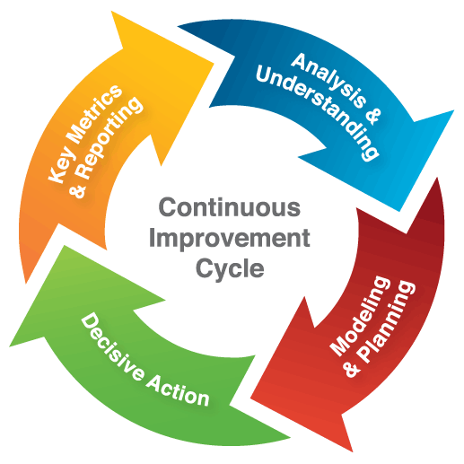
Continuous improvement
A continual continuous improvement process is an ongoing effort to improve products, services, or processes
Continuous improvement processes allow project team members to uncover problems and determine ways to fix them
Through careful analysis, team members can see how individual tasks impact a business's overall process
Because project teams work closely together, work group conflicts can also be resolved as a part of the continuous improvement effort
Notes:
Features
http://smallbusiness.chron.com/continuous-improvement-process-definition-4534.html
Continuous improvement processes feature a systems approach to improving the work flow in an organization. Typical phases of the model include an analysis phase to identify specific problems. During this phase, teams conduct brainstorming sessions and interviews to gather relevant information. In the next phase, the design phase, the project team determines what to do to remedy the problems. During the implementation phase, the team members responsible for carrying out the tasks take action. Finally, during the evaluation phase, team members monitor the outcome and determine if the adjustment to the process has produced the desired result.
Benefits
Continuous improvement processes allow project team members to uncover problems and determine ways to fix them. Through careful analysis, team members can see how individual tasks impact a business's overall process. Because project teams work closely together, work group conflicts can also be resolved as a part of the continuous improvement effort.

Slide 5
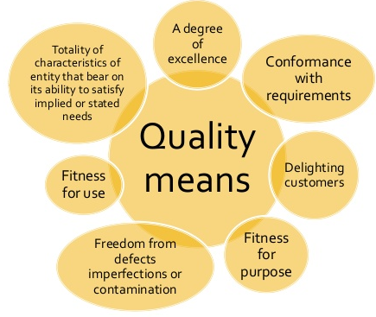
Improved output quality
Improving the quality of outputs (products or services) is achieved by strict and consistent commitment to certain standards that achieve uniformity of a product in order to satisfy specific customer or user requirements.
BS/ISO etc are forms of accreditation that show that a standard has been met
Zero defects aims to prevent complaints or returns
If a business produces poor quality products or services, reputation and business may be lost
Notes:
Output: The amount of energy, work, goods, or services produced by a machine, factory, company, or an individual in a period
Quality : In manufacturing, a measure of excellence or a state of being free from defects, deficiencies and significant variations. It is brought about by strict and consistent commitment to certain standards that achieve uniformity of a product in order to satisfy specific customer or user requirements. ISO 8402-1986 standard defines quality as "the totality of features and characteristics of a product or service that bears its ability to satisfy stated or implied needs." If an automobile company finds a defect in one of their cars and makes a product recall, customer reliability and therefore production will decrease because trust will be lost in the car's quality.

Slide 6
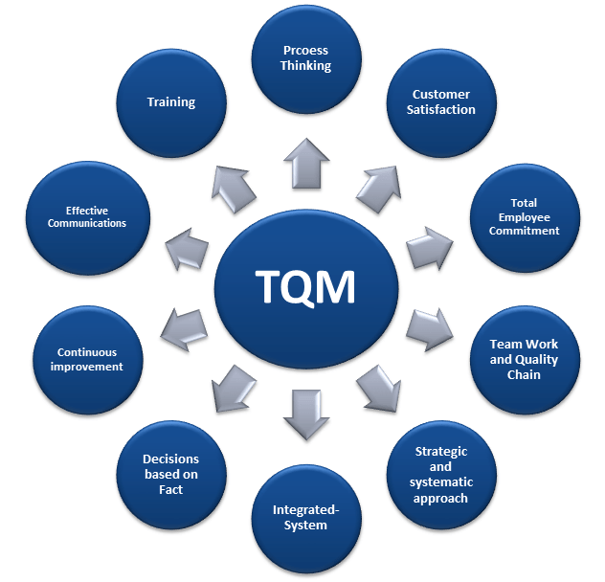

Slide 7
BENEFITS OF QUALITY OUTPUT
Improved efficiency and profitability
Can lead to lower costs and lower prices thus leading to more competitiveness
Consistent high quality can lead to a well known brand image where higher prices can be justified for this USP
As income rises buying decisions will become more and more influenced by quality and fitness for purpose
Reduced inspection requirements
Supplier engagement and satisfaction
Customer involvement and satisfaction
Notes:
www.businesscasestudies.co.uk (A series of real-life business cases studies covering a variety of management-related issues.)

Slide 8
Team sky and iip
Sir Dave Brailsford MBA, CBE is the coach who led the British cycling team to victory in two Olympics and produced two British winners of the Tour De France within four years
https://www.investorsinpeople.com/resources/share-and-inspire/sir-dave-brailsford%E2%80%99s-top-5-tips-outperforming-team?utm_source=twitter&utm_medium=social-cpc&utm_content=dave-brailsford&utm_campaign=2015-new-framework

