Slide 1
Shifts in Educational Policy
A Group 2018

Slide 2
What we need
Can we identify the policy as:
Theory
Of the New Right?
Of the Social Democratic tendency?
What might a functionalist think of the policy?
What might a Marxist think of the policy?
What might a feminist think of the policy?
Differential Educational Achievement
Different social classes
Different sexes
Different ethnic groups

Slide 3
IN ORDER
Business Investment in State Education
Students Meeting the Cost of their own (Higher) Education
Marketization in Schools
Raising the School Leaving Age
Selective Education in State Schools
Positive Discrimination in Education
Compensatory Education
Vocational Education

Slide 4
Social Democracy

Slide 5
New Right

Slide 6
The Presentations
From A group

Slide 7
Business investment in education by Harriet and Alex

Slide 8
Public private partnership
Investing to help economies grow, governments are increasingly turning to the private sectors as a source of funding to meet the funding gap
The idea of raising taxes to improve schools, such as school buildings, sponsorships and equipment

Slide 9
Academy schools
Kings College Guildford is an academy school that is funded by local authorities, such as parents, teachers and local commodities.
In addition, some academies are run by private educational businesses and funded directly by the state and central government
Academy schools can choose when they have their curriculum

Slide 10
Free schools
  Although funded directly by the state they are also funded by teachers, parents, faith organisations and businesses, rather than local authorities

Slide 11
Glenn Rikowski
Rikowski: Argues that schools are increasingly operating markets and are being transformed into commodities
This is evident by the fact that the state has raised the finance for schools and schools are being run by private industry
For example, schools are being sponsored by local business through sports teams, school cafeterias and equipment, such as computers
Another example is that in 2002 Tony Blair invested a large proportion of money to British comprehensive schools

Slide 12
Sharon Gerwitz
Gerwitz argues that marketisation is advantaging middle-class students at school and is disadvantaging working-class students
This is because middle-class students’ economic and cultural capital means that they have a wider choice of schools for their children. Gerwitz argues there are three types of parents.
For example, Gerwitz identified skilled choosers who were strongly motivated parents who can identify the difference in standards in between schools. In addition, they possess an economic and cultural capital that can influence the standard of school that they send their child too, for example private and independent schools.
Gerwitz also identified the semi-skilled choosers who were strongly motivated to get involved with the education market, however, they do not possess the cultural and economic capital similar to the skilled choosers
Finally, Gerwitz also identified disconnected choosers who are not motivated to get involved with the education market, tend to choose schools closest to where they live and struggle to identify the difference in standards between schools.

Slide 13
Stephen Ball
Ball argues that marketization policies and exam league tables advantage middle-class students and disadvantage working-class students
This is because it creates increasing inequalities between schools and means that schools that are succeeding continue to succeed and schools that underperforming will continue to underperform
For example, cream-skimming and silt-shifting which means that schools that are highly rated in exam league tables can recruit high achieving pupils and avoid accepting underachieving pupils.

Slide 14
Cream-skimming and silt-shifting
Will Bartlett argues that publishing of school league tables results in high performing schools continuing to succeed and school that underperforming will continue to increasingly fail, which therefore results in parents wanting to send their children to schools that are highest in the school league table.
Bartlett argues this is achieved by both the process of cream-skimming and silt-shifting. Cream-skimming is the idea of schools being selective and choosing high performing, middle-class students, this means that these high performing schools continue to increasingly succeed. This is due to the fact that schools that are high up in the school league tables encourage students parents to send them to that school
Bartlett also argues the concept of silt-shifting the idea that high performing schools avoid underachieving pupils in order to maintain the reputation of the school. For example, universities have entry requirements in order to silt-shift less academically talented students.

Slide 15
The funding formula
Some sociologists argue that funding creates inequalities between schools, advantaging middle-class students and disadvantaging working-class students. In addition, it results in high performing schools continuing to succeed and underperforming schools continuing to underperform.
This is because high achieving schools receive more funding compared to underachieving schools that therefore means they can afford better-qualified teachers and better facilities. In addition, their popularity means they can attract high achieving pupils and silt-shift less academically talented students.
However, on the other hand, low achieving schools struggle to find talented teachers and do not have the facilities to compete with high performing schools. Therefore, it is difficult for these schools to attract academically talented pupils and means they have to recruit less academically talented students.

Slide 16
General examples of marketization in schools
League tables
Ofsted inspections that measure how successful the school is and give pupils parents the information they need to choose the right school
Business sponsorship of schools, such as sports teams and school cafeterias
Open enrolment
Free schools
Academies

Slide 17
Parentocracy
David argues that marketization in schools creates parentocracy, an idea that the power shifts from the schools to the parents which creates inequalities in schools due to the fact marketization gives parents more choice. In addition, marketization advantages middle-class student, benefitting middle-class students and disadvantages working-class parents in terms of choice for their children, so therefore disadvantaging working-class students.

Slide 18
Myth of parentocracy
Stephen Ball argues that marketization reproduces and legitimises inequality and creates parentocracy and establishes freedom of choice for parents.
However, Ball argues that parentocracy is a myth, not a reality. This is because middle-class parents have the ability to take advantage of the choices open to them
Therefore, by hiding the fact that the education system reproduces and legitimises inequality, claiming that it is meritocratic makes inequalities in the system appear fair and inevitable

Slide 19
Students meeting the cost of their own education
Lydia & Jade

Slide 20
Students meeting the cost of their own education
Higher education funding:
Higher Education Funding Council for England was a public body responsible for the distribution of money in higher education. However, this had recently changed to Office for Student on the 1st April 2018.
Tuition fees can now cost up to £9250 per year for higher education.

Slide 21
Social Democrats and New Right:
Social Democrats:
1944 Education Act which allowed students to go to university for free (Welfare State).
New Right:
Post 1998 Labour Government brought in tuition fees of £1000 so that people would value their education.
From 2007-2010 Gordon Brown brought in the EMA (Education Maintenance Allowance) which meant that people from poorer backgrounds had the opportunity to attend higher education past the legal leaving age at the time.
After the coalition tuition fees capped at £9250 with grants and exceptions for those who come from a poorer background and meet the standard requited to attend university. However, the grants and exceptions slowly disappeared.

Slide 22
Differential Educational Achievement:
Social Class:
If you come from a lower class family it is less likely that you would be encouraged to university in todays society (due to a lack of financial support for university).
Another factor effecting social class are anti-school subcultures within the education system where some may be encouraged not to attend university by others in their friendship group (Paul Willis Lads).
Labelling and the self-fulfilling prophecy can cause students to either achieve or underachieve in education which could either help or hinder their opportunity for higher education.

Slide 23
Differential Educational Achievement:
Sexes:
Girls are more likely to attend higher education because of their changing ambitions. Sue Sharpe discovered that in 1974 girls had low aspirations and were more concerned with love and marriage compared to receiving a good level of education to get a good job in the future. Whereas in the 1990s girls were focused on becoming independent and having the ability to support themselves increasing the number of girls attending higher education.
According to Tony Sewell boys have fallen behind in education because education has become feminised and do not nurture masculinity and competitiveness. This may cause them to underachieve in education therefore causing them to not be able to continue in higher education and fall into more masculine jobs such as building.

Slide 24
Differential Educational Achievement:
Ethnic groups:
In Louise Archers study certain ethnic groups valued education and success. For example, Chinese families/parents would not approve of their children's choice to not go to university, it was seen as compulsory in their culture. This meant that children attended higher education in order to please their parents.
Even Chinese families of a poorer background want their children to attend university in order to protect their ‘face’ even if they struggle to afford the tuition.

Slide 25
Theories:
Functionalist:
Functionalists believe in meritocracy and therefore would not agree with students having to pay their own tuition fees for higher education. They think that people should succeeds further because of their own talent.
Marxist:
Marxists would not agree with tuition fees because it re-enforces capitalism.

Slide 26
Marketization
Harriet, Easa, Reuben

Slide 27
Examples of marketization
League tables – increase the competition between schools and encourages consumer choice to determine the demand and thus the success of the school. This encourages parentocracy which essentially gives parents more choice to discriminate between schools. However this policy is criticised because it encourages good schools to be more selective which means they can choose more high achieving consumers and take in less able pupils, through the process known as cream skimming and silt shifting. The policy is also criticised because it means bad schools are more likely to lack improvement and are stuck with the worst students and continue to be bad schools.

Slide 28
New Right Policy
Marketization is a New Right policy. Social Democrats do not particularly like it because people such as Sharon Gerwitz and Stephan Ball argue that competition between schools only benefits the middle class who can use their cultural and economical capital to gain access to more desirable schools.
New Right like this policy because it encourages parentocracy (a system in which a child’s education conforms to the wealth and wishes of a child’s parents). This essentially provides parents with choice, which the New Right theorists believe drive up standards.
However, Social Democrats such as Sharon Gerwitz argue that parentocracy only benefits middle class parents since they have more wealth they have more choice. They are privileged/skilled choosers.

Slide 29
Different Educational Achievement
Different social classes - This affects different social classes because, as mentioned before, middle class parents have more choice so the working class parents are put in a position of disadvantage as a result of having less economic capital.
Different Sexes - David Jackson supports the fact that marketization improves opportunities for girls and gives the example of league tables. He says league tables have created a self fulfilling prophecy where girls have more pressure by good schools to do well, and thus are more likely to do well. Schools opt for girls because girls are stereotyped to do better than boys.
Different ethnic groups – Class links to ethnicity through intersectionality because most ethnic minority groups tend to be working class. Marketization has encouraged cream skimming where good schools can be more selective; this is particularly advantageous to Chinese students as they tend to achieve highest out of other ethnic minority groups. Good schools look for these students. However, marketization also encourages silt shifting where good schools take in less able students who are less likely to get good results, such as Black African Caribbeans who are known to have a very high rate of suspension and poor educational achievement. This policy can either be advantageous for these ethnic groups or disadvantageous.

Slide 30
Theory
Marxists believe that marketization is a bad policy, such as Glenn Rikowski, who argues that the education system is becoming a commodity where students are treated as consumers and the education services are for the benefits of shareholders and this is not a good thing because it means education is now a commodity that is simply driven by profit. Stephan Ball and Sharon Gerwitz also argue this.
Functionalists believe that marketization is good because it encourages consumer choice and drives up standards of schools. Shultz talks about the investment in human capital and this can be seen as an investment in developing human capital. Davis and Moore’s study into role allocation and social stratification can also be applied here because the most talented people are being placed in the best schools because they are being sifted and sorted in these selective agencies.

Slide 31
Theory
Liberal feminists may embrace this because it gives girls more opportunities to do better through league tables as good schools want to choose girls over boys as they are expected to do better.
Marxist feminists may think this policy is bad for the same reasons given by all Marxists that have been explored before.

Slide 32
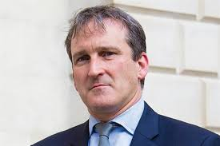
Raising the school leaving age?
DAMIEN HINDS MP FOR EAST HANTS AND
EDUCATION SECRETARY.
BY ALEX AND JONAS

Slide 33
Raising the school leaving age!
2015 Government Policy raised the school leaving age from 17 to 18, they did this to prevent the further falling behind of the UK to other countries.
The Education and Skills Act 2008, increased the minimum age at which students in England can leave education and requires them to continue in education to the age of 17 in 2013 and to 18 in 2015.

Slide 34
Is it new right or social democratic policy?
Both the conservative and labour governments wanted to raise the school leaving age. But it is a social democratic policy as they believe in keeping children In education longer because they can have more qualifications which leads to a more skilled workforce!

Slide 35
Differential educational achievement!
Raising the school leaving age encourages students of the lower social class to get higher qualifications, so they can improve social mobility amongst the lower class. This is because they are no longer able to drop out of education before receiving any qualifications.
Raising the school leaving age will benefit ethnic groups because it will allow them to stay in education to receive the qualifications they need to be successful in society, that may have been previously unavailable to them.

Slide 36
Theory!
A functionalist would view this policy a benefit to society because it creates a skilled workforce to support society.
A Marxist would view this policy a beneficial to society as well because it increases social mobility for lower social classes because they can get better qualifications.
A feminist would also view it as beneficial because it gives equal opportunities to both girls and boys to receive the same level of qualifications.

Slide 37
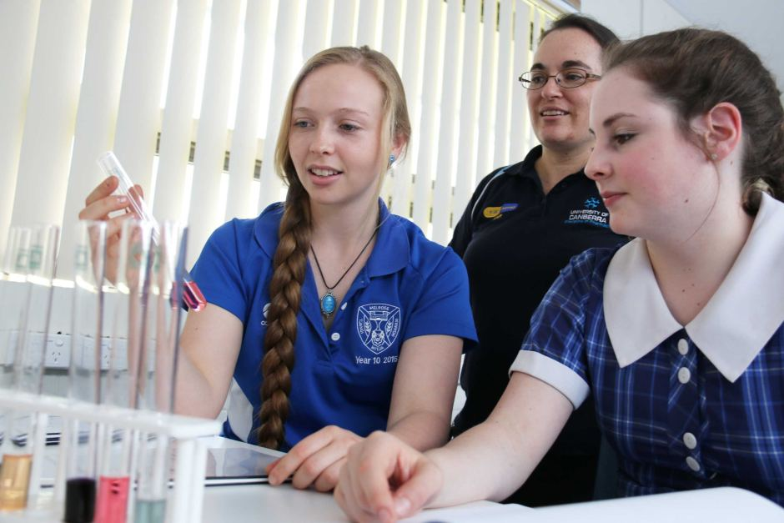
Selective education
By Emily and Tom

Slide 38
What is selective education?
A selective school is a school that admits students on the basis of some sort of selection criteria, usually academic. The term may have different connotations in different systems and is the opposite is a comprehensive education, which accepts all students, regardless of aptitude.
Many schools prefer to select, if possible, the brightest, best behaved and best-motivated pupils. They prefer pupils with well-off and well-education parents who can support the school financially and as volunteer helpers, who can provide educational support to their children, and thereby enable the school to be seen as the best in the area, and to gain high positions in the School Performance tables.

Slide 39
New right and social democratic
The New Right reflects the many ideas of the functionalist perspective. The new right argues education should be concerned not with promoting equality or equality of opportunity, but with training the work force, making sure the most able students have their talents developed and are recruited into the most important jobs, while others are prepared for lower level employment.
Social Democratic approach is associated with education policies, pre 1979 (when the conservatives come to power). Social democratic views are associated with a belief in the welfare state and the necessity for government to intervene on behalf of those who are weakest or who need support, often through tax and spend-policies, redistributing wealth through services and benefits (Robin Hood policies).

Slide 40
So what is policy is selective education?
New right- associated with the political right, namely the Conservative party, in particular Margret Thatcher's government and the formation of the Education Reform Act 1988.

Slide 41
Sociologist involved with the policy?
Chubb and Moe. They believe an education system controlled by the state and local authorities (local councils) is not the best means of achieving the aim of training an effective workforce.

Slide 42
What is functionalism?
Functionalism sees society built up and working like the human body made up of parts which function for or contribute to, the maintenance of society as a whole. For example, in order to understand the importance of the heart, lungs and brain in the human body, we need to understand what function or purpose each carries out and how they work together in providing and maintaining the basic needs of human life.
Functionalism applies to selective education, well all education, as in schools, we get taught social and academic skills within the curriculum and we learn about the hidden curriculum. The education system then trains us up, and we become adults, get jobs, have children, and the cycle repeats. Is the education system the heart of society?

Slide 43
What is Marxism?
Conflict structuralism. The term comes from Karl Marx.
Marx believed that the economy was the driving forces in society, and it was this that determined )or influenced) the nature of social institution, and people’s values and beliefs.
Marxism applies to selective education as it….

Slide 44
What is feminism?
Feminism examines society particularly from the point of view and interests of women. Feminists argue that a lot of mainstream sociology has been focused on the concerns of men – ‘male stream society’ – and has failed to deal with the concerns and interests of women and unequal position they have traditionally occupied in society. There are 3 main types of feminism;
1. Liberal feminists: Men and Women are being treated as equals.
2. Marxist feminists: Marxist feminism is feminism focused on investigating and explaining in ways which women are oppressed through systems of capitalism.
3. Radial feminists: Radical feminism is a perspective within feminism that calls for a radical reordering of society in which male supremacy is eliminated in all society.
Feminism applies to selective education as we are now seeing more female teachers in the education system teaching us, becoming role models which young girls, may aspire to be. We are also incorporating famous/ historical females figures into lessons, which is giving girls more confidence that they can be what they want when they grow up.

Slide 45
Sociologist involved with the theory?
Emile Durkheim, Solidarity and Skills. According to Durkheim, as everyone has to coexist with other people one of the main functions of education should be to socialise children to the norms and values agreed by society.
Talcott Parsons, Meritocracy. The family is the primary agent of socialisation and education is the main secondary agent of socialisation. For Parsons, schools operate on meritocratic principles. Everyone is treated in the same way and has the same chances to succeed (equality of opportunity) so those that achieve the most in school do on their own merit (Ability + Effort = Merit).
Davis and Moore, Role allocation. Social stratification is a means of ensuring that the most talented people fill the positions that are most functionally important for society.
Schultz, Human capital. Schultz argues high levels of spending on education and training are justified to develop people’s knowledge and skills, and this investment is an important factor in a successful economy.

Slide 46
Selection process
There are 3 main types of selection:
1. Selection by ability. This is where the intake of a school is selected on the basis of their academic ability, assessed by their performance in an intelligence test at age 11 (the 11+ exam).
2. Selection by aptitude. This is where pupils are selected on their ‘aptitude’ or potential to be good in certain subjects.
3. Selection by faith. Faith schools – those of a religious character – may select a proportion of their pupils based on the religious beliefs and commitment of their parents.

Slide 47
Controversy?
A few arguments against selection by ability.
1. Late developers benefit. Those whose intelligence and ability improve later in life can be catered for better in non-selective systems.
2. Fewer social diversions and more social cohesion through social mixing. As all children attend the same type of school, there is more social mixing between students from homes of different social class and ethnic background.
3. Reduced risk of labelling and the self fulfilling prophecy. Children are less likely to be labelled as failures at an early age, lowering their self esteem and avoiding the damaging effects of the self fulfilling prophecy.

Slide 48
Academies
Academy schools are state-funded schools in England which are directly funded by the Department for Education and independent of local authority control. The terms of the arrangements are set out in individual Academy Funding Agreements. Most academies are secondary schools (and most secondary schools are academies). However, slightly more than 25% of primary schools (4363 as at December 2017), as well as some of the remaining first, middle and high schools, are also academies.
Academies are self-governing non-profit charitable trusts and may receive additional support from personal or corporate sponsors, either financially or in kind. They do not have to follow the National Curriculum, but do have to ensure that their curriculum is broad and balanced, and that it includes the core subjects of mathematics and English. They are subject to inspection by Ofsted.

Slide 49
Grammar schools
A grammar school is one of several different types of school in the history of education in the United Kingdom and other English-speaking countries, originally a school teaching Latin, but more recently an academically-oriented secondary school, differentiated in recent years from less academic Secondary Modern Schools.
Grammar schools became the selective tier of the Tripartite System of state-funded secondary education operating in England and Wales from the mid-1940s to the late 1960s and continuing in Northern Ireland. With the move to non-selective comprehensive schools in the 1960s and 1970s, some grammar schools became fully independent and charged fees, while most others were abolished or became comprehensive (or sometimes merged with a secondary modern to form a new comprehensive school). In both cases, many of these schools kept "grammar school" in their names. More recently, a number of state grammar schools still retaining their selective intake gained academy status, meaning that they are independent of the Local Education Authority (LEA). Some parts of England retain forms of the Tripartite System, and a few grammar schools survive in otherwise comprehensive areas. Some of the remaining grammar schools can trace their histories to before the 16th century.

Slide 50
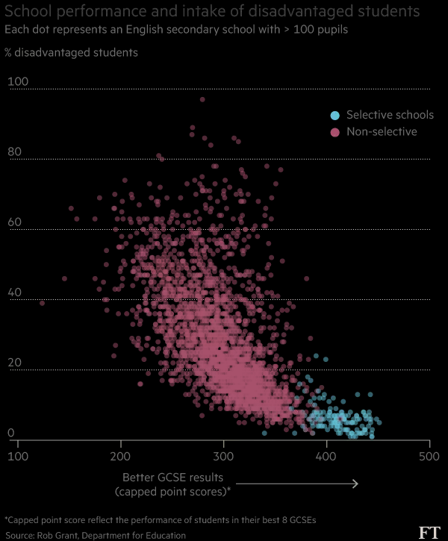

Slide 51
“new grammar schools”
Education Secretary Justine Greening has detailed proposed education reforms that will see a new generation of grammar schools in England, saying the move will widen access to good school places and create a “truly meritocratic” system that “works for everyone, not just the privileged few.”
The proposals include the right for all schools in England to select pupils by academic ability “in the right circumstances” and £50m of new funding for existing grammars to expand. Access conditions for selective schools were detailed – including an obligation to take a share of pupils from low-income backgrounds.
Setting numbers for children from lower-income families would deliver on Theresa May’s pledge that admission to selective schools would not be determined by parents’ ability to pay for private tuition or buy houses nearby.
Grammar schools that expand, new selective schools and existing schools that become grammars will have to support non-selective schools by sponsoring a feeder primary school in a poor area, opening a secondary school or helping a chain of academies.

Slide 52
Positive Discrimination
In education.
Elodie & Emily

Slide 53
What is positive discrimination?
the practice or policy of favouring individuals belonging to groups which suffer discrimination.

Slide 54
Different sexes
GIST
WISE
Girls into Science and technology encourages school girls to take STEM subjects such as maths and science that will lead them into industries that are based on science and technology, this is to break gender stereotypes.
WISE enables and energises people in business, industry and education to increase the participation, contribution and success of women in science, technology, engineering and mathematics (STEM)

Slide 55
Different social classes
Free school meals
Bursary and Grants
Free school meals are offered to students that come from low income families to avoid going hungry. It is mainly Working class students that have free school meals because their families cannot afford to feed them. You have to be able you are eligible for the free meals, otherwise you are not allowed them, therefore many middle class students do not have free school meals.
These are like student loans bur are also given to low income families that cannot afford to send their child to higher education, however student loans have to be paid back but because they come from low income families, people who receive Bursary and grants often do not have to pay them back.

Slide 56
Different Ethnic groups
Multicultural education
Outreach programmes
A policy that recognises and values minority cultures and includes them in the curriculum, this means many cultures are included in the curriculum.
Some universities follow outreach programmes that encourage other ethnicities to apply for their university and support them in this process.

Slide 57
What do functionalists think about positive discrimination?
Functionalists would think positive discrimination is a good thing. This is because positive discrimination helps to support disadvantaged groups in the education system which helps them gain the skills they need to achieve a good job, and therefore become an economic advantage. It also encourages meritocracy in the system which is something that functionalists support. On the other hand, some believe that positive discrimination can give an unfair advantage to those who benefit from it, which is therefore un-meritocratic.

Slide 58
What do Marxists think about positive discrimination?
Marxists would think that positive discrimination is also a good thing because they believe the education system is designed to disadvantage the working class and keep the upper classes in control, but positive discrimination helps those in the lower classes and gives them more of an advantage to do well and move into the upper classes by achieving high status jobs and earning more that gives them access to social mobility.
What do feminists think about positive discrimination?
Liberal feminists would think that positive discrimination is a good thing because it helps women who are disadvantaged in the education system which gives them equal opportunities to men. Radical feminists may believe that positive discrimination is an insult to women because it makes it seem as if women are the weaker sex and need help in the system if they want to do as well as the men.

Slide 59
Social democratic vs new right
Social democratic
New right
Social democratic perspectives believe that as well as promoting economic growth, education is essential to promoting equality of opportunity in a meritocracy. ... Critics have argued that social democratic policies have not been particularly successful in helping the working class to do better in education.
The New Right created an ‘education market’ – Schools were run like businesses – competing with each other for pupils and parents were given the choice over which school they send their children to rather than being limited to the local school in their catchment area. This lead to the establishment of league tables.

Slide 60
Compensatory Education
Adam & Genny

Slide 61
Compensatory Education
What is compensatory education?:
The idea that extra help should be given to those social groups who underperform in education. It’s traditionally been associated with the working class and ethnic minorities. This form of education has been associated with positive discrimination.
Is it of the New Right or Social Democratic tendency?:
It is of the social democratic tendency because social democrats believe that governments should invest heavily in education and use education as a means to improve equality of opportunity which will contribute to economic growth.
Differential educational achievement:
Students that are linguistically deprived are given the opportunity to study English as a second language in many schools. Students who are talented and have good abilities can be given scholarships by some schools to enable them to excel and not be held back by external factors such as financial issues at home. In America it is often found that children who are disadvantaged by cultural deprivation or material deprivation are offered the opportunity to take up extra classes or attend summer camps.

Slide 62
Theory
Marxists do not agree with this policy because they claim that programs of compensatory education were based on an uncritical acceptance of the theory that social class differences in educational achievement were based on the cultural deprivation of the working class.
Functionalists agree with this policy because they believe this will help combat working class disadvantages which involved providing more resources for children in deprived areas. This links well with meritocracy as students are given equal chances to achieve. Furthermore they believe that children’s education should be invested in because it will improve economic growth.
Feminists also agree with this idea of compensatory education because they believe in equal opportunities for all children to succeed in the education system as schools are starting to show less discrimination against girls and focussing on and showing more concern towards the underachievement of boys but gender inequality is still the main role of education as girls are now achieving significantly higher than boys and more girls are going on to higher education compared to boys.

Slide 63
Vocational Education
Max and Alexxe

Slide 64
What is Vocational Education?
Is a certain type of education which prepares people to be able to work in various different jobs such as: tradesman ship, craftsmanship or even as a technician.
It is also sometimes referred to as career education/technical education, due to be educated for specific and technical types of careers.

Slide 65
New Right Policy:
The New Right introduced vocational education in the 1980’s.
They argued that Britain needed job related training in order to fight against high levels of unemployment of the time, and in order to prepare youngsters for a variety of new upcoming jobs within the technology industry.
Two vocational policies the New Right introduced were National Qualifications (NVQ’s) AND Youth Training Scheme (YTS).

Slide 66
Theory
According to Functionalists, whilst this vocational education is centred, they would argue that this is not an effective method of educating students. An example of this criticism is theorist Birdwell (2011). He suggests that secondary schools in England and Wales often neglects pupils with vocational aspirations, and instead focus on educating the brighter students, who are destined to peruse higher education.
According to Marxists, the vocational education’s authentic function is serving the needs of capitalism at the expense of young people by reproducing existing inequalities. For example, Phil Cohen (1984) argued that Youth Training Schemes serves capitalism by teaching young workers not genuine job skills but instead attitudes and values needed in a subordinate labour force.
According to Feminists, men are stereotypically more likely to pursue a vocational education as traditional work in more technical working environments.

