Slide 1
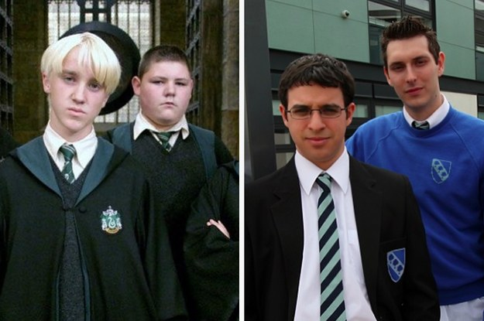
Topic 1: the structure and organisation of the education system
E¹ Group

Slide 2
Learning objectives of this booklet
Learning Objectives:
To understand and evaluate key concepts associated with functionalist, New Right and Marxist sociologists’ views of education.
To understand how these approaches explain the function of education and examine the link between education and work wider society.
After studying this Topic, you should:
Have a good knowledge of the history of the British education system since 1945
Know the functions of education that functionalists identify.
Understand the neoliberal and New Right views of the role of the market in education.
Understand the social democratic view of the role of the education system and their criticisms of New Right arguments.
Understand different Marxist views of the role of education, particularly the reproduction and legitimation of class inequality.
Be able to evaluate the functionalist, neoliberal and New Right, and Marxist views of education.

Slide 3
Formal and Informal Education
Page 2 of booklet
When we think of education we think of sitting in a school or college and being taught by teachers. However this is not the only way of being educated. Sociologists make distinction between;
Formal Education = Delivered by agencies specifically designed for teaching and learning – for instance, schools, colleges, universities – or through virtual institutions
Relies on formal programme, syllabus, curriculum etc.
Informal Education = Used to refer to all of the agencies and institutions, which, although not explicitly existing to encourage learning, nevertheless play an important educational role.
Learning may occur ad hoc, i.e, randomly

Slide 4
Activity page 2
Page 2 of booklet
Outline in the boxes some examples of things that you learn directly through the formal curriculum and then things that you learn indirectly through the hidden curriculum.

Slide 5
Meritocracy Page 3
Page 3 of booklet
A key argument in the sociology of education is whether the education system in the UK is meritocractic. Find out what this means and write in box.
Meritocracy:

Slide 6
Meritocracy
Page 3 of booklet
Meritocracy is the idea of a society governed by people selected according to merit (e.g. ability and skill).
Do you believe this statement?
"Britain is a meritocracy, and everyone with skill and imagination may aspire to reach the highest level“
In what ways is our society meritocratic/un-meritocratic?
On p.3 provide some examples of how our education system is meritocratic and how it is not.

Slide 7
Introducing the British Education system
Selective Education
Non-selective Education
The idea that education should be directed at those who will most benefit from it, and that different levels and types of education may suit different types of pupils
The idea that all students should have a common experience through the education system and that everyone should have an equal chance of achieving the same outcome.

Slide 8
History of the British Education system- p.4 Activity
Using pages 77-78 of Webb outline briefly the main features of:
￼￼￼
1. the tripartite school system.
2. the comprehensive school system.

Slide 9
Timeline
Using the key dates and issues provided, as a starting point, create a timeline for changes to the state education system in England and Wales since its foundation.
Bear in mind that a lot of changes occur since 1988, and the exam board expect exam answers to focus on changes from this point.
You could cut and stick the dates/issues onto a timeline, or write the points on the timeline instead.
Aim to include other changes that have occurred.

Slide 10
History of the British Education system- p.4 Activity
Using pages 77-78 of Webb outline briefly the main features of:
￼￼￼
1. the tripartite school system.
2. the comprehensive school system.

Slide 11
Types of School and Education
It is important that you are aware of the different types of schools and how these link to the theories, differential educational achievement, meritocracy and social mobility. Types of school include:
This activity will ask you to research a particular type of school or schooling in small groups
You will need to complete and present your findings in a PowerPoint format which should include a minimum of four frames These will include
A title frame naming all of those involved in the research and presentation
At least one frame identifying the purpose of the school, numbers of them in the country
At least one frame identifying the admission policy associsated can we regard it as meritocratic and supporting social mobility?
At least one frame identifying the school’s sources of funding and who it is governed and regulated by.
Use the sources on Godalming Online to help you

Slide 12
Types of school
Type of Schooling | Whose research?
Comprehensive Schools
Independent Schools
Grammar Schools
Faith Schools
Academies and Free Schools
City Technology Colleges
Specialist schools
Home schooling
TITLE FRAME
A brief outline of the history, PURPOSE, STRUCTURE of these schools in the UK
The degree to which this type of schooling is meritocratic and supports social mobility
How this type of schooling is funded, governed and regulated.

Slide 13
PRESENTATIONS
E Group

Slide 14
Comprehensive schools
Anna, Lucy and Kate
A secondary school for children of all abilities from the same district.

Slide 15
History
After the Second World War, parents were against the idea of the 11+ examination because of a concern about the reliability of the 11+ examination for categorising children. At the same there was a decrease in people wanting to send their children to grammar schools because working class children and their parents were alienated in these schools and that was a waste of talent, particularly in girls.
In the 1950s there were many alternatives to comprehensive schools but the conservative government didn’t want to use them because of a risk of rebellion. So when labour got into power, Education secretary Anthony Crosland, asked local authorities to make plans for going comprehensive.
Between 1965 and 1975, nearly all state schools in Wales and Scotland went comprehensive and in England this was 90 percent.
Purpose
The purpose of comprehensive schools is to democratize education and provide equal opportunities for success for all students.
It does not select its pupils based on academic achievement or talent whereas the selective school system restricts the entrance of pupils on the basis of selection criteria.
Structure
Comprehensive schools are for students aged 11-16, going from Year 7 to Year 11.
At the end of Year 11, students sit their GCSEs which allow them to go to sixth-form or college if they achieve good grades.
They tend to teach a wider range of subject which allow children to reach their full potential.

Slide 16
Is it meritocratic?
Comprehensive schools are meritocratic because students are not judged by their gender, class or ethnicity. Instead they are excepted into a school and there is support from the school for those with learning disabilities.
They are also meritocratic because it is free education for all and it follows the national curriculum, Ofsted and league tables.
Comprehensive schools support social mobility as people from all different social backgrounds and social strata can attend these schools. This is because when leaving comprehensive schools you have the opportunity to attend higher education such as college and university. This means that students will have better qualification which will lead to a better future career.
Also because these schools are free, despite the students background whether it’s low-income or high-income, they are supported and have an equal opportunity as everyone else.

Slide 17
How are comprehensive schools funded, governed and regulated?
They are funded through the state and local taxation, this money is given to them by the local authorities. Because of this, they are required to follow the National Curriculum. This also means that all teachers are employed under the nationally agreed ‘School Teachers’ Pay and Conditions Document’.
This type of school is regulated by consistent Ofsted inspections. After Ofsted has visited, they publish a report for the public and parents to show how the school is currently teaching. They are valuable when your family are deciding which schools to apply to, therefore they can compare the Ofsted ratings.
Comprehensive schools are independent school that although it is financed by the government are usually not dependent upon national or local governments.

Slide 18
Independent schools
By Emily, Amy and George.

Slide 19
Independent schools and what they do.
All private schools must be registered with the government and are inspected regularly. Private schools are also known to specialise with children who have special educational needs. These schools are mostly attended by children of wealthy upper class parents as these schools cost thousands a year.
In 2011 there were more than 2,600 independent schools in the uk educating some 628,000 children, comprising over 6.5 per cent of uk children, and more than 18 per cent of pupils being over the age of 16

Slide 20
Independent schools arent meritocratic and support local mobility

Slide 21
Funded, goverened and regulated.
A private school (also known as an independent school) is a school that is independent in its finances and governance. It is usually not dependent upon national or local government to finance its operations. instead is funded by a combination of tuition charges and donations

Slide 22
GRAMMAR SCHOOLS
Molly & Esme

Slide 23
Schools select their pupils using entrance exam (the 11-plus.)
Grammar schools have existed since the 16th century furthermore, the modern grammar school concept dates back to the Education Act 1944, making secondary education after the age of 14 free.
In 1965, the government the government ordered the local education authority's to divide out the grammar schools and replace them with comprehensive schools

Slide 24
The decline of grammar schools
Quickest changes were made over Labour controlled areas, whereas Conservative counties moved slowly or not at all.
England have kept largely selective schools systems, including Kent, Medway, Buckinghamshire and Lincolnshire, while others such as Gloucestershire, Trafford and Slough have a mix.

Slide 25
Criticisms
The 11-plus was unreliable, a young persons education future should not be based on an IQ test.
The selection of the process was unfair and wasteful, it denied opportunity's and became a waste of ability for both the student and the nation
No parity of esteem, grammar schools were always seen with higher status and more ability's- leading to high payed occupations where as secondary modern schools were seen as second-rate.
Three quarters of students ‘failed’, this failure lead to the danger of labelling the self- fulfilling prophecy.
Social class divisions, one of the main aims in 1944 was to widen educational opportunity's for working class pupils. However the class divide still remains s more middle class students went to grammar schools than working class in 1980, Halsey.

Slide 26
Schooling
Grammar schools are academies, run by a governing body, independent from the local council.
They are state funded and have to pass the 11-plus test to be accepted.

Slide 27
Faith Schools
By Sophie Stagg, Sophy Short, Millie Marshall

Slide 28
History, Purpose & Structure
Faith schools are required to follow the National Curriculum, however in Religious studies they are allowed to teach solely their religion.
They’re among some of the highest performing schools in the country and therefore are usually oversubscribed.
State-funded faith schools are either voluntary aided (VA) or voluntary controlled (VC) meaning that they receive their funding from a religious organisation that also usually owns the school buildings and land.
There is a required number of school governors who must be foundation governors (these are governors who are appointed by the faith authority in order for representation of the religious ethos).
As of September 2014, there were 6,210 state-funded faith primary schools which makes up 37% of the total number of primary schools. 4,395 Church of England schools 1,661 Roman Catholic schools 36 Jewish schools 9 Muslim schools

Slide 29
Degree of Meritocracy & Social Mobility Support
Better overall attainment.
Increased support in social mobility
Government are planning to remove the restriction on faith schools that limit admission to 50%
83% of Church of England and 85% of Roman Catholic schools achieved level 4 in reading and writing - 81% for non-faith schools
60.6% of Church of England and 63.2% got 5 good GCSEs - non-faith schools got 57.4%
Faith schools have a lower percentage of disadvantaged children (12.1% KS2) than non-faith schools (18.0%)
Grammar schools are most socially selective, only 1/5 will have free school meals in the local area
65 of the 100 most social selective school are grammar and ‘faith grammar’s
This means that faith schools are not representative of the local area

Slide 30
Funding, Government & Regulations
Publicly funded, state 85%, government wants to raise that to 90%
Pays teachers
Admissions are…
Voluntary-aided and voluntary-controlled
Can be private/state/grammar, always centred around religion
Governors can insist that all students come from certain faith and require proof of baptism and Church attendance
Usually Roman Catholic or Church of England
HAVE to teach national curriculum, but religious education can vary – some teach locally agreed syllabus (i.e. other religions too) and some teach just their own faith (not multi-ethnic)

Slide 31
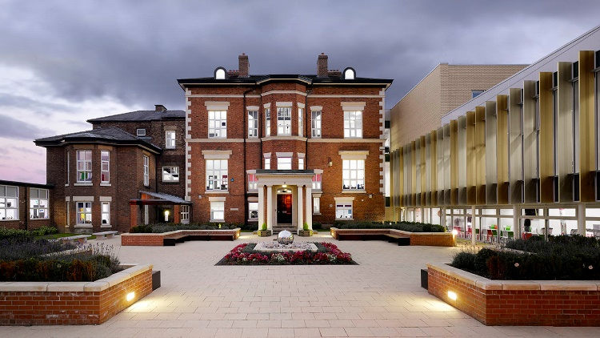
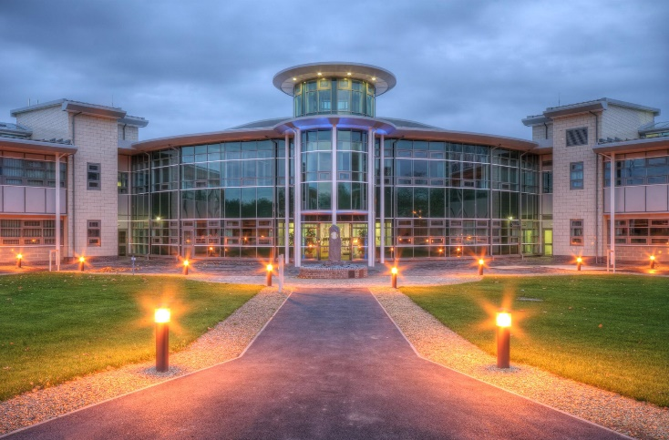
Academies and Free Schools
By Georgia and Ayesha

Slide 32
What is an Academy School?
Academy schools are state-funded schools in England which are directly funded by the Department for Education and independent of local authority control. The terms of the arrangements are set out in individual Academy Funding Agreements
Most academies are secondary schools
Academies are self-governing non-profit charitable trusts and may receive additional support from personal or corporate sponsors, either financially or in kind. They do not have to follow the National Curriculum, but do have to ensure that their curriculum is broad and balanced, and that it includes the core subjects of mathematics and English.
They are subject to inspection by Ofsted.

Slide 33
Types of academy
Sponsored academy: A formerly maintained school that has been transformed to academy status as part of a government intervention strategy. They are consequently run by a Government-approved sponsor. They are sometimes referred to as traditional academies.
Converter academy: A formerly maintained school that has voluntarily converted to academy status. It is not necessary for a converter academy to have a sponsor
Free schools are new academies established since 2011 via the Free School Programme. From May 2015, usage of the term was also extended to new academies set up via a Local Authority competition. The majority of free schools are similar in size and shape to other types of academy. However, the following are distinctive sub-types of free school

Slide 34
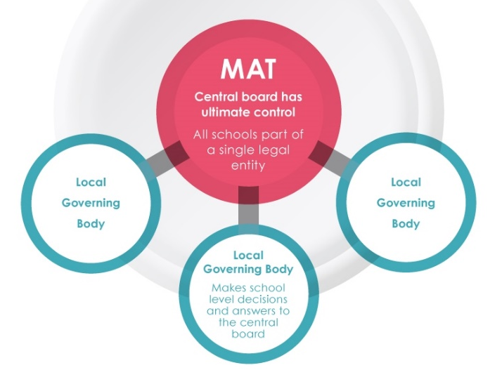
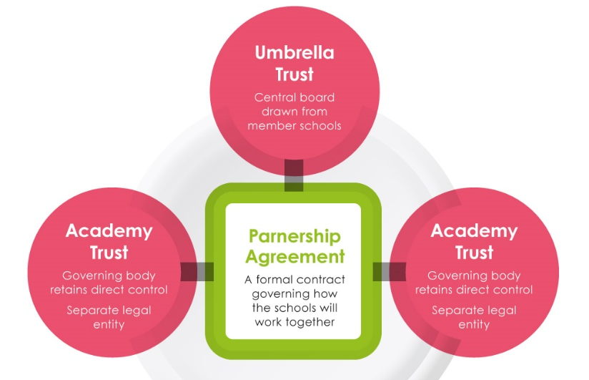
History, Purpose and structure
The Labour Government under Tony Blair established academies through the Learning and Skills Act 2000
Academies have more independence over what they teach, they can choose to award bonuses to their staff and pay head teachers £30,000 more than in other schools. They are not under local authority control and so arguably are subject to less bureaucracy and have more freedom over their budgets. They can change the length of the school term and day.
Increased buying power, Reduction in admin, Sharing best practice and expertise, The ability to focus funds where they’re most needed, Increased and flexible staffing resources, Succession planning to retain key staff , Local governors and SLT can focus on teaching
Supporting the free schools claim that they improve educational standards by taking control away from the state and giving power to the parents. They give parents and teachers the opportunity to create a new school if they are unhappy with the new state schools in the area.

Slide 35
How is academy schools funded?
Sponsors of the first academies contributed up to £2m towards the costs of the new or refurbished school buildings, and the government provided the rest of the funding. Since then, the Building Schools for the Future programme has taken over, and academy buildings have been acquired through Partnerships for Schools and local authorities, with sponsorship providing other income unconnected to building work.
The biggest academy sponsor in England is the United Learning Trust, which runs 17 schools.

Slide 36
How are academy and free schools regulated and governed?
They are regulated by

Slide 37
Is a academy school meritocratic?
Centrally funded
Free schools can open pretty much anywhere, therefore bringing up the standards in that particular area (making it better)
However middleclass areas tend to attract free schools therefore there is less opportunities for the lower-class.

Slide 38
City Technology colleges
Hannah&Georgina

Slide 39
The history of city technology colleges
In England, a City Technology College (CTC) is a state-funded all-ability secondary school that charges no fees but is independent of local authority control, being overseen directly by One fifth of the capital costs are met by private business sponsors, who also own or lease the buildings. The rest of the capital costs, and all running costs, are met by the Department.
City Technology Colleges teach the National Curriculum, but specialise in mainly technology-based subjects such as technology, science and mathematics. Like maintained schools, they are regularly inspected by the Office for Standards in Education. CTCs also forge close links with businesses and industry (mainly through their sponsors), and often their governors are directors of local or national businesses that are supporting or have supported the colleges. The programme has been successful in the long term with all the CTCs being considered strong establishments with consistently high academic results.
The CTC programme was established in the late 1980s by the Conservative government under the terms of the Education Reform Act 1988 and the Colleges themselves opened in the late 1980s and early 1990s.

Slide 40
The purpose of ctcs
City technology colleges and ‘ the city college for the technology of the arts’ are independent schools in urban areas that are free to go to. They’re funded by central government - companies can also contribute.
City technology colleges emphasise teaching science and technology.
The city college for the technology of the arts teaches technology in its application of performing and creative arts, for example by offering interactive digital design courses.

Slide 41
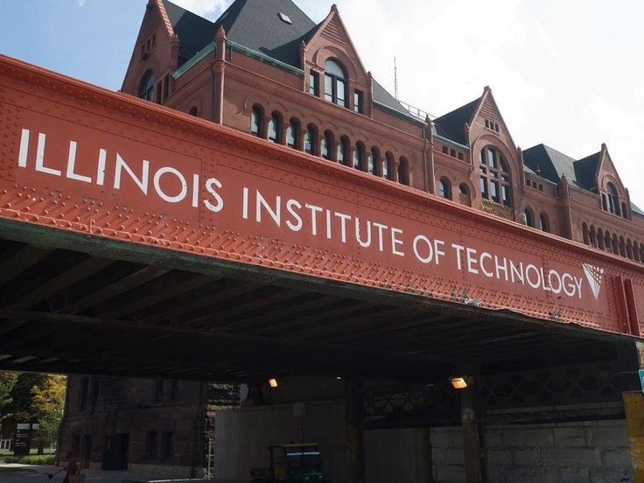
The Structure of ctcs
City Technology Colleges are urban-based, independently managed secondary schools geared towards science, technology and the world of work. They offer a range of vocational qualifications as well as GCSEs and A levels.

Slide 42
Specialist Schools

Slide 43
Specialist Schools are schools that focus more on one specific subject, or provide extra support for students that need it. As well as this, they get extra funding for giving priority to this particular subject.
History:
The Specialist Schools programme began in 1993, when the Conservative Government gave permission for schools to apply for this status.
Purpose:
To ext6end the range of opportunities for students
Raise standards of achievement for pupils of all abilities
Raise standards of teaching and learn specialist subjects
Structure:
.

Slide 44
Specialist schools are not meritocratic. This is because if a certain school is given permission to specialise in a subject, students attending that school will have an advantage over other students.
This is because teaching standards for these specialist schools would be higher than at a normal, comprehensive school.

Slide 45
Education otherwise
Lily and Sophie

Slide 46
The history, purpose, structure of the schools in the UK
The Royal Family have all in the past been educated at home, including the current Queen, though more recently royalty have attended various public schools. However, since the advent of compulsory education in the UK in the 1870s and secondary education in the twentieth century, home education became increasingly rare among the population at large.
Education is compulsory in the UK for children between the ages of 5 and 16.
Many families prefer to educate their children otherwise than at school, and it is their right under UK law to do so. Home educating families do not have to follow the National Curriculum and there is no single 'right' way to educate a child at home.

Slide 47
Meritocratic and Social Mobility
Home-schooling is more about meritocratic because you’re being taught by someone who knows your speed of working as well as your strengths and weaknesses. Due to the fact that you only have one person in your class then the student is able to be rewarded more for their improvement in a certain area.
Most people who have been home-schooled will not have social mobility as most of them will not have much contacts with different groups of ethnicities as they are home-schooled and will not go out much, unless they do other clubs outside of school however even if they do they wont have interaction with different types of people, like there different personalities.

Slide 48
Funding and mini grants
Mini grants that help pay for home-schooling costs, many parents that choose to give their children a home-schooling education could use extra money to help home-school expenses.
They get money from them as they need to buy things like books, material, and science projects and field trips. Also the parents will need to pay for the exams for there children to take at the end of year6 and 11 and at the end of year 12 and 13 which can cost up to £100.
Also with home-schooling you will have to pay for the courses and maybe some tutors to help out which can cost like more but the benefit is you wont have to pay for things like uniform, buses and things you have to pay in school

Slide 49
Ivan Illich
Read the material on pages 8 and 9
Answer the two questions on page 9 – and be prepared to discuss your answers in class.
Deschooling Society

Slide 50
The Purpose of Education p.7
THE PURPOSE OF EDUCATION
Highlight in one colour the purposes that relate to the individual, and then in another colour highlight those relating to society
.

Slide 51
Sociological Perspectives p7
In the Sociology of the Family you have begun to study how different sociological perspectives viewed the family.
We will, in this module. look at how
Functionalist
Marxist
Feminist and
Interactionist
sociologists view education.

Slide 52
Overview on Sociological Perspectives
Structuralists are sociologists who view aspects of social life such as education, in terms of how they affect whole groups of people and institutions on society. They are more interested in how education affects the economy and stability of the country than in how education affects the individual. (These sociologists are also known as macro sociologists)
Not all sociologists are macro sociologists. Some sociologists are less concerned with studying large social systems. Micro sociologists are more interested in how people react to, and influence each other in small groups – for example, in classrooms.

Slide 53
Consensus structuralist
Conflict structuralist
Functionalists
Emphasise value consensus holding society together
Believe in the Organic Analogy – society is like an organism in some ways – its parts are interdependent
Consider that modern society needs to establish a set of common bonds to hold it together
The modern economy has an increasingly complex Division of Labour
Marxism
Emphasise class division in society
Believe that everything in capitalist society serves the needs of the economy and its ruling class
Observe that wealth and privilege are often inherited
Believe that class is a cultural phenomenon as well as an economic status (Neo Marxists)
Feminism
Emphasise the impotance of gender division in society
Believe that everything in patriarchal society serves the needs of men rather than women
Believe the family to be the basis of women’s oppression
Think that both women and men suffer from sex-role stereotyping
Interactionism
Focus on micro sociology – not the whole social structure
Observe that generalisations about society may distort research
Outline on how some people/groups may be positively or negatively labelled through social processes
Believe the self to be a social construction – the looking-glass self
Conflict structuralist
Non-structuralist – Action Theory

Slide 54
Sociological Perspectives
Using the this material and your work on sociological perspectives in the other side of the course, see if you can figure out what each of these perspectives might say about the education system

Slide 55
Consensus structuralist
Conflict structuralist
Functionalists
Marxism
What do you think these perspectives believe is the point or purpose of schools?
Feminism
Interactionism
Conflict structuralist
Non-structuralist – Action Theory

Slide 56
Notes
Use pages 27-29 of Browne ready for the next lesson on
FUNCTIONALISM
& EDUCATION

Slide 57
NB – Class work follows

Slide 58
Class work
Complete notes on pages 30-32 of you booklet using the Webb textbook on recent trends in Educational Policy
If work is not completed in this session you will need to use library copies of the textbook to complete this work to a satisfactory level
Homework: Complete the glossary on pages 33-34 and ensure that you have a satisfactory definition to cover any gaps

