Slide 1
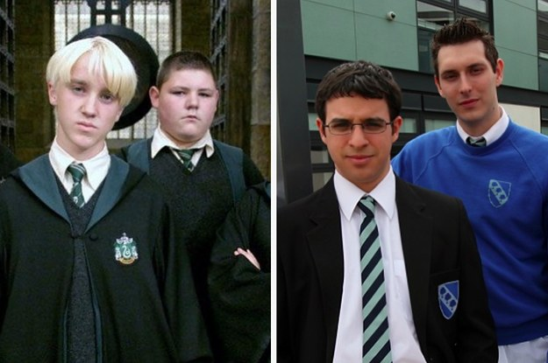
Topic 1: the structure and organisation of the education system
A Group

Slide 2
Learning objectives of this booklet
Learning Objectives:
To understand and evaluate key concepts associated with functionalist, New Right and Marxist sociologists’ views of education.
To understand how these approaches explain the function of education and examine the link between education and work wider society.
After studying this Topic, you should:
Have a good knowledge of the history of the British education system since 1945
Know the functions of education that functionalists identify.
Understand the neoliberal and New Right views of the role of the market in education.
Understand the social democratic view of the role of the education system and their criticisms of New Right arguments.
Understand different Marxist views of the role of education, particularly the reproduction and legitimation of class inequality.
Be able to evaluate the functionalist, neoliberal and New Right, and Marxist views of education.

Slide 3
Formal and Informal Education
Page 2 of booklet
When we think of education we think of sitting in a school or college and being taught by teachers. However this is not the only way of being educated. Sociologists make distinction between;
Formal Education = Delivered by agencies specifically designed for teaching and learning – for instance, schools, colleges, universities – or through virtual institutions
Relies on formal programme, syllabus, curriculum etc.
Informal Education = Used to refer to all of the agencies and institutions, which, although not explicitly existing to encourage learning, nevertheless play an important educational role.
Learning may occur ad hoc, i.e, randomly

Slide 4
Activity page 2
Page 2 of booklet
Outline in the boxes some examples of things that you learn directly through the formal curriculum and then things that you learn indirectly through the hidden curriculum.

Slide 5
Meritocracy Page 3
Page 3 of booklet
A key argument in the sociology of education is whether the education system in the UK is meritocractic. Find out what this means and write in box.
Meritocracy:

Slide 6
Meritocracy
Page 3 of booklet
Meritocracy is the idea of a society governed by people selected according to merit (e.g. ability and skill).
Do you believe this statement?
"Britain is a meritocracy, and everyone with skill and imagination may aspire to reach the highest level“
In what ways is our society meritocratic/un-meritocratic?
On p.3 provide some examples of how our education system is meritocratic and how it is not.

Slide 7
Introducing the British Education system
Selective Education
Non-selective Education
The idea that education should be directed at those who will most benefit from it, and that different levels and types of education may suit different types of pupils
The idea that all students should have a common experience through the education system and that everyone should have an equal chance of achieving the same outcome.

Slide 8
Ivan Illich
Read the material on pages 8 and 9
Answer the two questions on page 9 – and be prepared to discuss your answers in class.
Deschooling Society

Slide 9
History of the British Education system- p.4 Activity
Using pages 77-78 of Webb outline briefly the main features of:
￼￼￼
1. the tripartite school system.
2. the comprehensive school system.

Slide 10
Timeline
Using the key dates and issues provided, as a starting point, create a timeline for changes to the state education system in England and Wales since its foundation.
Bear in mind that a lot of changes occur since 1988, and the exam board expect exam answers to focus on changes from this point.
You could cut and stick the dates/issues onto a timeline, or write the points on the timeline instead.
Aim to include other changes that have occurred.

Slide 11
History of the British Education system- p.4 Activity
Using pages 77-78 of Webb outline briefly the main features of:
￼￼￼
1. the tripartite school system.
2. the comprehensive school system.

Slide 12
Types of School and Education
It is important that you are aware of the different types of schools and how these link to the theories, differential educational achievement, meritocracy and social mobility. Types of school include:
This activity will ask you to research a particular type of school or schooling in small groups
You will need to complete and present your findings in a PowerPoint format which should include a minimum of four frames These will include
A title frame naming all of those involved in the research and presentation
At least one frame identifying the purpose of the school, numbers of them in the country
At least one frame identifying the admission policy associsated can we regard it as meritocratic and supporting social mobility?
At least one frame identifying the school’s sources of funding and who it is governed and regulated by.
Use the sources on Godalming Online to help you

Slide 13
Types of school
Type of Schooling | Whose research?
Comprehensive Schools | Reuben Alex
Independent Schools | Josh Jenny
Grammar Schools | Harriet Elodie Jade
Faith Schools | Alex Jonas
Academies and Free Schools | Tom Easa Emily
City Technology Colleges | Alexxe Max
Specialist schools | Adam Chloe Lydia
Home schooling | Tansy Harriet Emily
TITLE FRAME
A brief outline of the history, PURPOSE, STRUCTURE of these schools in the UK
The degree to which this type of schooling is meritocratic and supports social mobility
How this type of schooling is funded, governed and regulated.

Slide 14
PRESENTATIONS
A Group

Slide 15
Comprehensive schools
Reuben and alex

Slide 16
History of Comprehensive schools
The first school (‘Walworth School’) was set up after the Second World War in 1946
Students sat the 11+ examination in their last year of primary education and were sent to one of a secondary modern, secondary technical or grammar school under the labour government depending on their perceived ability from 1964-1970
Children were now sent to a school where academic achievements and qualifications were not needed

Slide 17
Purpose
A purpose of a comprehensive school is that everyone should have equal opportunities to succeed in the education system
The Tripartite system was abolished in 1975 as it was not providing children equal opportunities in the education system
The Tripartite system was now changed into a state comprehensive system

Slide 18
Structure
It’s a state school which doesn’t select its intake of students of achieved status or attitude.
In contrast with the grammar schools where admission is restricted on academic ability.
90% of children in society attend state comprehensive schools

Slide 19
Funding
Comprehensive schools are funded by the state as they have to select children of all abilities and have to accept children who are disadvantaged or who are of low self esteem.
The Comprehensive schools have to follow a curriculum of Art, Citizenship, DT, Geography, History, ICT, Modern Foreign Languages and Music. Also, the core subjects
The government can take over the governors of the comprehensive schools as well as other comprehensive schools which are owned by companies who want to privatise profits for themselves

Slide 20
Independent schools
By Josh and Genny

Slide 21
History, purpose and structure
Permanent feature of the British education system.
A way of passing on privilege.
These schools are structured independently. This meaning that each school is run in a different way. For example one private school may be extremely strict as they may want the children who attend the school to get as many qualifications as possible however another private school may want the children to be who they want to be. For example attend classes when they feel like it and leave school with as many qualifications as they want.

Slide 22
Supports meritocratic, supports social mobility?
No because it is based on privilege not talent.
No because you cannot go to those schools unless you are willing to pay the money which some people might not have.

Slide 23
Funded, governed and regulated?
The school is funded by the parents/guardians of the children who attend the school. They will pay a termly fee well in excessive of over £5,000 a term.
Independent schools are governed by an elected board of governors and independent of many of the regulations and conditions that apply to state-funded schools. For example, pupils do not have to follow the National Curriculum.
Yes they are regulated by the ISI who make sure that the schools are run up to government standards.

Slide 24
Grammar Schools in sociology
Elodie, Jade, Harriet

Slide 25
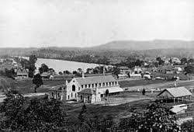
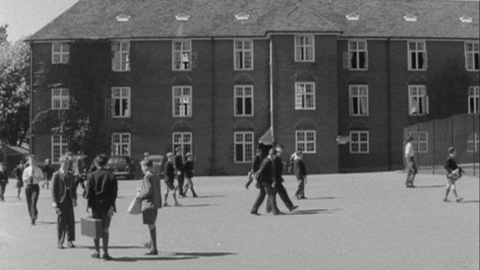
What is a grammar school?
A state secondary school to which pupils are admitted on the basis of ability…
AND
…A school founded in or before the 16th century for teaching Latin, later becoming a secondary school teaching academic subjects.
Example of a Grammar school
Brighton, Hove and Sussex Grammar School as seen in 1959:
The first Grammar school
The Celje First Grammar School, is a coeducational nondenominational state secondary general education school for students aged between 15 and 19 in Celje, Slovenia. It was the first high school built in the region, established in 1808 by the Austrian Empire.

Slide 26
Pros and cons
Pros
Cons
They made some pupils more employable, however they did disregard some pupils.
It gave all classes the opportunity to apply for a better education if the children could pass the 11+ exams.
They were free and provided better than average education.
You can’t really predict how smart the pupils are at age 11.
Selection at 11 is unfair because it denied many the chance to carry on their education after the age of 15.
¾ of the school population failed and went to secondary modern schools instead.

Slide 27
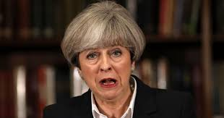
Theresa May and Grammar schools
The prime minister will end days of speculation by confirming that her government will reverse the “arbitrary” ban on the creation of new grammar schools that has been in place since 1998.The education secretary has revealed that the government is considering lifting its ban on selective grammar schools
Speaking in London, May will say: “For too long we have tolerated a system that contains an arbitrary rule preventing selective schools from being established – sacrificing children’s potential because of dogma and ideology. The truth is that we already have selection in our school system – and it’s selection by house price, selection by wealth. That is simply unfair.”

Slide 28
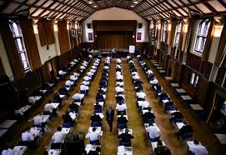
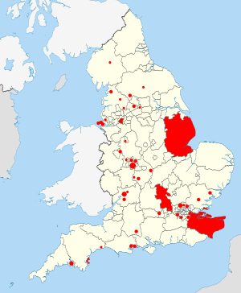
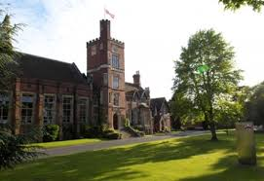
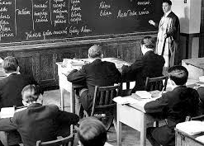
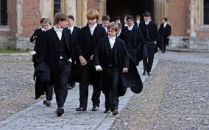
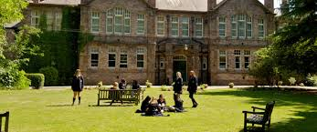
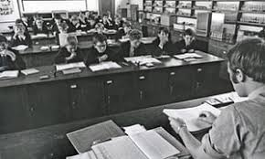
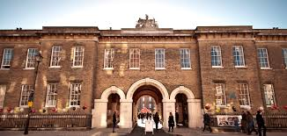
Fun facts
Grammar school areas and groups as identified by the Education (Grammar School Ballots) Regulations 1998. LEAs considered grammar areas are shown filled, while circles indicate isolated grammar schools or clusters of neighbouring schools
Grammar schools became the selective tier of the Tripartite System of state-funded secondary education operating in England and Wales from the mid-1940s to the late 1960s and continuing in Northern Ireland.
The original purpose of medieval grammar schools was the teaching of Latin.
Come the Victorian times the grammar school curriculum had evolved to take in English, European languages, mathematics, history, geography and natural sciences.
The term grammar school was coined in medieval times, but modern-day state grammar schools came into being as a result of the 1944 Education Act; this made provision for a tripartite system of education, open to all.

Slide 29
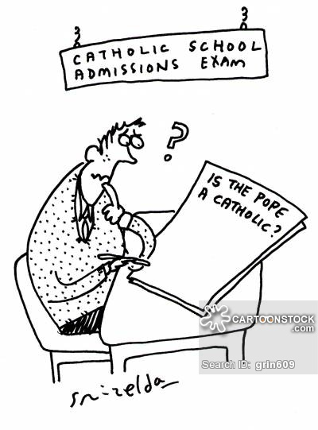
Faith Schools
By Jonas and Alex!

Slide 30
Type of school?
Faith Schools are religiously driven schools, that run on the base curriculum but have link with religious organisation that they are run by. Faith schools have to follow the original curriculum but are able to teach whatever they want in religious studies as long as it has a link to their religion, apart from the creation theory and evolution.
Purpose?
To teach the children the general curriculum but whilst embedding the religious values that the school follows.
When were they introduced?
In 1944 the education act made it a requirement for daily prayers in all state-funded schools.

Slide 31
Admission Policy
Anyone can apply to get into a faith school but they give priority to:
Those who have siblings in the school
Those who live close to the school
Those of particular religion of the faith school
Those who do well in the entrance exams
Those who went to a particular primary school
Those in care (schools top priority)
Those who are eligible for pupil premium.

Slide 32
Funding
Faith schools are mostly funded by their local council and the state, however they do receive some payments from the church of England.
On average £4,306 is spent on every pupil in faith schools yearly.
Faith schools are governed by their local authorities in their local council.
In 2016 £23.1 million was donated to all faith schools across the country by faith groups who were required to donate this money to the state for the schools.

Slide 33
Academies and free schools
Emily, tom, easa

Slide 34
What are Academies and free schools?
Academies are publicly funded schools which operate outside of local authority control. The government describes them as independent state-funded schools. Essentially, academies have more freedom than other state schools over their finances, the curriculum, and teachers' pay and conditions. Secondary schools usually convert into academies. Any school can become an academy.
Free schools are a non profit making independent state funded school which is free to attend but is not controlled by local authority.

Slide 35
Admission Policy
You just sign up and get in. ☺ Its open access FOR NOW, until they fill up and can’t take any more students.

Slide 36
How is it funded and who is it governed by?
Academies: Funding was taken from local authorities and they are in charge of there own curriculum. Some are run by private educational businesses and funded directly from the state.
Free schools: Free schools are funded by the state but are run by parents faith organisations.

Slide 37
Problems?
Some people argue that free schools only benefit children from highly educated families.
Academies and free schools create divisions in poor areas as to many different schools encourage social segregation this is because most free schools are in poor areas which means those who are wealthier are more likely to succeed and continue to control the education resources whereas those who are poor are going to fail as they do not have great educational resources to do well in the state education system.

Slide 38
City Technology colleges (CTc)
By Alexxe and max
Notes:
Start thurs 4 oct

Slide 39
What are they? Its Purpose? When were they introduced?
a state-funded all-ability secondary school that charges no fees but is independent of local authority control, being overseen directly by the department for education.
Their aim was to improve education inside cities
Established in the late 1980s by the conservative government

Slide 40
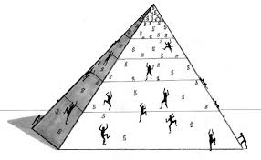
Is It meritocratic?
The intention is for it to be meritocratic, however it is not because not all citizens within the city have an opportunity to attend these colleges.

Slide 41
How is it funded and who is it governed by?
One in five of the capital costs are funded by private business sponsors, who also own or lease the buildings. The remaining capital costs, and all running costs, are met by Central government.
It is governed by the businesses and industry (mainly through their sponsors), and often the governors are directors, local or national businesses which are currently supporting or have supported the colleges.

Slide 42
Specialist Schools
Lydia and Adam

Slide 43
Specialist schools
A specialist school is a state specialist school that aimed to be local centres of excellence in their chosen specialist subject.
Subject include: art, business and enterprise, engineering, humanities, languages, mathematics and computing, music, science, and sports and technology.
A school can specialise in a maximum of two of these subjects.
The programme stared in 1993 by the Conservative Government.
In 1994 the first 50 technology colleges were opened.
Specialist schools performed higher in GCSEs than non specialist schools.

Slide 44
Funding
The school receives extra funding from the government for specialising in a subject.
In 2010 during the coalition government Michael Gove stated that all funding was stopped and absorbed into the general school budget.
It costs about £129 per student over their 4 years in this education system.
These schools took fewer children from poorer families compared to non specialist schools possibly because it is easier for middle class parents to raise the necessary sponsorship to attend the school.

Slide 45
Administration policy
Under the school Standards and Framework act of 1998 specialist schools were permitted to select up to 10% of their pupil intake on a basis of their ability for the specialism subject. However, this option is often not taken up.
Only 7% on 403 schools operating in September 1999 had taken up the option to select 10% of students.
These schools have reduced the number of students eligible for free school meals. 29% of schools in England attracted more socially privileged people between 1999 and 2000.

Slide 46
Home schooling
By Tansy, Harriet and Emily

Slide 47
What is home schooling?
‘Home schooling’ is the term used in North America – in the UK it is called ‘home education’ because in the US, parents recreate school at home.
A brief history of home schooling: the modern home school movement began in the 1970s when John Holt began arguing that formal schools’ focus on learning creates an oppressive classroom essentially making children compliant employees. John Holt was an educational theorist and supporter of school reform. Holt wanted parents to liberate their children from formal education and follow home schooling. This began in America but slowly started to make it’s way to the UK.
There was a 65% increase in children recorded as home educated in the UK between 2009 and 2015.
There are expected standard of home education:
There is obligation to follow the national curriculum,
There is not a standard of how rooms should be or the equipment used,
You do not have to follow the school terms, hours or days and a scheduled time table is not compulsory,
There is no need to be inspected by Ofsted and you do not have to be registered to the department of education.
There is no legal age in which children who are home educated should start or finish their education.

Slide 48
Admission policy
Home education is not meritocratic, and therefore has no admission policy.
Consequently, in some cases the system does not support social mobility because some students won’t achieve GCSEs or A levels, which are essential for most job opportunities. However, there are a select few that do achieve these and therefore are able to climb the social structure by having a respectable job.

Slide 49
How is it funded? Who is it governed by?
In theory there is no funding for elective home education. Individual families do not receive any of the money which is paid to schools for registered pupils. Parents have full financial responsibility, including the cost of examinations, when their children are outside the “state school system”.
Parents who decide to home educate do not need teacher training or any specialised qualifications in order to teach their child.

Slide 50
The Purpose of Education p.7
THE PURPOSE OF EDUCATION
Highlight in one colour the purposes that relate to the individual, and then in another colour highlight those relating to society
.

Slide 51
Sociological Perspectives p7
In the Sociology of the Family you have begun to study how different sociological perspectives viewed the family.
We will, in this module. look at how
Functionalist
Marxist
Feminist and
Interactionist
sociologists view education.

Slide 52
Overview on Sociological Perspectives
Structuralists are sociologists who view aspects of social life such as education, in terms of how they affect whole groups of people and institutions on society. They are more interested in how education affects the economy and stability of the country than in how education affects the individual. (These sociologists are also known as macro sociologists)
Not all sociologists are macro sociologists. Some sociologists are less concerned with studying large social systems. Micro sociologists are more interested in how people react to, and influence each other in small groups – for example, in classrooms.

Slide 53
Consensus structuralist
Conflict structuralist
Functionalists
Emphasise value consensus holding society together
Believe in the Organic Analogy – society is like an organism in some ways – its parts are interdependent
Consider that modern society needs to establish a set of common bonds to hold it together
The modern economy has an increasingly complex Division of Labour
Marxism
Emphasise class division in society
Believe that everything in capitalist society serves the needs of the economy and its ruling class
Observe that wealth and privilege are often inherited
Believe that class is a cultural phenomenon as well as an economic status (Neo Marxists)
Feminism
Emphasise the impotance of gender division in society
Believe that everything in patriarchal society serves the needs of men rather than women
Believe the family to be the basis of women’s oppression
Think that both women and men suffer from sex-role stereotyping
Interactionism
Focus on micro sociology – not the whole social structure
Observe that generalisations about society may distort research
Outline on how some people/groups may be positively or negatively labelled through social processes
Believe the self to be a social construction – the looking-glass self
Conflict structuralist
Non-structuralist – Action Theory

Slide 54
Sociological Perspectives
Using the this material and your work on sociological perspectives in the other side of the course, see if you can figure out what each of these perspectives might say about the education system

Slide 55
Consensus structuralist
Conflict structuralist
Functionalists
Marxism
What do you think these perspectives believe is the point or purpose of schools?
Feminism
Interactionism
Conflict structuralist
Non-structuralist – Action Theory

Slide 56
Notes
Use pages 27-29 of Browne ready for the next lesson on
FUNCTIONALISM
& EDUCATION

Slide 57
NB – Following to be done after perspectives

Slide 58
Class work
Complete notes on pages 30-32 of you booklet using the Webb textbook on recent trends in Educational Policy
If work is not completed in this session you will need to use library copies of the textbook to complete this work to a satisfactory level
Homework: Complete the glossary on pages 33-34 and ensure that you have a satisfactory definition to cover any gaps

